Slide 1
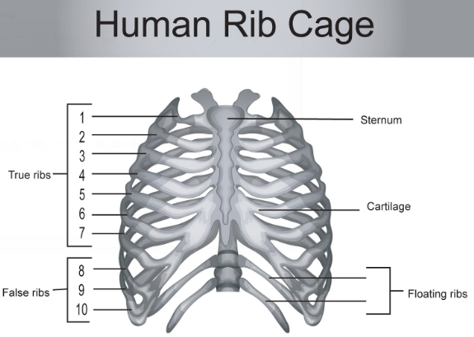

Slide 2
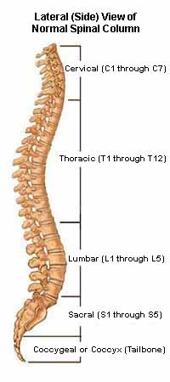
Vertebral Column/ Spine/ Backbone
  Composed of 33 bones called vertebrae
  Vertebrae
    Cervical (first 7)
    Thoracic (12) - ribs are attached to them
    Lumbar (5)
    Sacral (5) - remain fused
    Coccygeal/Caudal(4) - remain fused, form coccyx/rudimentary tail
  Functions
    Pivot joint between first and second vertebra enable our neck and head to rotate
    The first vertebra supports our head
    Helps to keep our body erect and maintain posture
    Protects the spinal cord - an extension of the brain
    Helps to form the rib cage and thus protects heart and lungs.
    Bending and twisting(Gliding Joint).

Slide 3
Appendicular Skeleton
It includes 2 girdles, arms and legs.
Girdle bones - attached to the backbone and support the limb bones.
Pectoral Girdle
Scapula/Shoulder Bone
Clavicle/Collar Bone
Flat triangular bone in shoulder.
Has ball and socket joint (contains cavity into which head of humerus fits; movement of arms)
Rod shaped bone between neck and shoulder

Slide 4
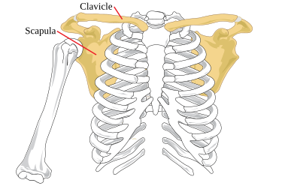
Clavicle
Scapula
Humerus
Front View
Pectoral Girdle

Slide 5
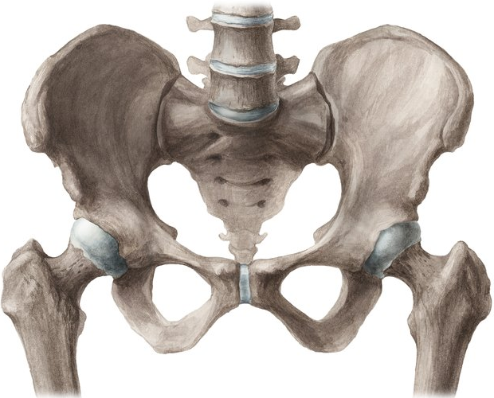
PELVIC GIRDLE / HIP BONE
Consists of three bones fused together
Has ball and socket joint (has cavity in which head of femur rotates)
It forms a bowl like structure on which the body rests and used to sit
Femur

Slide 6
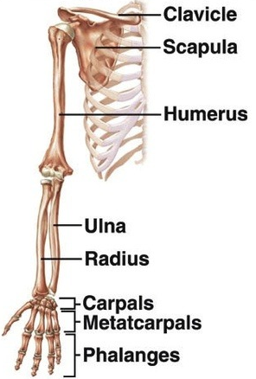
Arms/Upper Limbs

Slide 7
ARMS - UPPER LIMBS / FORELIMBS - 30 bones each
  UPPER ARM
Single long bone called humerus joined to pectoral girdle
  FOREARM
Two long bones radius and ulna joined with humerus at the elbow
  WRIST
  Small bones called carpals, 8 in no (2 rows of four bones each)
  Has gliding joint
  PALM
Metacarpals, 5 in no, give shape to the palm
  5.FINGERS -14 Phalanges - 2(thumb),3,3,3,3

Slide 8
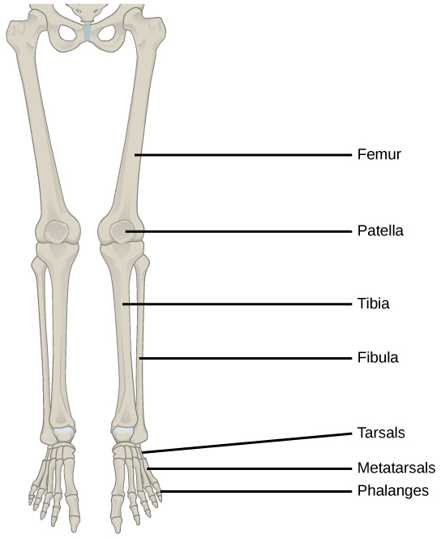
LEGS - LOWER LIMBS / HINDLIMBS - 30 BONES each
  THIGH - Femur
    Longest bone
    Joins with pelvic girdle forming ball and socket joint on one end
  SHANK/BELOW KNEE
Two bones tibia and fibula - joins with femur at the knees
  KNEE -
Patella - disc shaped knee cap for giving additional support to the knee
  ANKLE - Tarsals, 7 in no
  FEET - Metatarsals, 5 in no
  TOES - Digits/Phalanges, 14 in no

Slide 9
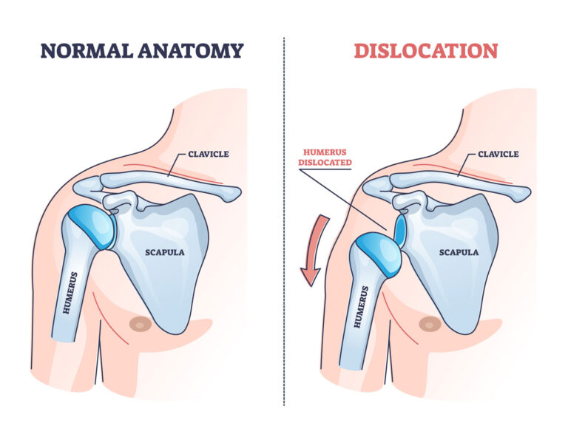

Slide 10
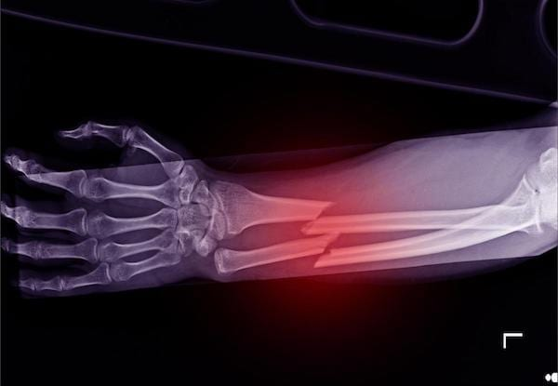

Slide 11
INJURIES TO BONES
Picturised by X-Ray Imaging
DISLOCATION - bones move out of their normal position. E.g. – Shoulder, Finger, Elbow, Knee, Hip.
FRACTURE - break or crack

Slide 12
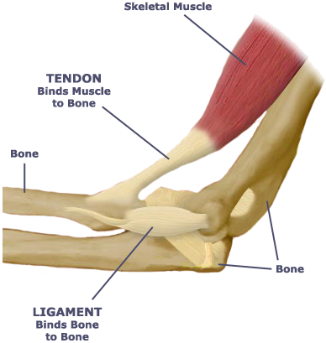
MOVEMENTS AND MUSCLES
Band of fibrous tissue that can contract and relax
Work together with bones for movement
LIGAMENTS - JOIN BONES TO BONES
TENDONS - JOIN MUSCLES TO BONES

Slide 13
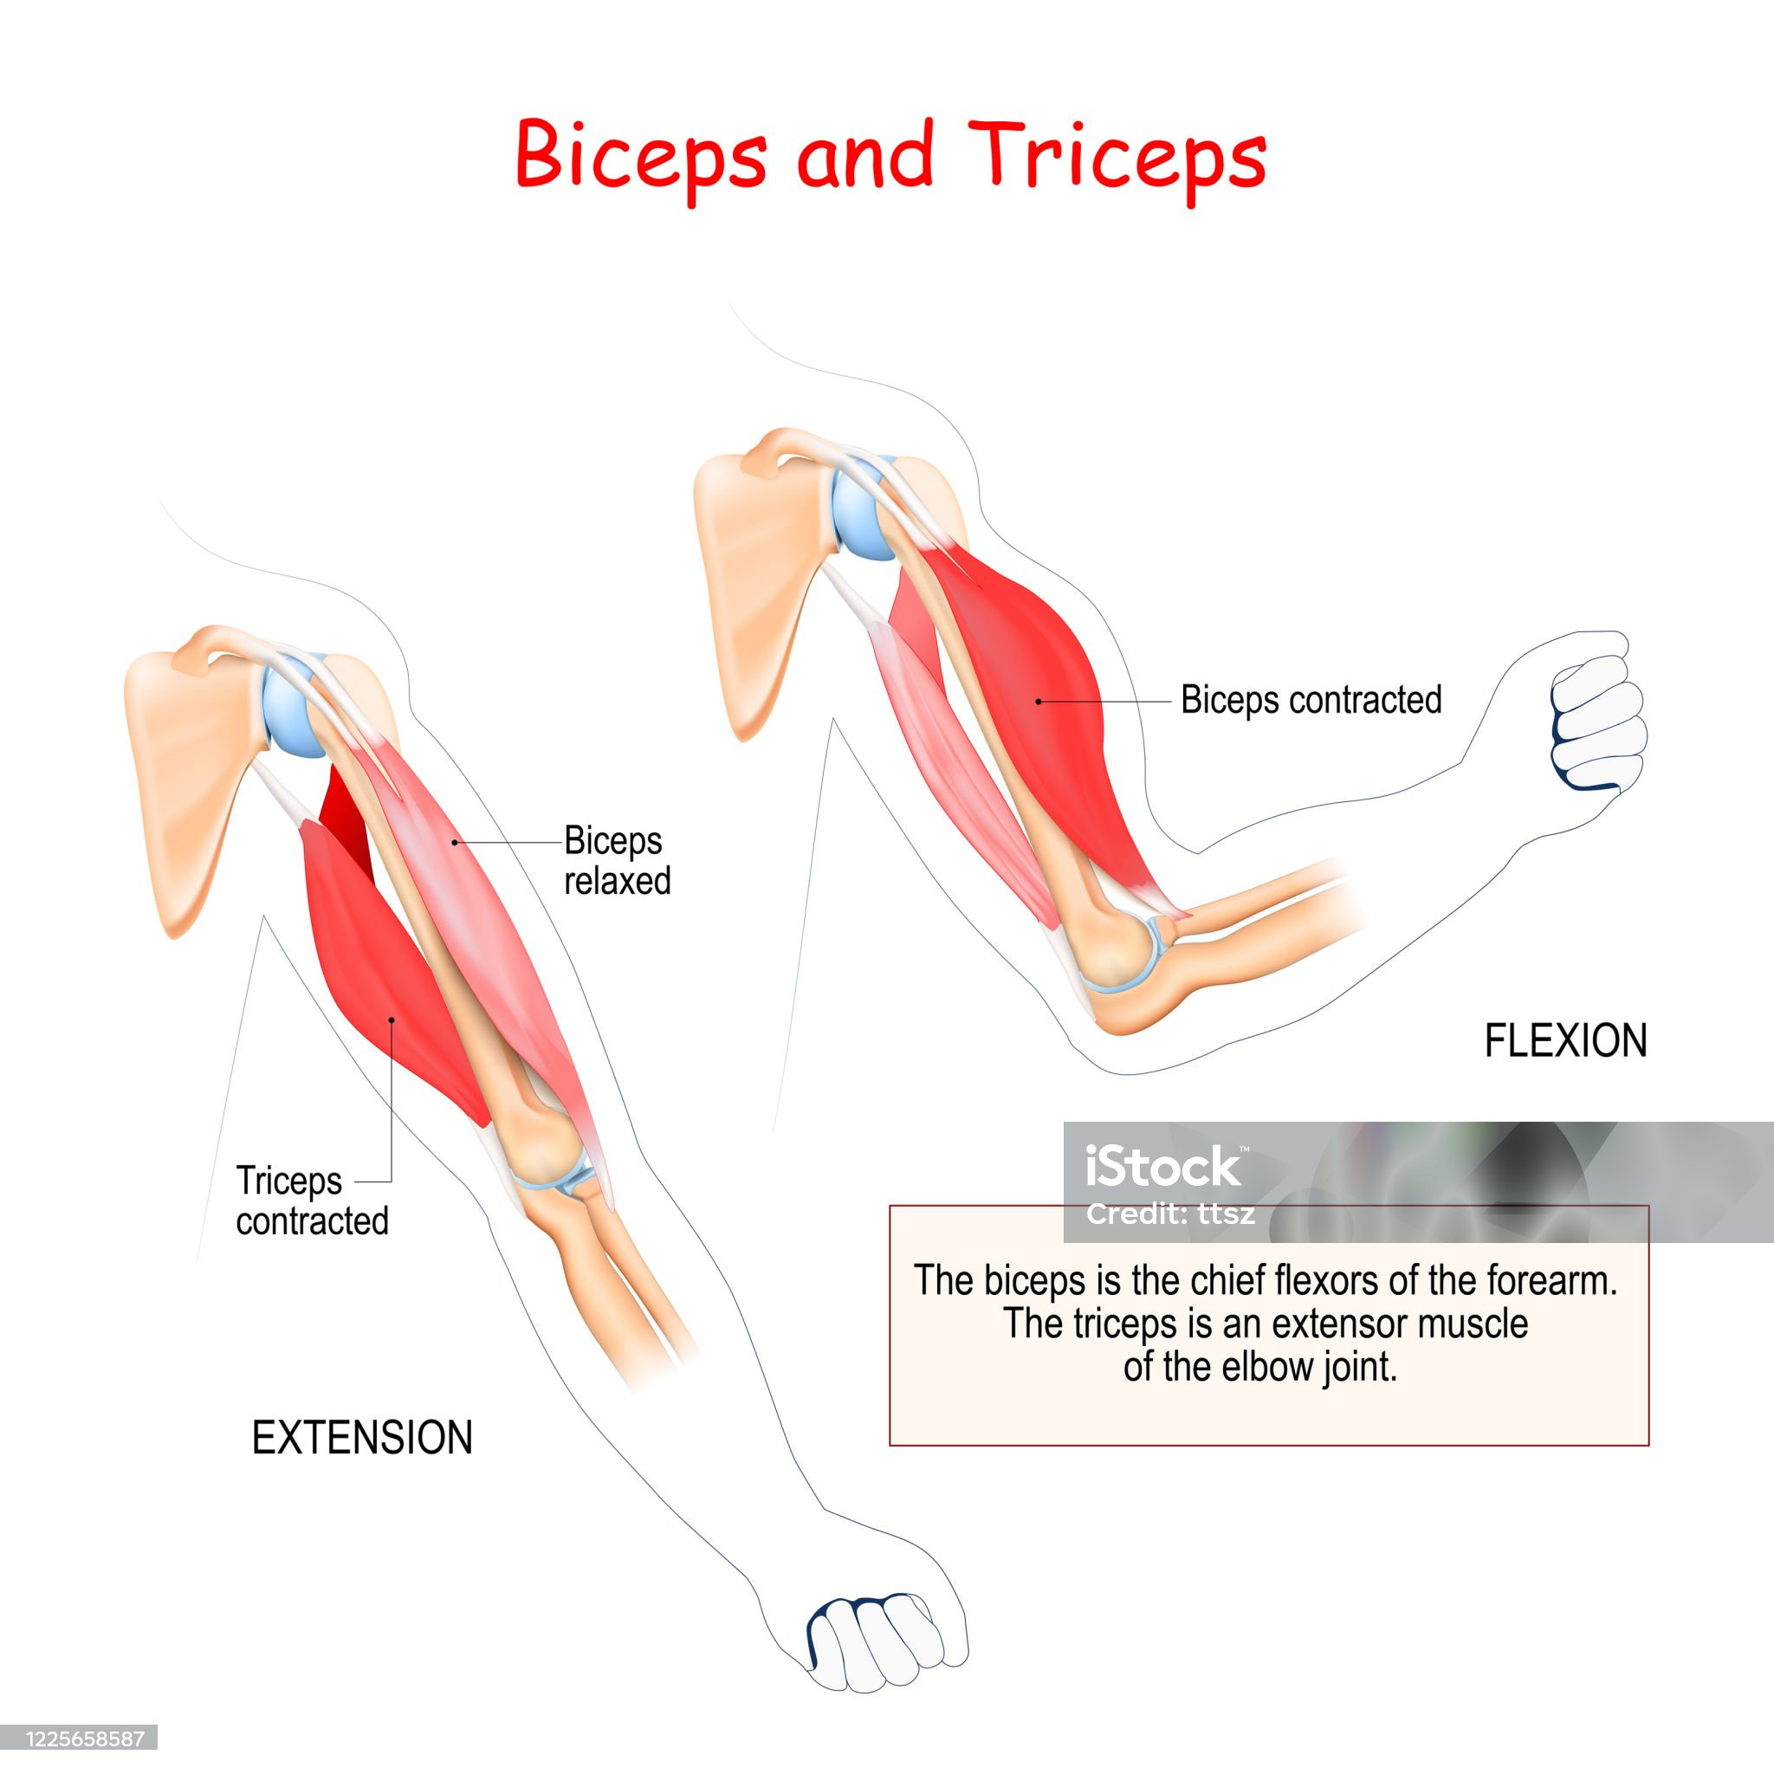
WORKING OF MUSCLES
Work in pairs
one contracts pulling the bone in one direction while the other relaxes
Next, the relaxed muscle now contracts to pull the bone back into original position and the other one relaxes
E.g. flexing of elbow - biceps (in front of upper arm) pulls the forearm by contracting while triceps (at the back of upper arm) relaxes. Opposite action occurs on straightening the elbow - triceps contract, biceps relax.

Slide 14
TYPES OF MOVEMENT
VOLUNTARY | INVOLUNTARY
Controlled by our will | Cannot be controlled by our will
Eg. walking, running, writing | Eg. heartbeat, eyelid movement, rib cage movement while breathing

Slide 15
TYPES OF ANIMALS ON BASIS OF BACKBONES
INVERTEBRATES | VERTEBRATES
Backbone absent | Backbone present
Eg. earthworm, cockroach | Eg. human, snake, cat, dog

Slide 16
GAIT OF ANIMALS - MANNER OF MOVEMENT
Earthworm
Body composed of rings or segments
Rear end fixes to the ground and the front end extends.
Now, the front-end fixes to the ground and rear end is pulled forward by shortening the body.
MOVEMENT BROUGHT ABOUT BY CONTRACTION AND RELAXATION OF MUSCLES
Secretes a slimy substance that keeps its body moist and protects it during movement
Setae - tiny bristles present on the underside of the body that help to grip the soil
They are called Farmers’ friend
As they eat through the soil and release undigested matter that makes the soil fertile.
Aeration by creating air spaces between soil particles.

Slide 17
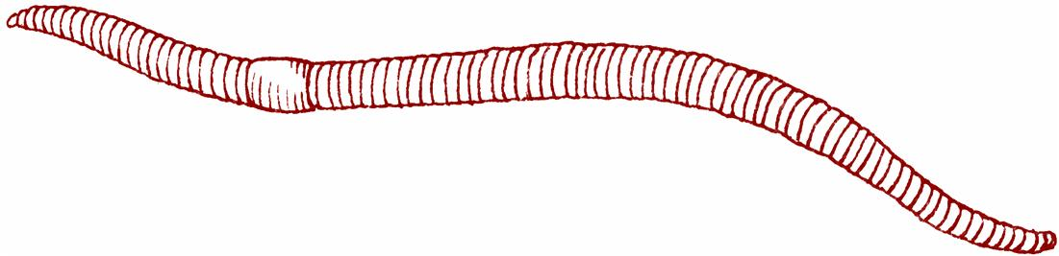
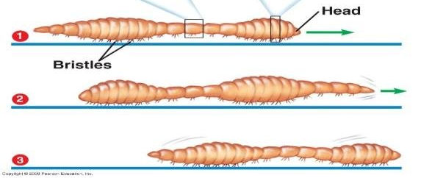

Slide 18
SNAIL
Has exoskeleton-one single shell ( shell is dragged along ; organism hides in it in case of danger )
Shell has an opening from which the head and a muscular foot comes out
The body is soft
The foot has muscles for gliding (wavy motion)

Slide 19
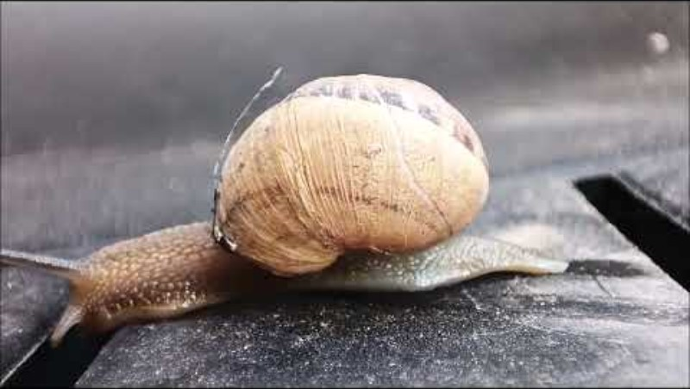

Slide 20
COCKROACH
WALK, CLIMB, FLY
Exoskeleton composed of large no of plates
Three pairs of legs and two pairs of wings
Distinct muscles for walking near legs and body muscles for flying

Slide 21
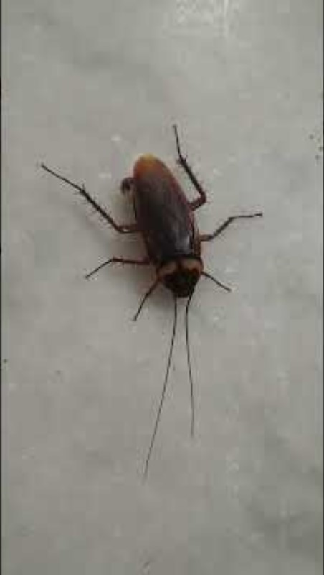

Slide 22
BIRDS
WALK, SWIM, FLY
STREAMLINED BODY (NARROW TAPERED ENDS WITH BROADER MIDDLE PORTION, HELPS TO CUT THROUGH AIR)
BONES HOLLOW AND LIGHT
STRONG SHOULDER BONE
BREAST BONES HOLD MUSCLES OF FLIGHT
HINDLIMBS - WALKING AND PERCHING
FORELIMBS - WINGS

Slide 23
FISH
Streamlined
Skeleton covered Strong muscles
Front end curve to one side and tail swings to the opposite side making a jerk that generates a push ; helped by tail fins
Other fins - maintaining direction and balance
Divers wear flippers

