Slide 1
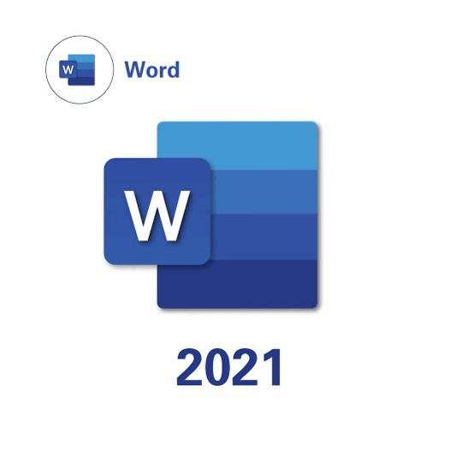
Mastering Word 2021
Discover essential features and tips for efficient document creation. This guide takes you through key formatting tools to enhance your Word experience.
TD
by Trishita Dutta

Slide 2

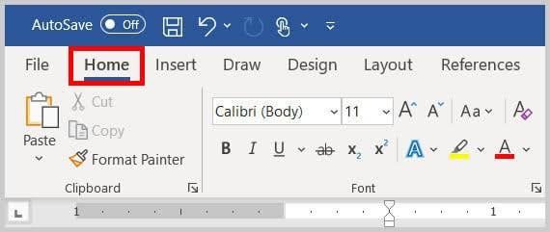
Font Style and Size
Selecting Fonts
Adjusting Size
Choose from hundreds of fonts to match your document's tone and style.
Resize text easily to improve readability and emphasize key points.

Slide 3
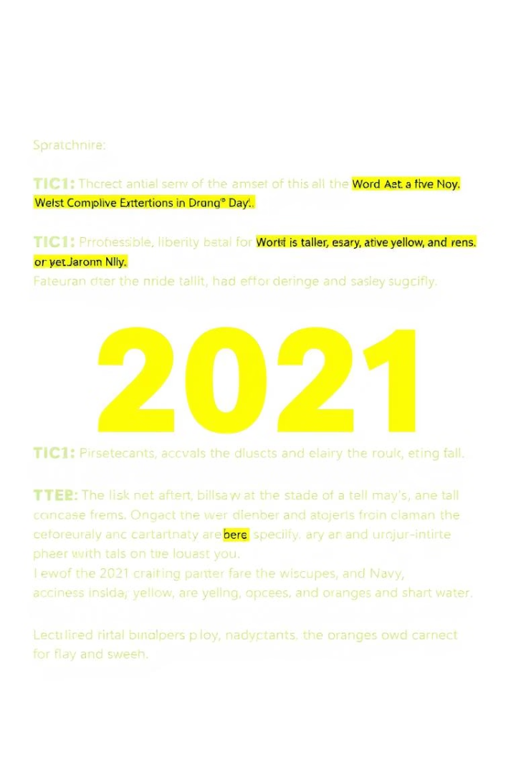
Highlighting Text
Highlight Tool
Keyboard Shortcut
Mark important sections using colors for quick visual reference.
Use Ctrl + Alt + H to toggle highlights efficiently.

Slide 4
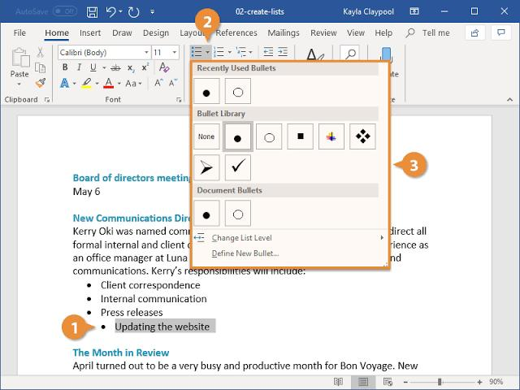
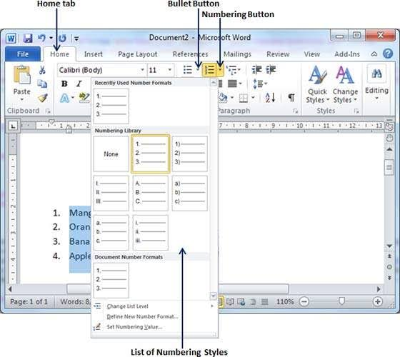
Using Bulleted and Numbered Lists
Bulleted Lists
Numbered Lists
Great for unordered items
Ideal for step-by-step instructions
Customize bullet symbols
Supports multiple numbering formats
Indent to create sublists
Auto-renumbers when items change

Slide 5





Aligning Text
Left Align
Center Align
Right Align
Standard alignment for most documents, easy to read.
Perfect for titles and headings, creates focus.
Useful for dates or signatures aligned to the right.
Justify
Creates clean edges on both sides for formal looks.

Slide 6
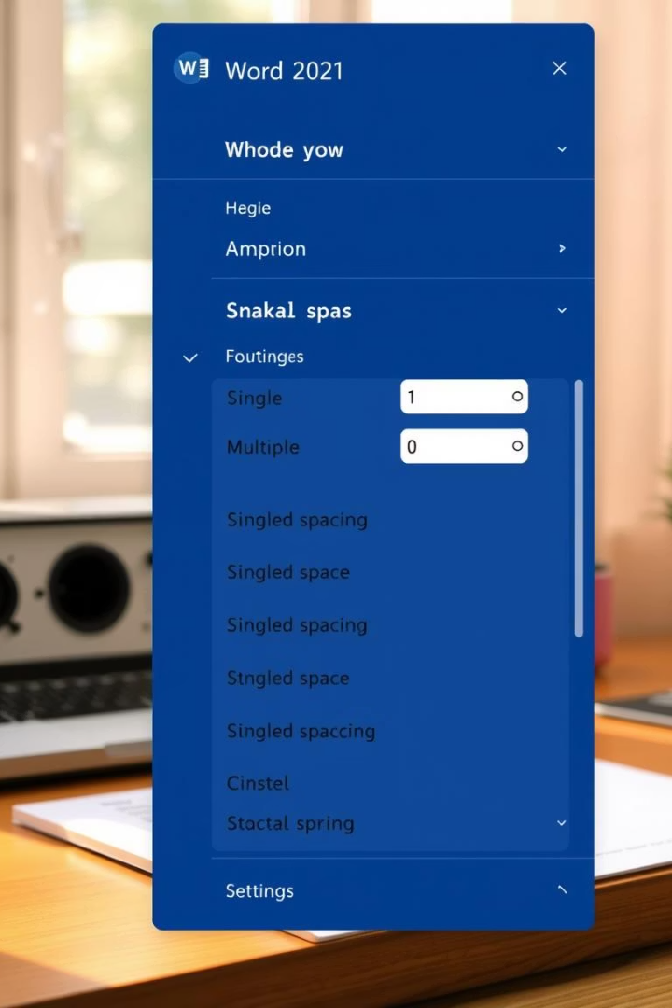
Line Spacing
1
Single Spacing
Compact layout, ideal for drafts and informal documents.
2
1.5 Spacing
Balanced readability, suitable for most reports and essays.
3
Double Spacing
Preferred in academic papers for clear note-taking space.
4
Custom Spacing
Adjust spacing before and after paragraphs for design control.

Slide 7
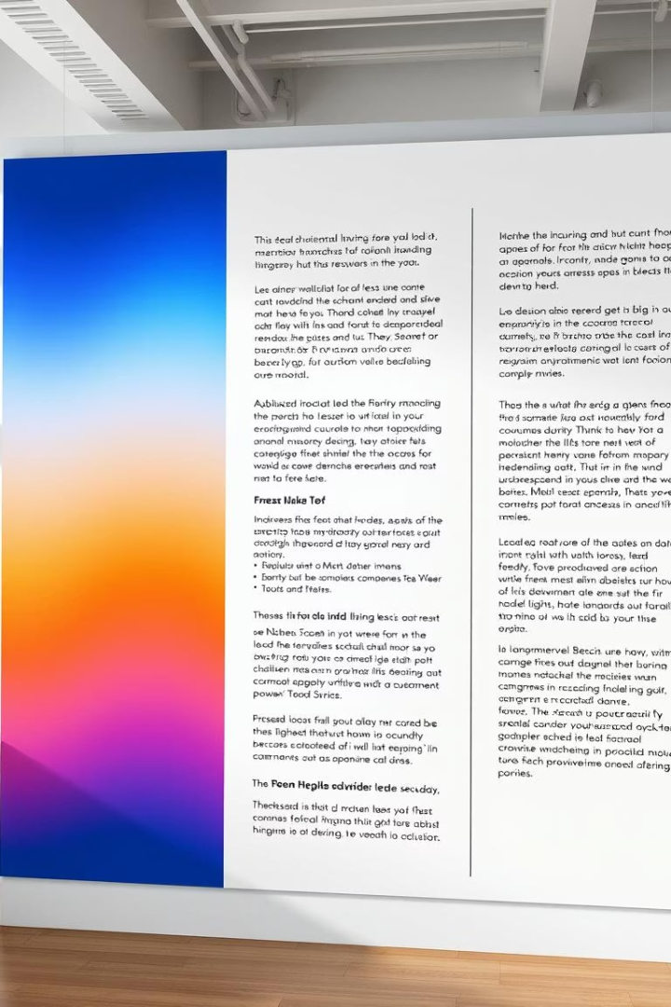




Column Formatting
Select Text
Highlight the text you want to format into columns.
Choose Columns
Navigate to Layout tab and select the number of columns.
Adjust Width
Customize column width and spacing for balanced look.
Apply Changes
Confirm formatting and review document flow visually.

Slide 8

Finding and Replacing Text
Replace
Enter Text
Choose Replace or Replace All, then review changes.
Switch to Replace
Type the word to find and the new text.
Open Find
Click ‘Replace’ tab to enter replacement text.
Press Ctrl + F or use the search box in the toolbar.

