Slide 1

CLOUD
COMPUTING​

Slide 2
Agenda
What is cloud computing?
OneDrive
01
04
How does cloud computing works?
Types of Cloud services
02
05
Cloud storage Service Provider
03

Slide 3
01
What is cloud computing?
Cloud computing is the delivery of computing services—including servers, storage, databases, networking, software, analytics, and intelligence—over the internet (“the cloud”) to offer faster innovation, flexible resources, and economies of scale.

Slide 4
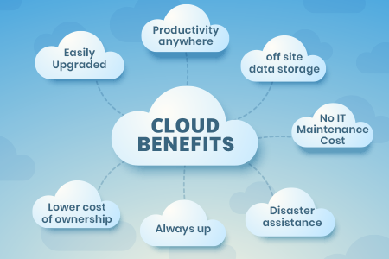

Slide 5
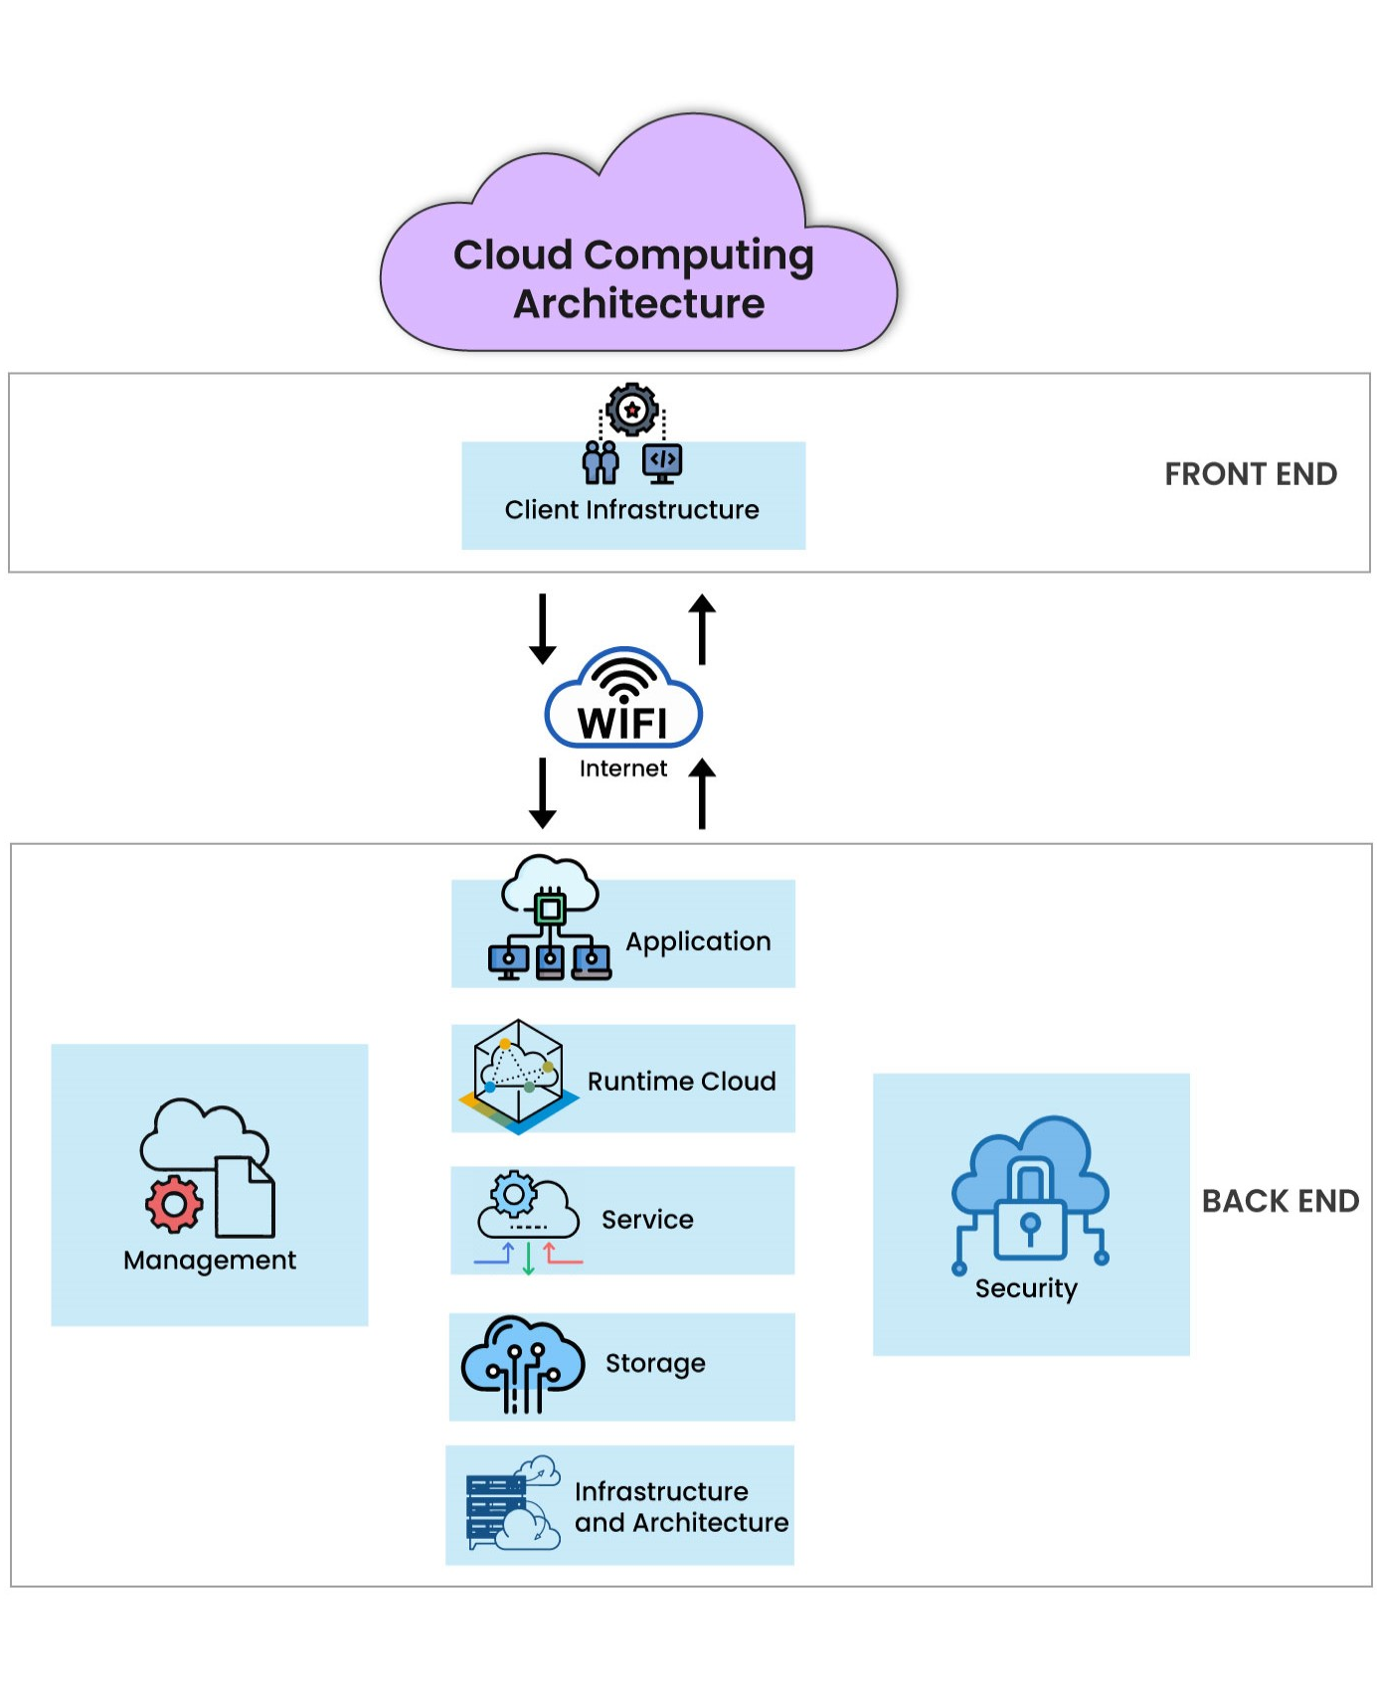
How does cloud computing works?
02

Slide 6


Slide 7
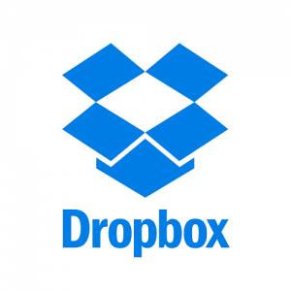
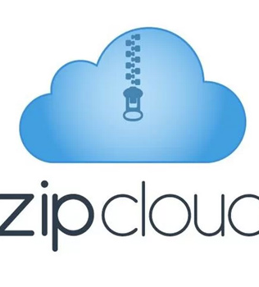
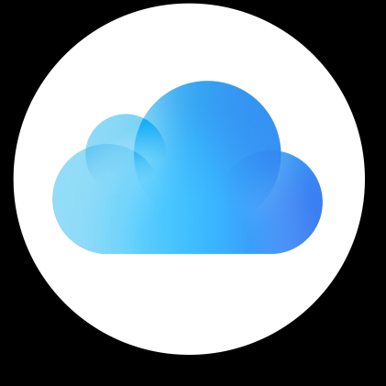
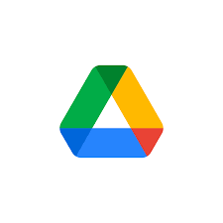
CLOUD STORAGE SERVICE PROVIDERS
03
DROPBOX
ZIPCLOUD
iCLOUD
GOOGLE DRIVE
2GB FREE SPACE
PREMIUM SUBSCRIPTION GIVES 1TB OD STORAGE SPACE
1GB FREE STORAGE
Users can upgrade to provide paid plans that provide 75GB,250 GB,1TB
5GB FREE STORAGE
Users can upgrade to provide paid plans that provide 50GB,200 GB,2TB,6 TB or 12 TB
15 GB FREE STORAGE
Users can upgrade to provide paid plans that provide 100 GB,1TB

Slide 8
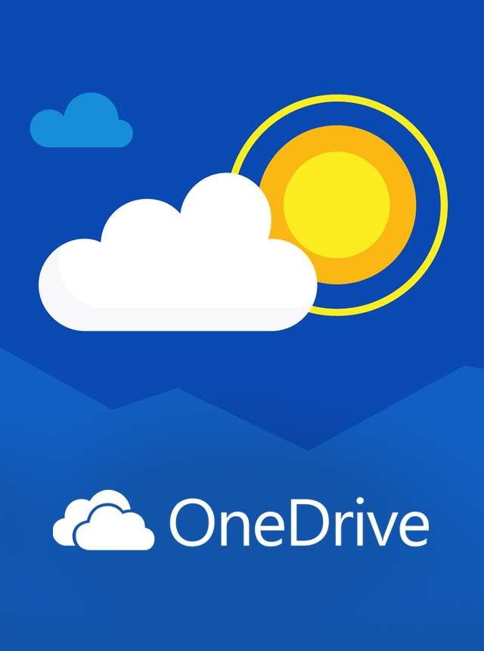
Welcome to the New Era of Microsoft OneDrive: AI, Productivity, and Memories at Your Fingertips
04
OneDrive is your gateway to seamlessly managing files, photos, and memories across work, home, and everywhere in between. Trusted by 94% of Fortune 500 companies millions of small businesses, and countless individuals, OneDrive is transforming how the world collaborates, stores, and connects.

Slide 9
ONE DRIVE
Cloud storage facility offered by Microsoft.
Launched on August 1,2007.
Earlier known as Skydrive.
Provides 5GB free storage ,but additional 5GB can be purchased through a monthly or yearly subscription plan.
OneDrive lets users store files and data on the remote servers.
These stored files can be synced with multiple devices and shared with the other users.

Slide 10
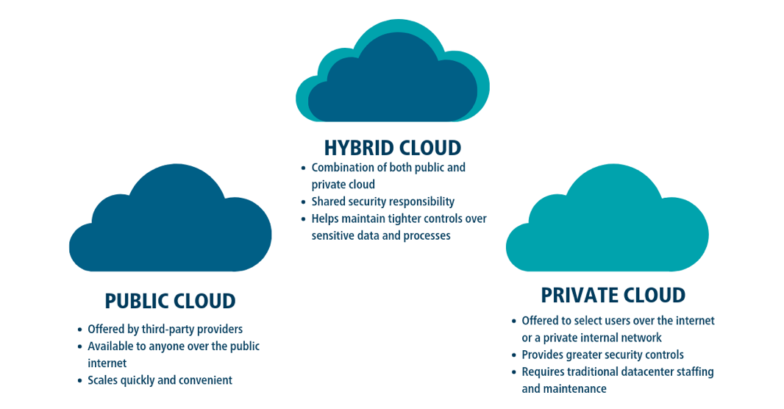
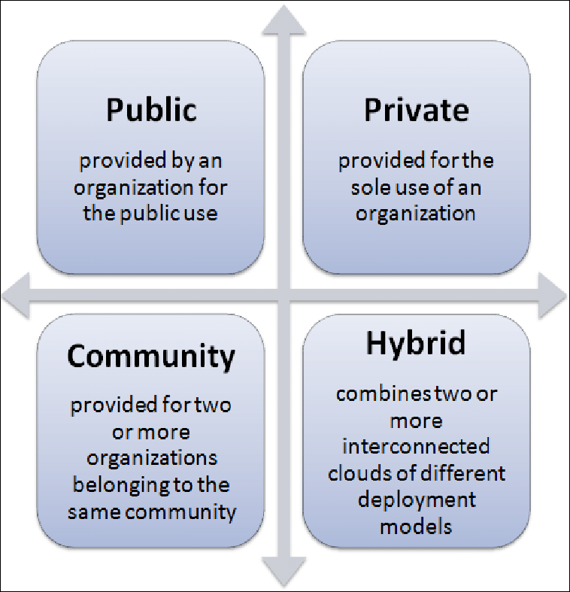
TYPES OF CLOUD SERVICES basis on ownership, size and access
05
Public cloud
Private cloud
Hybrid cloud
Community cloud

Slide 11
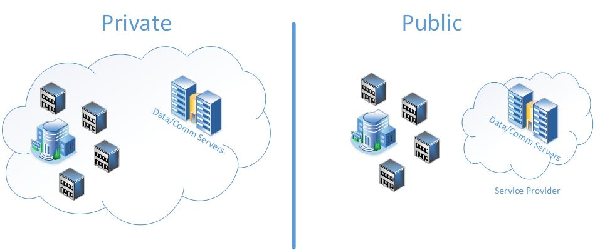

Slide 12
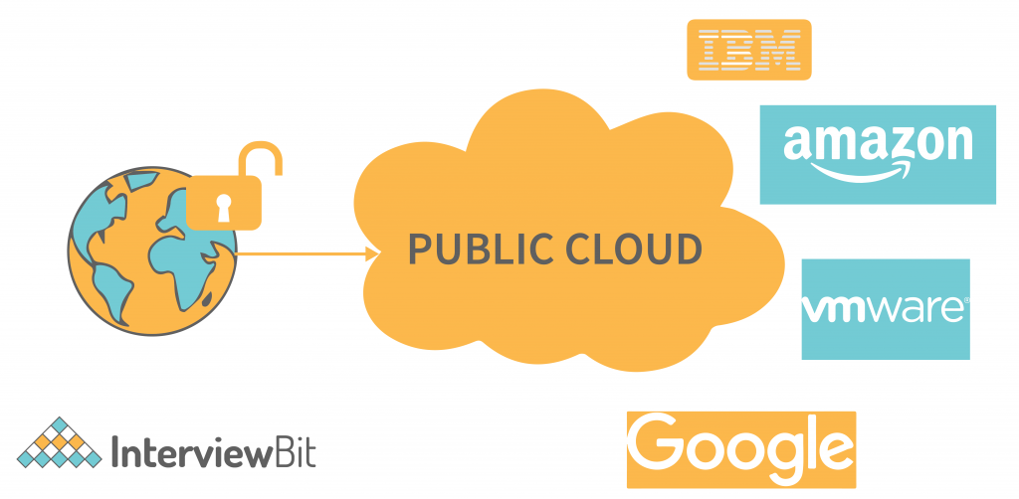

Slide 13
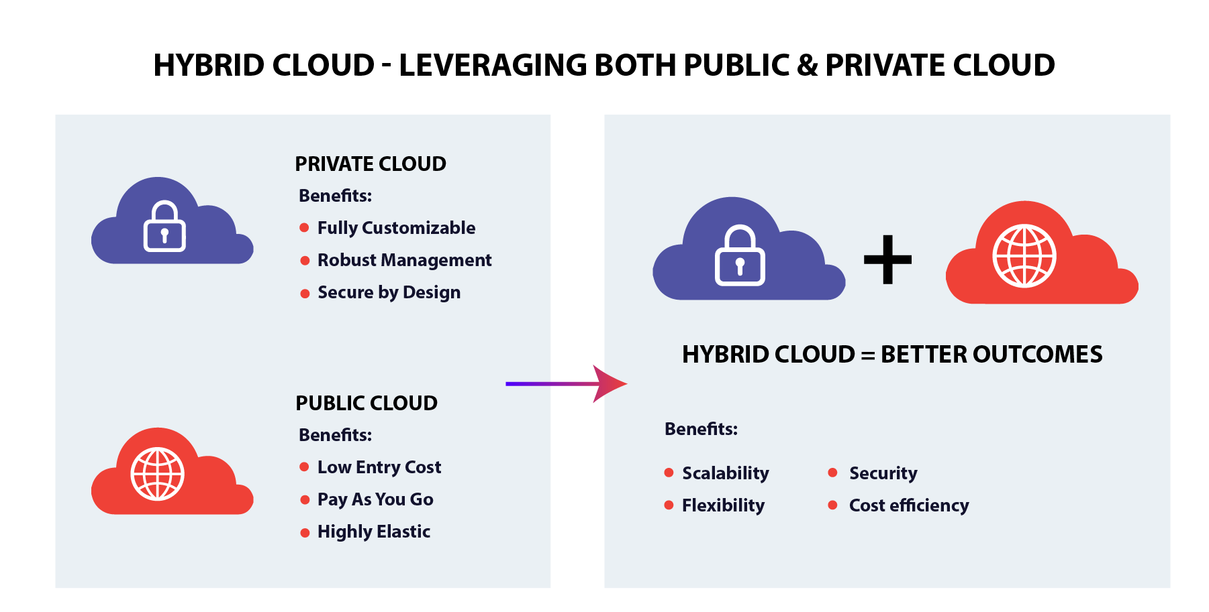

Slide 14
Choose the correct option:
Which of the following option correctly explains the cloud computing concept?
a type of hardware
An internet-based service that provide shared resources.
a software installed on your computer.
A local network set up.
2. Which of the following is NOT a benefit of cloud computing?
a. easy accessibility
b. high cost
c. flexibility
d. shares workload with the user.

Slide 15
Choose the correct option:
Name the cloud storage service which is provided by Google
a. OneDrive
b. iCloud
c. ZipCloud
d.Google Drive
2. How much free storage does Dropbox offer to basic users?
a. 1 GB
b. 2 GB
c. 5 GB
d. 15 GB

Slide 16
Choose the correct option:
Which of the following Cloud is owned by a single company and not meant for the general public?
a. public cloud
b. private Cloud
c. hybrid Cloud
d. community cloud

Slide 17
2. Write True or False:
The internet bridges the gap between client and cloud.
Cloud services can be accessed globally by anyone with an internet connection.
Cloud computing increases the workload on the user’s computer by installing multiple programs .
icloud provides 2GB of free storage to its users.
To use OneDrive, you must have a Google account.

Slide 18
3. Fill in the blanks with the option given below: community cloud/demand/skydrive/public cloud/cloud computing
Cloud computing helps users get shared resources, software and information over a network on ……………….
In ……………………., information and data can be accessed from anywhere at anytime.
OneDrive was formerly known as ……………..
A ……………….. Is owned by a third-Party service provider whose services are easily accessible to the general public.
…………………. Are services offered to a group of organizations and communities that share common interests.

Slide 19
4.Answer in one or two words
What do you call the online storage space where users can save their document?
How many type of cloud services are available in the market?
Name the cloud that comprises both public and private cloud.
Which company provides iCloud storage services?
Name the cloud storage that provided by Microsoft.

Slide 20
Thank You

