Slide 1
Making Presentations: Audio, Video, Graphics and More!
What We'll Learn Today

Slide 2
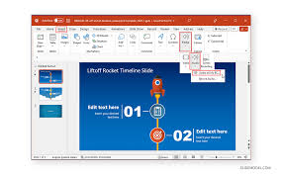
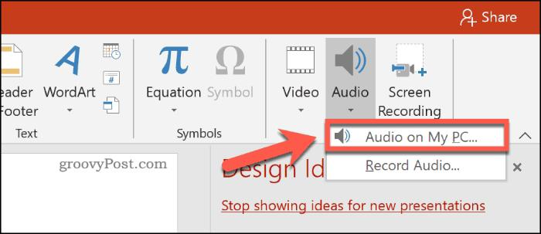
Adding Audio to Your Slides
Click the "Insert" tab
Look for the "Audio" button
Choose from:
Audio from your computer
Record your own voice
Find audio online
Use audio icons or hide them
Set audio to play
automatically or when clicked

Slide 3
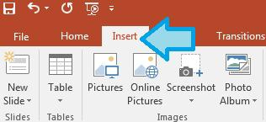
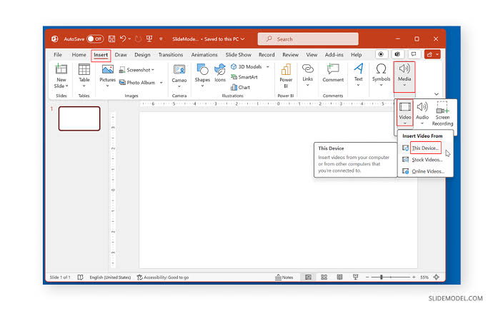
Making Videos Part of Your Story
Find the "Insert" tab
Click "Video"
You can:
Use videos from your computer
Search online videos
Record your own video
Resize the video to fit your slide
Choose when the video starts playing

Slide 4
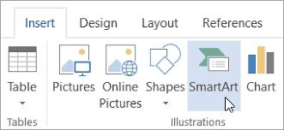
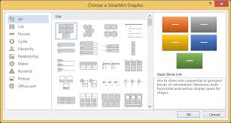
What is SmartArt?
Special graphics that make information look cool
Helps organize ideas in pictures
Makes lists more interesting
Shows steps in a process
Perfect for showing how things connect
Easy to change and customize

Slide 5
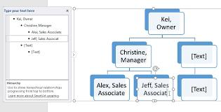
Popular SmartArt Layouts
Lists: Turn boring bullets into pictures
Process: Show steps in order
Cycle: Show how things go around
Hierarchy: Show who reports to who
Picture: Add photos to your diagrams
Pyramid: Show levels of importance

Slide 6
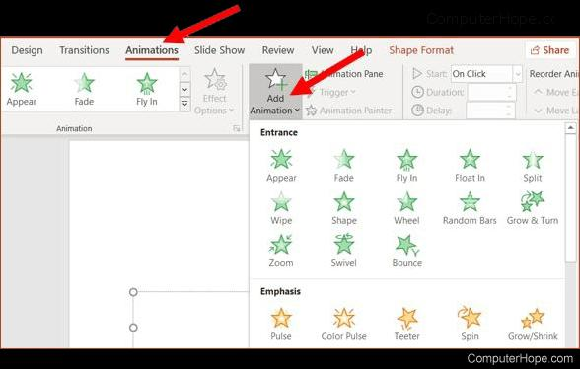
Adding Animation to Objects
Select what you want to animate
Click "Animations" tab
Choose from:
Entrance effects (how things appear)
Exit effects (how things disappear)
Emphasis effects (make things stand out)
Motion paths (make things move)

Slide 7
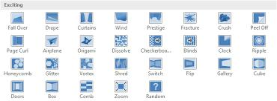
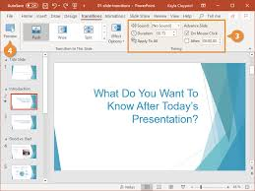
Slide Transitions
Find the "Transitions" tab
Popular transitions:
Fade
Push
Wipe
Morph
Don't use too many different ones!

