Slide 1
Special Purpose Books-Cash Book
CLASS XI CBSE

Slide 2
Introduction
Business transactions are first recorded in Journal and then posted into a Ledger.
In practice, number of business transactions are too large
  It, thus, becomes difficult to record all of them in one book of primary entry.
    For example, most of the transactions may relate to receipt & payment o cash, sale of goods, purchase of goods.
A register of this type is called a book of original entry or of primary entry.
  It is special form of a Journal.
The system by which transactions of a class are first recorded in a book, specially meant for it, and then posted into a Ledger is called the Practical System of Accounting.

Slide 3
Subsidiary Books of Accounts
These books of primary entry are also known as a Special Journal or Subsidiary Books
  because Ledger Accounts are prepared on their basis and
  without this process of Ledger posting, a Trial Balance cannot be drawn.
The Ledger is thus called the Principal Book of Accounts.

Slide 4
Types of Subsidiary Books
Recording all transactions in a single book of primary entry is practically difficult.
To make it convenient, the Journal is divided into a different Subsidiary Books, which are:
Cash book
  To record cash receipts and Payments, including banking transactions
Purchase Book:
  To record credit purchases of goods or the materials and stores required in the processing plants
Sales Book:
  To record the credit sales of goods by the firm
Purchase Returns Book:
  To record return of goods purchased on credit.

Slide 5
Types of Subsidiary Books Contd.
Sales Return Book:
  To record credit sales made by customers
Bills Receivable Book:
  To record the receipts of promissory notes from various parties
Bills Payable:
  To record the issue of promissory notes to other parties
Journal Proper:
  To record the transactions which cannot b recorded in an of the books mentioned above.

Slide 6
Cash Book
Cash Book is a book of primary entry in which cash and bank transactions of business are recorded chronologically.
It is imperative to regularly know the cash or bank balance.
Cash receipt are recorded on the debit side of the cash book and
Cash payments on the credit side.
A balance is worked out by deducting the total cash payments from the total cash receipts.

Slide 7
Features of Cash Book
Only cash transactions are recorded.
Cash and cheque receipts are placed in the debit side.
All cash and cheque payments are recorded in the credit side.
It enters only one form of transaction, i.e. Cash
Cash and bank transactions are recorded in chronologically in the cash book.
It performs the function of both Journal and Ledger at the same time.

Slide 8
Cash Book
Cash transactions are recorded in the Cash Book
Ledger Accounts are prepared on the basis of records in cash Book.
The Cash Book is, therefore, a subsidiary book.
However, the Cash Book itself serves as the cash account and the bank account.
The balances are entered in the Trial Balance directly.
Cash Book is also treated as a Principal Book.
  The Cash Book, therefore, both a subsidiary Book and a Principal Book.

Slide 9
Types of Cash Book
There are three types of Cash Books:
Simple Cash Book or single Column Cash Book
  Only cash transactions are recorded.
Two Column Cash Book
  It has Cash Book with cash and bank column for recording cash and bank transactions.
Three Column Cash Book
  Cash Book having cash, bank and discount column
    For recording cash and bank transactions involving loss or gain on account of discount.

Slide 10
Simple Cash Book
Simple Cash Book looks like an account with one account column on each side.
Dr.
Receipts
Payments
Cr.
Date | Particulars | V. No. | L.F. | Rs. | Date | Particulars | V. No. | L.F. | Rs.
 | Receipts |  |  |  |  | Payments
Left hand side records receipts of cash and right hand side records cash payments

Slide 11
Example: Enter the following transactions in a Simple Cash Book
2019 |  | Rs.
Jan. 11 Jan. 15 Jan. 17 Jan. 18 Jan. 20 Jan 24 Jan. 29 | Cash in Hand Received from Raj Paid rent Sold goods Paid Mohan Purchased furniture Paid salaries | 1,20,000 30,000 3,000 30,000 70,000 20,000 10,000

Slide 12
Solution : Simple Cash Book
In the Books of Raj
Dr.
Receipts
Payments
Cr.
Date | Particulars | L.F. | Rs. | Date | Particulars | L.F. | Rs.
2019 Jan. 11 Jan.15 {{{{{{{{{ Feb. 1 | To Balance b/d To Raj To sales A/c |  | 1,20,000 30,000 30,000 | 2019 Jan.17 Jan.20 Jan. 24 Jan. 29 Jan. 31 | By Rent A/c By Mohan By Furniture A/c By Salaries A/c By Balance c/d |  | 3,000 70,000 20,000 10,000 70,700
 |  |  | 1,80,000 |  |  |  | 1,80,000
 |  |  | 70,700
It can be concluded that
Only cash receipts and cash payments are recorded in a Simple Cash Book. Credit transactions are not recorded.
Debit side is always larger than credit side since the payment can never exceed the available cash.
It is like an ordinary account.

Slide 13
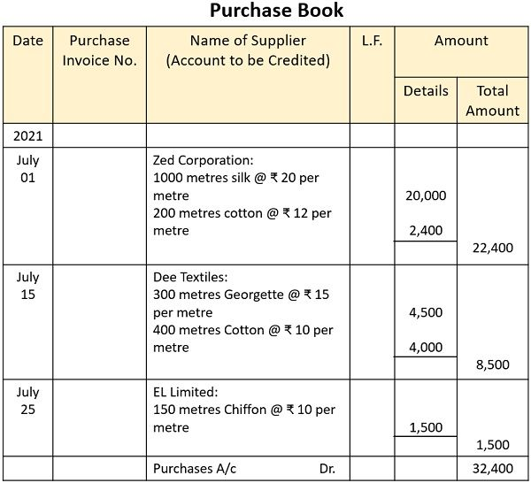
FORMAT OF PURCHASE DAY BOOK

