Slide 1
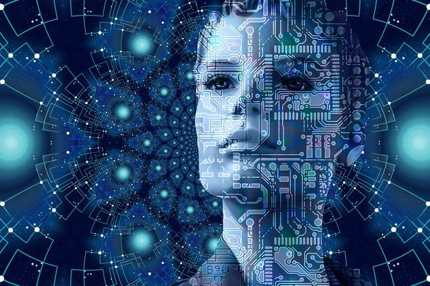
AI AND ITS DOMAINS

Slide 2
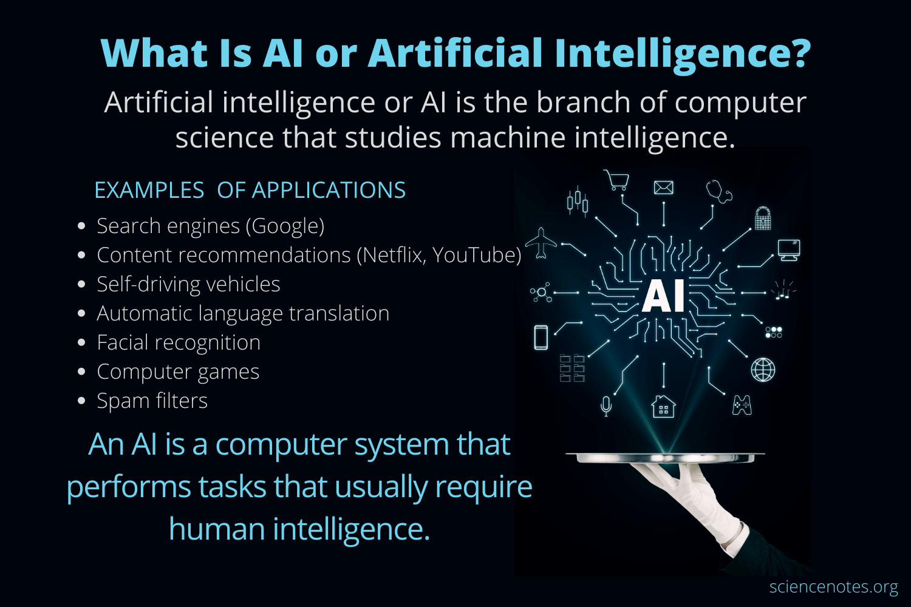

Slide 3
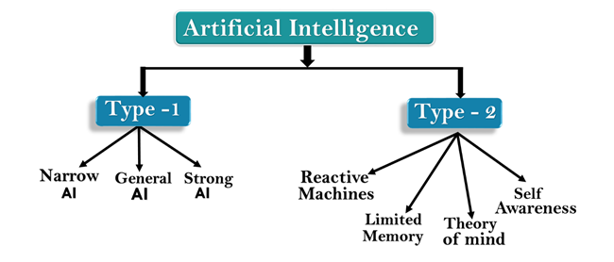

Slide 4
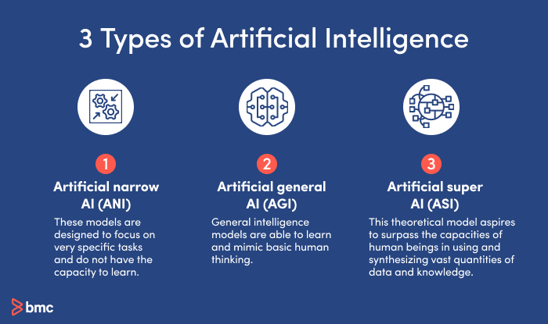

Slide 5
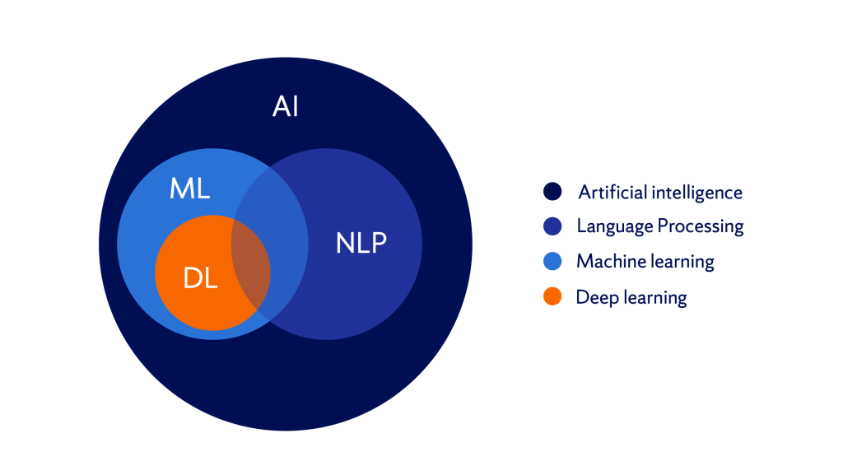

Slide 6
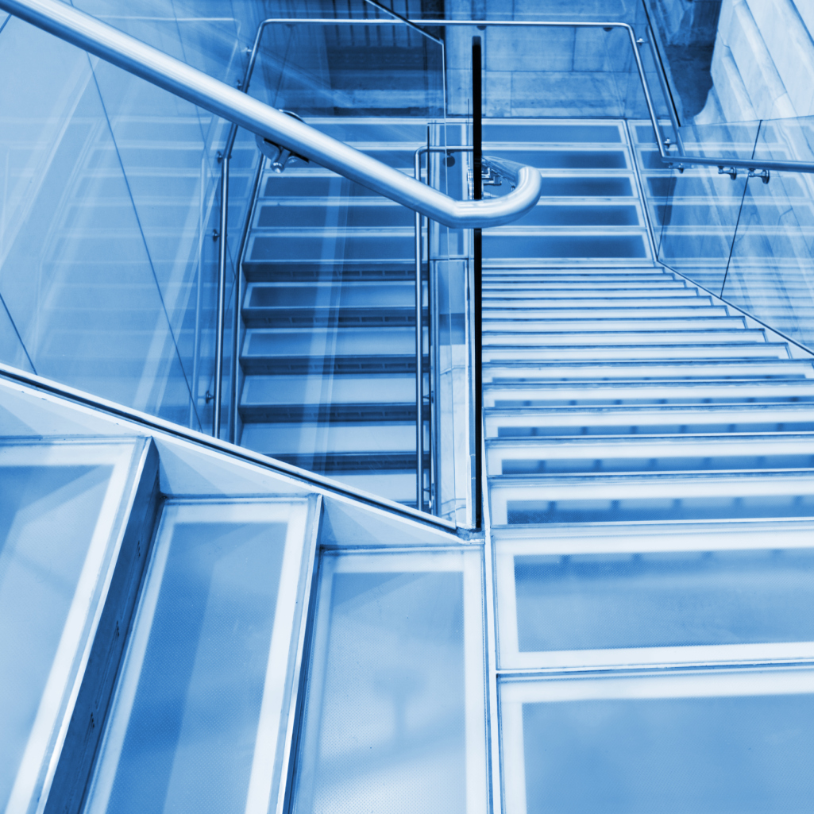
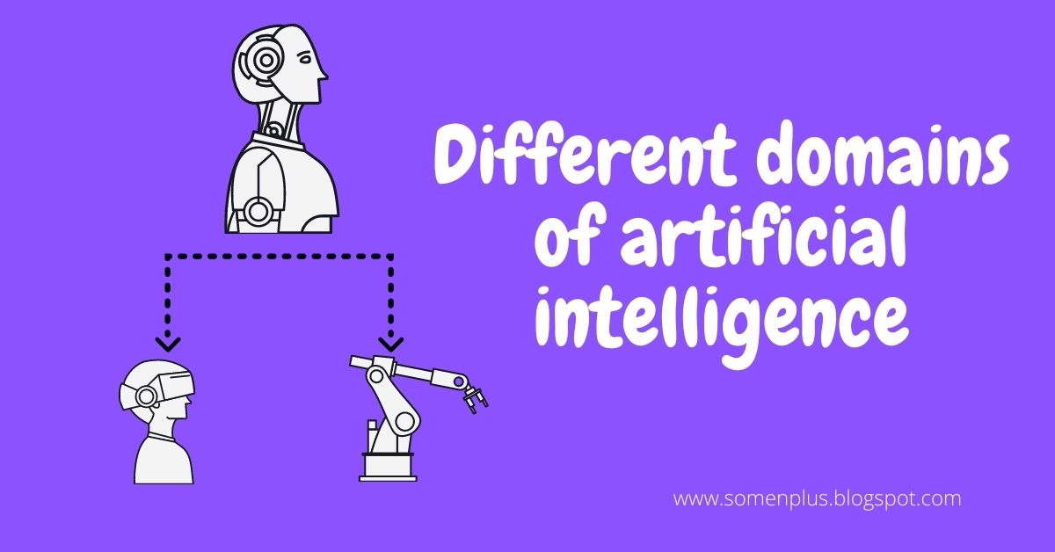
Front cover
DOMAINS OF AI
Every machine or organism is made of smaller parts that perform a specific type of task. Similarly, the AI system is also built from different smaller mechanisms that help the AI to work properly. These working mechanisms are the different components with which the AI system can work. They are commonly called Domains Of AI.

Slide 7


Slide 8

DOMAINS OF AI
Artificial intelligence (AI) is the part of computer science concerned with designing intelligent computer systems, that is, systems that exhibit characteristics we associate with intelligence in human behavior- understanding language,learning,reasoning,solving problems, and so on.
01-Aug-25
8

Slide 9
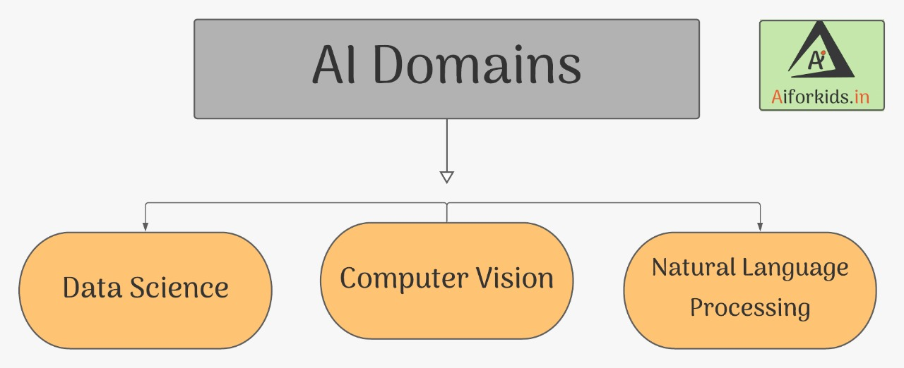
DOMAINS OF AI
BIG DATA

Slide 10
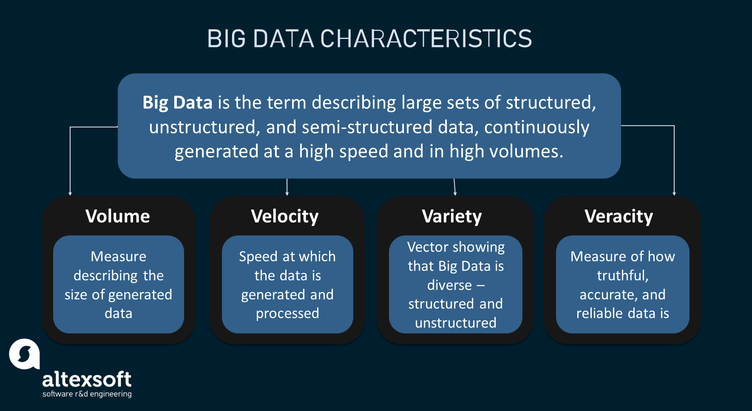
BIG DATA
1

Slide 11
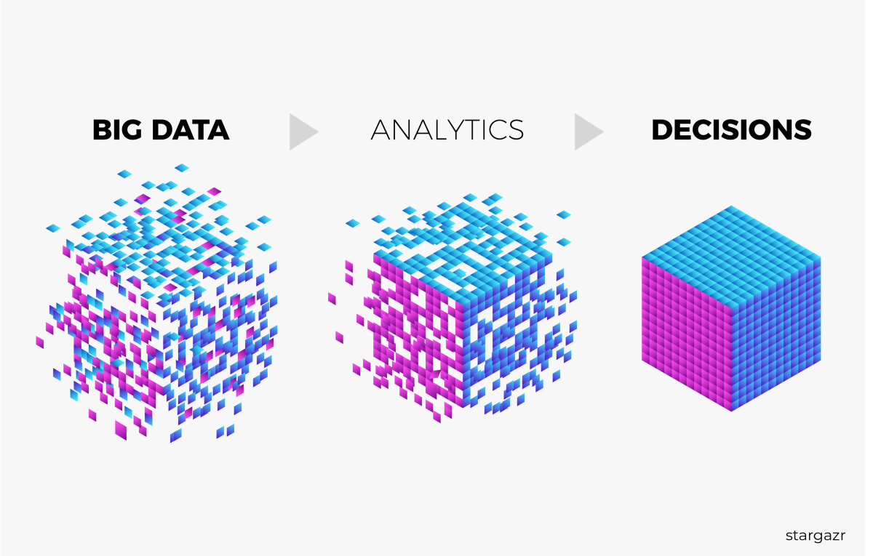
USAGE OF BIG DATA
INTERNET IS THE BIGGEST DATA PROVIDER OF
CONSUMER HABITS,LIKES
DISLIKES , ACTIVITIES
PERSONAL PREFERENCES WHICH WERE OTHERWISE NOT POSSIBLE .SOCIAL MEDIA ACCOUNTS
ONLINE PROFILES,
PRODUCT REVIEWS,
TAGGED INTEREST
SHARED CONTENT
ALMOST EVERY INFORMATION ADDS VALUE TO THE BIG DATA POOL.
USING DATA FROM MANY SOURCES,
AI CAN BUILD A STORE HOUSE OF KNOWLEDGE THAT ULTIMATELY LEADS TO ACCURATE PREDICTIONS ABOUT A CONSUMER.

Slide 12
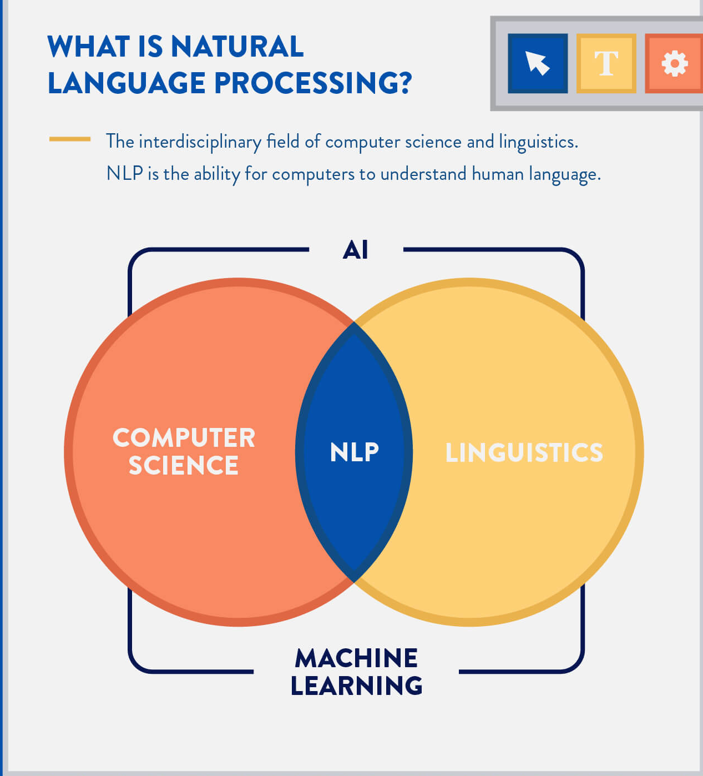
NATURAL LANGUAGE PROCESSING
2
USES of NLP
Email filters
Auto complete and spell check feature of auto processors.
Text messaging
Virtual assistants

Slide 13
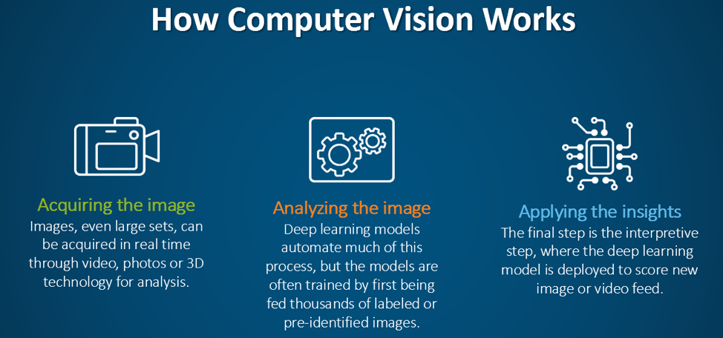
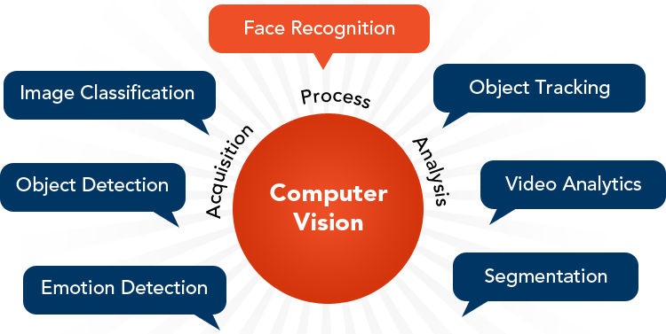
COMPUTER VISION(CV)
3
Computer vision is defined as a subset of mainstream artificial intelligence that deals with the science of making computers or machines visually enabled,i.e., they can analyze and understand an image.
USES
Self-driving cars
Drones are used to examine the health of crops .
Check the patients image and determine the ailment
Used for security and surveillance.

Slide 14
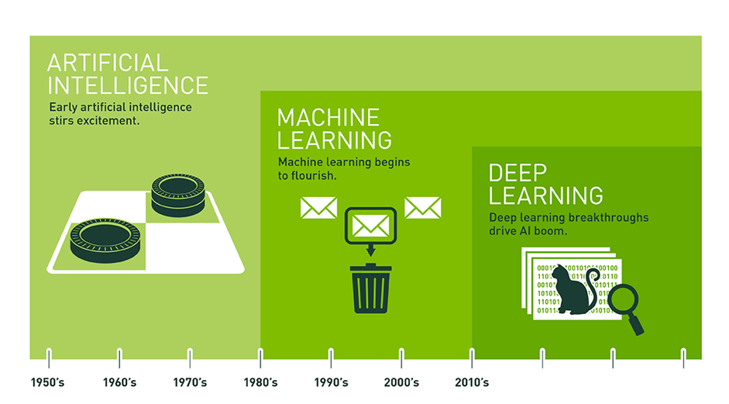

Slide 15
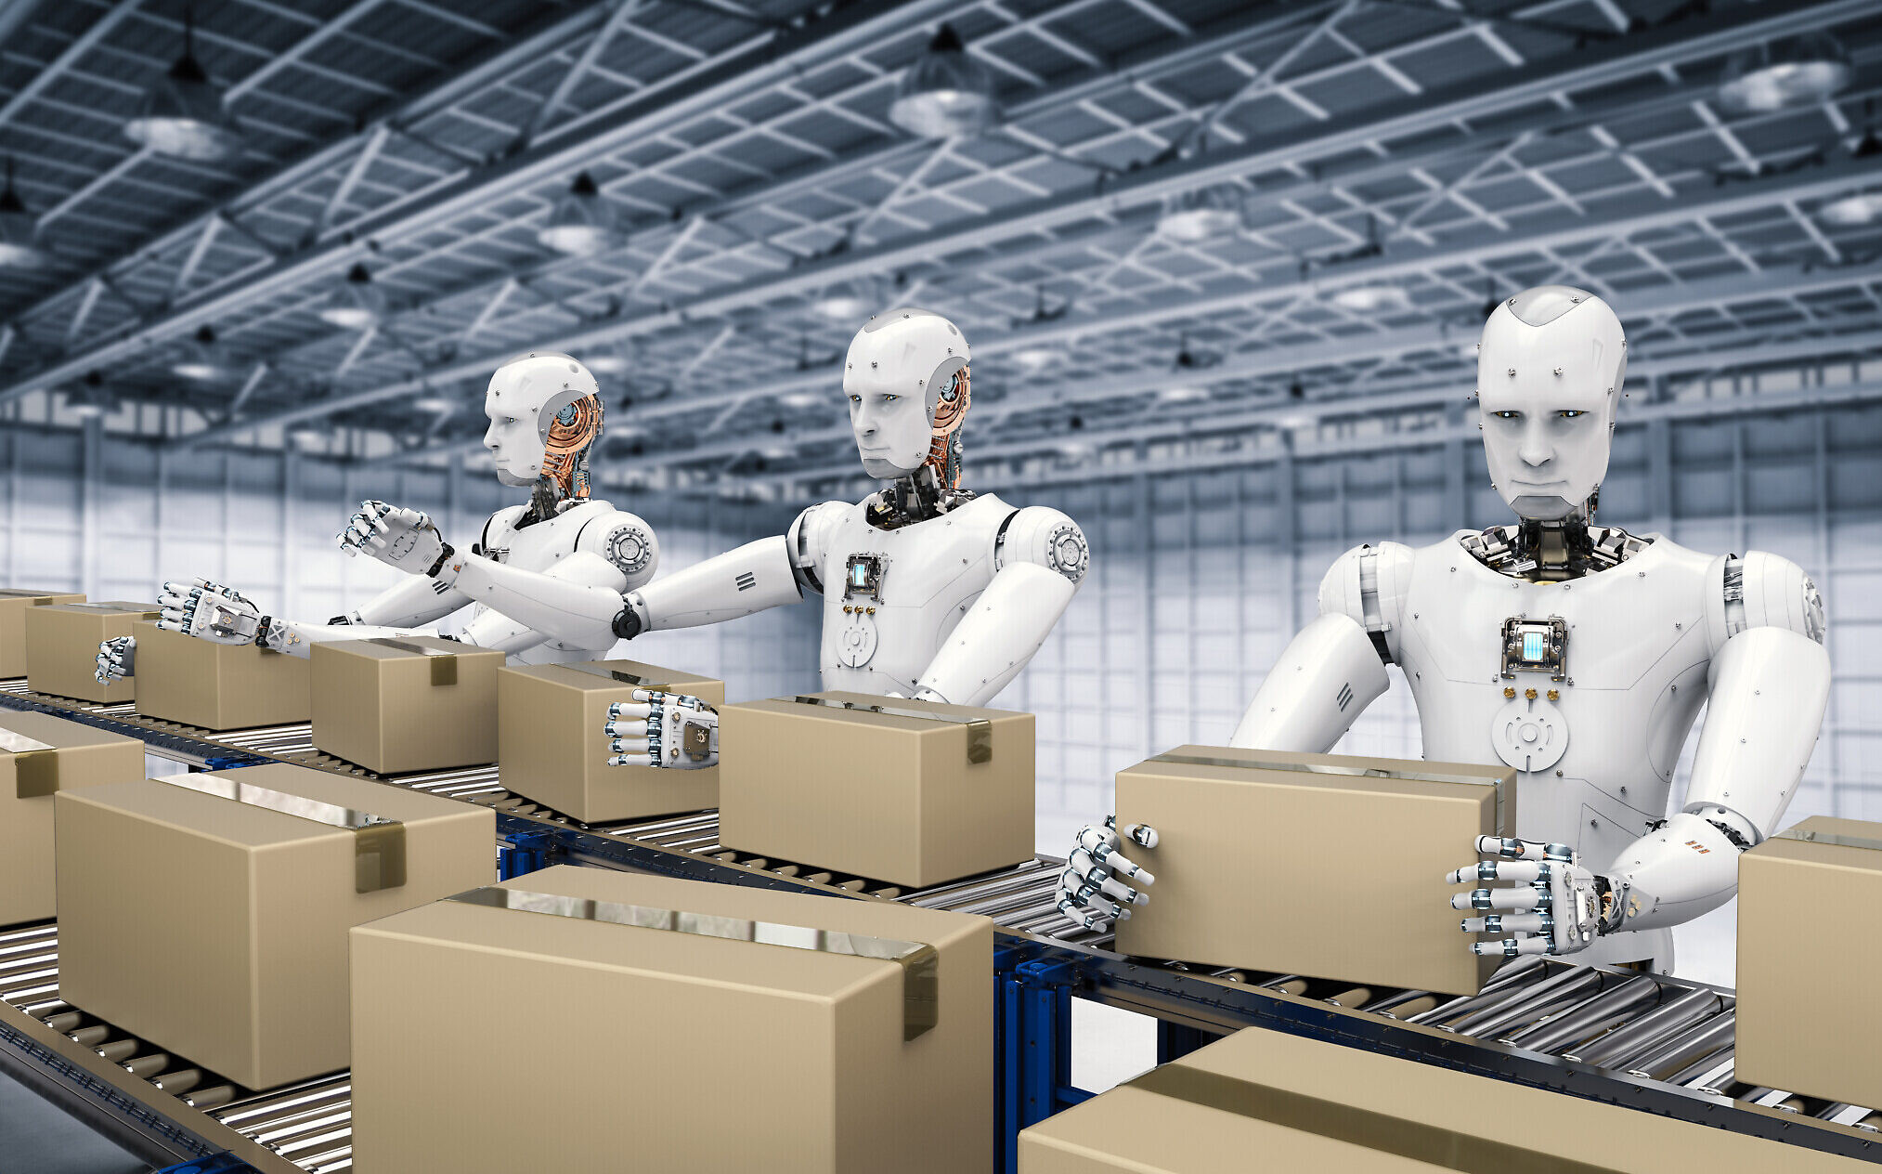
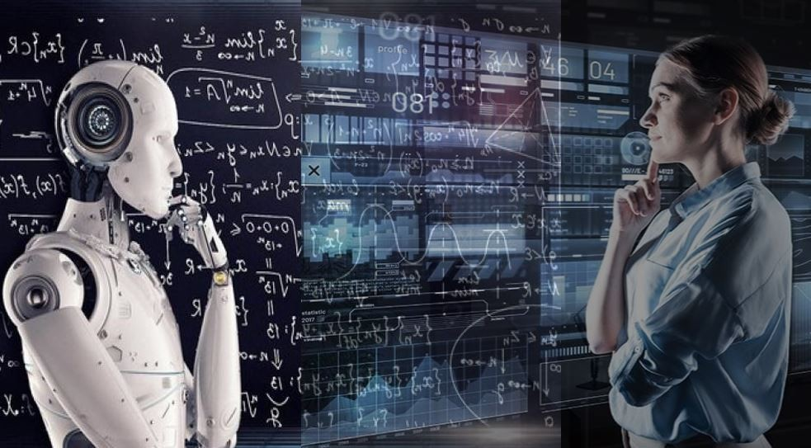
ADVANTAGES OF ARTIFICIAL INTELLIGENCE
PROCESS AUTOMATION
Humans have the tendency to get bored while performing repetitive tasks, which can hamper their productivity. Such tasks done by intelligent machines without any external intervention, allowing humans to engage in more demanding and creative tasks.
2. QUICK DECISION MAKING
The speed at which humans take decision is much slower than AI systems. Humans’ reaction to situations is much slower whereas AI enabled system can process information faster and are also structured way more efficiently.
Picture caption can be written here.

Slide 16
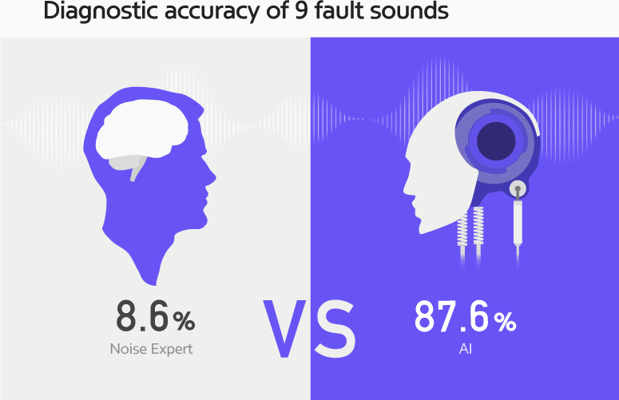
ADVANTAGES OF ARTIFICIAL INTELLIGENCE
3. ACCURACY
Human intelligence is not failure proof, but AI systems are.AI driven software can only be faulty due to human limitations or hardware failure.
4. QUICKER DATA ANALYSIS
HUMANS SPEND A LARGE AMOUNT OF TIME AND EFFORT TO ANALYSE AND FILTER DATA, BUT AI SYSTEMS CAN MANAGE AND ORGANISE HUGE VOLUME OF DATA IN MUCH LESS TIME.
Picture caption can be written here.

Slide 17
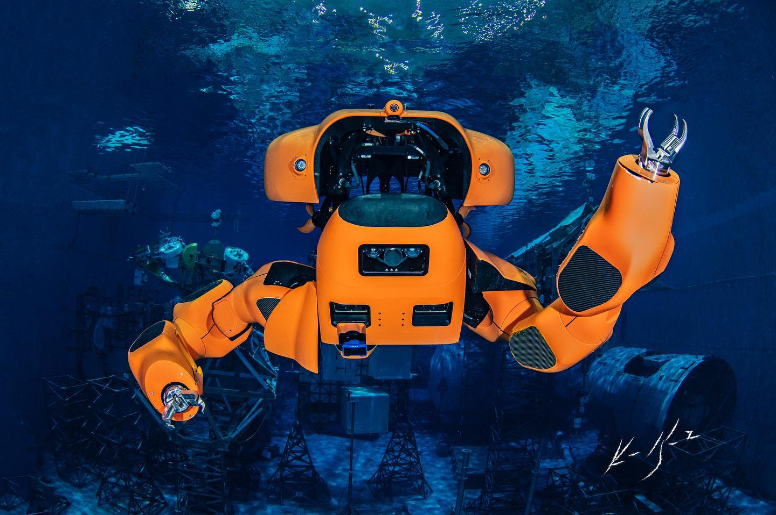
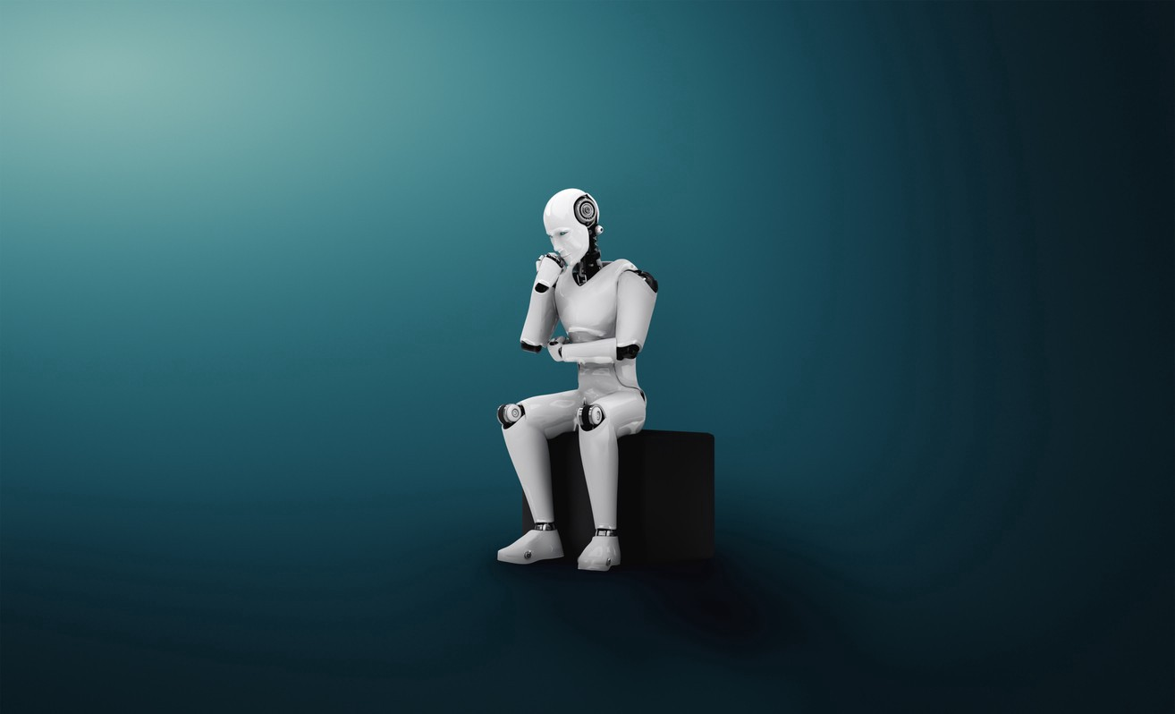
ADVANTAGES OF ARTIFICIAL INTELLIGENCE
5. ABILITY TO COMPLETE DANGEROUS TASKS
Ai enabled machines/systems can explore in space, go underwater, help in digging and mining tasks. The tasks that are considered dangerous for human beings are easily handled by using ai enabled machines.
6. TAKE DECISIONS RATIONALLY
Everyday human intelligence processes a lot of phenomena that affects the quality of decisions taken by humans. Humans might take decisions rationally, but ai systems can think logically without emotions, making rational decisions with fewer or no mistakes. They don’t need to sleep,rest,take breaks or anything.
Picture caption can be written here.

Slide 18
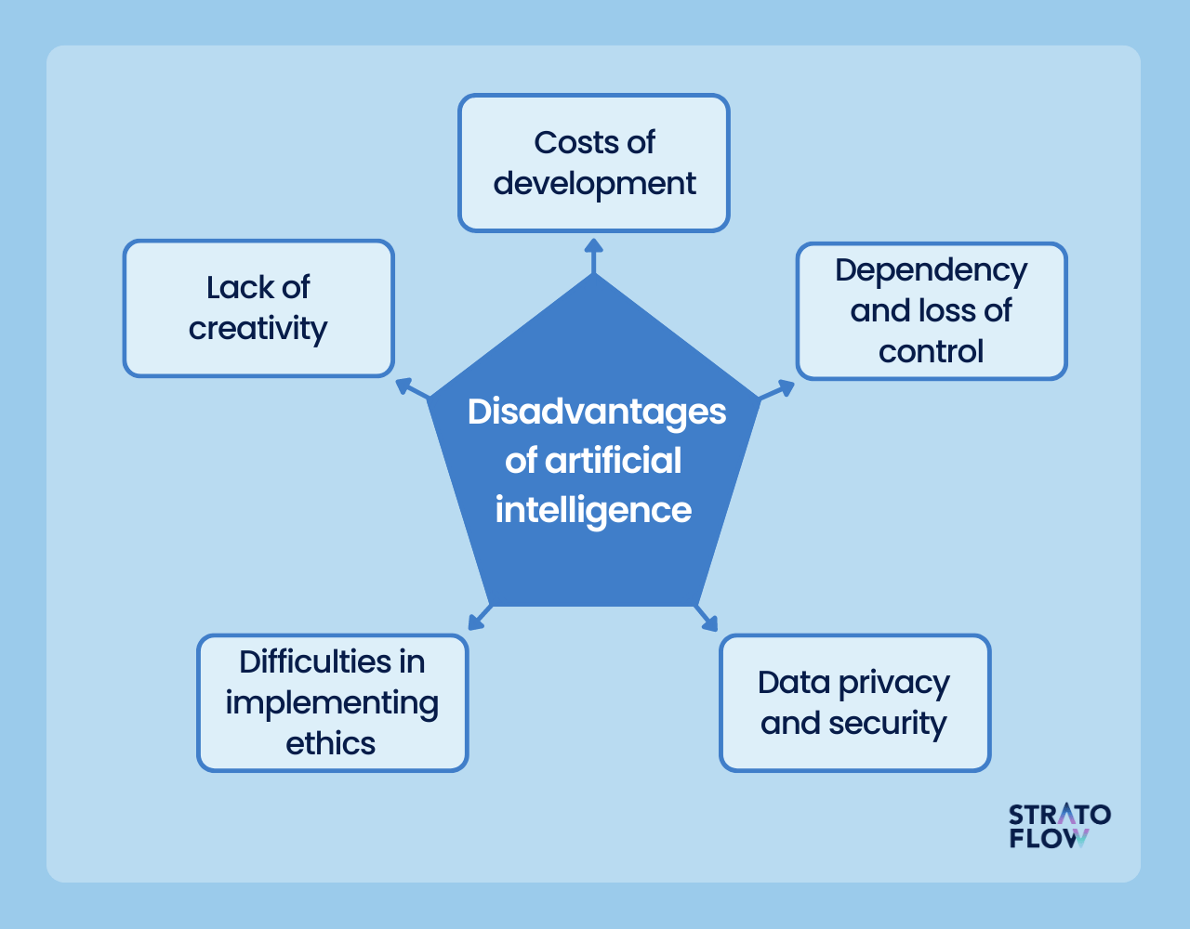

Slide 19
1. CHOOSE THE CORRECT OPTION:
CITE AN EXAMPLE OF NARROW AI
A) R2-D2 in star wars
B) Self-Driven cars
C) Jarvis in Iron-Man
D) The terminator

Slide 20
1. CHOOSE THE CORRECT OPTION:
2. Determine which of the following is required for an AI system to process and understand visual data
A)NLP
B) Machine Learning and CNN
C) Supervised learning
D) General AI

Slide 21
1. CHOOSE THE CORRECT OPTION:
3.Which of the following is not a domain AI?
A) data
B) NLP
C) quantum computing
D) CV

Slide 22
1. CHOOSE THE CORRECT OPTION:
4.Identify the significant risk associated with the widespread adoption of AI.
A) increased creativity
B) enhanced emotional intelligence
C) unemployment
D) better decision making

Slide 23
1. CHOOSE THE CORRECT OPTION:
5.Which of the following enables AI to make quicker decisions than humans
A) emotional intelligence
B) limited data analysis
C) faster information processing
D) supervised learning

Slide 24



Programming is an ART….
Add your colours to it and make your own

