Slide 1


Learn
HTML 5 & CSS3

Slide 2

Introduction to HTML 5
HTML 5 is a markup language used to structure and present content on the World Wide Web.
The main feature of HTML 5 is that you can add multimedia content without using Flash and another audio video media player.
HTML 5 supports the traditional HTML and XHTML-style syntax and other new features in its markup, New APIs, XHTML and error handling.

Slide 3
About HTML
HTML stands for Hypertext Markup Language which is used to create web pages and web applications.
Hypertext: It simply means “Text within text”. A text has a link within it. When you click on a link it brings you to a new webpage.
Markup language: It is a computer language that is used to apply layout and formatting conventions to a document. It makes text more interactive and dynamic.

Slide 4
History of HTML
In late 1991, the first version of HTML (ver 1.0) was created by Tim Berners-Lee.
Then in 1995 the HTML 2.0 was published.
In 1997 HTML 3.0 was invented by Dave Raggett.
Then in 1999 the HTML 4.0 was published.
HTML 5.0 was published in 2012 which is said to be the extended version of HTML 4.01

Slide 5
CREATING & SAVING
HTML DOCUMENTS
We will be using Notepad as the text editor for creating HTML documents. Follow the steps below:
Step 1
Use the Search box next to the Windows Start button to open the Notepad window.
Step 2
Type the HTML code in the Notepad window.
Step 3
Click on the File menu and choose the Save option. The Save As dialog box gets displayed.
In the Save As dialog box, after selecting the appropriate folder, specify the name of the HTML file along with the extension .html or .htm in the File Name box.
Step 4

Slide 6
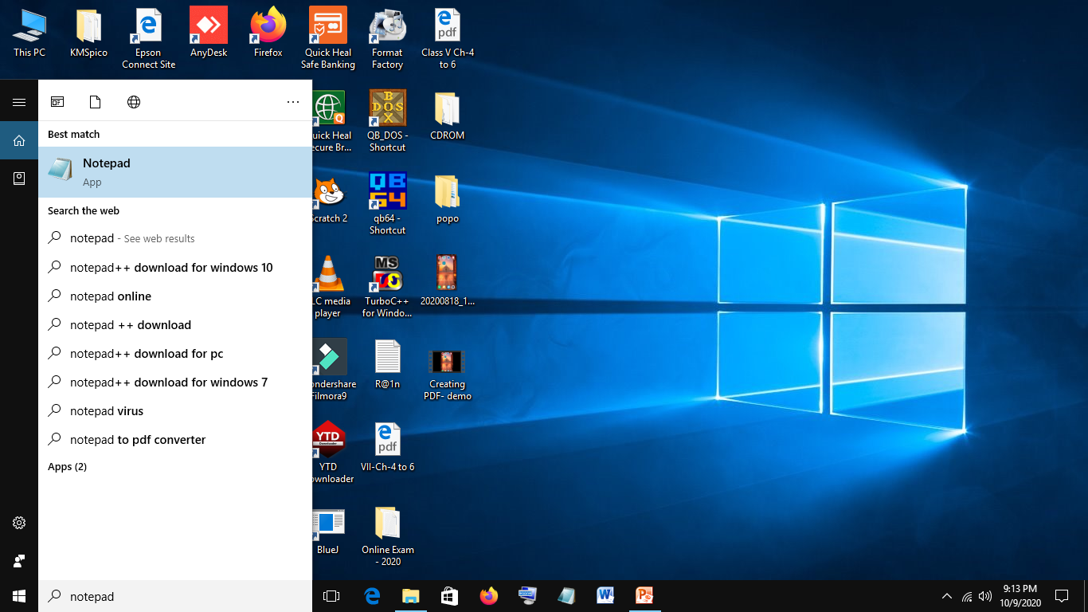
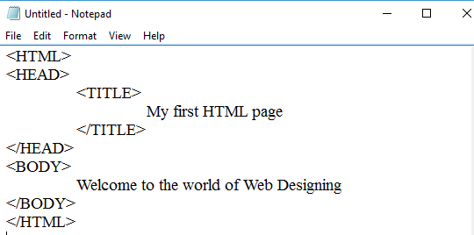
CREATING & SAVING
HTML DOCUMENTS
Step 1
Step 2
Typing HTML code in Notepad

Slide 7
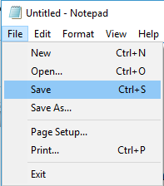
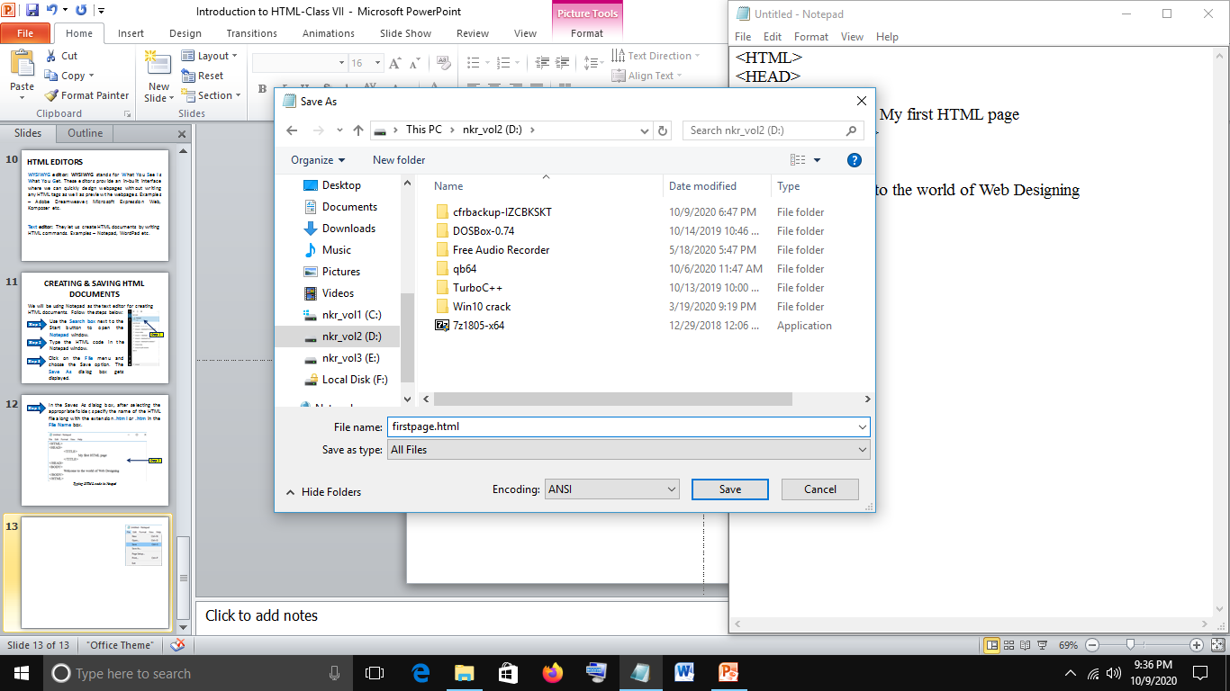
CREATING & SAVING
HTML DOCUMENTS
Step 3
Saving document HTML file
Step 4
Step 5
Save As dialog box

Slide 8
VIEWING HTML DOCUMENTS
We can check how the webpage will look like, using a web browser. Examples – Internet Explorer, Mozilla Firefox, Netscape Navigator and Google Chrome.
Follow the steps below to view webpage:
Step 1
Open Google Chrome and press Ctrl+O. Open dialog box appears.
Step 2
Choose the folder and file.
Step 3
Click on the Open button. The selected file opens in the Google Chrome window.

Slide 9
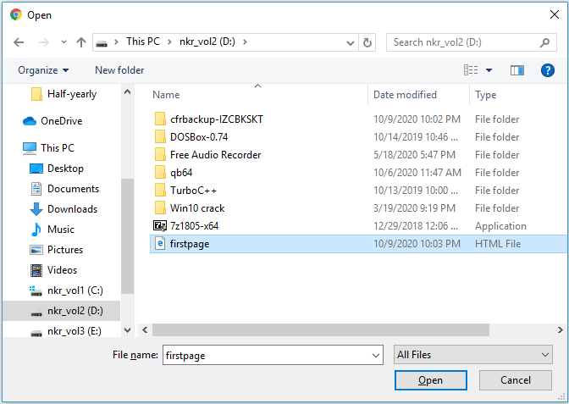
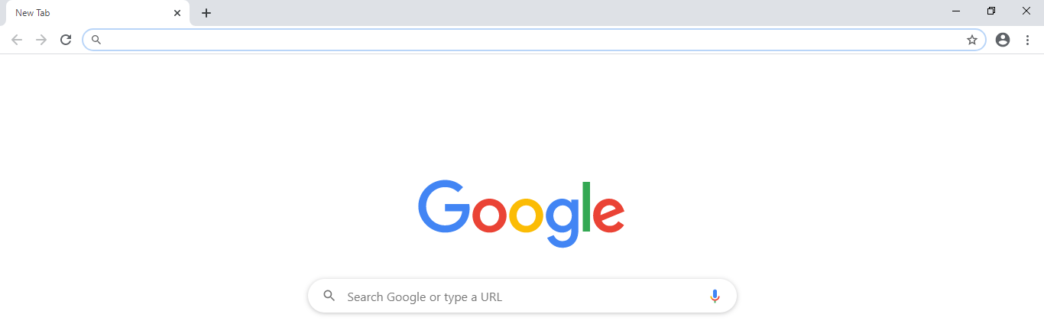
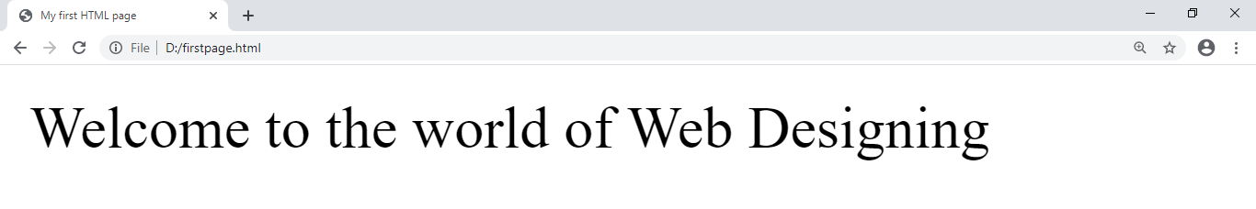
VIEWING HTML DOCUMENTS
Step 1
Step 2
Step 3
Title of the webpage
Google Chrome output window
Content of the webpage

Slide 10
HTML TOOLS
There are two basic tools required for creating an HTML document.
Editor: It is a software program that allows a user to edit or compose HTML documents.
HTML editors are of two types –
WYSIWYG editor: WYSIWYG stands for What You See Is What You Get. These editors provide an in-built interface where we can quickly design webpages without writing any HTML tags as well as preview the webpages. Examples – Adobe Dreamweaver, Microsoft Expression Web, Kompozer etc.

Slide 11
HTML TOOLS
Text editor: They let us create HTML documents by writing HTML commands. Examples – Notepad, WordPad etc.
Browser: Web browser is used to view of display HTML documents. Examples: Internet Explorer, Opera, Mozilla Firefox etc.

Slide 12
ELEMENTS OF HTML
An HTML element usually consists of a start tag and end tag, with the content inserted in between.
Tags
HTML tags are hidden keywords within a web page that define how the browser must format and display the content. All HTML tags are enclosed within the angle brackets (< >). Examples - <BODY>, <BR>, <HR> etc. HTML is not case sensitive i.e., we can write commands either in small letters or capital letters or both.
Tags are of two types:
Container Tag
Empty Tag

Slide 13
Container Tag
A container tag is a tag that needs to be closed. It is closed by putting a forward slash (/) in front of the tag name. They are used in pairs. Example –
<H1> Hello World </H1>
Here, <H1> is the opening or the start tag and </H1>
is the closing or end tag.
Empty Tag
An empty tag is a tag that does not require closing tag. Examples - <HR> , <BR>

Slide 14
ATTRIBUTE
An attribute is a special keyword used inside the tag to specify additional information about the tag and customize it.
Most attributes are optional and are only used when the default behavior of a tag is to be changed.
Example –
<H1 ALIGN=“CENTER”> Text </H1>
It indicates that the text inside the <H1> tag is to be displayed in the center of the browser window.

Slide 15
STRUCTURE OF AN HTML DOCUMENT
Every HTML document must contain certain standard HTML tags. These tags define the basic structure of a webpage.
<HTML>
<HEAD>
<TITLE>
Title of the webpage
</TITLE>
</HEAD>
<BODY>
Tags that define the content of a webpage are written here.
</BODY>
</HTML>

Slide 16
Let’s discuss those standard tags in detail:
<HTML> Tag: It is a container tag. It tells the browser that the text contained between <HTML> and </HTML> is a web page and can be viewed using a web browser.
<HEAD> Tag: It is a container tag. It contains information about, including title, scripts used and style definitions used in the document, it is optional.
<TITLE> Tag: It is a container tag. It is used to specify the title of a webpage. The title appears on the Title bar or on the tab in the browser window.
<BODY> Tag: It is a container tag. It defines the content of a webpage that would be visible in the browser. All the tags that display text, images or links in a webpage are written between the opening and closing <body> tags.

Slide 17
Lets now explore some other tags of HTML.
<Hn> Tag
Heading tags display text in larger as well as bolder font than normal body text. HTML provides six level of headings - <H1> to <H6>, with 1 being the largest and 6 being the smallest size. A blank line gets automatically inserted before and after the heading.
Attribute | Description | Example
ALIGN | This attribute is used to specify the placement of the heading text with respect to the margins. The values that can be specified are – LEFT RIGHT CENTER. | <H1 ALIGN=“CENTER”>

Slide 18
<P> Tag
It is a container tag. It defines start and end of a paragraph in the text. When a text is included within the opening and the closing <P> tag, a blank line is inserted automatically before and after the enclosed text. It has only one attribute called ALIGN.
Attribute | Description | Example
ALIGN | This attribute is used to specify the placement of the text enclosed within the <P> tag with respect to the margins. The values that can be specified are LEFT, RIGHT and CENTER. If you do not used the ALIGN attribute, the paragraph will be left aligned by default. | <P ALIGN=“CENTER”>

Slide 19
<BR> Tag
It is an empty tag. It is also known as line break. It shifts the text following to it forcefully to the next line. It does not have any attributes.
<HR> Tag
It is an empty tag. The <HR> tag stands for Horizontal Rule. It inserts a straight horizontal line across the webpage. By default, it appears shaded and spans the entire width of the browser window.
Attribute | Description | Example
SIZE | To specify the vertical size or the thickness of the horizontal line. The value is given in pixels | <HR SIZE=“5””>
WIDTH | To specify the length of the horizontal line. The value can be given in pixels or in percentage of the page width. | <HR WIDTH=“500” Or <HR WIDTH=“50%”>
ALIGN | To specify the placement of the line on the webpage. Values are – left, right and center (default). | <HR ALIGN=“RIGHT”>

Slide 20
<B>, <I>, <U> Tags
Font style tags are used to change the appearance of the text.
Bold: <B>…</B> tag is used when you want to create bold text.
Italic: <I>…</I> tag is used when you want your text in italics.
Underline: <U>…</U> tag is used when you want to create underlined text.

Slide 21
CSS
CSS stands for Cascading Style Sheets with an emphasis placed on “Style”. It is the language for describing the presentation of Web pages, including colors, layout and fonts. CSS is independent for HTML and can be used with any XML-based markup language.
It allows one to adapt the presentation to different types of devices, such as large screens, small screens, or printers.
It brings style to your web pages by interacting with HTML elements. For example.
p{
color:pink;
font-weight:bold;
}
<p>This is a paragraph </p>

Slide 22
Methods of Applying CSS
CSS can be applied to HTML or XHTML using three methods:
Inline: Inline styles are placed directly into the HTML tags using the style attribute.
They look something like this:
<p style=“color:red”> text </p>
Internal or Embedded: Internal or Embedded styles are used for the whole page. Inside the head element, the style tags surround all of the styles for the page.
Let’s see with an example:

Slide 23
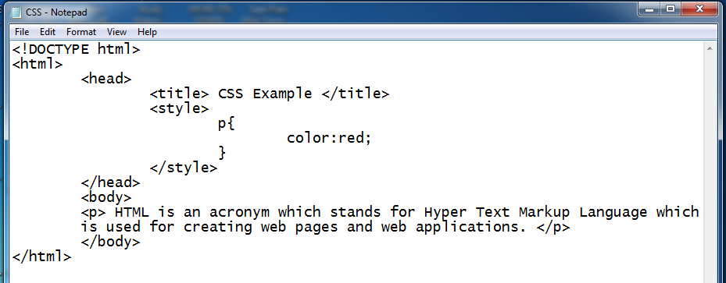
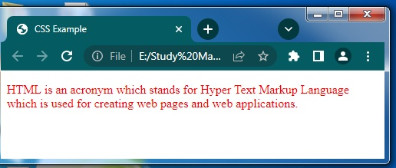
Methods of Applying CSS

Slide 24
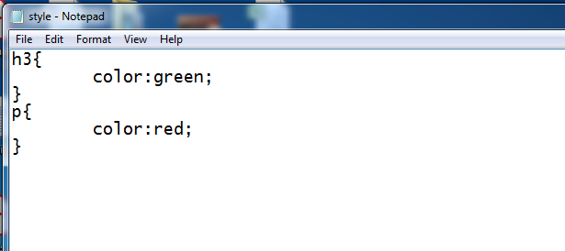

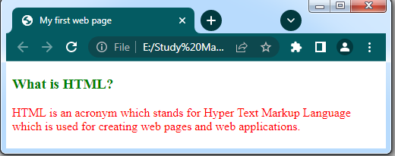
Methods of Applying CSS
External: External styles are used for the whole, multiple-page website. There is a separate CSS file, which will simply look as given below:

Slide 25
BACKGROUND PROPERTIES
The background properties allows you to control the background of any element. The various background properties and their values are as follows:
Property | Value | Description
background-color | Name of the colour | It is used to set the background color of an element
background-image | URL of the image | It is used to set an image as a background of an HTML element
background-position | right top, left top etc | Specifies the indentation of the first line of the text

Slide 26
Thank You

