Slide 1


Slide 2
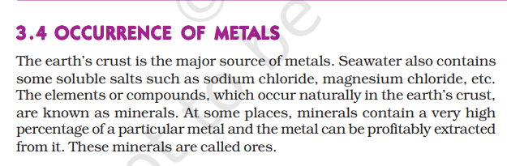
METALLURGY

Slide 3
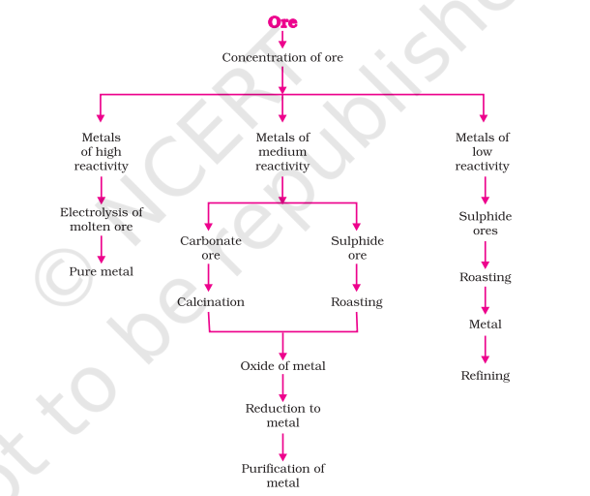
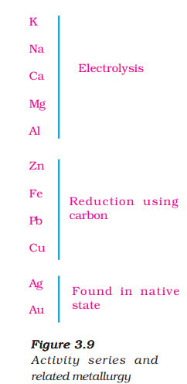

Slide 4
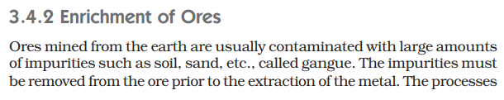


Slide 5
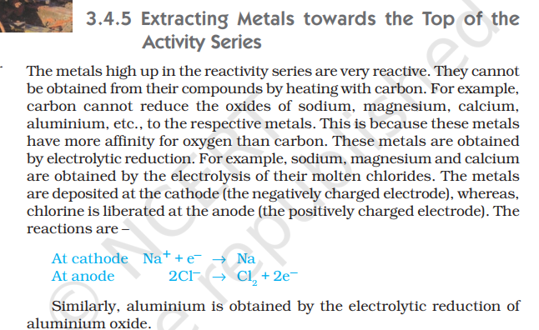

Slide 6
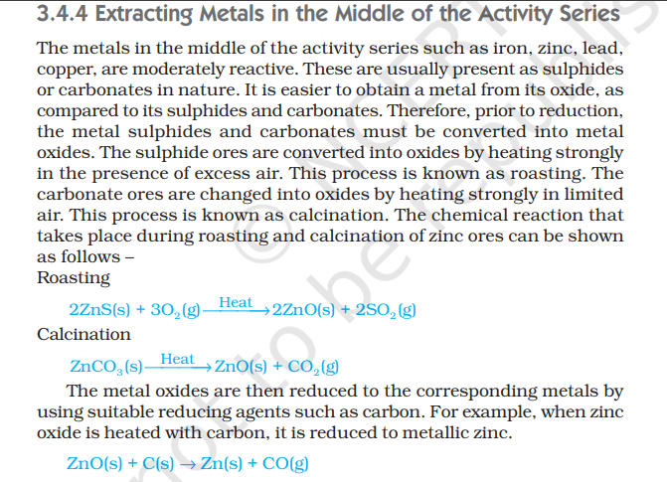

Slide 7
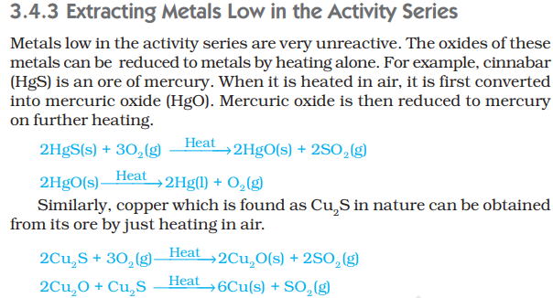

Slide 8
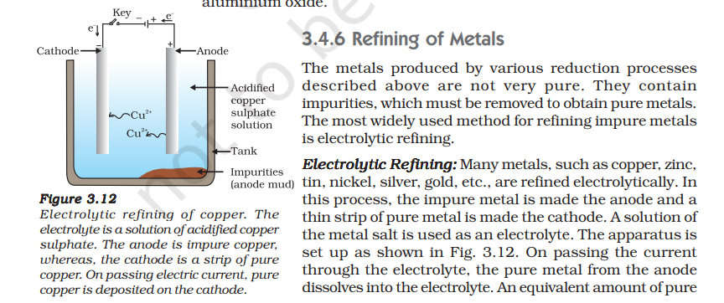
metal from the electrolyte is deposited on the cathode. The soluble impurities go into the solution, whereas, the insoluble impurities settle down at the bottom of the anode and are known as anode mud.

