Slide 1
Algorithmic Intelligence

Slide 2
Agenda
01
02
Multiple conditions in a program
Loops in a program
03
04
Algorithm
Objectives and Goals

Slide 3
Algorithm
An algorithm is a well-defined, step-by-step procedure or set of instructions used to solve a specific problem or perform a particular task. Algorithms are fundamental to computer programming and the functioning of all digital systems.

Slide 4
Significance
Problem-solving:
Efficiency
breaking down complex problems into manageable steps that a computer can execute.
It refers to how effectively an algorithm utilizes computational resources like time (running time) and space (memory usage).
Design Trchniques
Applications
Divide and conquer
Dynamic Programming
Greedy algorithm
Algorithms are applied across all areas of computer science, including:
Machine learning and AI
Data structure

Slide 5
Objectives and Goals
Outline the primary objectives and goals of the project

Slide 6
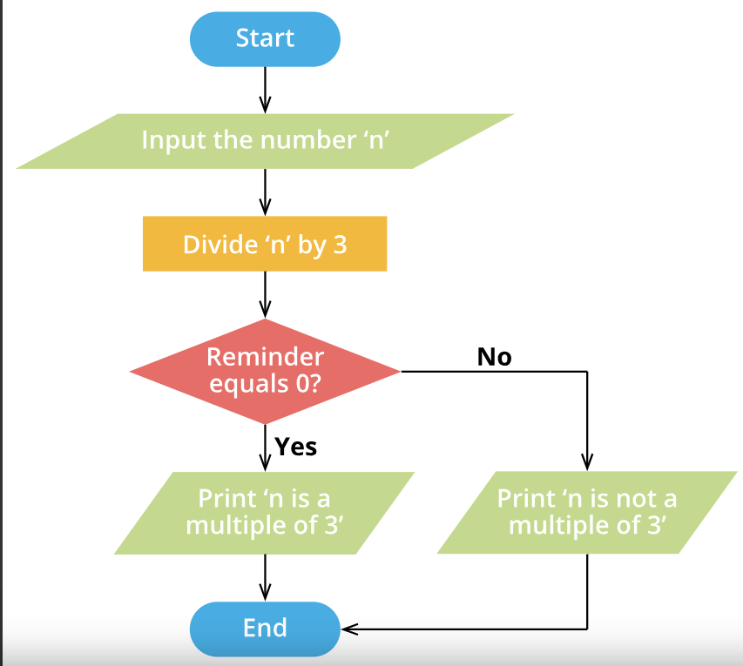

Slide 7
Find the output:
Age=20
IF age>=12 and age<=19 then
PRINT ”you are a teenager”
ELSE
PRINT ”you are not a teenager”

Slide 8
Find the output:
Day=“Sunday”
IF Day=“Sunday” or Day=“Saturday”
then
PRINT ”it’s a holiday”
ELSE
PRINT ”not a holiday”

Slide 9
Find the output:
Shop=500
Customer=“new”
IF shop>100 or Customer=old then
PRINT ”eligible for a free gift”
ELSE
PRINT ”not eligible for a free gift”

Slide 10
Find the output:
Height_inch=46
ticket=“no”
IF Height_inch>40 and ticket=“yes” then
PRINT ”entry allowed”
ELSE
PRINT ”entry not allowed”

Slide 11
The result of the computer’s decision for a ......... Will always be either true or false.
a)Loop
b) Expression
c) Condition
d) function

Slide 12
Which of the following results in true if both the conditions are true?
a)AND
b) OR
c) NOR
d) NAND

Slide 13
Write the algorithm to display “we have a match on Sunday” or “no match on Sunday” based on whether today is Sunday or not.
Write the algorithm to display “exam today” or “no exam today” if it is Wednesday or not.

Slide 14
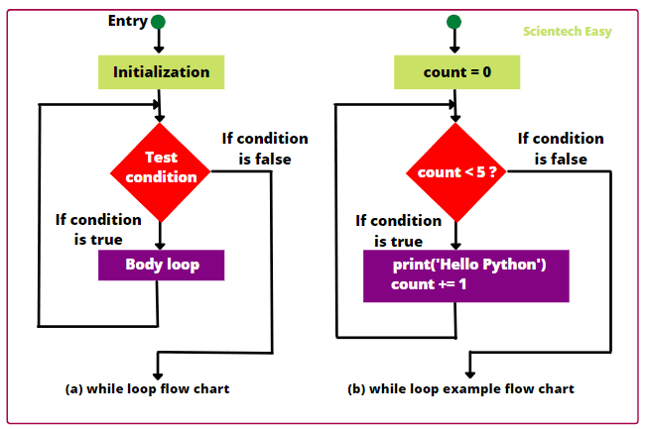

Slide 15
PROGRAM WITHOUT A LOOP
Move 1 down and fill colour

Slide 16
PROGRAM WITHOUT A LOOP
Move 1 down and fill colour
Move 1 down and fill colour

Slide 17
PROGRAM WITHOUT A LOOP
Move 1 down and fill colour
Move 1 down and fill colour
Move 1 down and fill colour

Slide 18
PROGRAM WITHOUT A LOOP
Move 1 down and fill colour
Move 1 down and fill colour
Move 1 down and fill colour
Move 1 down and fill colour

Slide 19
PROGRAM WITHOUT A LOOP
Move 1 down and fill colour
Move 1 down and fill colour
Move 1 down and fill colour
Move 1 down and fill colour
Move 1 right and fill colour

Slide 20
PROGRAM WITHOUT A LOOP
Move 1 down and fill colour
Move 1 down and fill colour
Move 1 down and fill colour
Move 1 down and fill colour
Move 1 right and fill colour
Move 1 right and fill colour

Slide 21
PROGRAM WITHOUT A LOOP
Move 1 down and fill colour
Move 1 down and fill colour
Move 1 down and fill colour
Move 1 down and fill colour
Move 1 right and fill colour
Move 1 right and fill colour
Move 1 up and fill colour

Slide 22
PROGRAM WITHOUT A LOOP
Move 1 down and fill colour
Move 1 down and fill colour
Move 1 down and fill colour
Move 1 down and fill colour
Move 1 right and fill colour
Move 1 right and fill colour
Move 1 up and fill colour
Move 1 up and fill colour

Slide 23
PROGRAM WITHOUT A LOOP
Move 1 down and fill colour
Move 1 down and fill colour
Move 1 down and fill colour
Move 1 down and fill colour
Move 1 right and fill colour
Move 1 right and fill colour
Move 1 up and fill colour
Move 1 up and fill colour
Move 1 up and fill colour

Slide 24
PROGRAM WITH A LOOP
Repeat 4 times
{ Move 1 down and fill colour}
Repeat 2 times
{Move 1 right and fill colour}
Repeat 3 times
{ Move 1 up and fill colour}

Slide 25
A loop is used to execute instructions or a block of code ………… times
a)two
b) three
c)ten
d) multiple

Slide 26
What is an endless loop called?
a) Counting loop
b) Conditional loop
c) Infinite loop
d) Finite loop

Slide 27
Fill in the blanks:
Condition/conditional/else/if
Conditional statements in a program instruct the computer to make a decision based on a given …………………….
The statements written after the ……………… condition in a program are executed when the condition is true.
In a program, the statements following ……………..are executed when the condition specified in the ‘if’ statement is false.
There are two types of loops counting loops and ………………… loops.

Slide 28
1.Write the output
start
Move 1 step down
Repeat 6 times
{
fill color
move 1 right
}

Slide 29
Write the output
start
Move 1 step down
Repeat 6 times
{
fill color
move 1 right
}

Slide 30
2.Write the output
start
Repeat 6 times
{
put a cross
move 1 right
move 1 down
}

Slide 31
2.Write the output
X
 | X
 |  | X
 |  |  | X
 |  |  |  | X
 |  |  |  |  | X
Repeat 6 times
{
put a cross
move 1 right
move 1 down
}

Slide 32
3.Write the output
start
Repeat 5 times
{
put a cross
move 1 right
put a tick
move 1 down
}

Slide 33
2.Write the output
X
 | X
 |  | X
 |  |  | X
 |  |  |  | X
Repeat 5 times
{
put a cross
move 1 right
put a arrow
move 1 down
}

Slide 34
4.Write the output
 |  |  |  |  | start
Repeat 5 times
{
write “8”
Move 1 step left
}

Slide 35
5.Write the output
Repeat 4 times
{
color yellow
skip one triangle
}

Slide 36
5.Write the output
Repeat 4 times
{
color yellow
skip one triangle
}

