Slide 1
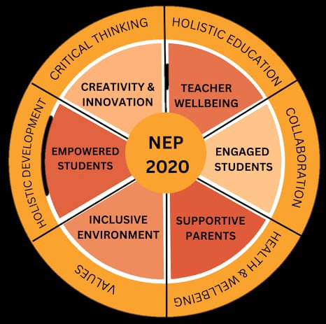
PARENTING CALENDER
2025 - 2026
To bridge the gap between parents, teachers and school ecosysytem.

Slide 2
Ancient history
Aatma – Vinigrahah
( self – discipline )
Shraddha
( Reverence for knowledge )
Sadhana
( perseverance )
Svadhyaya
(self – reflection )

Slide 3
KEY OBJECTIVES
Strengthen Parent’s Teacher Engagement
Supports students needs
Consistent Communication
Structured Support

Slide 4
GOAL
Self – care
Manage behaviour
Separation Anxiety
Technology – Boundary
Raising Happy children
Understanding Learning Styles
Nutrition

Slide 5
Parents – child relationship
Show your love .
Say “ I love you “ often .
Set boundaries , rules and consequences.
Listen
Play together.
Be available and distraction free.
Eat meals together

Slide 6

Thank you

