Slide 1
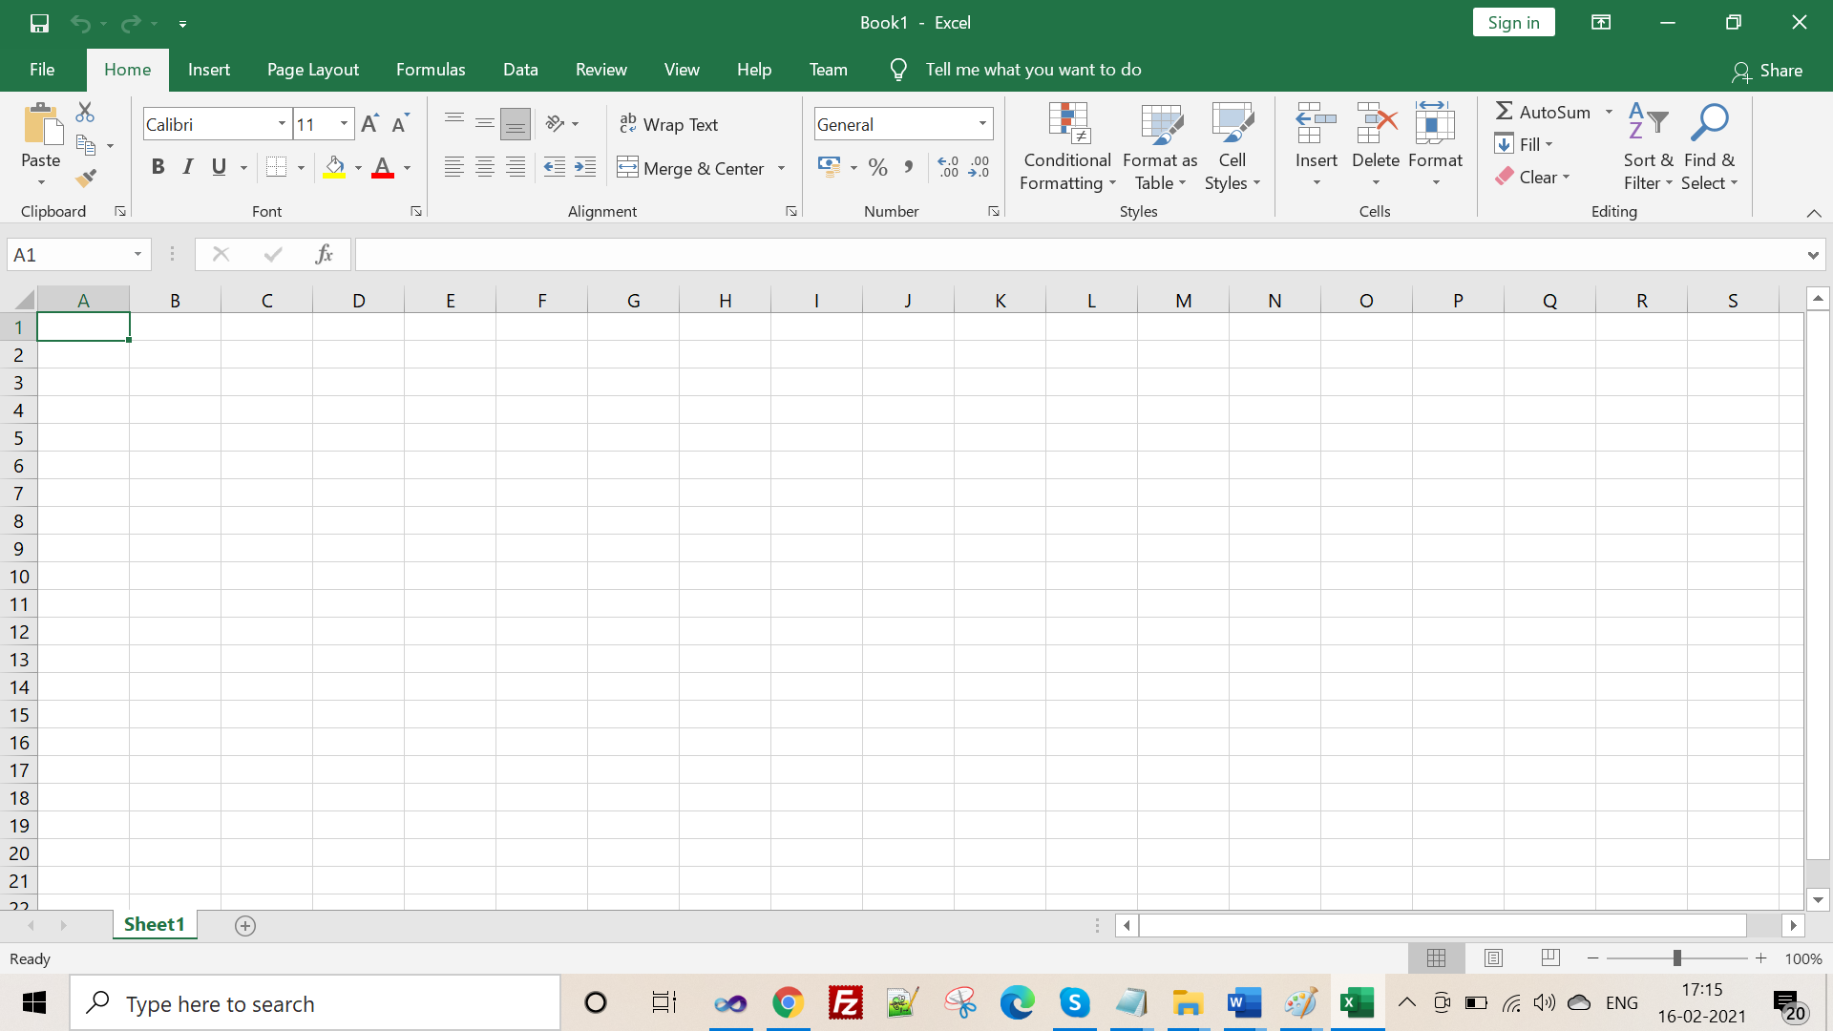
Introduction to Excel
By Probir Sir

Slide 2

Contents
Features of Excel
Starting Excel 2019
Workbook and Worksheet
Components of a Worksheet
Moving around the Spreadsheet
Entering Data
Types of Data
Performing Calculations
Managing Worksheets
Saving a Workbook

Slide 3

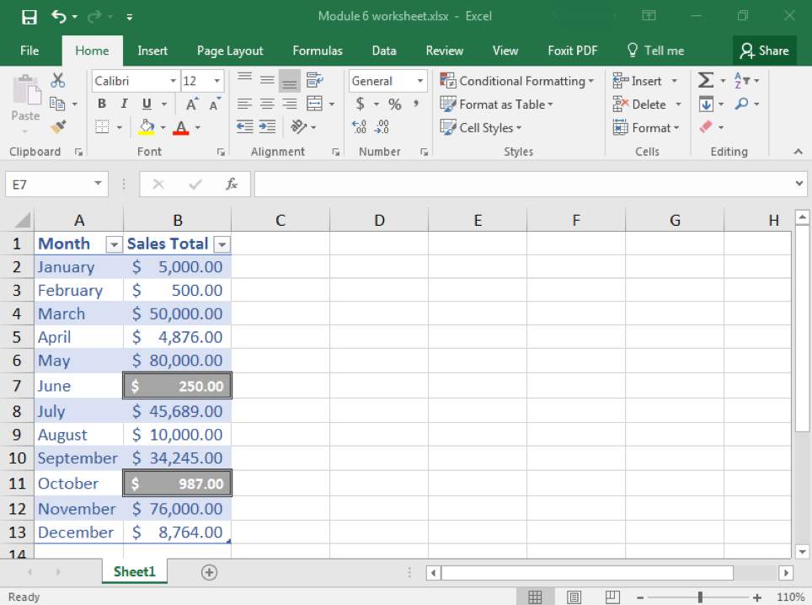
Introduction
Microsoft Excel 2019 is a popular spreadsheet application of Microsoft Office Suite 2019.
It allows you to organize and manipulate the data. It is widely used to perform mathematical calculations.
In Excel, data is spread in a tabular form, consisting of rows and columns.
You can use different inbuilt features and tools on these rows and columns to handle the data easily and quickly.

Slide 4
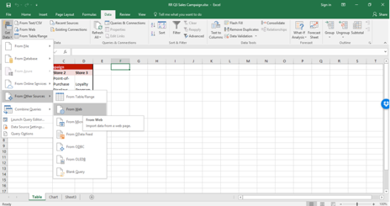
Features of Excel
Excel can handle vast amount of data.
In Excel there are different Formulas that are mainly used for performing simple and complex mathematical calculations.
Functions are the built-in formulas used for calculating percentage, interest, average, etc.
The data can be searched quickly and if required replaced instantly.
Using Auto Fill option, quick data entry can be done in a large series of cells.
The data can be viewed in a graphical form, such as charts, which help to understand, analyze, and compare data in an effective manner.

Slide 5
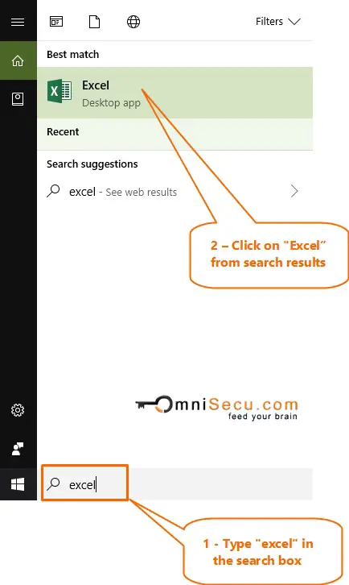
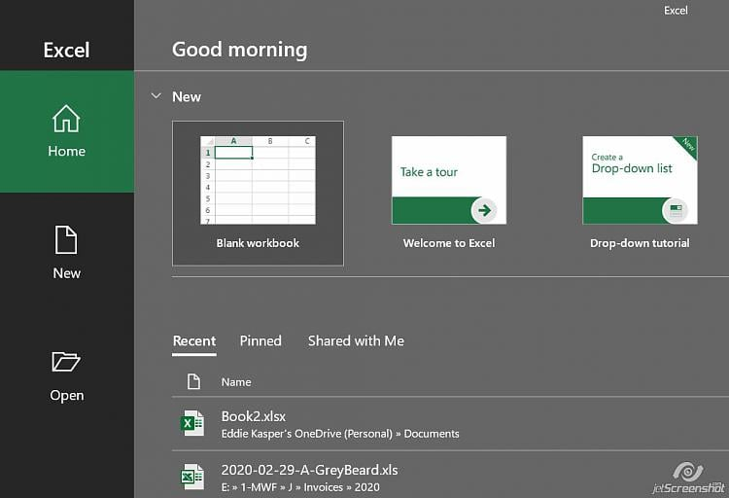
Starting Excel 2019
To start working on with Excel 2019, follow the given steps:
Click on Start Menu→ Look for Excel → Click on Excel → Excel Window will appear → Select a blank Workbook.

Slide 6
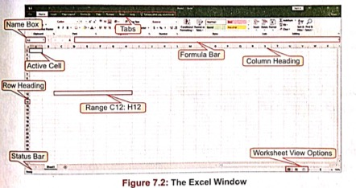
Workbook and Worksheet
A workbook is an Excel file that contains one or more worksheets where you can enter and store data.
A workbook is like a notebook, it is assigned a temporary name as Book1.
A worksheet is a grid-like area, made up of rows and columns, where you can enter and work with data. By default, an Excel workbook holds a single worksheet, named Sheet1. You can add any number of worksheets in a workbook according to the limits of memory available on a computer.
A worksheet consists of 1,048,576 rows and 16,384 columns.

Slide 7
Components of a Worksheet
Cell: - A cell is an intersection of a column and row in a worksheet, identified by its column letter and row number, known as Cell address. For example, A5 refers to the cell at the intersection of column A and row 5. A cell is used to store data, such as text, numbers, formulas, functions, etc. A cell can have up to 32,767 characters.
Active Cell: - When you click on a cell, a thick black border appears around it, which differentiates it from the rest of the cells. This highlighted box is called a Cell pointer. It indicates that the current cell is active. Data can be entered only in the active cell.
Range: - A range is a group of contiguous cells, which form the shape of a rectangle. It can be as small as a single cell or as big as an entire worksheet. You can specify a range by writing the starting cell address followed by the ending cell address, both separated by a colon (:). For example, C1:C10 indicates a range starting from the C1 cell address and ending in the C10 cell address.

Slide 8
Components of a Worksheet
Column Headings: - Letters across the top border of each worksheet are called Column headings. These headings identify columns with letters A to Z, AA…. AZ, BA.....BZ, ….XAA……XFD. Every worksheet in Excel contains 16,384 columns.
Row Headings : - Row headings are the numbers marked from 1to 1,048,576 along the left border of the worksheet to represent each row of it.
Name Box : - The Name box is located just above the column headings on the left side of the window. This area displays the location of the cell pointer.
Formula Bar: - The Formula bar is located to the right of the Name box. This bar shows the characters and formulas that you enter in an active cell.
Status Bar: - The Status bar is located at the bottom of the Excel window. It gives you information about the current selection.
Title Bar: - It displays the name of the workbook on which you are currently working.

Slide 9
Moving Around the Spreadsheet
To input data in a worksheet, you have to move the cell pointer from one cell to another with the help of the various keys defined in the given table.
Keys | Function
 | Moves one column right
 | Moves one column left
 | Moves one row up
 | Moves one row down
Page Up | Moves the active cell highlight to first row of the spreadsheet and can be used as an alternative to scroll up the worksheet.
Page Down | Moves the active cell highlight to the next sheet and can be used as an alternative to scroll down the worksheet.
Ctrl +Home | Moves the cell pointer to the first cell of the topmost row, i.e., A1
Ctrl +End | Moves the cell pointer to the last used cell on a spreadsheet

Slide 10

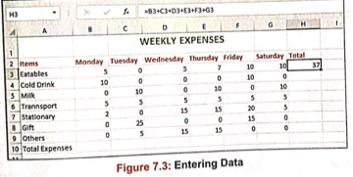
Entering Data
Open a new workbook by selecting the Blank workbook thumbnail from the Start Screen.
Click on the cell D1 and type 'Weekly Expense'. Now, select the cell range where you enter the text. Click on the Merge & Center button in the Alignment group on the Home tab. The selected cells will be merged and the text will be centered.
Click on the cell A2 and type 'Items'. Press the Right arrow key. Type 'Monday' in B2 and "Tuesday' in C2. Likewise, enter data in the rest of the cells as displayed in Figure 7.3.
Click on the cell A3. Type 'Eatables' and press the Enter key. The cell pointer shifts to cell A4.
Type 'Cold Drink' and press the Down arrow key to move to cell A5 and type 'Milk'. Similarly, enter the remaining data.

Slide 11
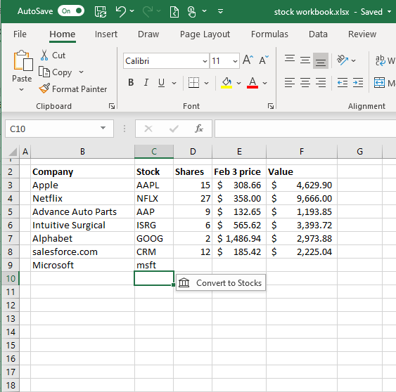

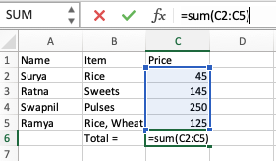
Types of Data
In Excel, different types of data can be entered, such as:
• Numbers • Text • Formulas
Numbers are values that consist of numerals from 0 to 9 and characters, like +, -,!, @, 5,%, ^, &, etc. They can be used in calculations. In addition to actual numbers, Excel also stores date and time as numbers. By default, numbers are right-aligned in a cell.
Text data has letters, numbers, spaces, and special characters. It is not used in calculations. By default, the text data is left-aligned in a cell. Most often, text entries are used for worksheet headings, names, and identifying columns of data.
Formulas are mathematical equations involving number values, operators, and cell addresses used for performing calculations on a worksheet. They can range from basic mathematical operations to complex calculations. Formulas begin with an equal to (=) sign.

Slide 12
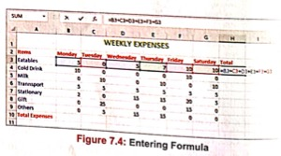
Performing Calculations
Excel has a powerful feature to perform calculations, like addition, subtraction, multiplication and division on the data. It can be done either by using formulas or functions. The result of the calculation is displayed in the cell where the formula is entered.
Excel also provides a quicker and easier way of performing calculations. Click on the AutoSum 𝚺 button present either on the Formulas tab or Home tab. Excel suggests a range, which you can either accept or select a different range.

Slide 13
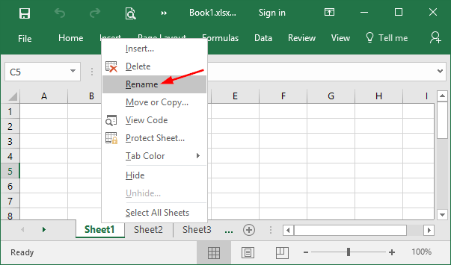
Managing Worksheets
Switching Between Worksheets
To switch between worksheets, use the Ctrl +Page Up or Ctrl + Page Down key combination.
Renaming a Worksheet
To rename a worksheet, double-click on the Sheet tab that you want to rename or right-click on it and select the Rename option. The Sheet tab will be highlighted. Type a new name and press the Enter key.
Adding a New Worksheet
Right-click on the Sheet tab and select the Insert option. The Insert dialog box appears with the Worksheet option selected. Click on OK. You will notice that a new worksheet gets inserted before the selected worksheet. Or
Click on the New Sheet icon present next to the Sheet tab. A new worksheet will be added. Or
Select the Insert >Insert Sheet option in the Cells group on the Home tab.
Removing a Worksheet
Right-click on the Sheet tab and select the Delete option. Or
Select the Delete > Delete Sheet option in the Cells group on the Home tab.

Slide 14
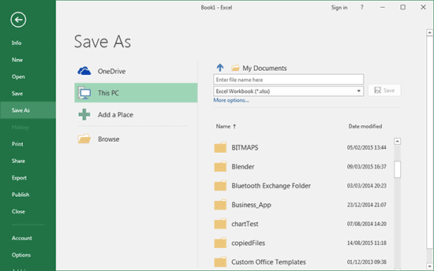
Saving a Workbook
To save a workbook, follow the given steps:
Click on the File tab → select the Save option → The Save As pane will appear.
Click on the Browse option → The Save As dialog box appears → Browse the drive and the folder, where you want to save the workbook.
Type the file name in the File name text box.
Click on the Save button.
The file will be saved with the extension •xlsx.
You can save your file by using the Ctrl+S or F12 key combination.
You can also select Save button on the Quick Access Toolbar.

Slide 15
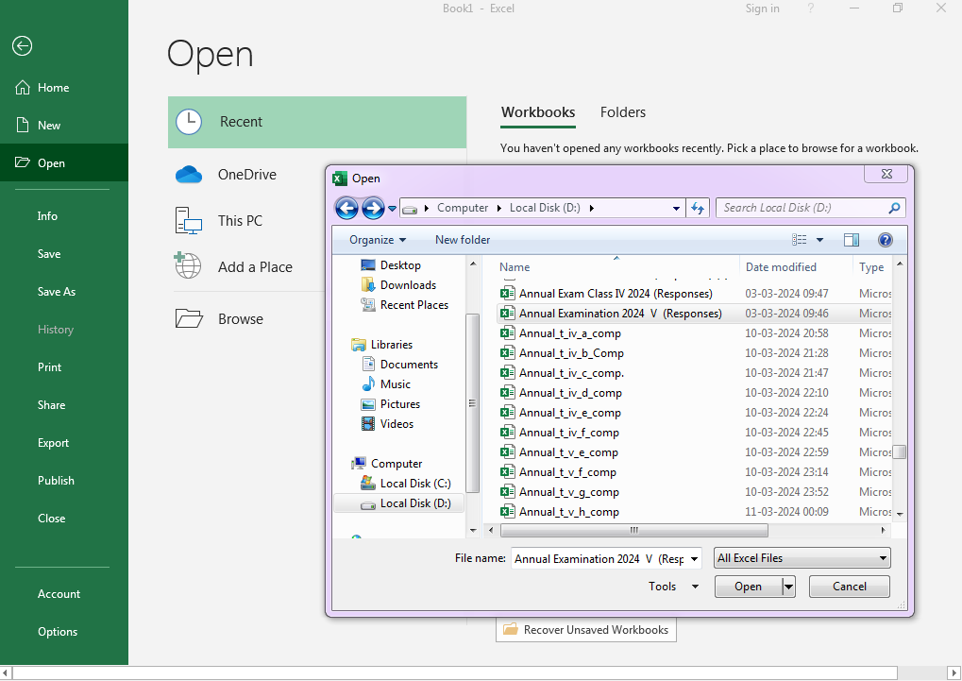
Opening and Closing a Workbook and closing the window.
To open, close a workbook, follow the given steps:
You can open a new workbook by pressing ctrl+O key combination and click on the file tab, then open to search an excel file. Click on the file to select and click open.
To close a workbook we go to file tab → close option or else we press ctrl+W or ctrl+F4 key combination.
To exit the window either we press close window button at the top right corner shown as x or we press alt+F4 key combination. Also we can do the same by going to the file tab and clicking on the exit button.

Slide 16

Conclusion
MS Excel is such a nice tool to handle our day to day data as well as very large amount of data in school, offices, accounting farms etc.
Excel may be used to create and store spreadsheet, analyze data, but also used to perform some forecast on the data.
Excel is used to create routine, marksheet, student data, generating graphs and charts, budgeting, managing school resources etc. in a school perspective.
Thank You

