Slide 1
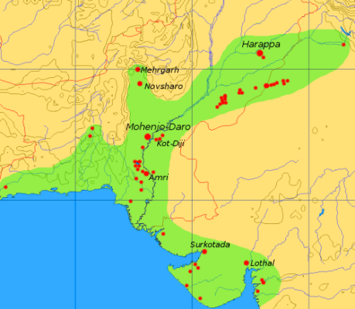
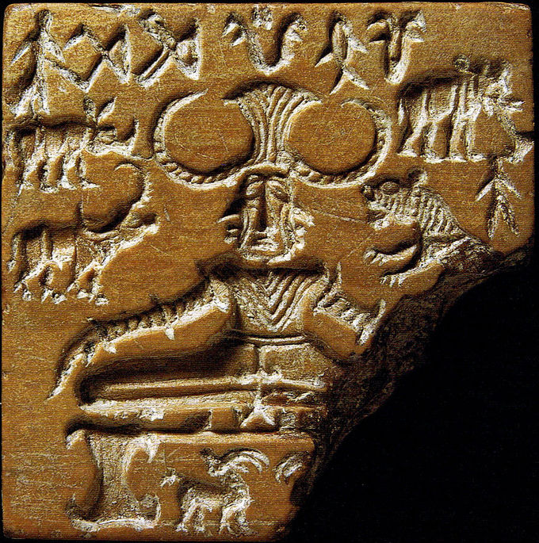
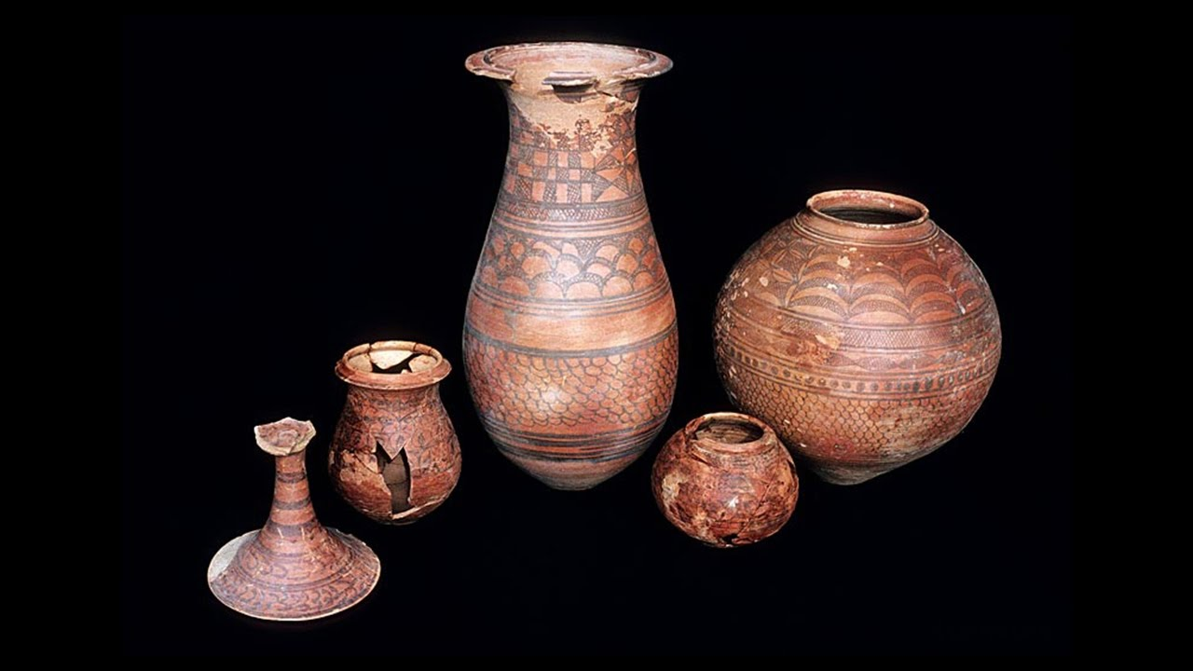
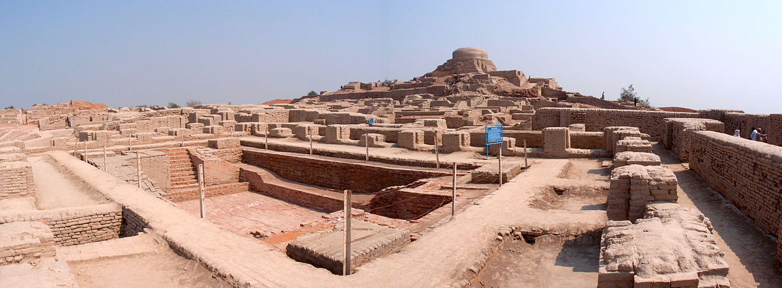
TOWN PLANNING
OF
INDUS VALLEY
CIVILISATION

Slide 2
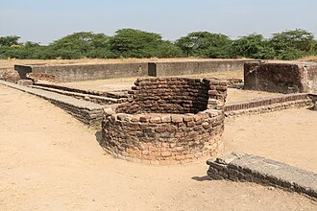
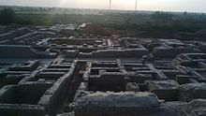
We all know about the Indus Civilization, the first civilization which had town planning. Along with its exciting artifacts and monuments, its town planning is also a miracle constructed by earlier humans. In this presentation we will look along though some of the surprising structures of town planning of this civilization.

Slide 3
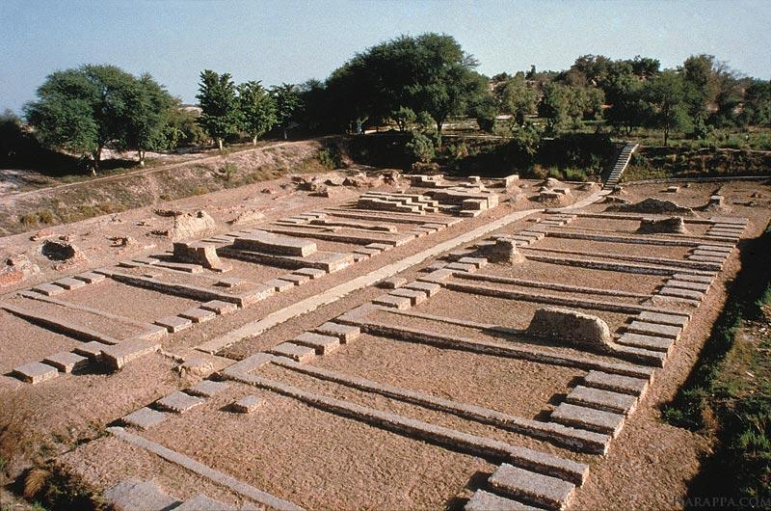
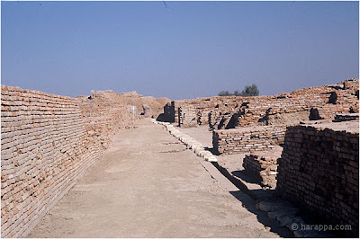
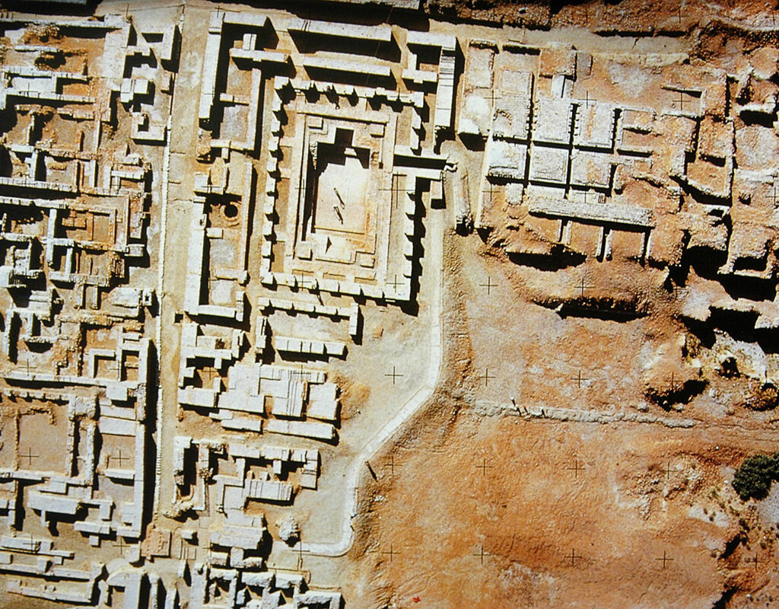
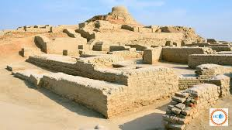
The larger Harappan cities were built according to precise plans. Let’s explore some :
TOWN PLANNING
Wide streets oriented to the cardinal directions
Upper town
Lower town
Some large buildings had different purposes
Houses lined along the streets
Cities seemed to be surrounded by fortifications
Streets cut at right angles

Slide 4
We have learnt about the features of the town planning in Harappan civilization. They also mastered on the water management in their cities. Let’s dive into some of their master pieces:
Reservoir
Reservoir
Well

Slide 5
These are some of the features of water-management:
Much more importance on water-management & cleanliness
Separate areas of bathing in their homes
All the bathrooms were connected to a large network of drains
The drains ran below the streets and took the waste water away
Reservoirs were connected through a large no. underground drains The drains made efficient water harvesting and distribution all over the cities
They also made many reservoirs, and wells in their cities to harvest rainwater.

Slide 6

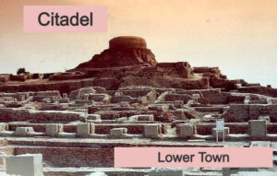
Upper town
It is the place where the local elite(higher layers of society) lived. It is also known as Citadel. It was protected from floods or any kind of outer attacks.
Lower town
It is the place where the common people lived. It was not protected from floods or any kind of outer attacks.

Slide 7

The Great Bath
It was a small but elaborate tank which measured about 12 into 7 metres and had waterproofing materials (such as natural bitumen, a form of tar) applied on top of carefully laid out bricks. The tank was surrounded by small rooms, one of which contained a well; there was a drain in one corner of the tank to empty it from time to time and refill it with freshwater. Archaeologists have proposed several possible reasons of the purpose of this structure ---- a public tank; a bath for the royal family; or a tank used for religious rituals. The first reason is ruled out because in Mohenjo-Daro most houses had individual bathrooms.
The large reservoirs of Dholavira Dholavira featured an extensive, sophisticated system of 16 or more large reservoirs, crucial for managing water in its arid environment. These were a mix of rock-cut and masonry structures, built with incredible foresight. Water was captured from seasonal rivers and diverted through channels into these interconnected reservoirs for storage and filtration, supplying drinking water, and supporting industrial and agricultural needs. This advanced water management system highlights the Harappans' expertise in engineering and resource management. The largest reservoir measured 73 metres in length!

Slide 8
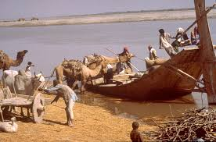
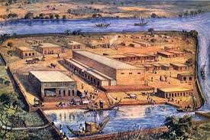
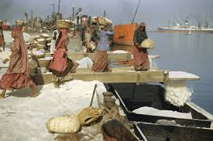
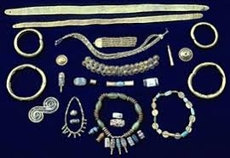
A few more points about harappan trade:
Trade was conducted using a barter system, meaning there was no use of metal money like coins for transactions
The Harappans engaged in both internal trade within the civilization and external trade with foreign lands
Trade was carried on using both land routes, possibly with bullock carts, and sea routes, utilizing boats and ships
The Harappans established a trading colony in northern Afghanistan to facilitate trade with Central Asia
Harappan civilization had economic links with Mesopotamian civilizations, exporting goods like cotton textiles and importing items such as silver
A significant port, Lothal, featured a dockyard that confirms the presence of advanced maritime trade networks
The uniformity of script, weights, and measures across a wide area indicates a regulated and organized trade system
Centers like Lothal and Chanhudaro were known for manufacturing items such as beads, while others like Balakot were centers for shell-working and bangle-making
The Harappans imported precious resources from various parts of this subcontinent

Slide 9
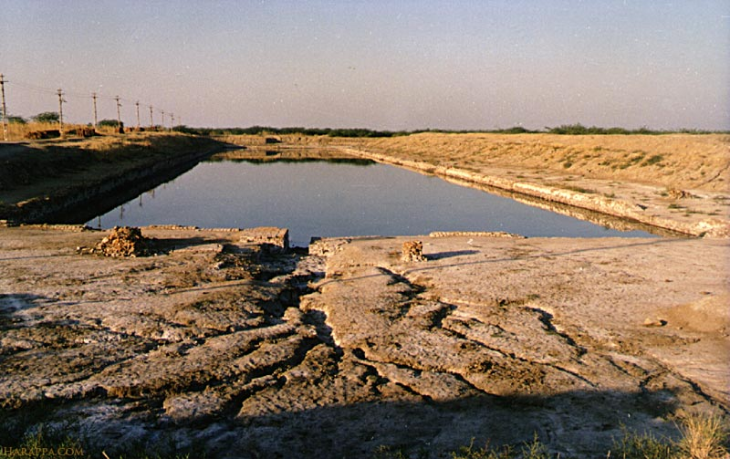
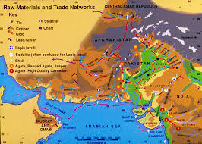
Dockyard of Lothal
The trade route of Harappans:
Look :
The Lothal dockyard is a significant archaeological site representing a major port of the Indus Valley Civilization. Located in present-day Gujarat, India, it is one of the world's oldest known dockyards, dating back to 2400 BCE. The dockyard, a large rectangular basin, was connected to a river channel, facilitating maritime trade and connecting Lothal to distant lands. The dockyard is a large, rectangular structure approximately 240 meters long, 36 meters wide, and 4 meters deep.

Slide 10

Thanks for viewing our presentation.
Hope this presentation will make you know more about harappan civilization.

