Slide 1
CLASS-6/F
DNA
DIAMOND
GROUP-5

Slide 2
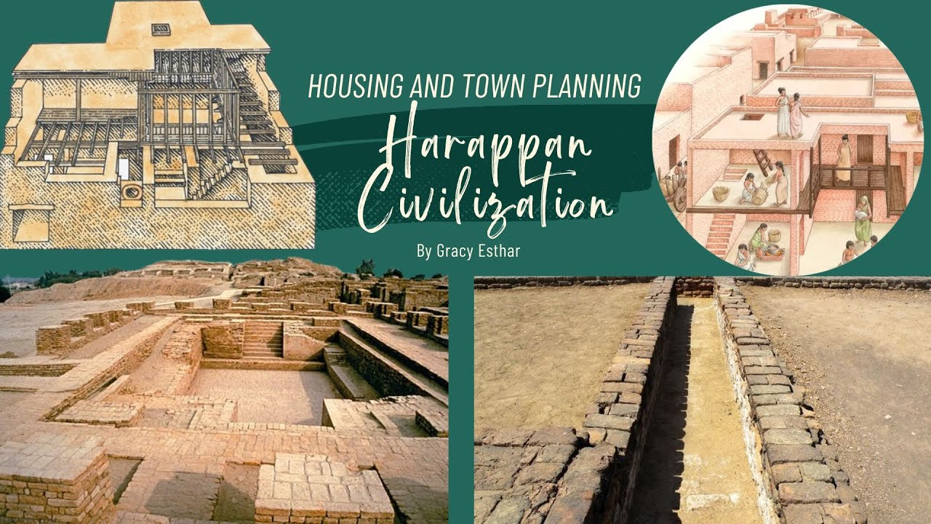
MOHENJO DARO

Slide 3
HARAPPAN CIVILIZATION
THE HARAPPAN CIVILIZATION WAS THE FIRST URBAN CIVILIZATION IN SOUTH ASIA,ITS ADVANCED TOWN PLANNING,DRINAGE SYSTEM MANAGEMENT OF WATER ETC.

Slide 4
MOHENJO DARO CIVILIZATION
The Mohenjo-daro civilization refers to the ancient Indus Valley Civilization, one of the world's earliest urban cultures, flourishing around 3000-1500 BC in what is now Pakistan and India. Also it is not a civilization by itself.

Slide 5
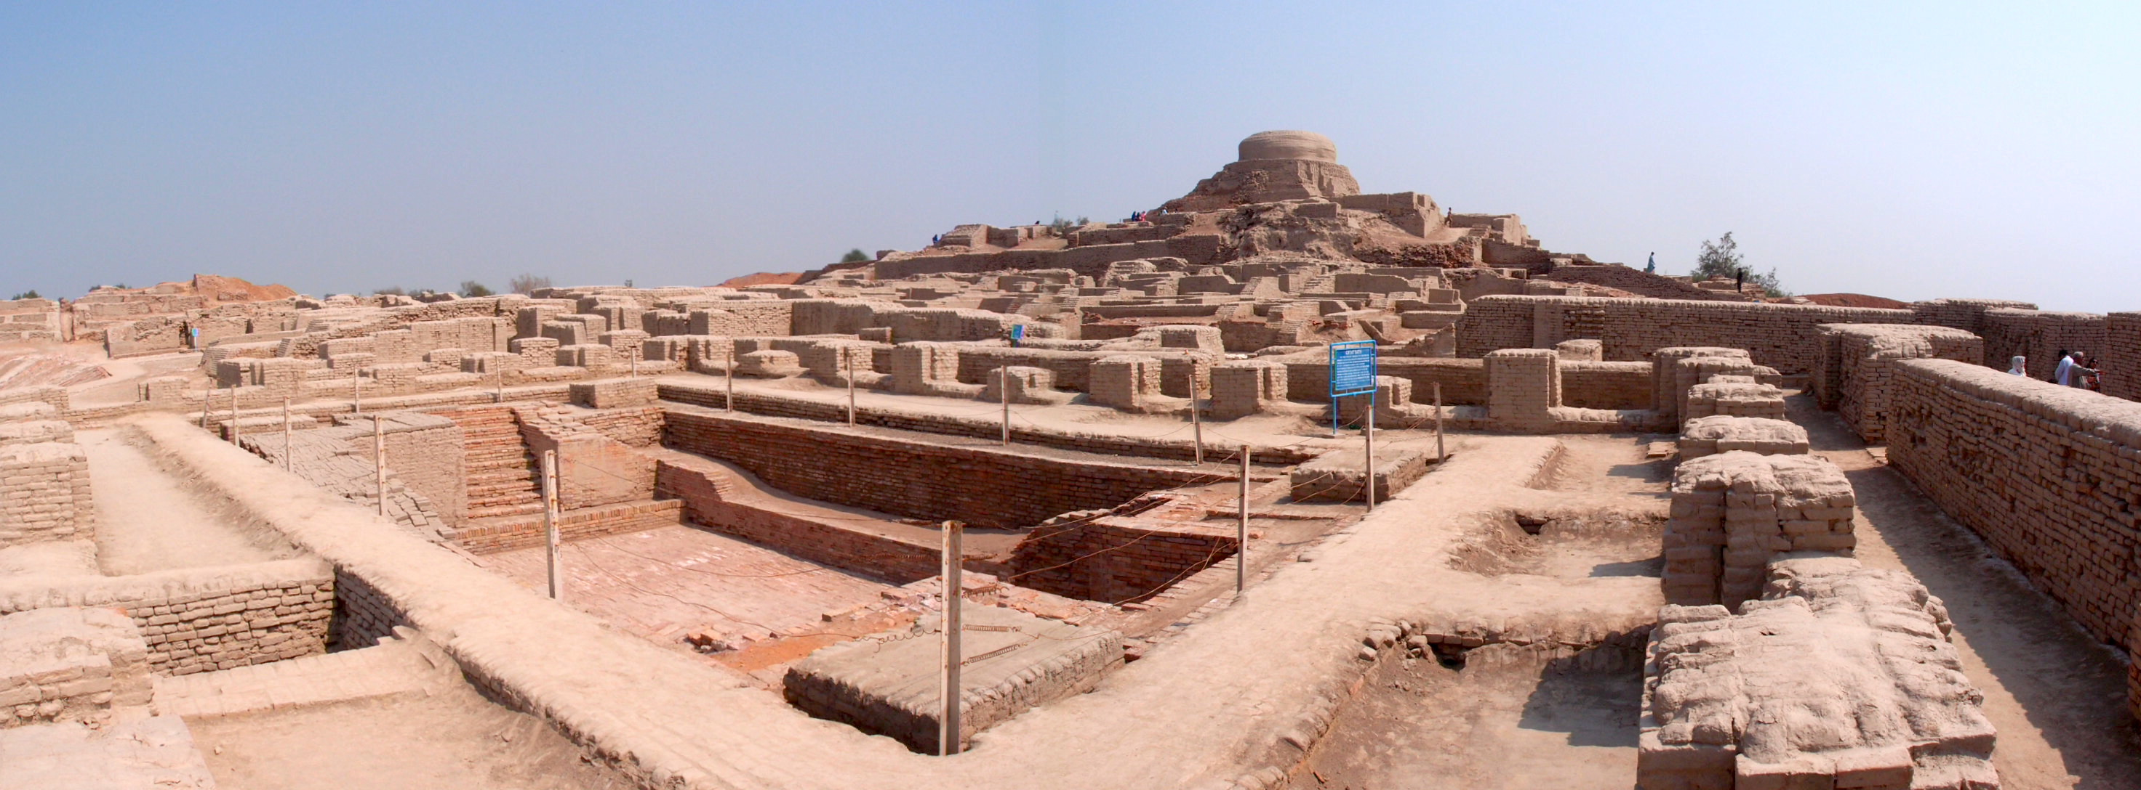
TOWN PLANNING OF HARAPPAN CIVILIZATION
THE TOWN PLANNING OF HARAPPAN CIVILAZATION REFLECTS REMARKABLE URBAN ORGANIZATION AND ENGINEERING SKILLS IN ANCIENT HISTORY. THE CITIES WERE DESIGNED ON A GRID PATTERN, WITH STREETS LAID OUT IN STRAIGHT LINES INTERSTING AT RIGHT ANGLES, CREATING A CLEANER DIVISION OF SPACE FURTHERMORE, THE RODS WERE WIDH AND WELL-ALIGNED, CONTRIBUTING TO THE CITY’s FUNCTIONALITY.

Slide 6
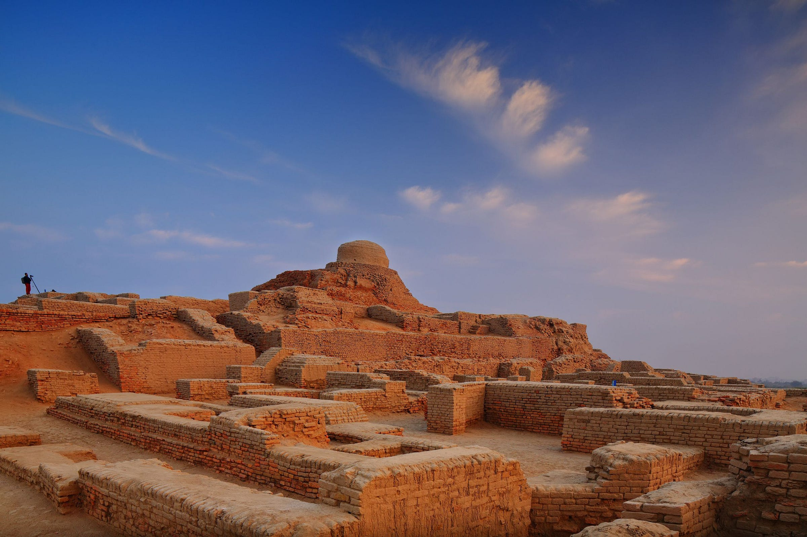
town planning of mohenjo daro covilization
Mohenjo-daro featured an exceptionally planned urban layout with a grid system of streets, separating the city into a raised citadel and a larger lower town. Key features included uniform, baked bricks for construction, advanced and well-laid-out covered drainage systems, and public buildings like the Great Bath and granaries located in the citadel. Homes were rectangular, often built around a central courtyard, and public structures were built on raised platforms to protect them from flooding.

Slide 7
URBAN STRUCTURE OF HARAPPAN AND MOHENJO DARO CIVILIZATION
The urban structure of Harappan and Mohenjo-Daro cities followed a planned grid system, divided into a raised, fortified citadel for public and administrative buildings, and a lower town for residential and commercial areas. Key features included standardized burnt bricks, well-organized drainage systems, private baths and wells in houses, and a sophisticated arrangement of streets and lanes.

Slide 8

THIS IS MOHENJO DARO CIVILIZATION
Heare we can see that The Great Bath of mohenjo daro is a large, ancient public tank from the Indus Valley Civilization. An archaeological site in Pakistan, built around 2500 BCE. This is an urban civilazation

Slide 9
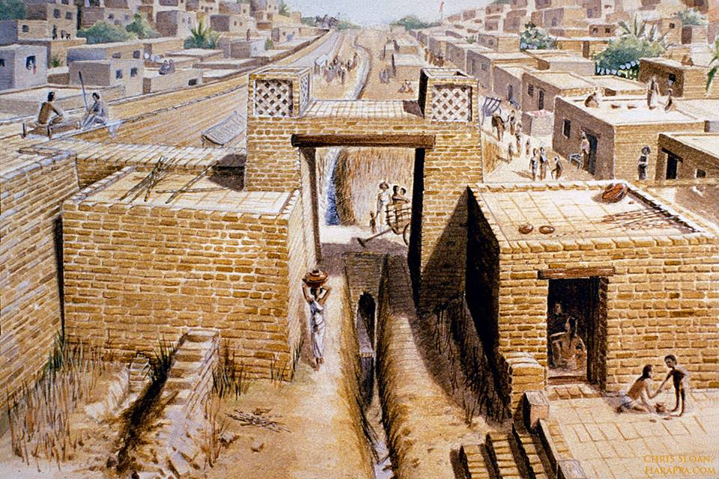
THIS IS THE HARAPPAN
CIVILIZATION
IN THIS CIVILIZATION THE DRINAGE SYSTEM ARE OPENED.THE GEARMS OF THE DRAIN ARE SPREADING ALL TIME AS THE CAP OF THE DRAINS ARE OPEN.

Slide 10
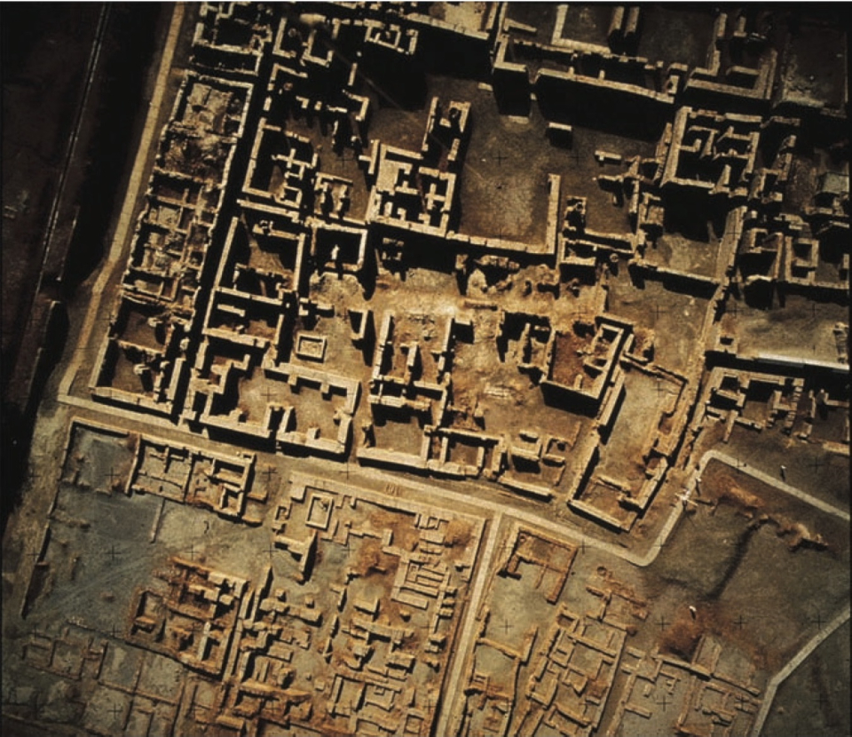
HOUSE PLANNING OF MOHENJO DARO
Mohenjo-daro had a planned layout with rectilinear buildings arranged on a grid plan. Most were built of fired and mortared brick; some incorporated sun-dried mud-brick and wooden superstructures. Sites were often raised, or built on man made hills. This could be to combat flooding in the nearby areas

Slide 11
THE HOUSE PLANNING OF HARAPPANS
HEARE IN THESE CIBILAZATION THERE IS NO IDEA TO DECORATE HOUSE THIS MEANS THAT THE HOUSES ARE MADE ANY WHERE IN THE ROAD.

Slide 12


