Slide 1
Ancient Urban Planning: Harappa and Mohenjo-Daro
Unearthing the blueprint of early civilization

Slide 2
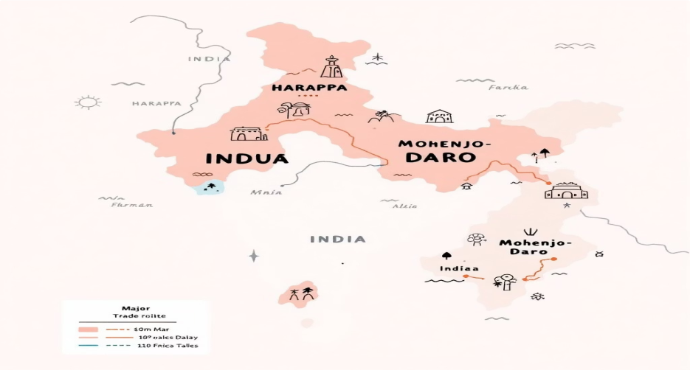
The Indus Valley Civilization: A Bronze Age Marvel
Flourished c. 330031300 BCE across modern Pakistan and northwest India
Population estimates up to 5 million at its peak, with major cities Harappa and Mohenjo-Daro
Among the world9s earliest urban cultures, contemporaneous with Egypt and Mesopotamia

Slide 3
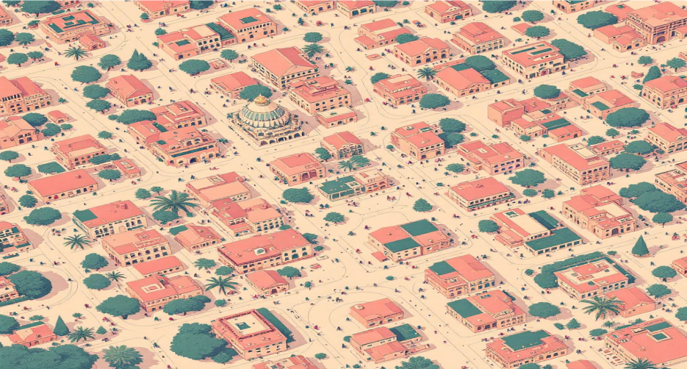
Mastering the Grid: The City Layout
Both cities were meticulously designed on a precise rectangular grid system, a testament to sophisticated urban planning. Streets intersected at perfect right angles, creating a highly organized and efficient layout.
Main streets ran north-south and east-west, dividing the city into uniform blocks.
Smaller lanes and alleys branched off, facilitating efficient movement of people and goods.
This methodical urban design allowed for easy expansion and reflected centralized city planning.

Slide 4


Advanced Sanitation: The World's First Sewer Systems
1
Covered Drainage
Covered brick drains ran beneath streets, connected to individual houses9 wastewater outlets, demonstrating remarkable foresight in public health.
2
Waste Disposal
Drains led to larger sewers that effectively disposed of waste outside the city, significantly reducing the spread of disease.
3
Clean Water Access
Public and private wells provided clean water, with some houses even having their own wells and private bathrooms.
4
The Great Bath
The iconic Great Bath of Mohenjo-Daro was a large public pool, likely used for ritualistic bathing and hygiene purposes.

Slide 5
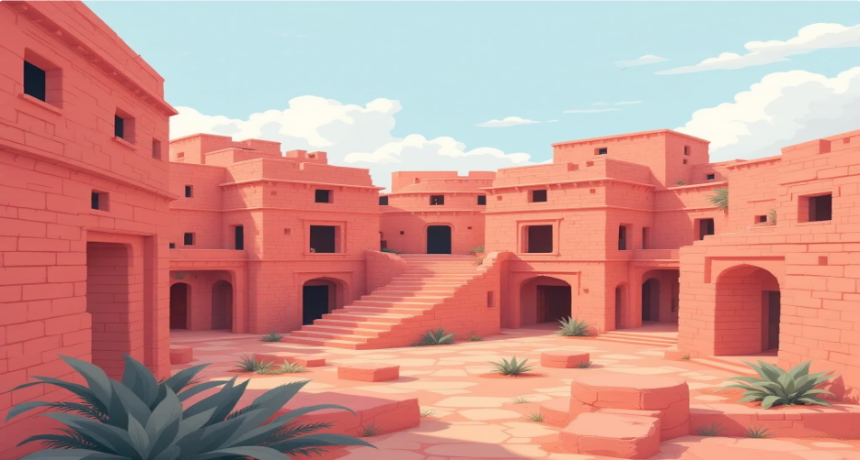
Standardized Architecture: Fired Bricks and Multi- Story Homes
Uniform baked bricks, standardized in size and shape, were used consistently across the civilization, highlighting advanced manufacturing.
Houses were typically two stories tall, built around central courtyards for optimal light and ventilation.
Thick walls and small windows helped regulate temperature, providing natural climate control in the hot climate.
Residences included private wells, bathrooms, and sophisticated drainage, indicative of high living standards for the time.

Slide 6
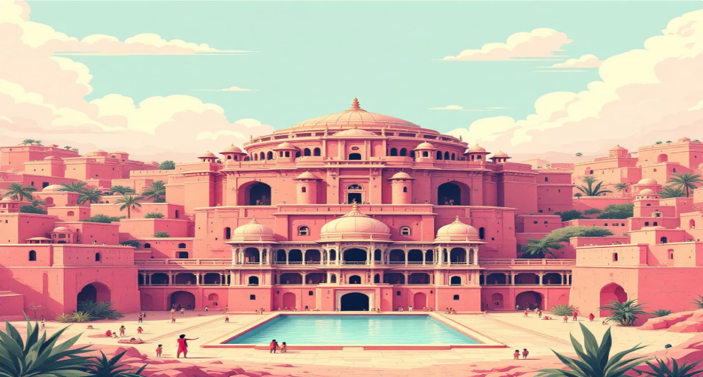
The Citadel: Political and Religious Heart
The elevated, fortified citadels were distinct from the lower residential towns, separated by thick walls. These structures were crucial centers of power and community.
Housed important public buildings, including granaries, assembly halls, and elite residences.
Fortifications with bastions and gates suggest significant concerns for defense and control.
Citadel platforms were strategically raised 6 meters above the flood plains to protect against the frequent Indus River floods.

Slide 7



Economic and Social Organization Reflected in Urban Design
Food Surplus
Large granaries indicate surplus food storage and centralized resource management, vital for supporting urban populations.
Trade Hubs
Dockyards along the Indus River facilitated extensive trade and transportation, connecting the cities to a broader network.
Standardization
Uniformity in weights, measures, and bricks points to a highly sophisticated and organized governance system.
Egalitarianism
The near absence of ostentatious palaces or temples suggests a more egalitarian society, prioritizing functionality and collective well- being.

Slide 8
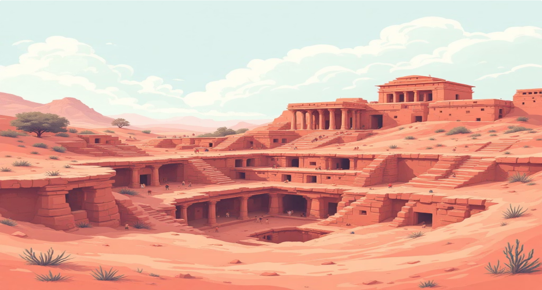
The Human Story: Peaceful, Advanced, and Lost to Time
The near absence of weaponry in archaeological finds suggests a peaceful civilization with a strong emphasis on social order.
Their sophisticated urban planning reflects an advanced understanding of engineering, public health, and sustainable living.
The cities were mysteriously abandoned around 1900 BCE, possibly due to climate change, seismic activity, or shifts in the Indus River's course.
Rediscovered in the 1920s, these magnificent ruins continue to reveal a profound and largely forgotten chapter of human ingenuity.

Slide 9
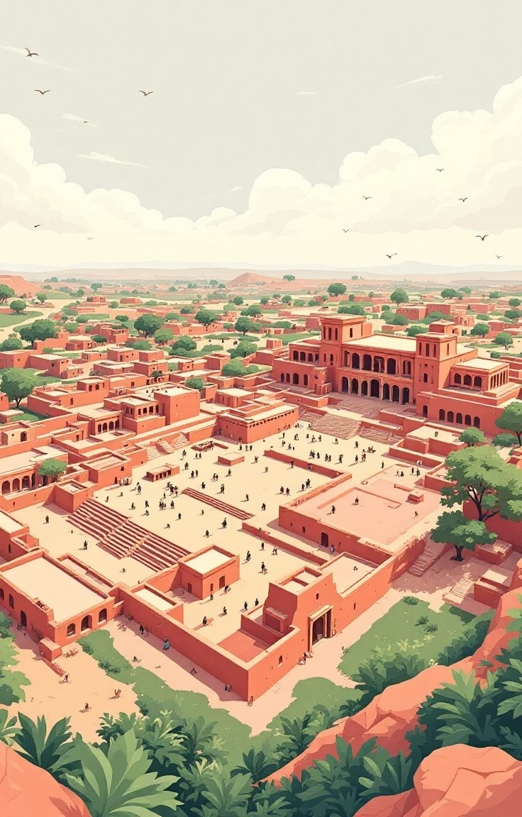
Legacy of Harappa and Mohenjo-Daro
Urban Planning Pioneers
These cities set unprecedented standards for urban planning, influencing generations of urban development millennia ahead of their time.
Modern Relevance
Their advanced drainage and grid systems continue to inspire modern urban planners seeking sustainable and efficient city designs.
Heritage at Risk
As UNESCO World Heritage Sites, they are threatened by erosion and require ongoing preservation efforts to protect this invaluable history.

Slide 10
Conclusion: Lessons from the Ancient Urban Pioneers
Harappa and Mohenjo-Daro demonstrate the timeless power of foresightful planning, robust sanitation, and cohesive social organization. Their achievements remind us that advanced urban living is deeply rooted in thoughtful design and collective community care. Preserving these sites connects us to humanity9s shared past and inspires future innovation in our own urban landscapes. Let us continue to honor and learn from these extraordinary ancient cities4the true cradle of urban civilization.

