Slide 1

URBAN PLANING
OF
HARRAPAN CIVILIZATION

Slide 2
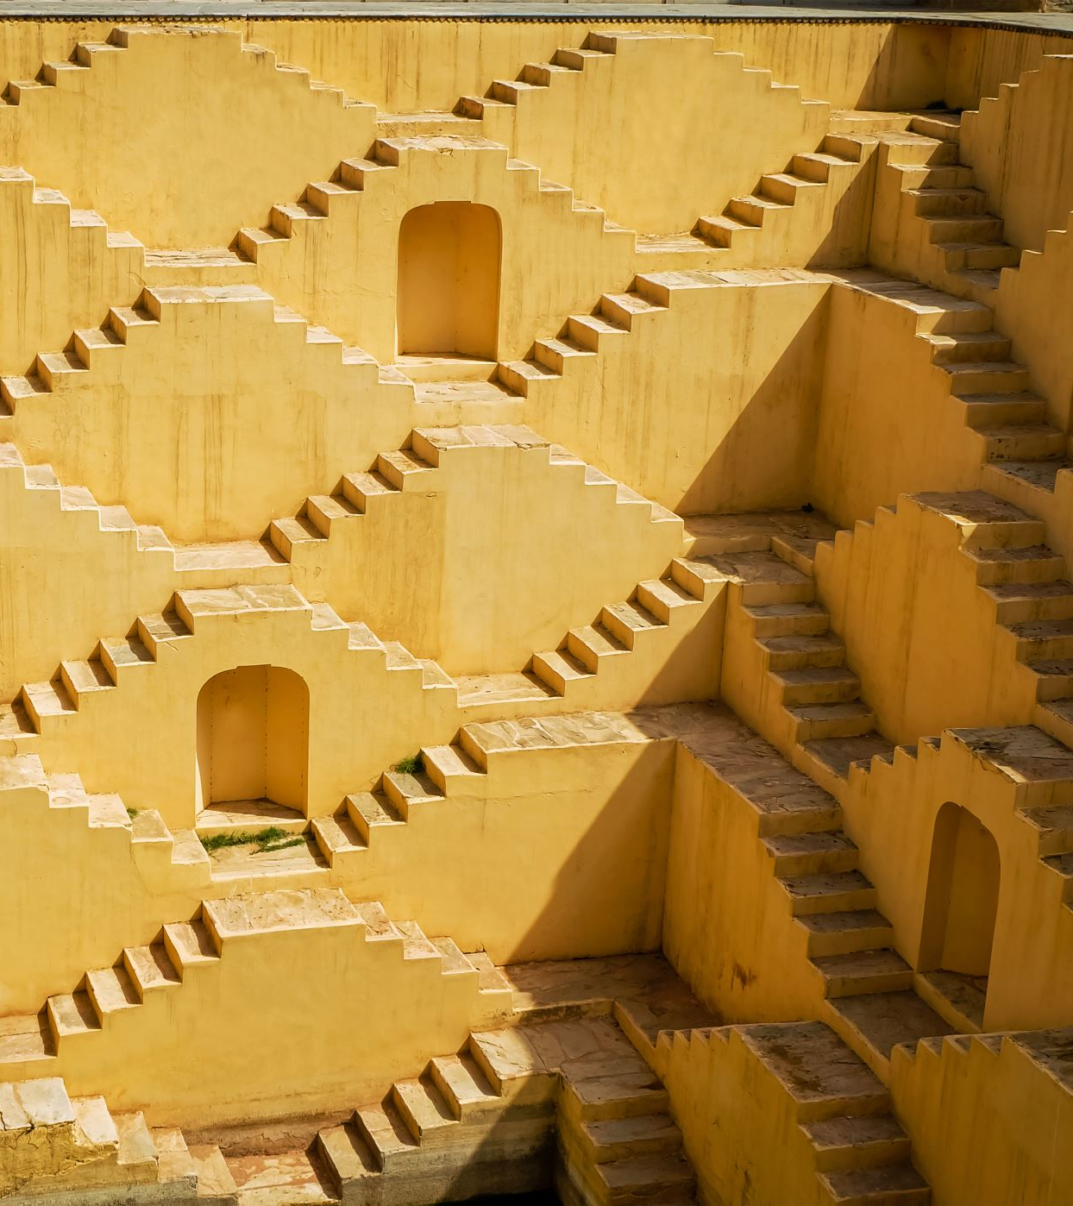
Harappan Urban Lifestyle
The Indus Valley Civilization, also called the Harappan Civilization, flourished between 2500 BCE and 1500 BCE in present-day Pakistan and north-western India. It was one of the world's earliest urban civilizations, contemporary with Mesopotamia and Ancient Egypt. Among its most remarkable features was its urban lifestyle, which reflected planning, cleanliness, social order, and advanced knowledge. The remains of Harappa, Mohenjo-daro, Dholavira, Kalibangan, Lothal, and other sites reveal how sophisticated their way of living was.
This essay explores the Harappan town planning, houses, water supply, sanitation, economy, trade, food, clothing, ornaments, entertainment, religion, and social values to understand their urban lifestyle.

Slide 3
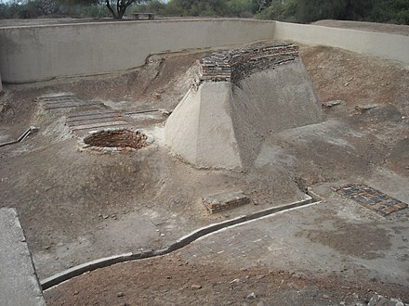
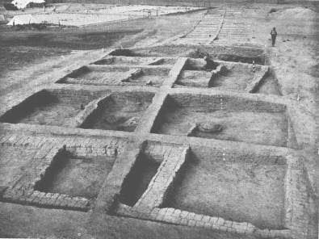
ThePhoto by PhotoAuthor is licensed under CCYYSA.
ThePhoto by PhotoAuthor is licensed under CCYYSA.

Slide 4
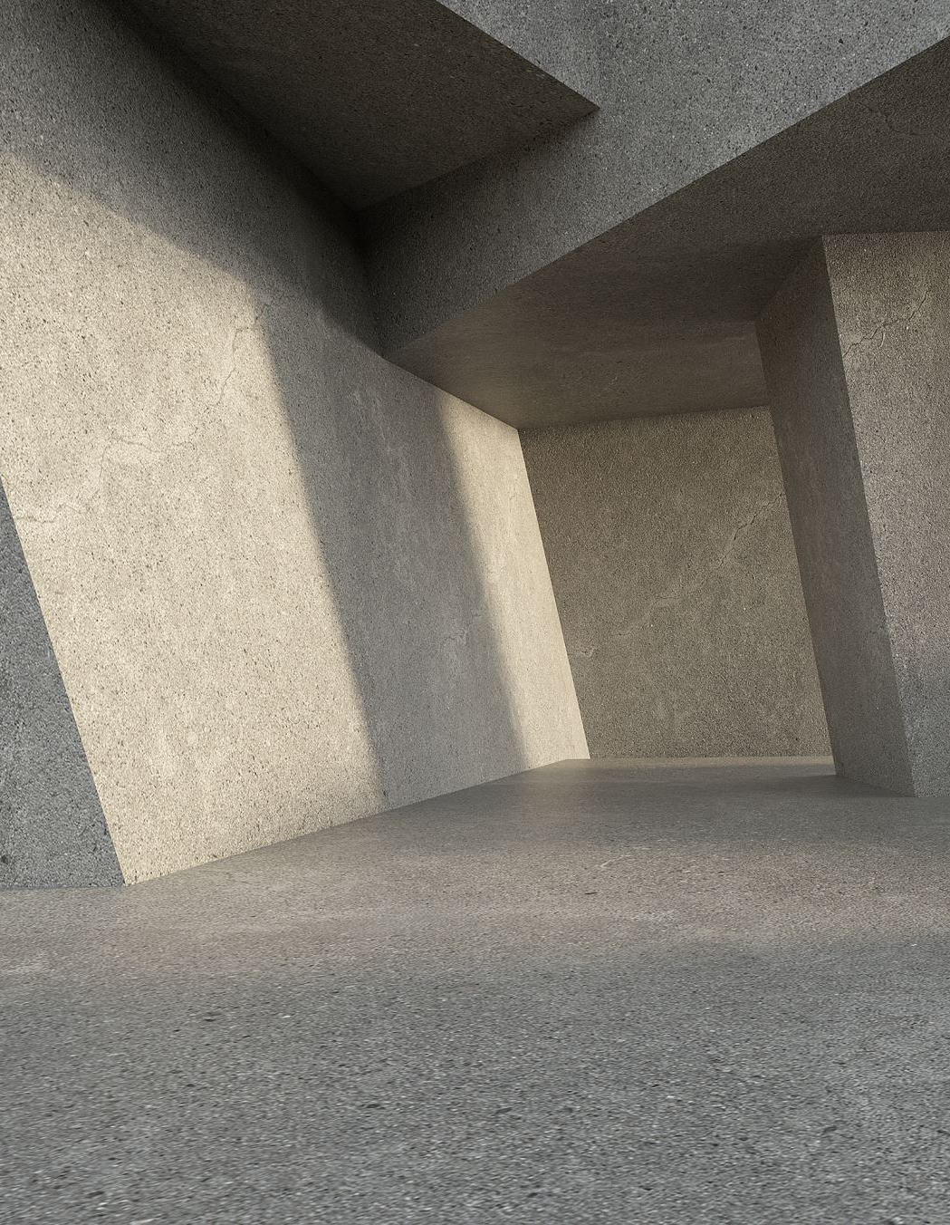
WATER SUPPLY AND DRAINAGE SYSTEM
Perhaps the most striking aspect of the Harappan lifestyle was its advanced drainage system.
Covered Drains: Underground drains ran along the streets and were covered with stone slabs.
Manholes: There were inspection holes for cleaning the drains, similar to modern systems.
Wells: Each house or group of houses had wells, ensuring regular water supply.
This shows that Harappans attached great importance to public health and sanitation. Their civic sense was highly developed, and they valued a clean environment.

Slide 5
Houses and Domestic Life
The houses of Harappa reveal much about the daily lifestyle of people.
Material: Houses were built with baked bricks, which were durable and uniform in size. This standardization shows planned production.
Design: Most houses had a central courtyard, rooms around it, and private wells. Many had two storeys.
Privacy: Doors and windows generally opened onto side lanes, not the main streets, reflecting concern for privacy.
Bathrooms: Almost every house had bathrooms connected to drains, a remarkable feature showing the importance of cleanliness.
This demonstrates that even ordinary citizens had access to basic comforts and were part of a hygienic urban culture.

Slide 6
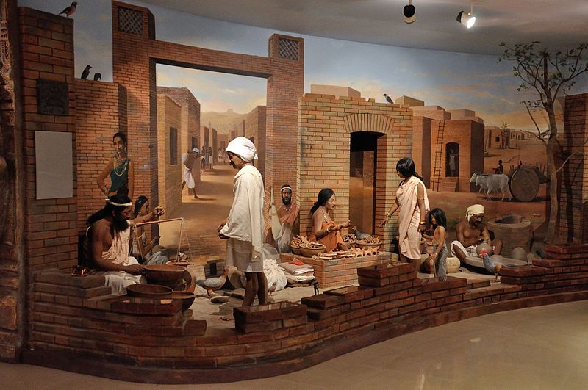
ThePhoto by PhotoAuthor is licensed under CCYYSA.

Slide 7
Town Planning and Architecture
The Harappan cities are celebrated for their scientific town planning. They were laid out in a grid pattern-streets crossed each other at right angles, dividing the city into blocks. This kind of geometric planning was far ahead of its time.
Citadel and Lower Town: The cities were divided
into two parts-the citadel (fortified, elevated area used for public buildings like granaries and the Great Bath) and the lower town (residential area where most people lived).
Uniformity: Despite being spread across a wide
region, cities showed remarkable uniformity in design, which means they followed a common set of planning rules.
Public Buildings: Granaries, assembly halls,
dockyards (Lothal), and baths show their collective life and civic administration.
This organized planning indicates a centralized authority that valued order and public welfare.

Slide 8
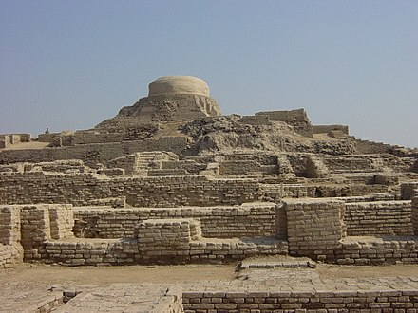
ThePhoto by PhotoAuthor is licensed under CCYYSA.

Slide 9

The Great Bath in Harappan Cities
One of the most remarkable structures of the Indus Valley Civilization is the Great Bath at Mohenjo-daro. It is considered the earliest known public water tank in the world and a fine example of Harappan engineering and civic planning.
The Great Bath was a large rectangular tank, about 12 meters long, 7 meters wide, and 2.5 meters deep. It was built with baked bricks and coated with a layer of bitumen to make it waterproof. Steps led down from both ends into the tank, and water was supplied through a well, while drains were provided to empty and clean it. Surrounding the bath were small rooms, possibly used by priests or participants in rituals.
Historians believe that the Great Bath was not for ordinary bathing but for ritual purification. This suggests that the Harappans attached great importance to spiritual cleanliness as well as physical hygiene. The presence of such a structure also highlights their ad' d water management and strong sense of con ty life.

Slide 10
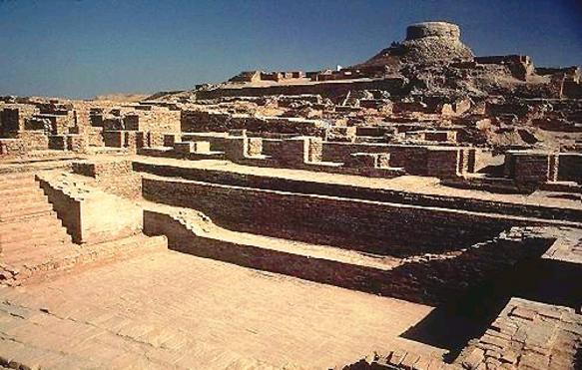
ThePhoto by PhotoAuthor is licensed under CCYYSA.

Slide 11

THANK YOU
A PRESENTATION BY:
          Sociosphere Explorers

