Slide 1
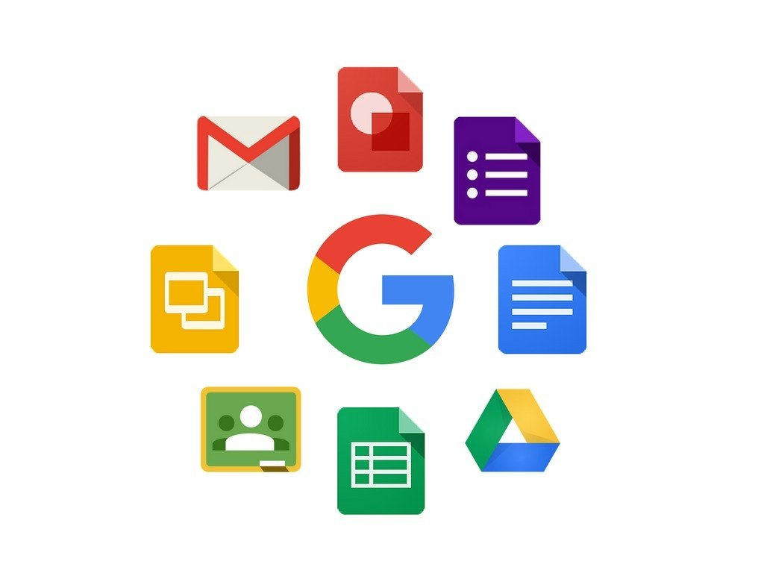
Google app

Slide 2
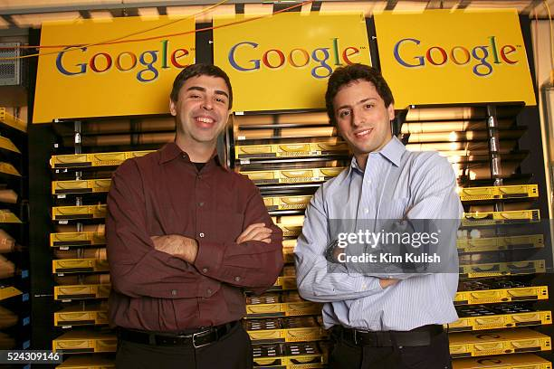
Google LLC is an American multinational technology corporation focused on information technology, online advertising, search engine technology, email, cloud computing, software, quantum computing, e-commerce, consumer electronics, and artificial intelligence.

Slide 3

Google workspace
Google Workspace includes the productivity apps you know and love—Gmail, Drive, Docs, Meet, and many more—in one location, so you can create, communicate, and collaborate.

Slide 4

How google apps are useful?
Google apps are helpful because they simplify and enhance everyday tasks by providing tools for communication, organization, information access, and collaboration.
These apps are generally free, accessible from multiple devices, and designed to work together seamlessly, boosting productivity for individuals and organizations.

Slide 5
Google apps

Slide 6
Gmail
Gmail is a popular, free, and web-based email service provided by Google that allows users to send and receive digital messages, files, and other information over the internet.
Key features
Centralized storage
Built-in chat and call functions
Advanced spam filtering
Automatic saving of work.

Slide 7
Google drive
Google Drive is a cloud-based storage platform provided by Google that allows users to store, access, and share their files and documents from anywhere with an internet connection..

Slide 8
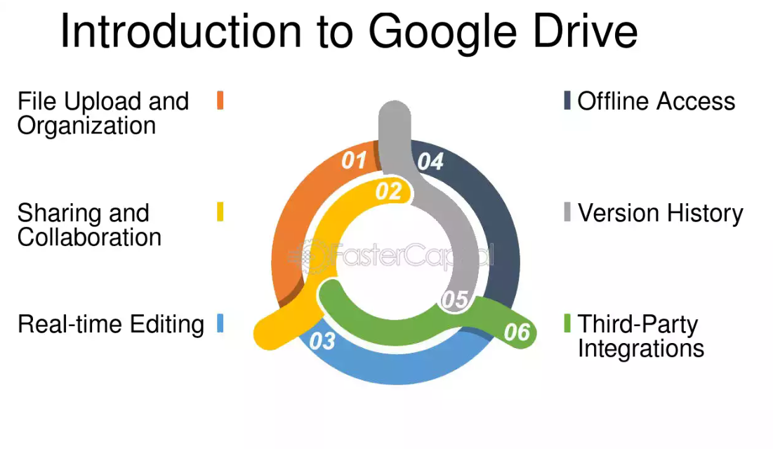

Slide 9
Google map
Google Maps is a web-based service by Google and app that provides detailed mapping, satellite imagery, and navigation for planning routes via various modes of transport.
Key features
Mapping & Navigation:
Street View:
Satellite Imagery & Aerial Photography:
Real-Time Traffic:
Local Business Information:
Accessibility:
Route Planning:

Slide 10
Google docs
Google Docs is a free, web-based word processor that allows users to create, edit, and collaborate on documents online in real-time
Key features
Real-time Collaboration:
Cloud-Based Storage:
Voice Input:
Suggesting Mode:
AI-Powered Assistance (Gemini):

Slide 11
Effective delivery techniques
This is a powerful tool in public speaking. It involves varying pitch, tone, and volume to convey emotion, emphasize points, and maintain interest.
  Pitch variation
  Tone inflection
  Volume control
Effective body language enhances your message, making it more impactful and memorable.
  Meaningful eye contact
  Purposeful gestures
  Maintain good posture
  Control your expressions

Slide 12
Speaking impact
Your ability to communicate effectively will leave a lasting impact on your audience
Effectively communicating involves not only delivering a message but also resonating with the experiences, values, and emotions of those listening

Slide 13

Thank you
Brita Tamm
502-555-0152
brita@firstupconsultants.com
www.firstupconsultants.com

