Slide 1
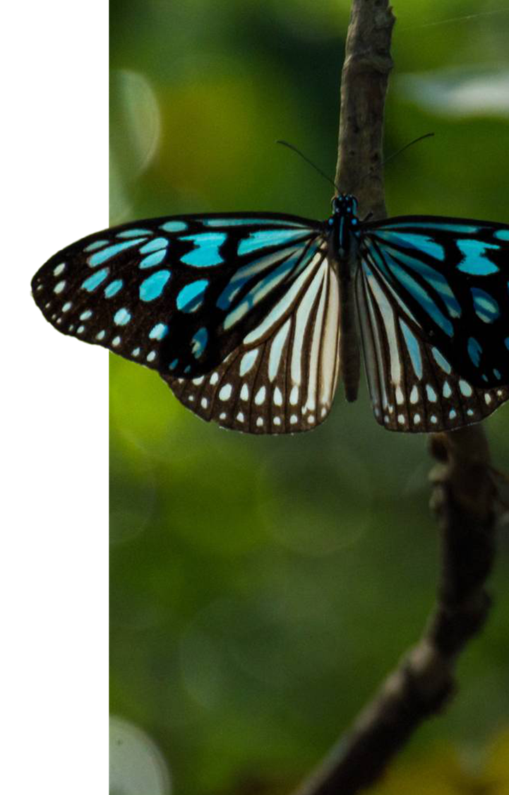
Python programs
Do the following programs using for loop

Slide 2
Write a program to print the first 20 whole numbers

Slide 3
Write a program to print the first 20 whole numbers
for i in range(20):
print(i,end=“ ")

Slide 4
Write a program to print numbers from 1…n

Slide 5
Write a program to print numbers 1..N
N=int(input(“enter a no”))
for i in range(1,N+1):
print(i,end=“ ")

Slide 6
Write a program to print first 10 multiples of 5

Slide 7
for i in range(5,51,5):
print(i,end=“ ")

Slide 8
Write a program to print the cubes of numbers from 1..n

Slide 9
N=int(input(“enter a no”))
for i in range(1,N+1):
print(i*i*i,end=“ ")

Slide 10
Write a program to print the squares of numbers from 10 to 50.
Write a program to print the numbers from reverse from 400 to 100.

