Slide 1
Pancha Kosha – The Five Layers of Our Being from Taittiriya Upanishad

Slide 2
What is Pancha Kosha?
Pancha Kosha means the five layers or sheaths that cover our true self, as described in yogic philosophy. These layers move from the physical body to the blissful inner self.
Notes:
Add intro narration here. Soft background music suggestion: 'Calm Classroom Music' from bensound.com

Slide 3
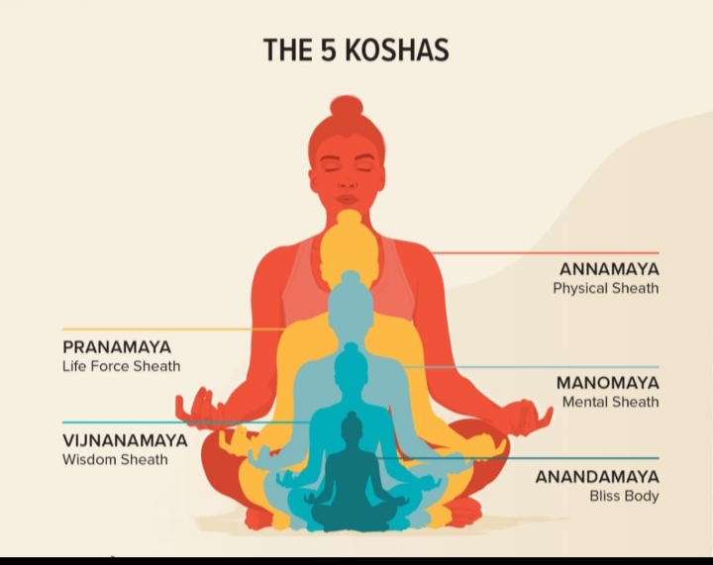

Slide 4
The Five Koshas
1. Annamaya Kosha – The Physical Body
2. Pranamaya Kosha – The Energy Layer
3. Manomaya Kosha – The Mind Layer
4. Vijnanamaya Kosha – The Wisdom Layer
5. Anandamaya Kosha – The Bliss Layer
Notes:
Add a video of a teacher explaining five layers using a diagram.

Slide 5
Annamaya Kosha – The Physical Body
This is the outermost layer — our physical body made of food. It helps us move, play, and do daily activities.
basically it's made a panchabhut. Earth, water air, fire and space.
This kosha is related to our organ,s bones muscle ,tissues etc.
Notes:
Add narration explaining body as food layer. Add video of children doing stretching or playing.

Slide 6
Pranamaya Kosha – The Energy Layer
This layer represents our life force or breath energy that keeps us alive and active.Related to the vital force or energy.
basically pranumaya kosha help to generate the annamaya khosa.
Acording to the yoga shastra five prana is there to develop Pranamaya kosha. we should know this five prana .
Notes:
Add video of breathing exercises or yoga for kids.

Slide 7
Manomaya Kosha – The Mind Layer
This layer includes our thoughts, emotions, and imagination and ego .This is total related to our mind.
we should do meditation to developed our Manomaya kosha .
Here we can choose like and dislike.
Notes:
Add calm background music and a clip of kids drawing or expressing emotions.

Slide 8
Vijnanamaya Kosha – The Wisdom Layer
This is our layer of understanding and intuition — knowing what is right and wrong.
About knowledge and wisdom. Here we can different from the other animals.
To developed and connect with this kosha we have to gether knowledge.
Notes:
Add narration explaining inner knowledge. Optional: Insert a video of storytelling or reflection.

Slide 9
Anandamaya Kosha – The Bliss Layer
This is the deepest layer — the feeling of happiness, love, and peace within us.It's symbolise inner peace and inner light.
If we can touch this layer we can free from other suffering .
For that we should practice yoga and sadhan.
In this stage we can enjoy love, peace and full of joy .
Notes:
Add soothing background music with calm visuals or meditation video clip.

Slide 10
Summary of All Five Koshas
All five koshas together make us complete human beings — body, energy, mind, wisdom, and bliss. Keeping all layers balanced helps us stay healthy and happy.
Notes:
Add video montage of all activities with joyful background music.

Slide 11
Classroom Reflection
Teachers can guide children to explore each kosha through fun activities, breathing, and art. Encourage calm moments and creativity every day.
Notes:
Add short meditation music or final thank-you narration.

Slide 12

Notes:
End slide narration with gratitude and calm outro music.

