Slide 1
Plant hormones
Ps SIR

Slide 2
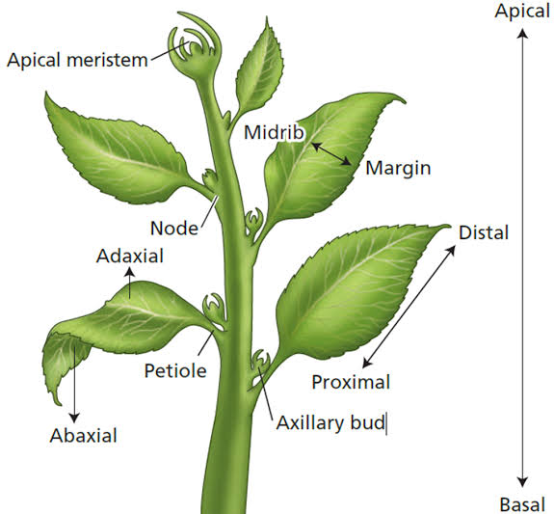
AUXIN
Discovery: First plant hormone discovered by F.W. Went (1928).
Source: Produced mainly in shoot apices and young leaves.
Natural auxin: Indole-3-acetic acid (IAA).
Synthetic auxins: 2,4-D (2,4-dichlorophenoxyacetic acid), NAA (Naphthalene acetic acid).
Functions:
  Promotes cell elongation in shoots.
  Responsible for apical dominance (inhibits growth of lateral buds).
  Promotes root initiation in cuttings.
  Used in weed control (2,4-D kills dicot weeds).
  Induces parthenocarpy (fruit formation without fertilization).
  Delays leaf and fruit abscission (shedding).

Slide 3
GIBBERELLINS (GA)
Discovery: From Gibberella fujikuroi fungus (caused “foolish seedling” disease in rice).
Types: Over 100 gibberellins known (GA₁, GA₂, GA₃…); GA₃ (Gibberellic acid) most common.
Functions:
  Promote stem elongation and internode elongation.
  Break seed dormancy (stimulate germination).
  Promote bolting and flowering in long-day plants.
  Stimulate enzyme synthesis (like α-amylase) during seed germination.
  Induce parthenocarpy (fruit development without seeds).

Slide 4
Cytokinins
Discovery: Kinetin (first cytokinin) discovered from herring sperm DNA by F. Skoog and Miller.
Natural cytokinins: Zeatin (from maize kernels and coconut milk).
Synthesized in: Root apices and transported to other organs.
Functions:
Promote cell division (cytokinesis).
Delay senescence (anti-aging effect) in leaves (called Richmond–Lang effect).
Promote lateral and adventitious shoot formation.
Work antagonistically with auxins in organ formation.
In tissue culture, high cytokinin:auxin ratio → shoot formation.

Slide 5
Ethylene
Nature: Only gaseous plant hormone.
Discovery: Reported by Cousins (1910).
Produced in: Ripening fruits and senescent tissues.
Functions:
Promotes fruit ripening (e.g., bananas, tomatoes).
Induces leaf and flower senescence and abscission.
Promotes epinasty (downward curvature of leaves).
Breaks seed and bud dormancy.
Stimulates root growth and root hair formation.
Triple response in seedlings: swelling of stem, horizontal growth, reduced elongation.

Slide 6
Abscisic acid
Nature: Growth-inhibiting hormone (also called stress hormone).
Discovery: 1960s, from abscising leaves and cotton bolls.
Produced in: Mature leaves and seeds.
Functions:
Induces dormancy in seeds and buds.
Promotes abscission of leaves, flowers, and fruits.
Acts as antagonist to gibberellins (inhibits growth).
Helps plants during stress conditions (drought, salinity, cold).
Causes stomatal closure to reduce water loss.

Slide 7
SUMMARY TABLE
Hormone | Nature | Major Function | Special Notes
Auxin | Growth promoter | Cell elongation, apical dominance | Used as rooting hormone, herbicide
Gibberellin | Growth promoter | Stem elongation, seed germination | Breaks dormancy, bolting
Cytokinin | Growth promoter | Cell division, delay senescence | Found in root tips
Ethylene | Growth regulator | Fruit ripening, abscission | Only gaseous hormone
Abscisic Acid | Growth inhibitor | Dormancy, stomatal closure | Stress hormone

