Slide 1

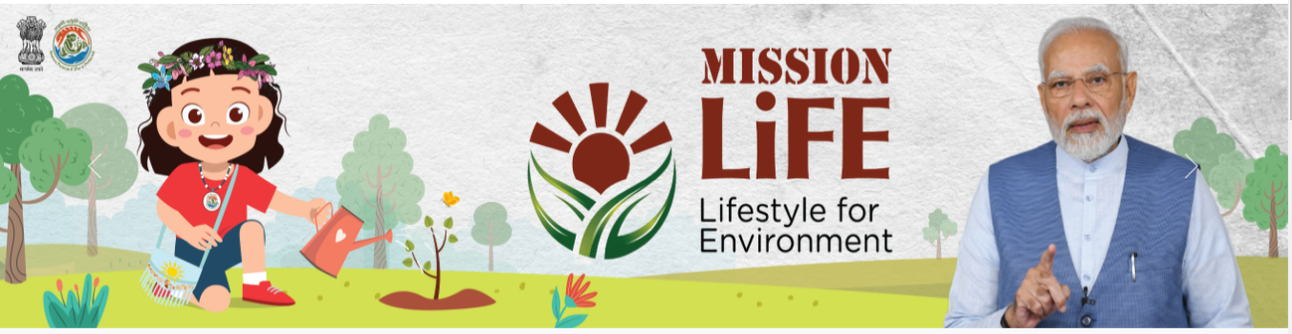
Satish Chandra Memorial School
Workshop on Awareness on Idol Visarjan
~Eco-Club for Mission LiFE

Slide 2
Problems with Pratima Visarjan
1. Environmental Damage from POP Idols
POP does not dissolve and remains in water bodies for months or years.
Toxic paints disrupt the natural water chemistry, damaging entire ecosystems.
2. Threat to Public Health
Contaminated water increases risks of skin allergies, asthma, and water-borne diseases.
Polluted immersion sites become breeding grounds for mosquitoes.
3. Impact on Local Communities
Polluted lakes and rivers reduce the availability of clean water for nearby villages/towns.
Fishermen face economic loss due to decline in fish populations.
4. Solid Waste After Immersion
Bamboo, cloth, thermocol, plastic garlands, and glitter accumulate at immersion ghats.
Municipal bodies struggle to clean large amounts of idol remains.
5. Strain on Urban Infrastructure
Heavy visarjan processions create traffic jams, noise pollution, and waste accumulation.
Large crowds increase the risk of accidents at immersion points.

Slide 3
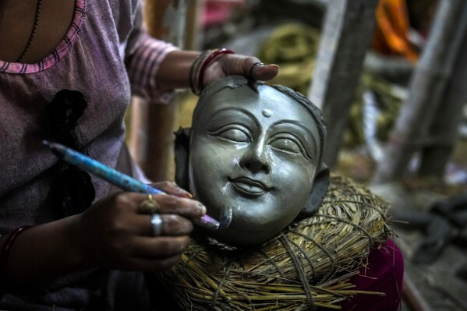
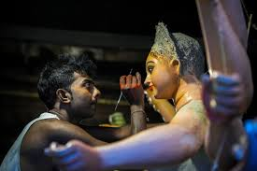
Eco-Friendly Alternatives (Aligned With Mission LiFE)
What We Can Do Instead?
1. Use Natural, Biodegradable Materials
Choose clay, red soil, or plant-based materials for making idols instead of POP.
Replace chemical paints with natural dyes made from turmeric, spinach, Multani mitti, or flower extracts.
2. Encourage and Celebrate Sustainable Choices
Motivate families and students to adopt eco-friendly idols by recognizing their efforts.
Organize events like “Green Visarjan Awards” or an “Eco Idol Festival” to showcase and reward sustainable creativity.
3. Opt for Artificial or Designated Immersion Tanks
Use temporary or specially created immersion tanks instead of natural water bodies.
Treat, filter, and reuse the immersion water to avoid polluting lakes and rivers.
4. Switch to Reusable Idols
Use idols made of metal, stone, or wood that can be kept year after year without immersion.
Reduce waste and conserve resources by adopting non-disposable idol traditions.

Slide 4
How Can we Help??
1. Try Fun, Hands-On Workshops
We can learn to make our own clay idols and natural colors—it’s simple, fun, and eco-friendly.
Our school exhibitions can display these handmade, biodegradable idols to inspire others.
2. Spread the Word in Our Community
We can talk to people in our neighborhoods about why eco-friendly visarjan matters.
Simple posters, leaflets, or even social media posts can help everyone understand what they can do.
3. Connect Our Efforts to Global Goals
Our small actions support big global goals like:
  using resources wisely,
  fighting climate change, and
  protecting life in our water bodies.
Showing these links in our projects makes our work more meaningful.

Slide 5
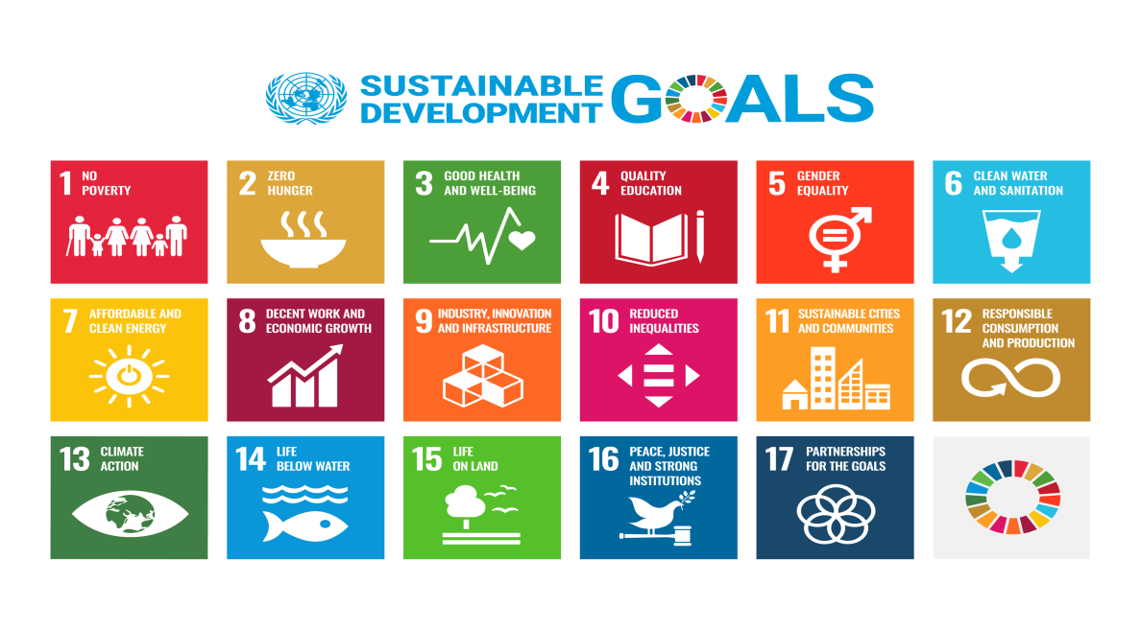
4. Understand Where Our Resources Come From
We can explore how idols are made—from raw materials to disposal—and see how each step affects nature.
This helps us realize how our choices shape things like groundwater, soil, and the cleanliness of our environment.
5. Make Eco-Friendly Living a Habit
We can take a simple pledge to follow eco-friendly habits in our everyday life.
Even small changes—like avoiding glitter, using natural decorations, or reducing plastic—add up to make a big difference.

