Slide 1
EVRYTHING AT ONCE –LYRICS
As sly as a fox, as strong as an ox
As fast as a hare, as brave as a bear
As free as a bird, as neat as a word
As quiet as a mouse, as big as a house
All I wanna be All I wanna be Oh-oh-oh, all
I wanna be Is everything
As mean as a wolf, as sharp as a tooth
As deep as a bite, as dark as the night
As sweet as a song, as right as a wrong
As long as a road, as ugly as a toad
As pretty as a picture hanging from a fixture
Strong like a family, strong as I wanna be
Bright as day, as light as play
As hard as nails, as grand as a whale
All I wanna be Oh-oh-oh, all
I wanna be - Oh-oh-oh, all
I wanna be Is everything
Everything at once Everything at once
Oh-oh-oh, everything at once
As warm as the sun, as silly as fun
As cool as a tree, as scary as the sea
As hot as fire, cold as ice
Sweet as sugar and everything nice
As old as time, as straight as a line
As royal as a queen, as buzzed as a bee
As stealth as a tiger, smooth as a glider
Pure as a melody, pure as I wanna be

Slide 2
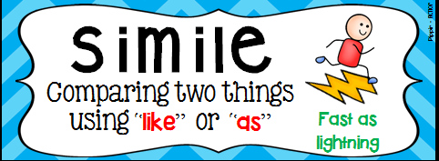
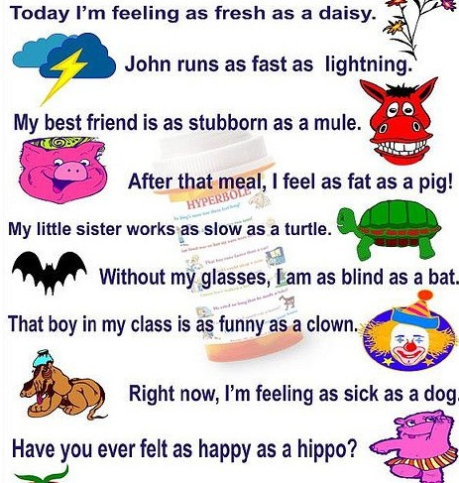
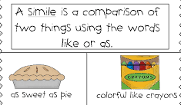

Slide 3
LITERARY DEVICES
SIMILE-METAPHOR--PERSONIFICATION-HYPERBOLE -OXYMORON-REPETITION-ANAPHORA –EPIPHORA –ALLITERATIONASSONANCE-ONOMATOPOEIA -IRONY-IMAGERY-PUN-ALLUSION AND MANY MORE ……..

Slide 4
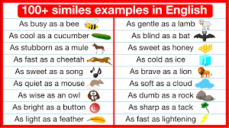

Slide 5
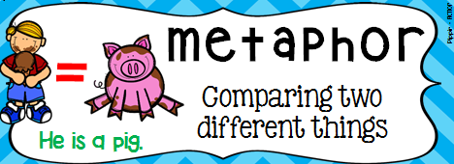
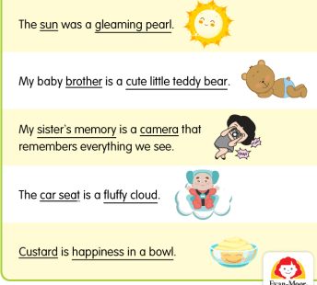
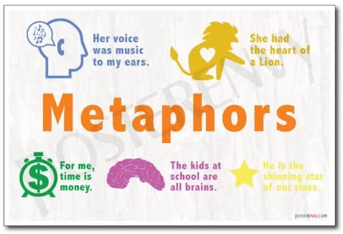

Slide 6
EXAMPLES
SCHOOL IS A GARDEN AND YOU ARE THE FLOWERS .
SCHOOL IS A CAGE AND YOU ARE THE CAGED BIRDS.
THE WORLD IS A STAGE .
OUR SOLDIERS ARE TIGERS .
MY TEACHER IS A DEVIL.
MY BROTHER IS A DRAGON.
CONSCIENCE IS A MAN’S COMPASS.
LIFE IS A JOURNEY .
HIS VOICE IS VELVELT.
OUR EYES ARE WINDOWS TO OUR SOUL.

Slide 7
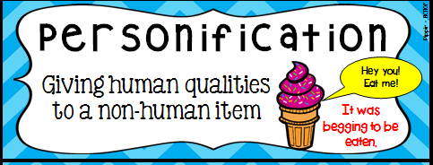
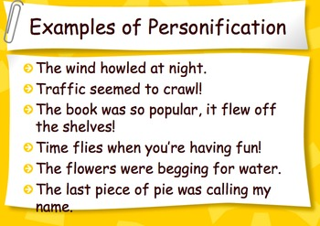
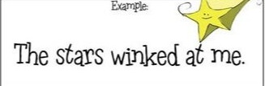
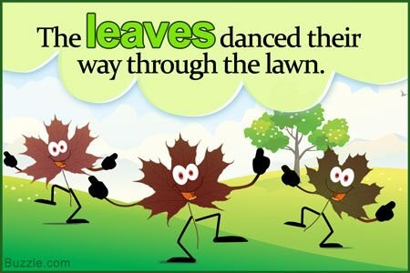

Slide 8
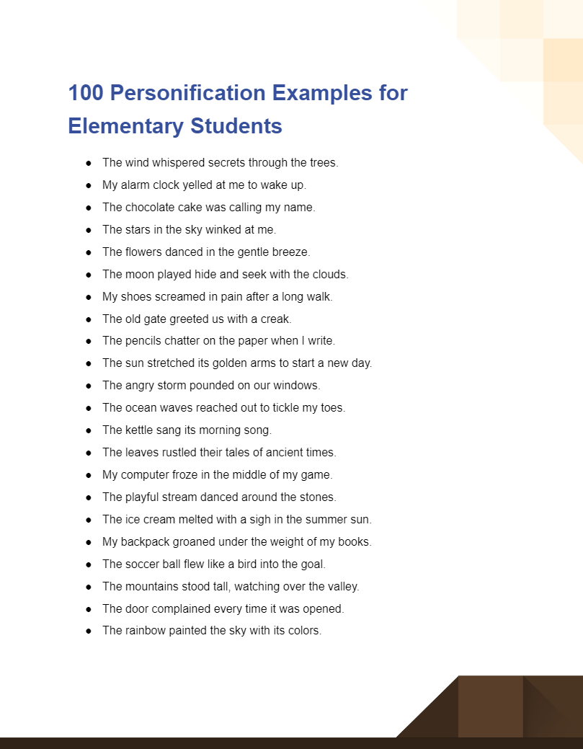

Slide 9
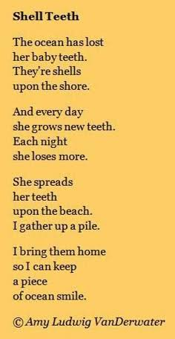
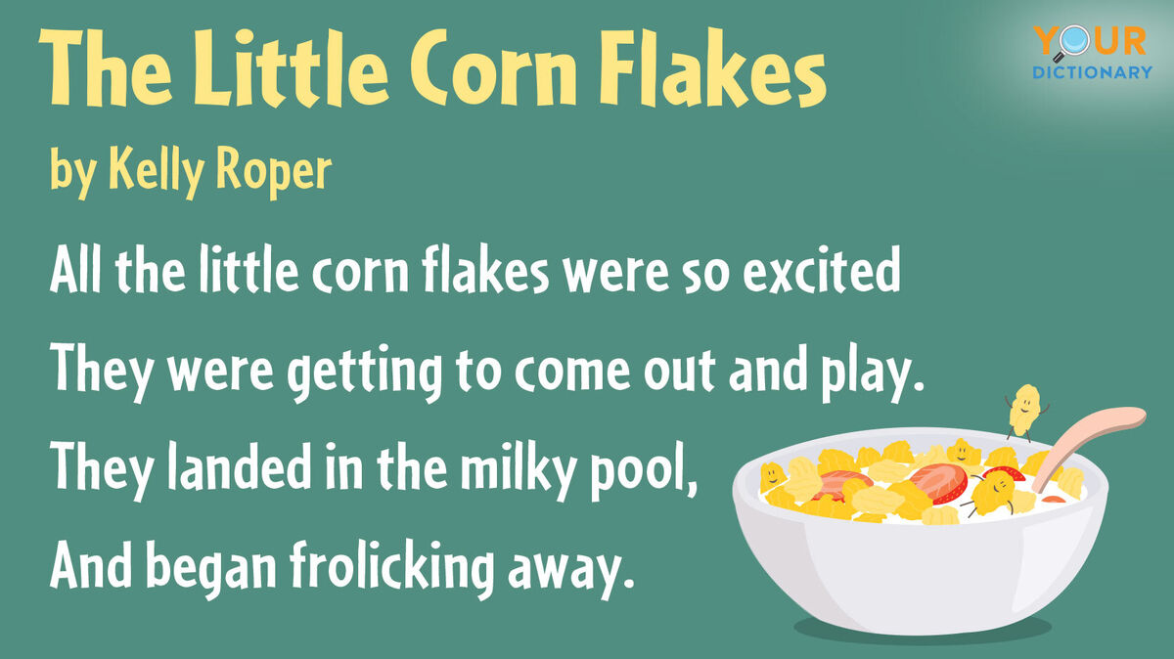

Slide 10
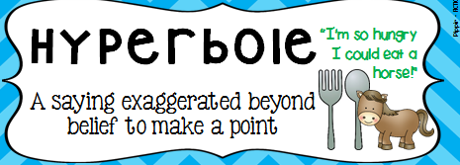
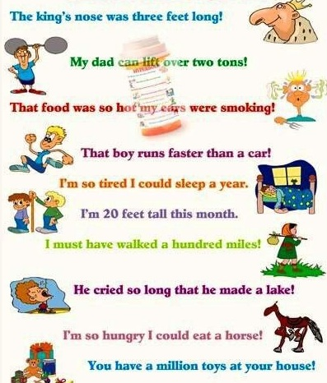
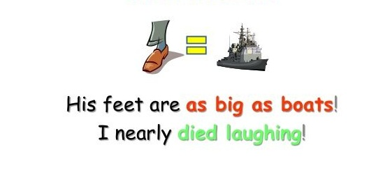

Slide 12
OXYMORON
THE COMBINATION OF TWO PHRASES THAT SEEM TO BE OPPOSITE TO EACH OTHER .
OPEN SECRET
BITTERSWEET
GREEDY-GOOD DOERS
ORIGINAL COPY
LIQUID GAS
DELIBERATE MISTAKE
SERIOUSLY FUNNY
REGULARLY IRREGULAR
THE SEA HOLIDAY WAS HER PAST ,MINE WAS HER LAUGHTER .BOTH WRY WITH THE LABOURED EASE OF LOSS.
HE STALKS IN HIS VIVID STRIPES
THE FEW STEPS OF HIS CAGE
ON THE PADS OF VELVET QUIET,
IN HIS QUIET RAGE .

Slide 13
REPETITION -.
THE DELIBERATE RE-USE OF WORDS ,PHRASES,LINES IN A TEXT /POEM.
PURPOSE-DRAWS ATTENTION TO CERTAIN IDEAS
ANAPHORA –REPETITION IN THE BEGINNING
EPIPHORA –REPETITION IN THE END
ALLITERATION –THE REPETITION OF SAME CONSONANT SOUND AT THE BEGINNING OF NEIGHBOURING WORDS
ASSONANCE –THE REPETITION OF VOWEL SOUNDS OF NEIGHBOURING WORDS

Slide 14
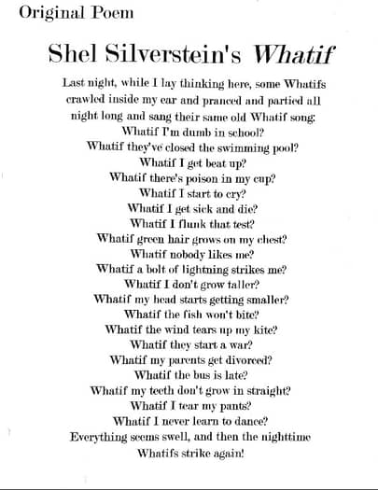
ANAPHORA
WINSTON CHURCHIL’S LINE-
‘WE SHALL FIGHT ON THE BEACHES .WE SHALL FIGHT ON THE LANDING GROUNDS.’
WHO CAN WE ASK?WHO WOULD KNOW THE ANSWER?WHO CAN HELP US?

Slide 15
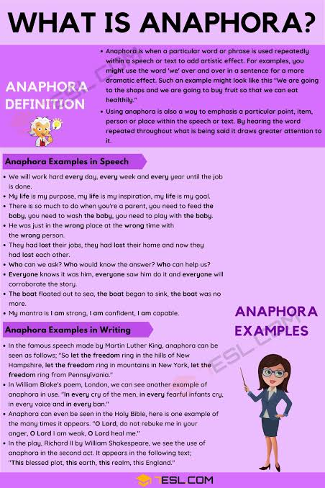

Slide 16
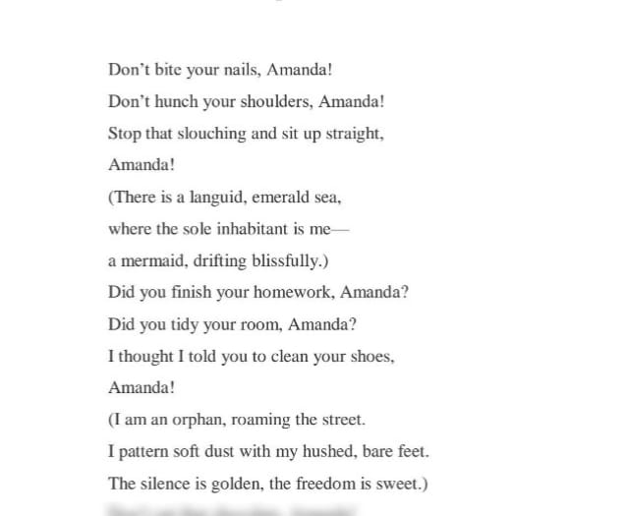
EPIPHORA-REPETITION IN THE END PART OF THE SENTENCE
WE ARE BORN ALONE ,WE LIVE ALONE AND WE DIE ALONE
KEEP GOING AND KEEP GOING AND KEEP GOING.(TAG LINE OF DURACELL AD )
DEMOCRACY IS THE GOVERNMENT OF THE PEOPLE ,BY THE PEOPLE ,FOR THE PEOPLE . (ABRAHAM LINCOLN)

Slide 17
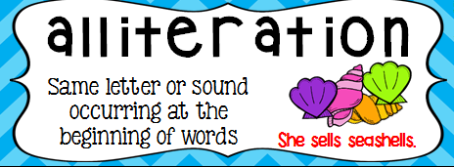
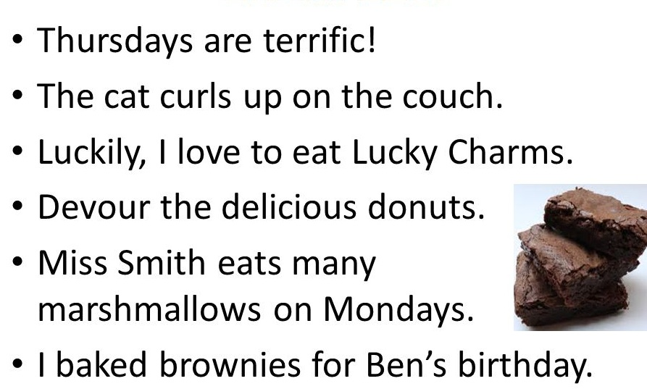

Slide 18
ALLITERATION –MORE EXAMPLES
BIG BLACK BUG
HAPPY HOME
GREEN GRASS GREW
BOOKS-
THE FANTASTIC FOUR
THE SECRET SEVEN
THE FAMOUS FIVE
BRAND NAMES
PAYPAL,COCA-COLA,TIK-TOK CLUB CADET
QUANTUM CLASSIC

Slide 19
TONGUE TWISTERS
PETER PPIPER PICKED A PECK OF PICKLED PEPPERS
I SCREAM ,YOU SCREAM ,WE ALL SCREAM FOR ICE CREAM
THE FAIR BREEZE BLEW .THE WHITE FOAM FLEW AND THE FURROW FOLLOWED FREE.
A BIG BLACK BEAR SAT ON A BIG BLACK RUG.
CAN YOU CAN A CAN AS A CANNER CAN CAN A CAN?
IF A DOG CHEWS SHOES ,WHOSE SHOES DOES HE CHOOSE ?
THIN STICKS ,THICK BRICKS
EDDIE EDITED IT.

Slide 20
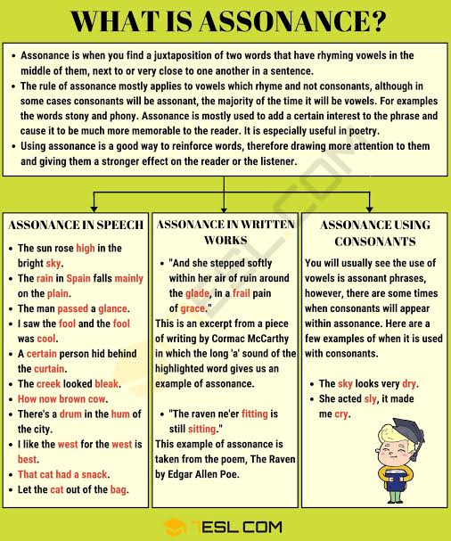
I HOLD WITH THOSE WHO FAVOUR FIRE.
GO SLOW OVER THE ROAD .
CLAP YOUR HANDS AND STAMPT YOUR FEET .

Slide 21
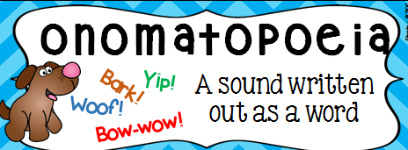
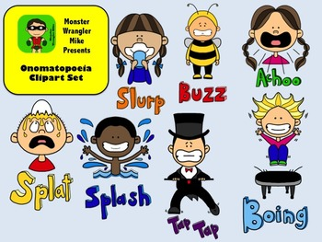
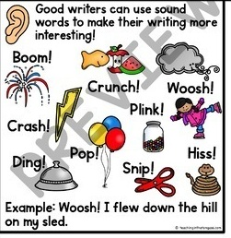

Slide 22
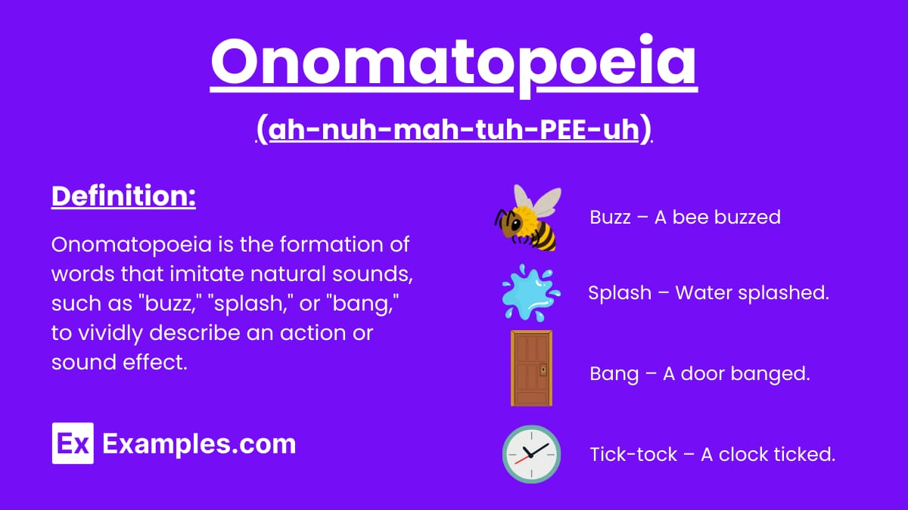

Slide 23
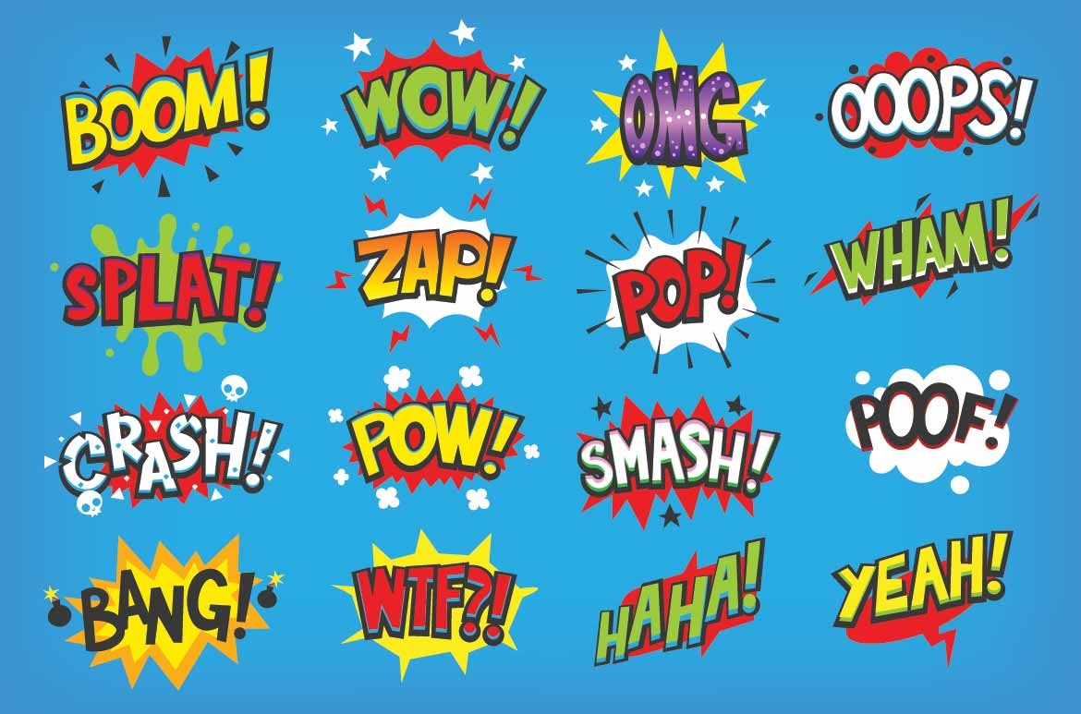
THE PROCESS OF FORMING A WORD THAT MIMICS A SOUND -

Slide 24
THANK YOU !

