Slide 1
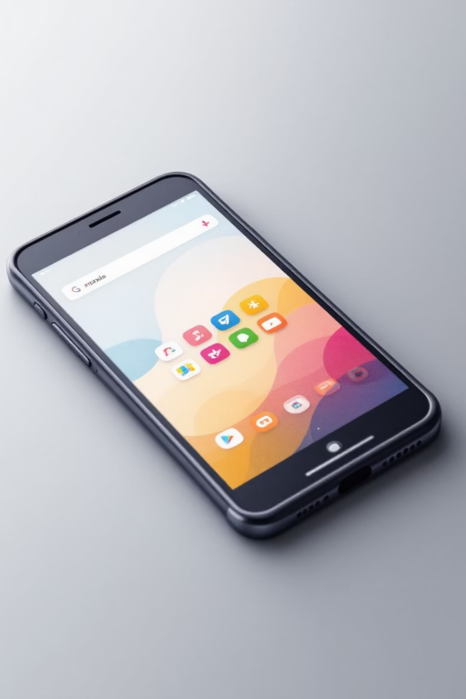
Introduction to Mobile Applications: What is an App?
A mobile application, commonly known as an app, is a software programme specifically designed to run on mobile devices such as smartphones and tablets. Apps transform our devices into powerful tools that can accomplish virtually anything—from managing finances to learning languages, connecting with friends, or ordering groceries. They provide intuitive, touch-optimised interfaces that make complex tasks simple and accessible at our fingertips.

Slide 2
Understanding Mobile Operating Systems: iOS vs Android
iOS Platform
Android Platform
Apple's exclusive operating system powers iPhones and iPads. Known for its sleek design, robust security features, and seamless integration across Apple devices. The App Store offers stringent quality control, ensuring apps meet high standards before reaching users.
Google's open-source operating system dominates the global market. Android offers tremendous flexibility, customisation options, and runs on devices from numerous manufacturers. The Google Play Store provides access to millions of apps across diverse price points and functionalities.
Both platforms have revolutionised how we interact with technology, each offering unique advantages that cater to different user preferences and needs.

Slide 3

Core Features That Define Modern Mobile Apps
Essential Characteristics
Intuitive touch-based navigation and gestures
Push notifications for real-time updates
Offline functionality for uninterrupted access
Cloud synchronisation across multiple devices
Location-based services and GPS integration
Camera and media integration
Biometric security (fingerprint, face recognition)
Responsive design adapting to various screen sizes

Slide 4

Native Apps: Platform-Specific Development
1
2
Platform-Specific Code
Superior Performance
Native apps are built using programming languages specific to each platform—like an iOS app can not work in Android platform and vice versa. These apps can be installed from Google’s Play Store or Apple’s App store.This approach ensures optimal performance and seamless integration with device features.
By leveraging platform-specific capabilities, native apps deliver exceptional speed, smooth animations, and responsive interfaces. They can fully utilise device hardware, including cameras, GPS, and sensors, providing the best possible user experience.
3
Enhanced User Experience
Native apps follow platform design guidelines, creating familiar and intuitive interfaces. Users benefit from consistent navigation patterns, gestures, and visual elements that feel natural on their chosen platform.

Slide 5
Web Apps: Cross-Platform Solutions
Single Codebase Development
1
Web apps use HTML, CSS, and JavaScript to create applications that run in mobile browsers. Developers write code once and deploy across multiple platforms, significantly reducing development time and costs.
2
Universal Accessibility
Users can access web apps through any browser without downloading from app stores. This eliminates storage concerns and ensures everyone has the latest version instantly through automatic updates.
Technical Limitations
3
However, web apps face constraints: limited access to device hardware, reduced offline functionality, slower performance compared to native apps, and inconsistent experiences across different browsers and devices.

Slide 6




Educational Apps: Learning and Skill Development
Interactive Learning Platforms
Educational apps transform traditional learning through engaging, interactive content. Platforms like Duolingo, Khan Academy, and Coursera offer courses ranging from languages to advanced mathematics, making quality education accessible to millions worldwide.
Personalised Study Experience
Modern educational apps use adaptive algorithms to tailor content to individual learning speeds and styles. Features include progress tracking, gamification elements, instant feedback, and multimedia resources that enhance retention and understanding.
Skill Development Tools
From coding bootcamps to music lessons, educational apps provide structured pathways for acquiring new skills. They offer flexibility to learn at your own pace, access expert instruction, and practise through interactive exercises anytime, anywhere.

Slide 7

Lifestyle and Social Media Apps
Connecting Communities
Social media apps like Facebook, Instagram, Twitter, and TikTok have revolutionised how we communicate, share experiences, and build communities. They enable instant connection with friends, family, and like-minded individuals across the globe.
Enhancing Daily Life
Lifestyle apps cover fitness tracking, meditation, recipe planning, fashion, and home organisation. Apps like MyFitnessPal, Headspace, and Pinterest help users maintain healthy habits, discover inspiration, and organise their lives efficiently.

Slide 8




Utility and Communication Apps
Email and Messaging
Productivity Tools
Gmail, Outlook, WhatsApp, and Telegram keep us connected through instant messaging, video calls, and email management. These apps have become essential for both personal and professional communication.
Utility apps like calculators, calendars, note-taking apps (Evernote, Notion), and file managers streamline daily tasks. They enhance efficiency by providing quick access to essential tools and information.
Cloud Storage Solutions
Apps like Dropbox, Google Drive, and OneDrive ensure your important files are accessible anywhere, automatically backed up, and easily shareable with colleagues or friends.

Slide 9
Entertainment and Gaming Apps
Streaming Services
Mobile Gaming Revolution
Netflix, Spotify, YouTube, and Disney+ deliver unlimited entertainment directly to our devices. Stream films, series, music, and podcasts on-demand, creating personalised entertainment experiences tailored to individual tastes.
Gaming apps have transformed smartphones into portable gaming consoles. From casual puzzle games like Candy Crush to complex multiplayer experiences like PUBG Mobile and Genshin Impact, mobile gaming offers entertainment for every preference and skill level.

Slide 10

E-commerce Apps: The Future of Mobile Shopping
Revolutionising Retail
E-commerce apps like Amazon, eBay, and ASOS have transformed shopping into a seamless mobile experience. Browse millions of products, compare prices instantly, read reviews, and complete purchases with a few taps—all from the comfort of anywhere.
01
Personalised Recommendations
02
Secure Payment Options
03
Order Tracking in Real-Time
04
Easy Returns and Support
The future of retail is mobile-first, with apps offering augmented reality try-ons, one-click
purchasing, and AI-powered shopping assistants that make finding the perfect product easier than ever.

