Slide 1
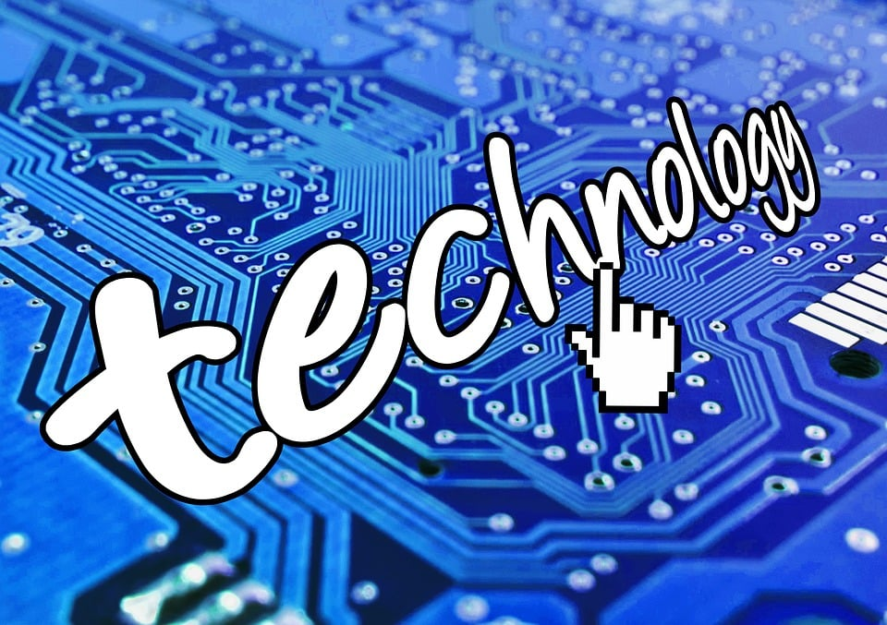

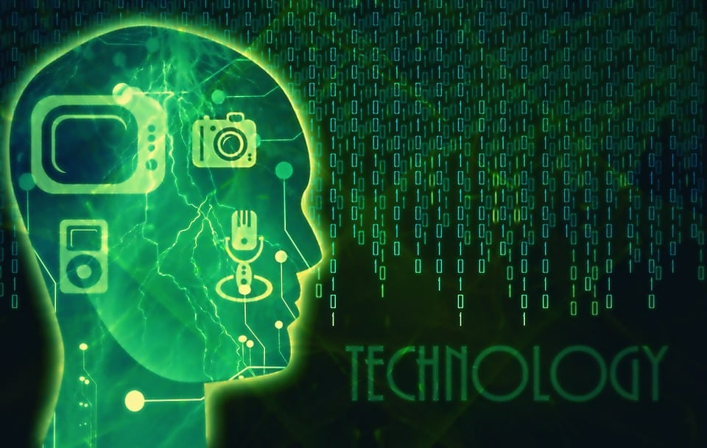
LATEST TECHNOLOGICAL DEVELOPMENTS

Slide 2
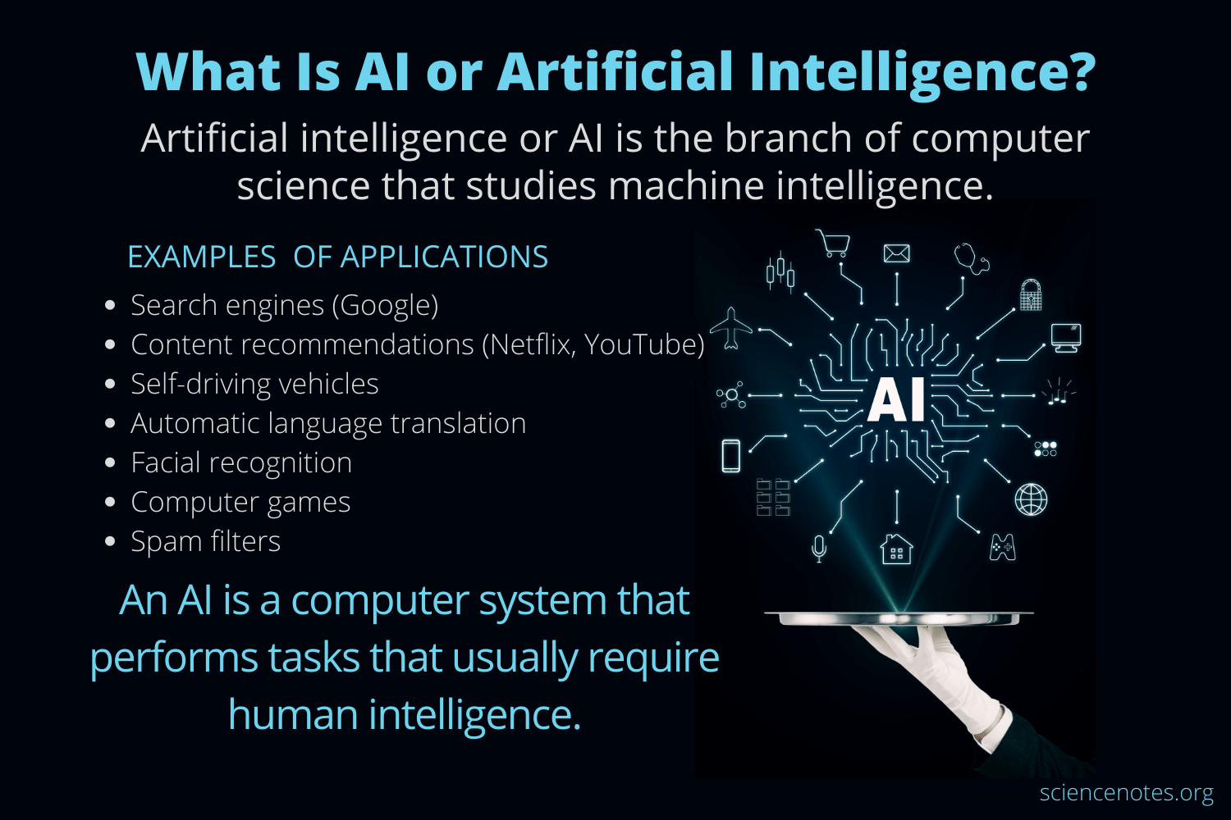
ARTIFICIAL INTELLIGENCE

Slide 3
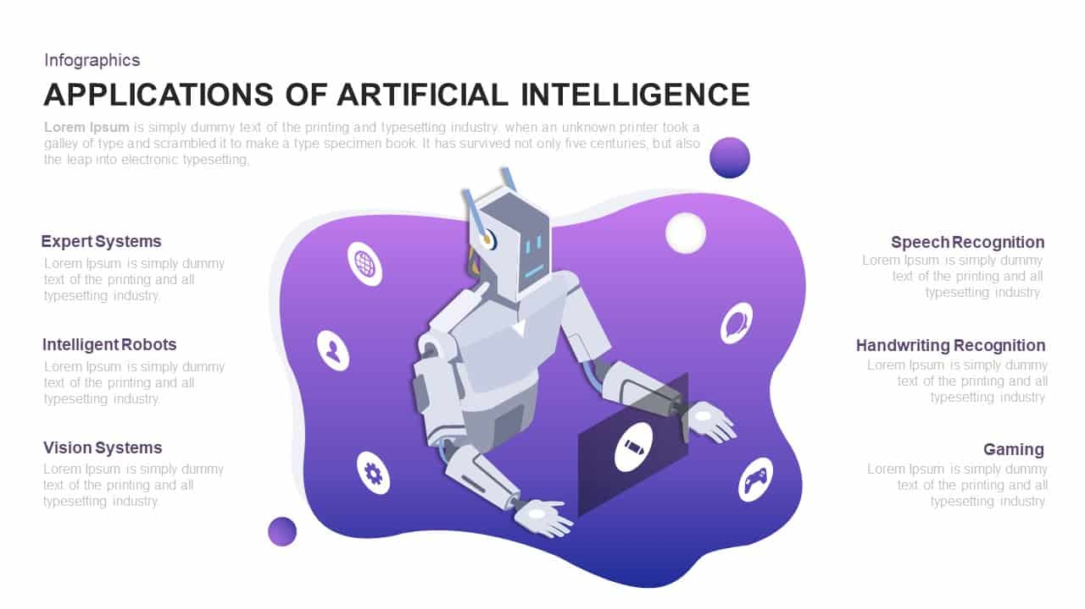

Slide 4

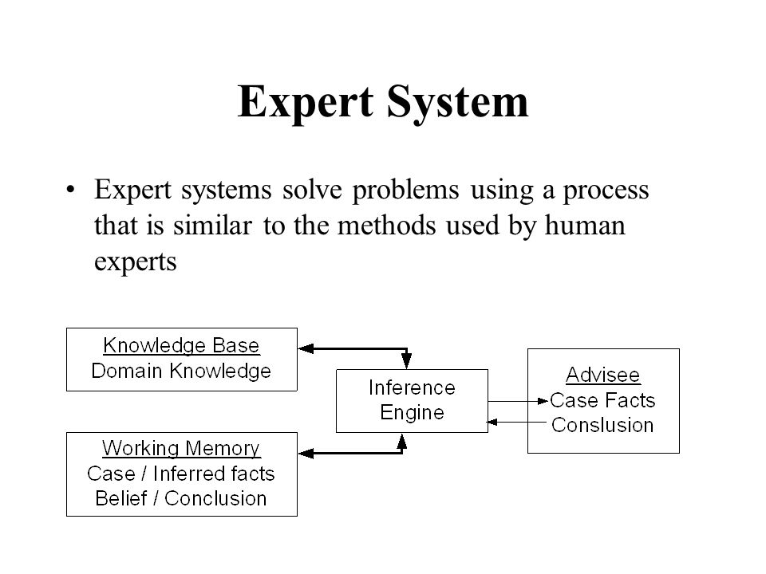
EXPERT SYSTEM

Slide 5
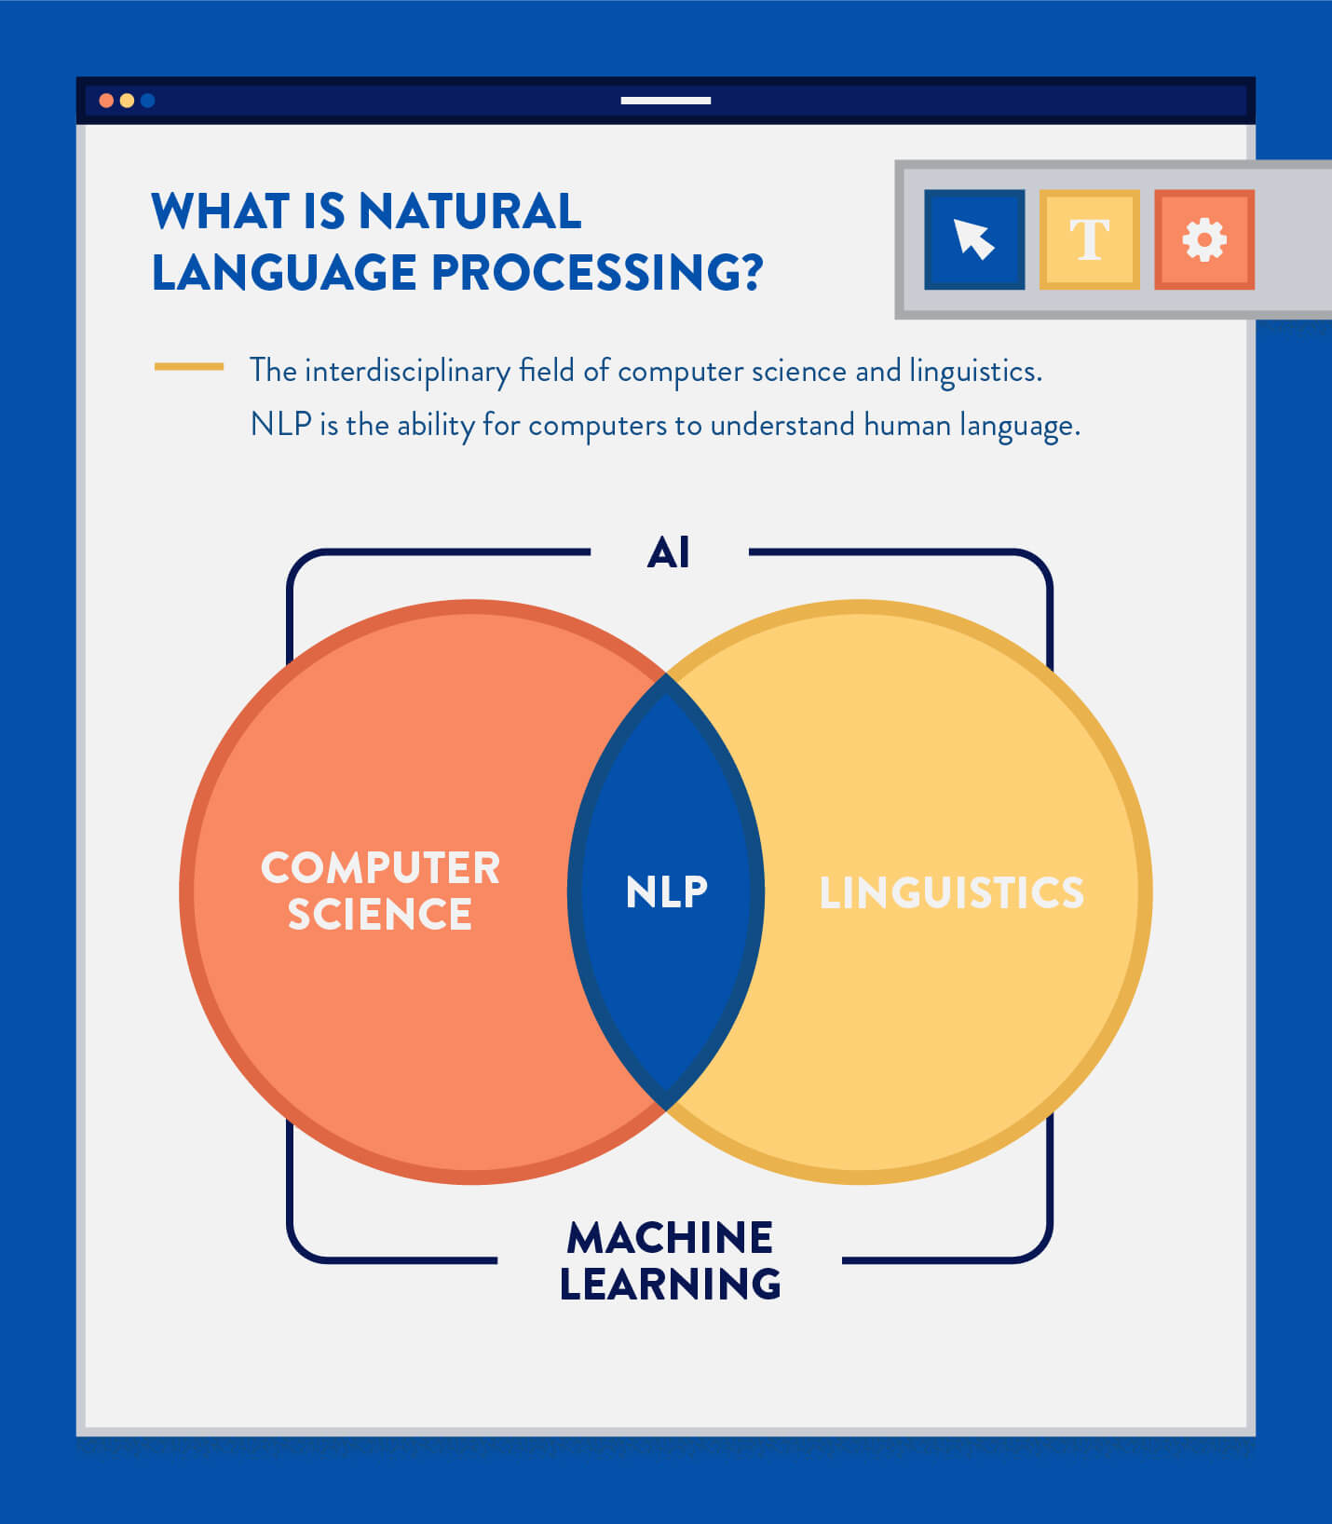

Slide 6

INTELLIGENT SYSTEM
IT IS A TYPE OF COMPUTER PROGRAM THAT HAS BUILT IN INTELLIGENCE WHICH KEEPS A CHECK ON THE WORK PATTERNS, ASKS QUESTIONS AND PERFORMS TASKS ON THE BEHALF OF THE USER.
E.G:-SURFING THE INTERNET.
WHAT HAPPENS WHEN WE SEARCH SOMETHING ON THE INTERNET?
The intelligent agent searches the internet and the available databases for information and compiles the result for you after filtering it based on your previous surfing history.

Slide 7
PATTERN RECOGNITION
This type of software comprises of a camera and software which together identify repetitive patterns and establish connections between the patterns stored in the database and the perceived patterns.
E.G: FACIAL RECOGNITION SOFTWARE, VOICE RECOGNITION AND FINGERPRINT IDENTIFICATION.

Slide 8
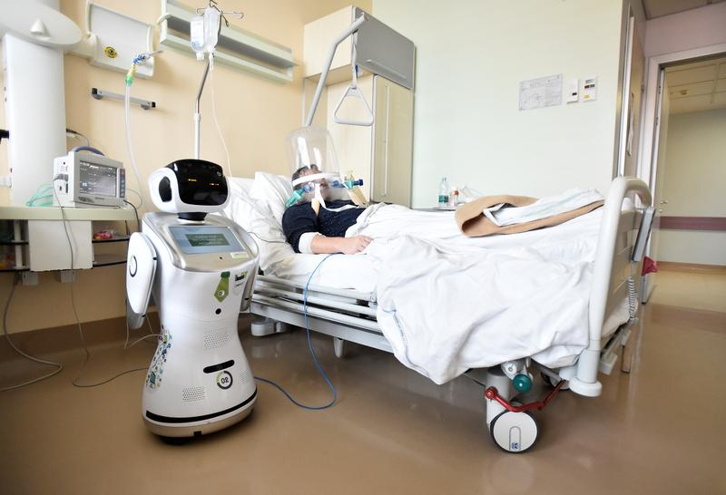
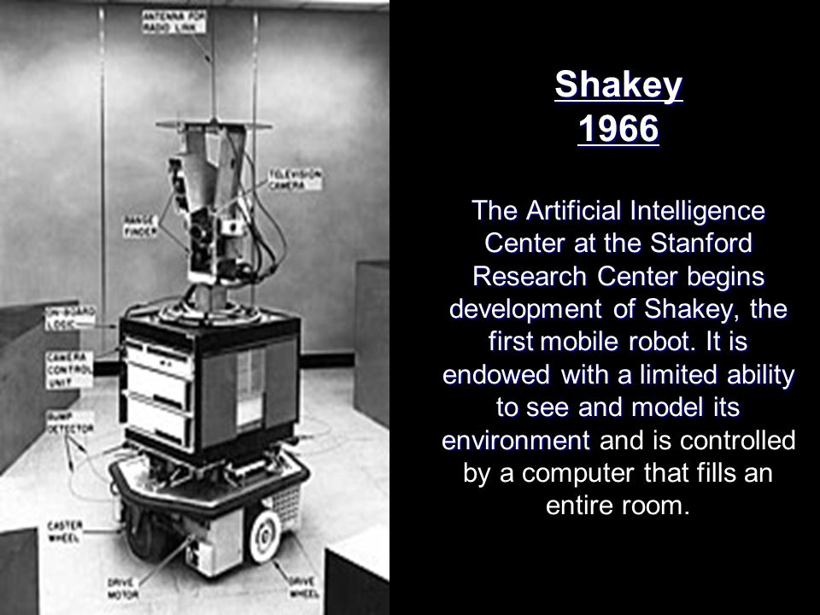
ROBOTICS

Slide 9
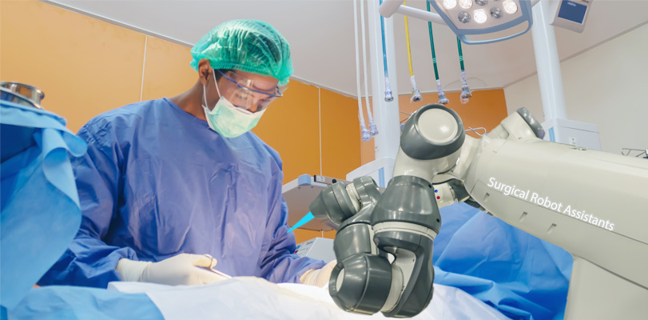
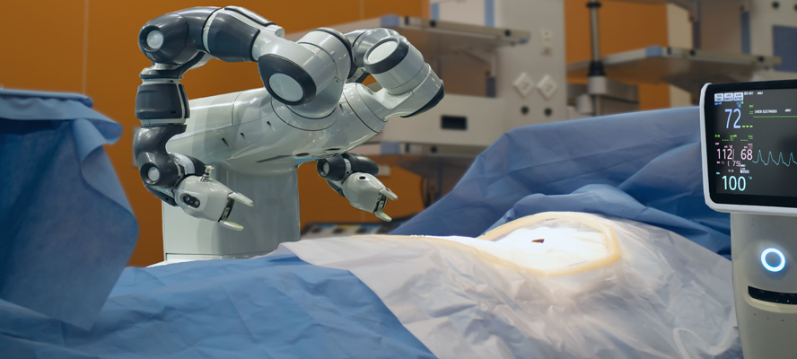

Slide 10
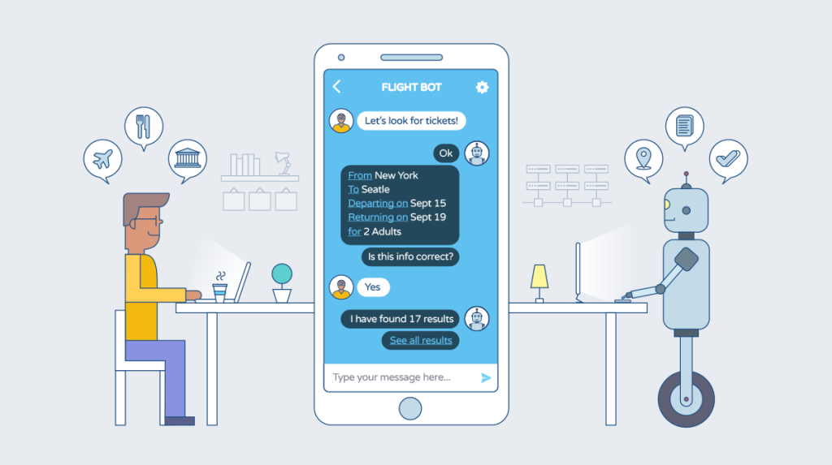
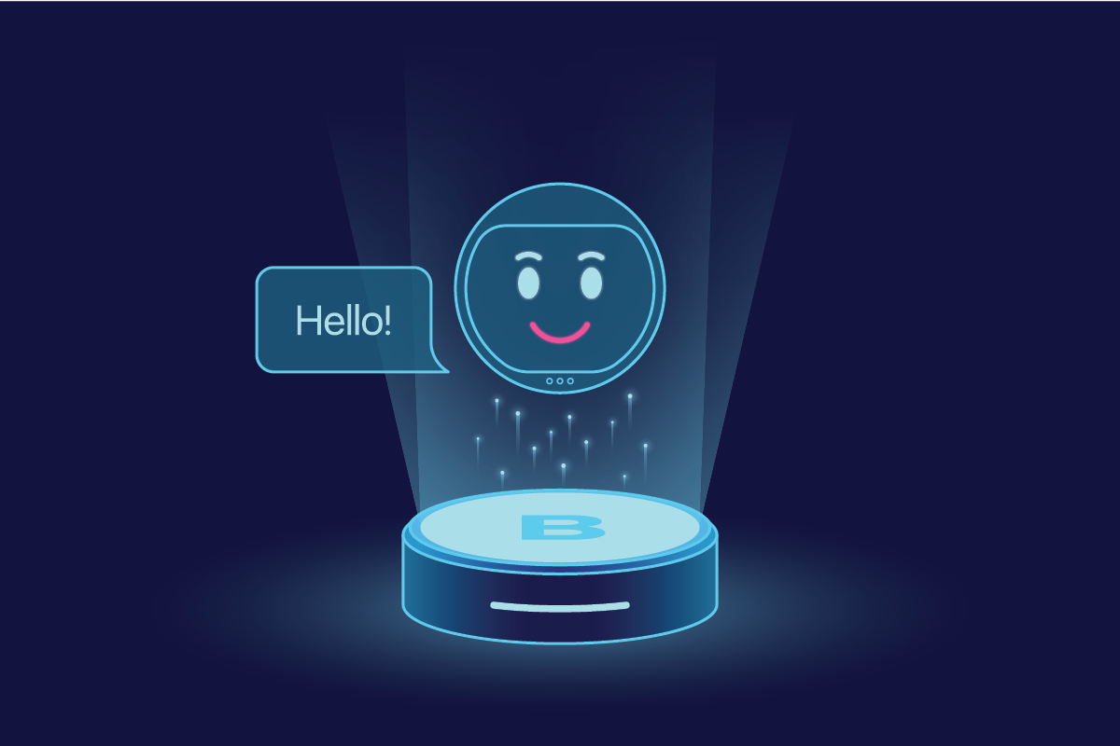
INTELLIGENT APPS(I-APPS)
INTELLIGENT APPS ARE WRITTEN FOR MOBILE DEVICES BASED ON ARTIFICIAL INTELLIGENCE AND MACHINE LEARNING TECHNOLOGY, AIMED AT MAKING EVERYDAY TASKS EASIER.

Slide 11
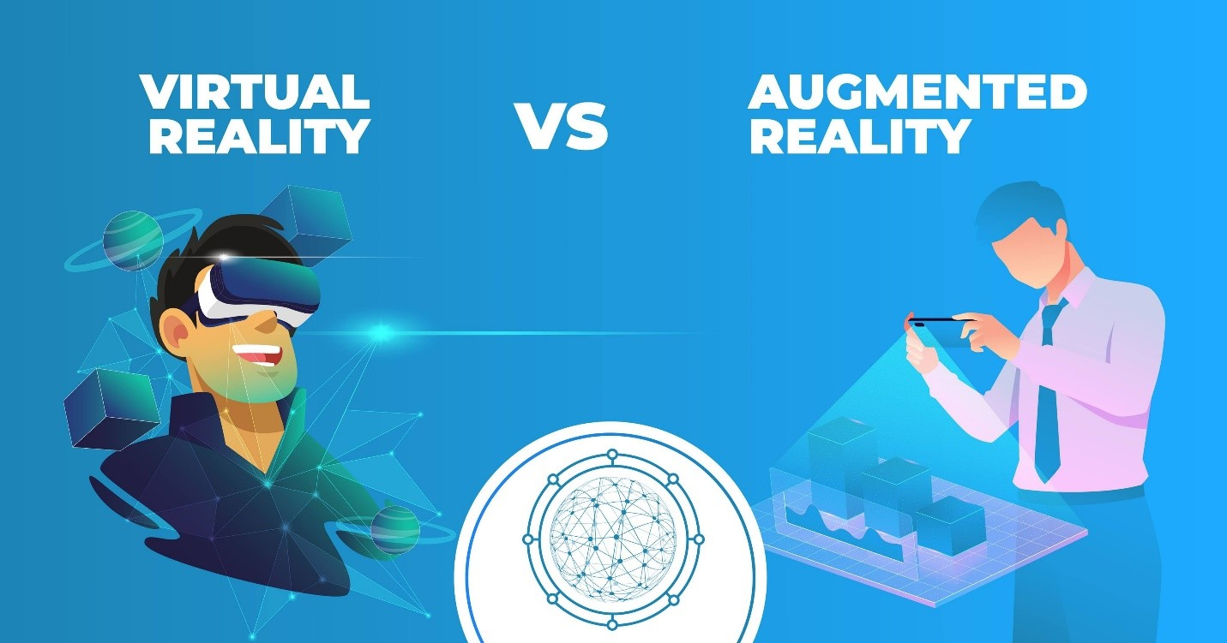

Slide 12
VIRTUAL REALITY
What is Virtual Reality?
The use of computer technology to create a stimulated environment. This is a virtual experience that can be observed, listened to, and interact with but you can't touch.

Slide 13
AUGMENTED REALITY
What is Augmented Reality?
Augmented Reality is an experience where designers enhance parts of users' physical world with computer-generated input.

Slide 14
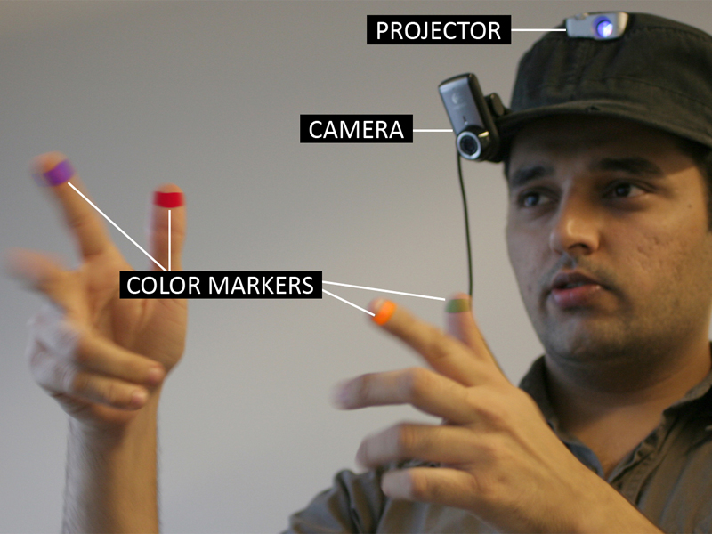
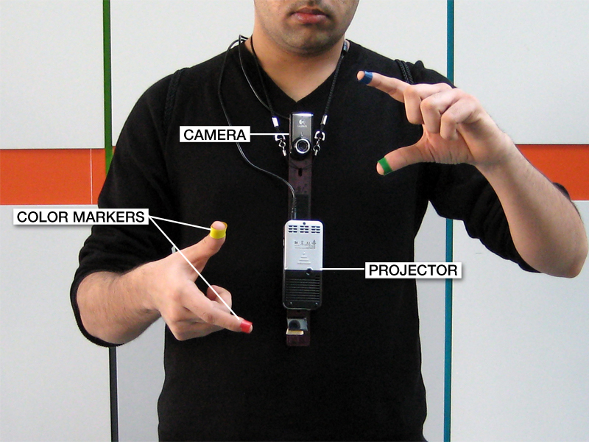
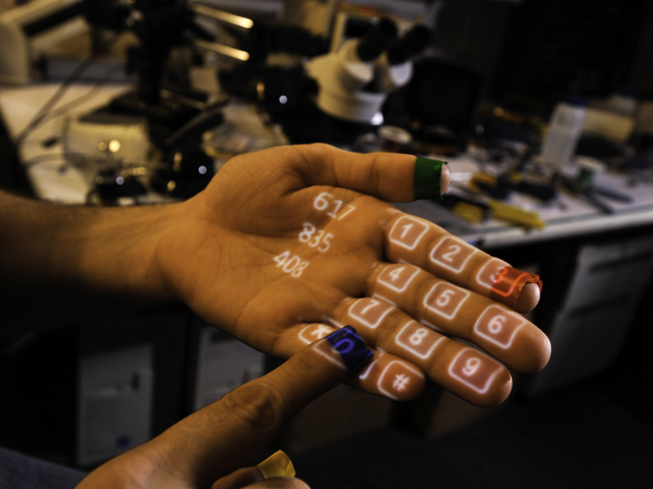
SIXTH SENSE , DEVELOPED BY MASSACHUSETTS INSTITUTE OF TECHNOLOGY IN 2009

Slide 15
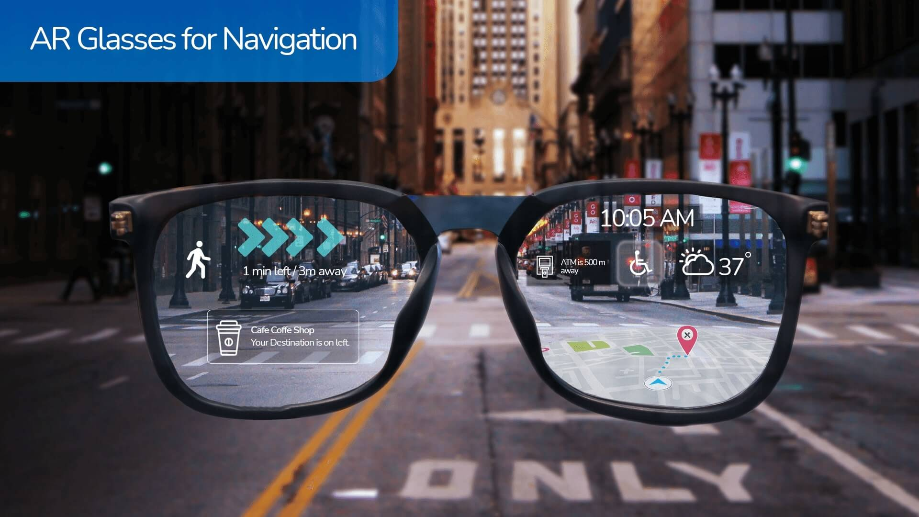

Slide 16
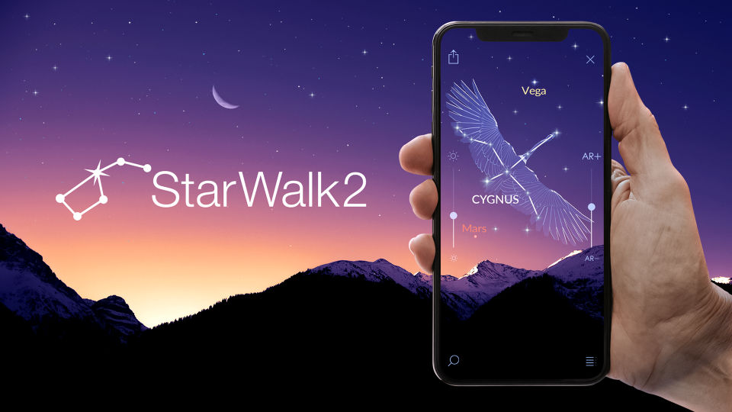

Slide 17
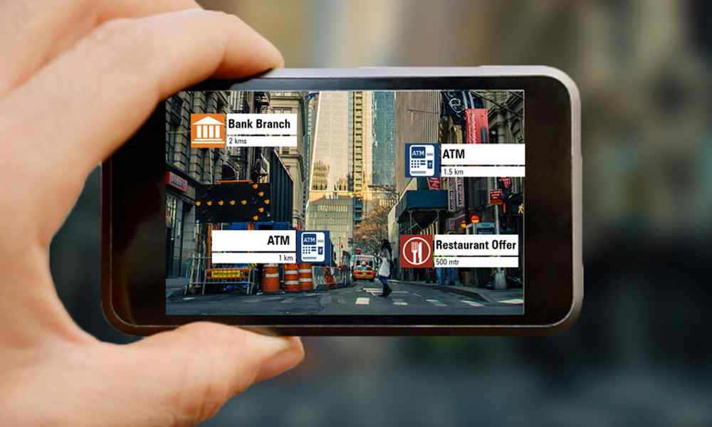
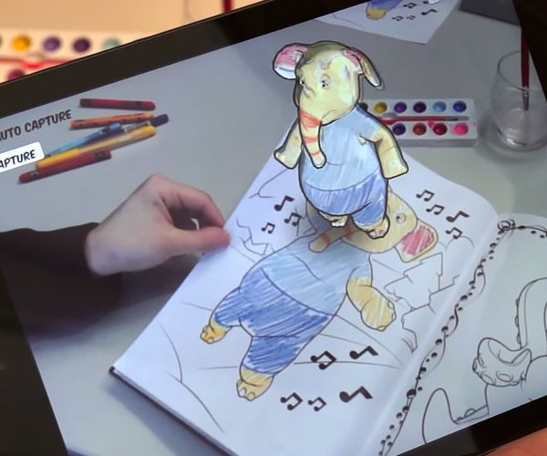
LAYAR
DISNEY COLORING BOOK

Slide 18
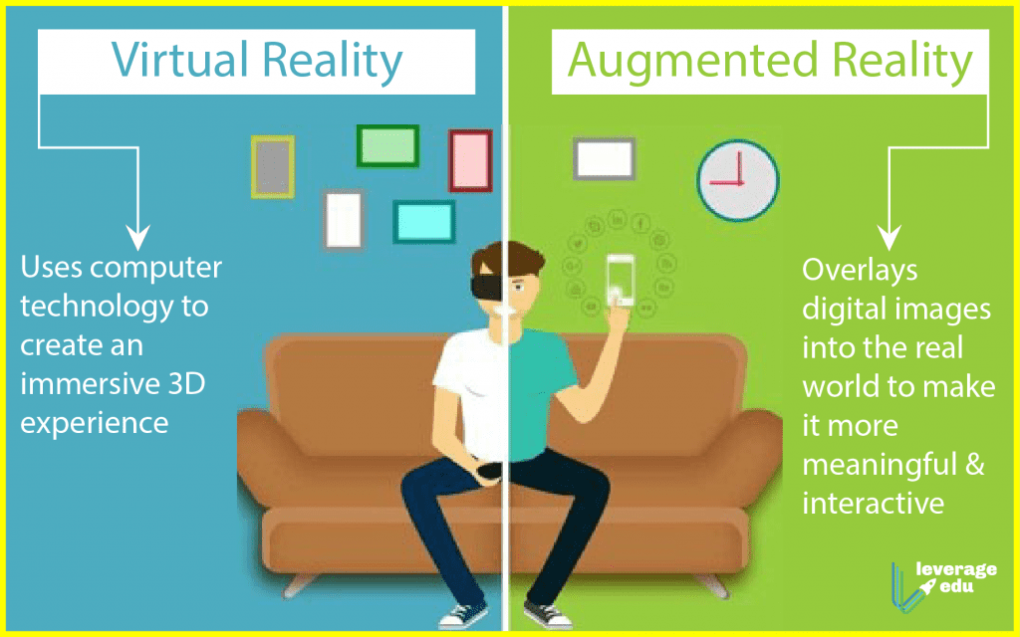

Slide 19
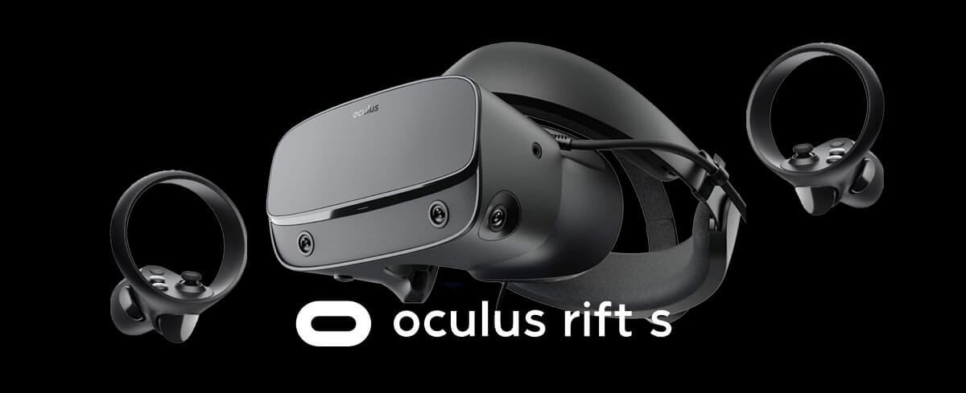
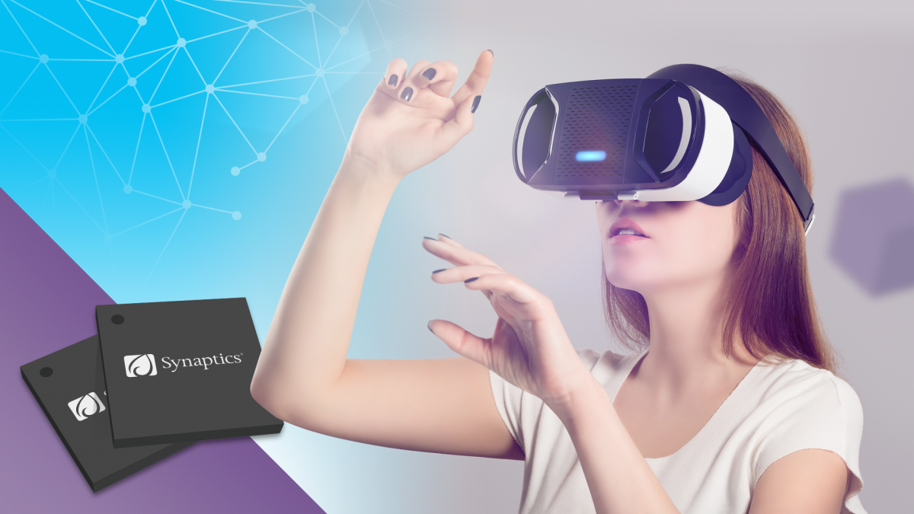

Slide 20
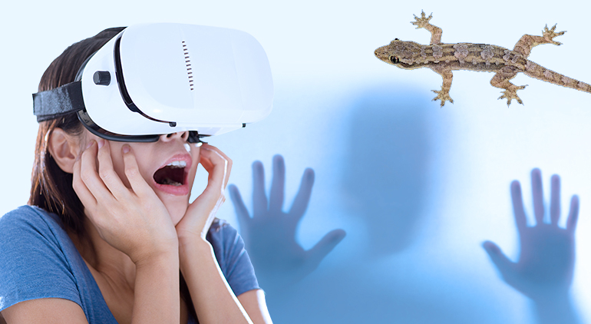
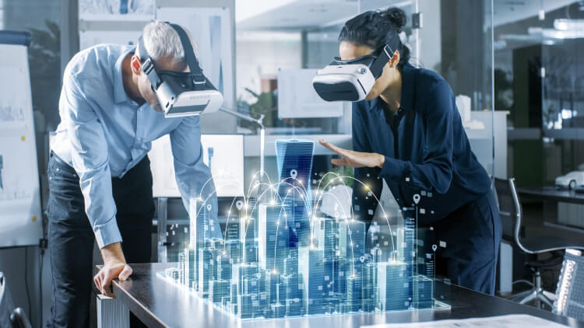
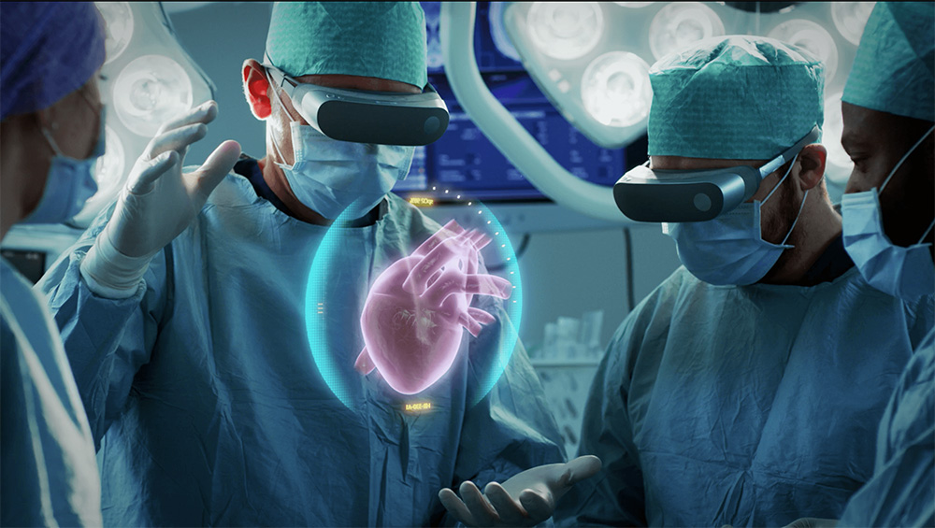

Slide 21
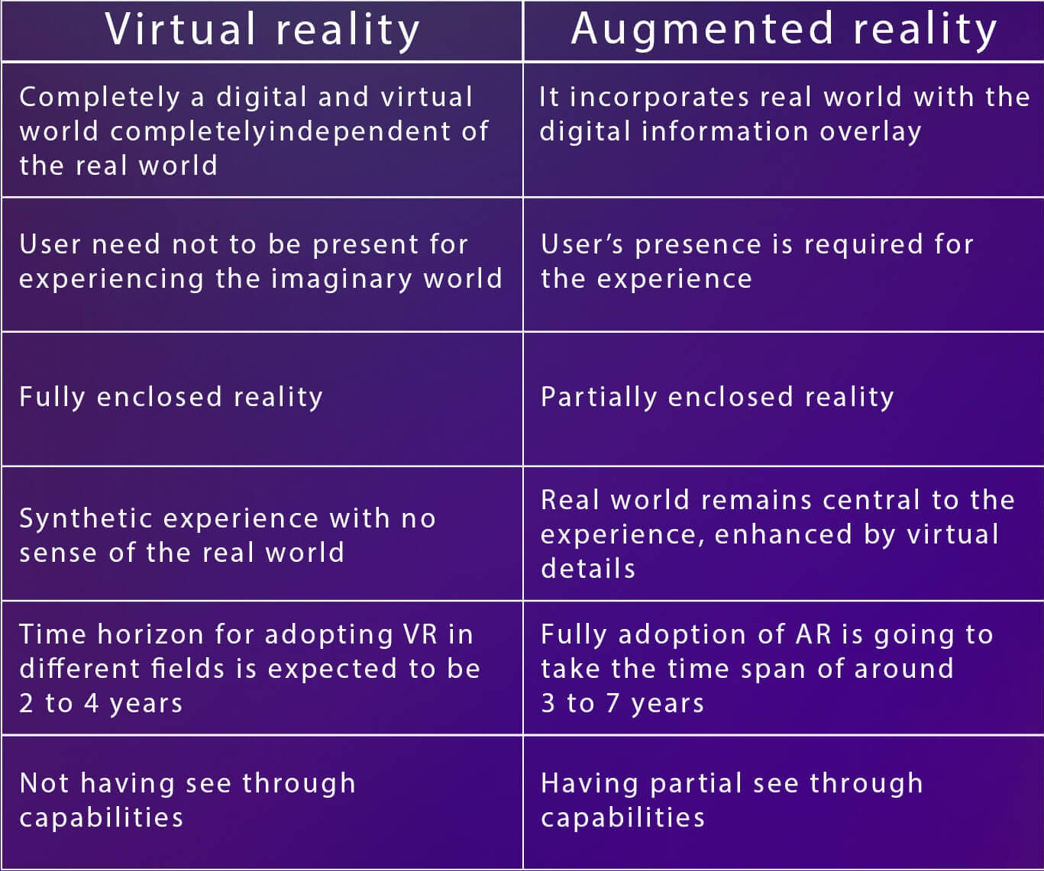

Slide 22
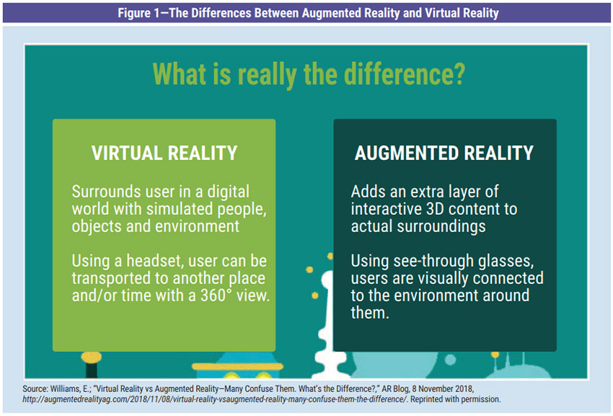

Slide 23
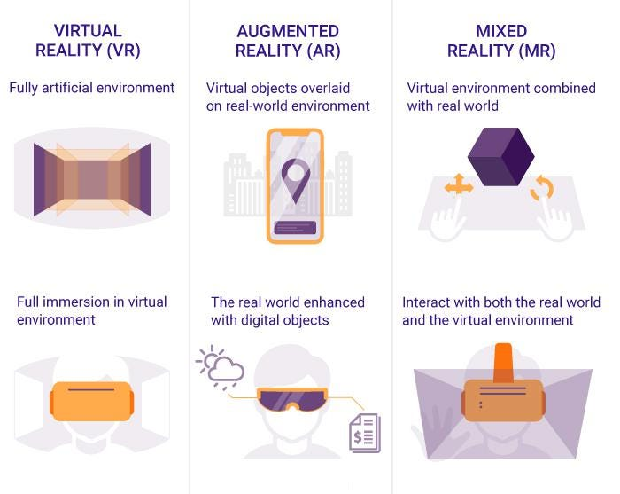

Slide 24
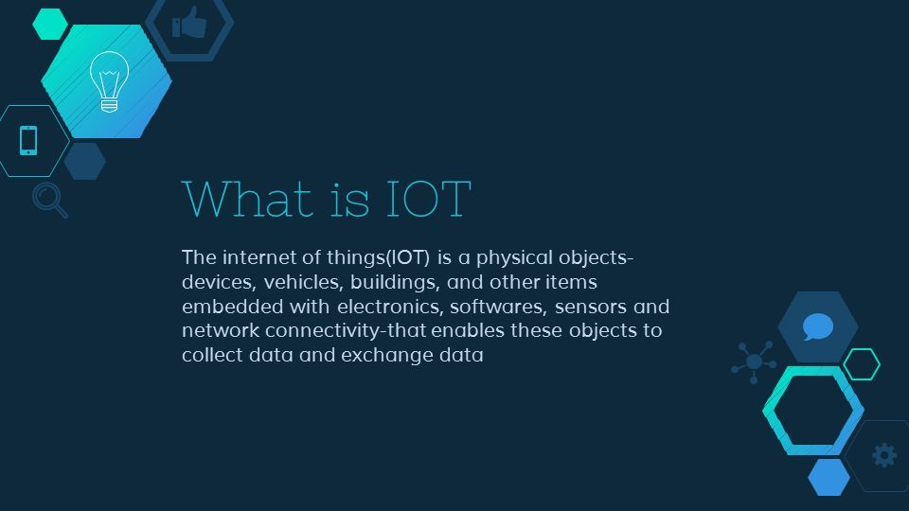

Slide 25
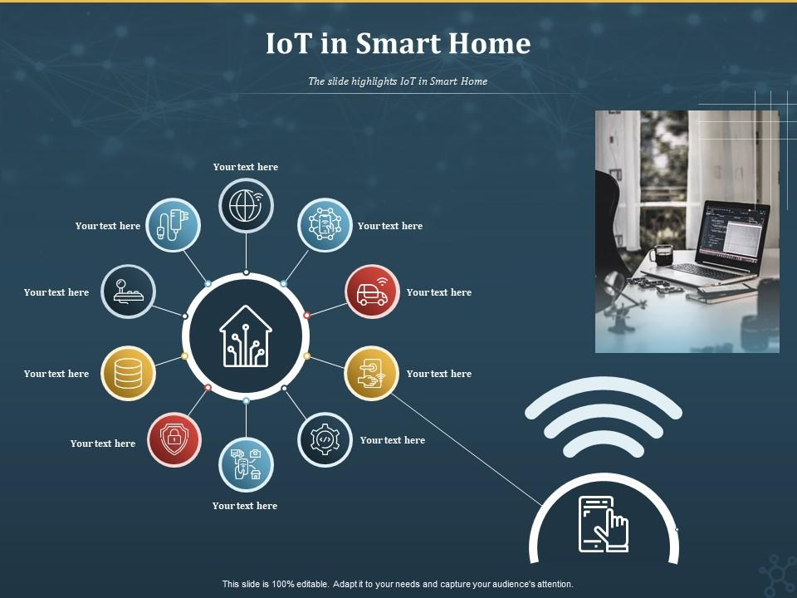

Slide 26

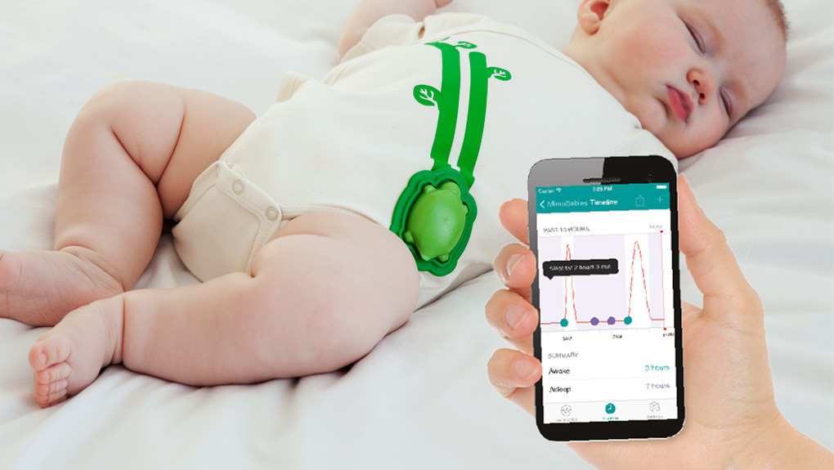

Slide 27
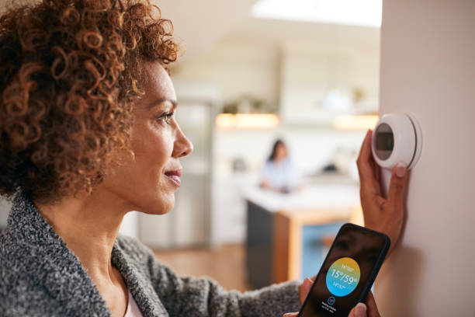

Slide 28
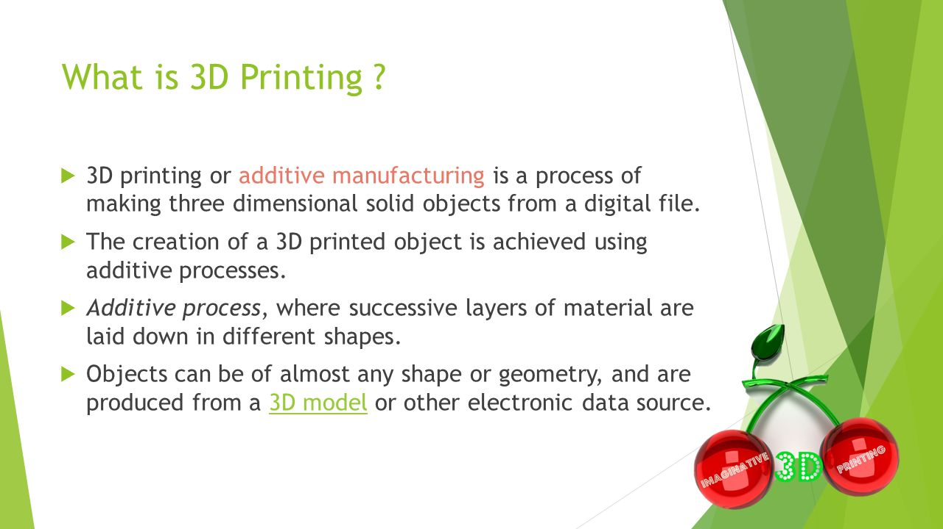

Slide 29
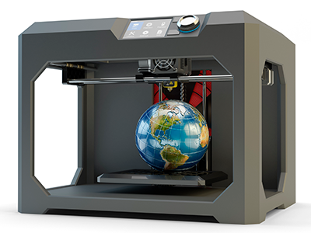
3D PRINTER

Slide 30
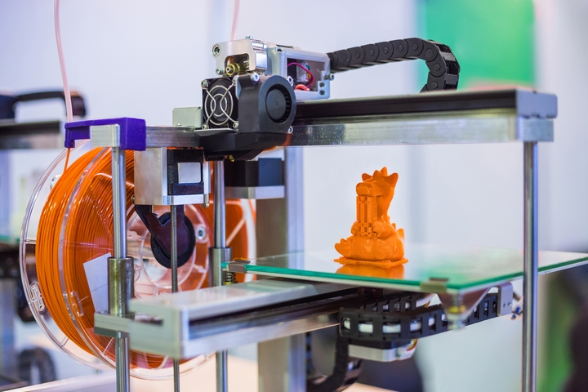
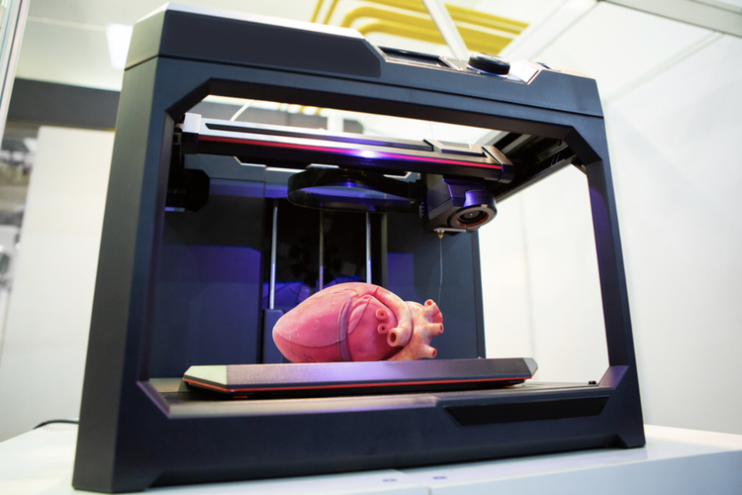

Slide 31
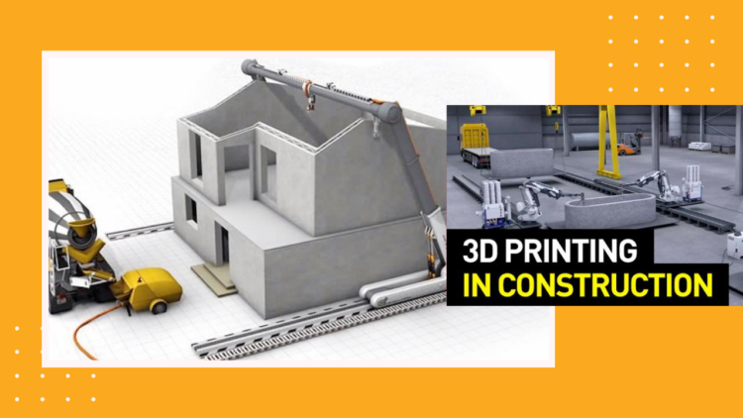
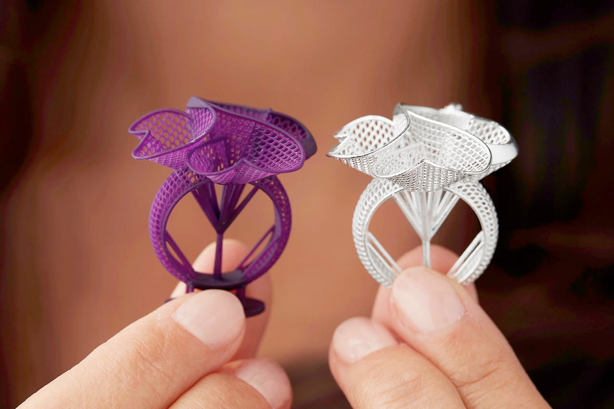

Slide 32
THERE ARE MANY 3D PRINTING METHODS
DIRECT 3D PRINTING
BINDER 3D PRINTING
MULTI-JET MODELLING(MJM)
FUSED DEPOSITION MODELLING
PHOTO POLYMERIZATION

Slide 33
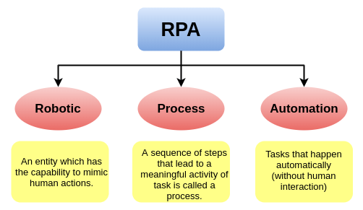

Slide 34
