Slide 1
FIELDS OF AI

Slide 2
FIELDS OF AI
SMARTPHONE INDUSTRY
SOCIAL MEDIA PLATFORMS
BANKING AND FINANCIAL SECTOR
E-COMMERCE
AUTONOMOUS VEHICLES
SECURITY AND SURVEILLANCE
NAVIGATION
AUTONOMOUS DRONES
HEALTHCARE
EDUCATION

Slide 3

1) SIRI ( VIRTUAL ASSISTANT AVAILABLE WITH iphone,ipad and AirPod)
AI IN APPS

Slide 4

2) Alexa voice-enabled virtual assistant from Amazon
Ai IN APPS

Slide 5
3) Grammarly
(AI powered writing assistant )
AI IN APPS

Slide 6
4) Google assistant
Launched in 2016 , voice enabled AI-powered virtual assistant that supports both voice and text entries
Ai IN APPS

Slide 7
5) ELSA speech recognition technology to help to learn english
AI IN APPS

Slide 8
6) SOCRATIC help students with their homework.
Ai IN APPS

Slide 9
7) FYLE expense management app
AI IN APPS

Slide 10
8) Youper
AI powered mental health assistant app.
Ai IN APPS

Slide 11
SMART HOME
A smart home refers to a convenient home setup where appliances and devices can be controlled remotely from anywhere with an internet connection using a mobile or other networked device.
e.g: smart hub,video doorbell,smart camera,smart smoke detector,smart light,smart speaker

Slide 12
Smart home
Pros
Enhanced security
Energy efficient
One point access
Flexibility
Remote control
Cons
Expensive
Vulnerable to hackers

Slide 13
SMART CITY
A smart city is an urban area that uses digital technologies to enrich residents’ lives, improve infrastructure, modernize government service, and accelerate economic development.

Slide 14
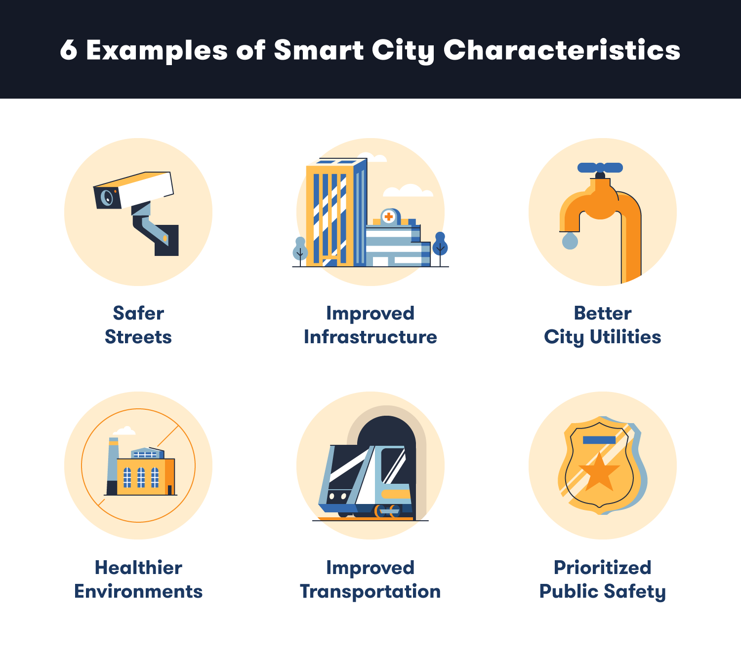

Slide 15
challenges
Financial challenges due to lack of funds
Growing population
Digital security issues
High speed internet facility
Lack of digital awareness
Difficulty in implementing government policies

Slide 16
thank you

