Slide 1
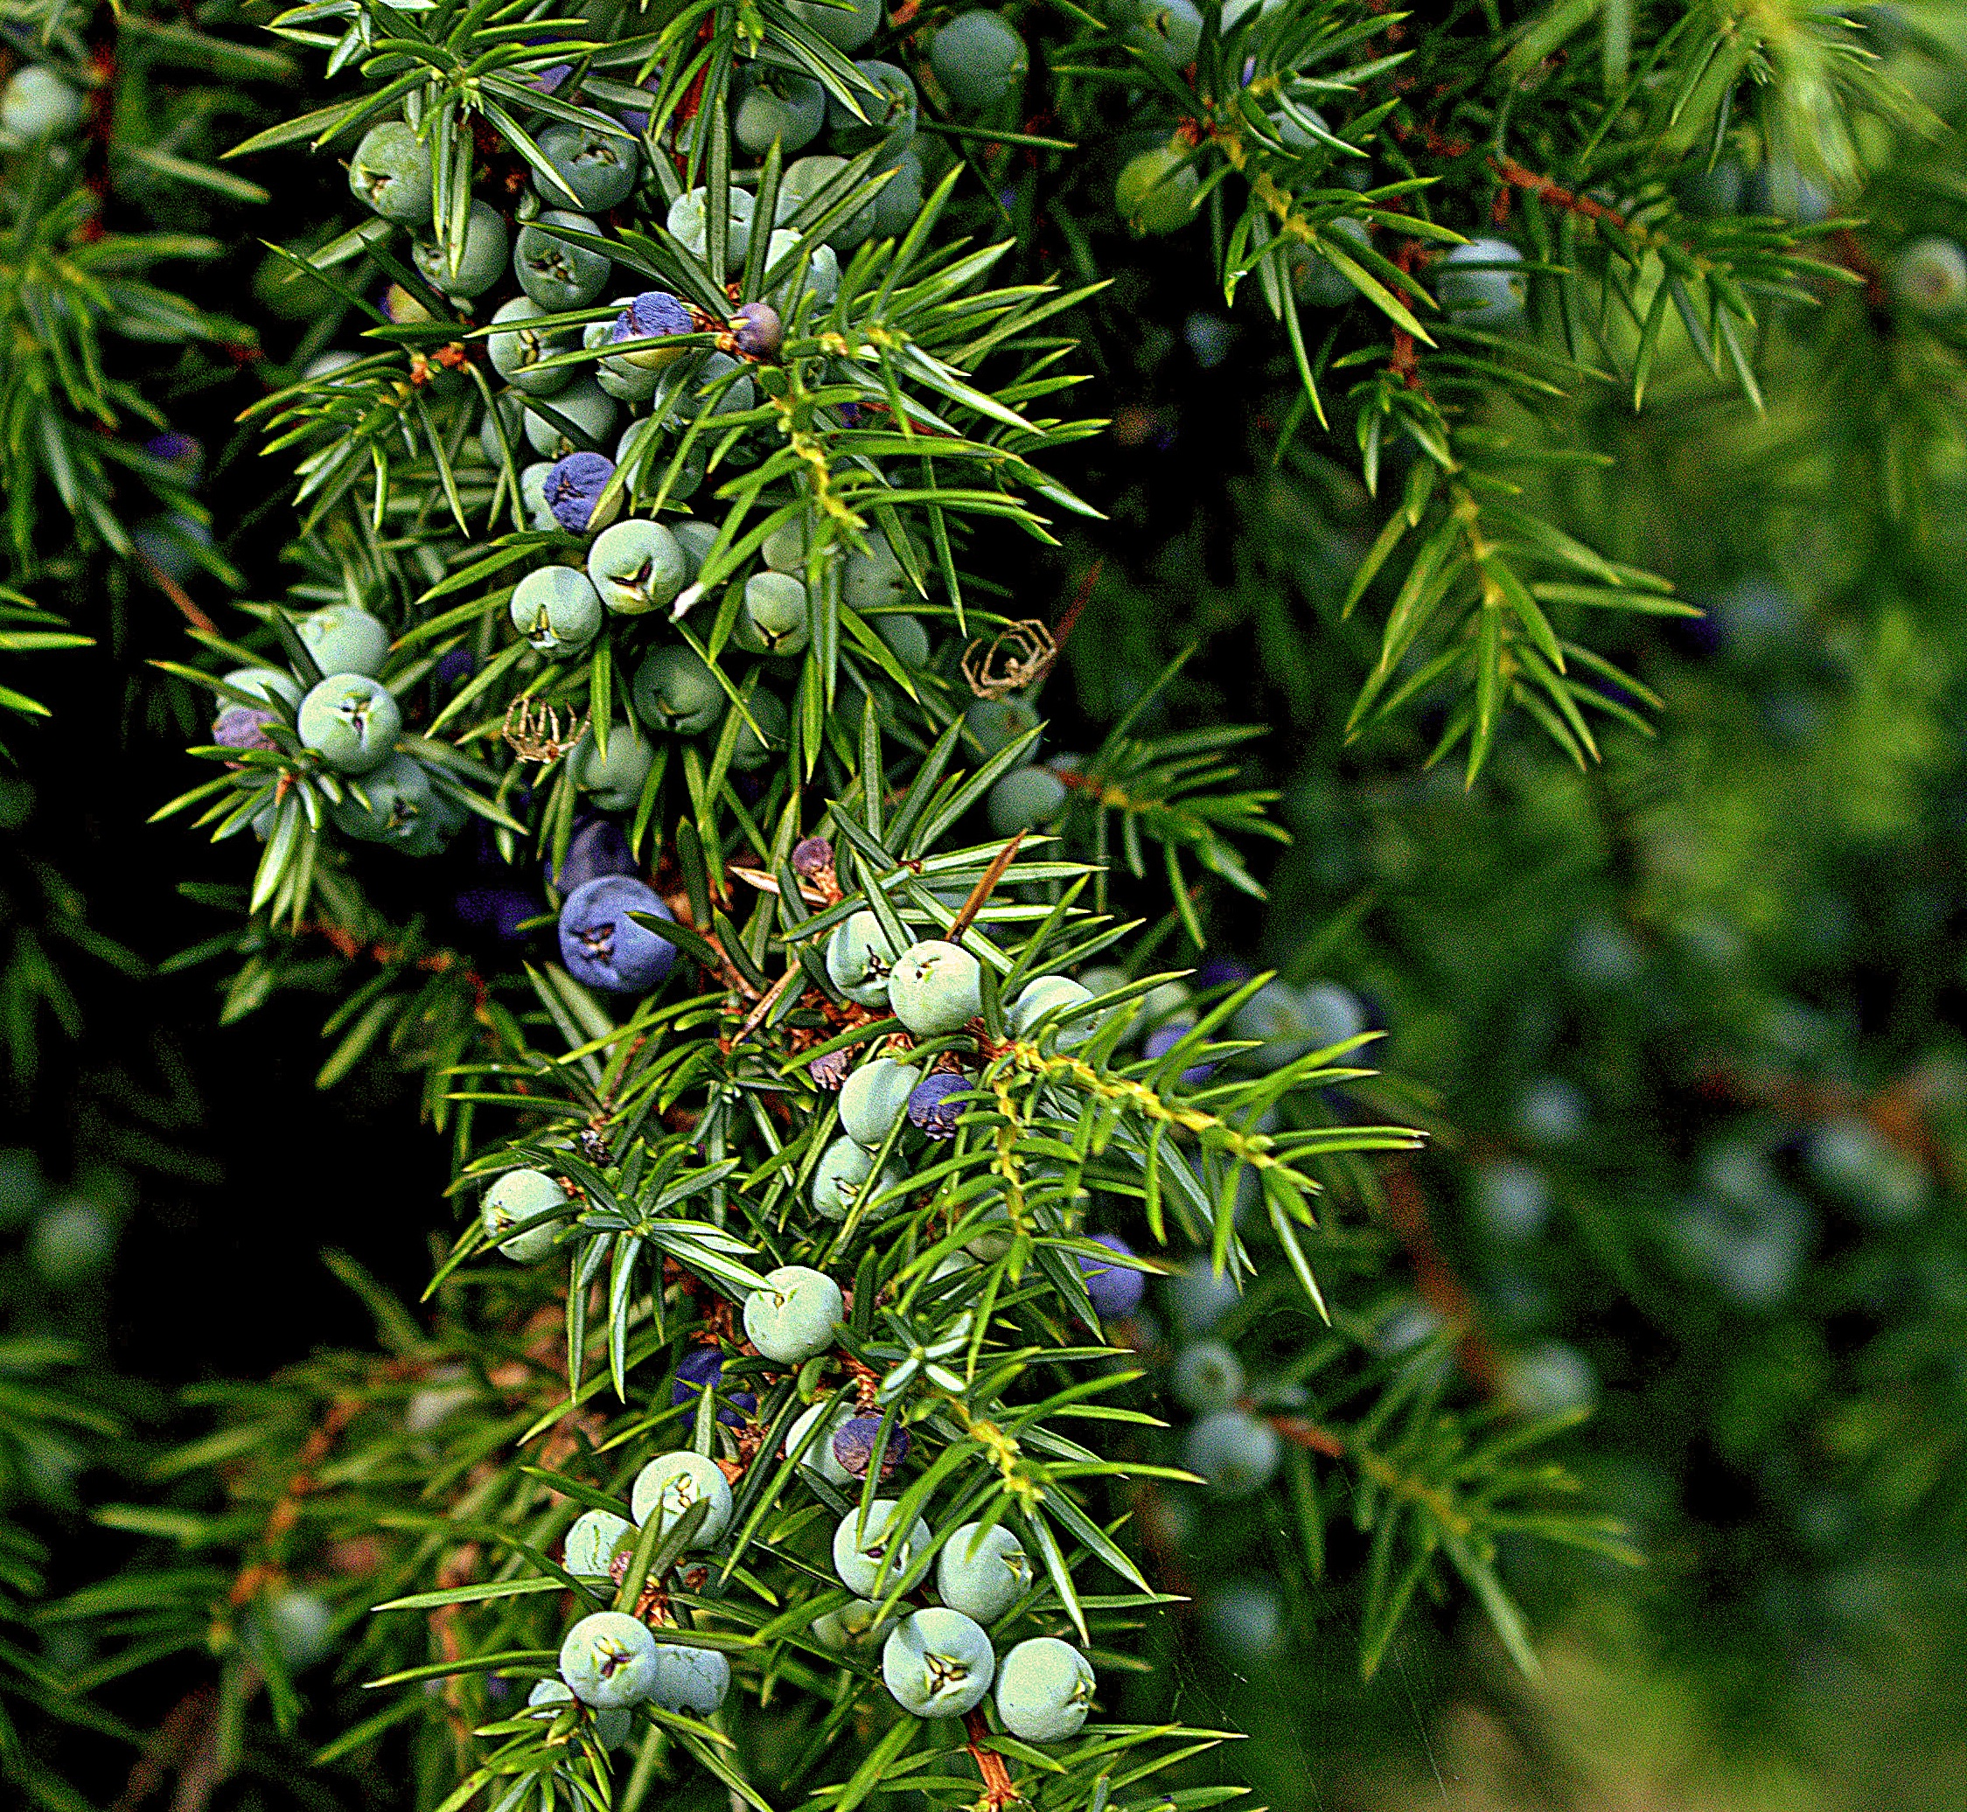

GOOD AFTERNOON, EVERYONE
OUR TOPIC OF THE DAY IS
GYMNOSPERMS

Slide 2
CONTENTS TO LEARN IN THIS TOPIC
What is gymnosperms?
ABOUT GYMNOSPERMS CONSTITUENTS WITH EXAMPLES
ECONOMIC USE OF GYMNOSPERMS*
REPRODUCTION POSSESS BY GYMNOSPERMS.
LIFE CYCLE OF GYMNOSPERMS

Slide 3
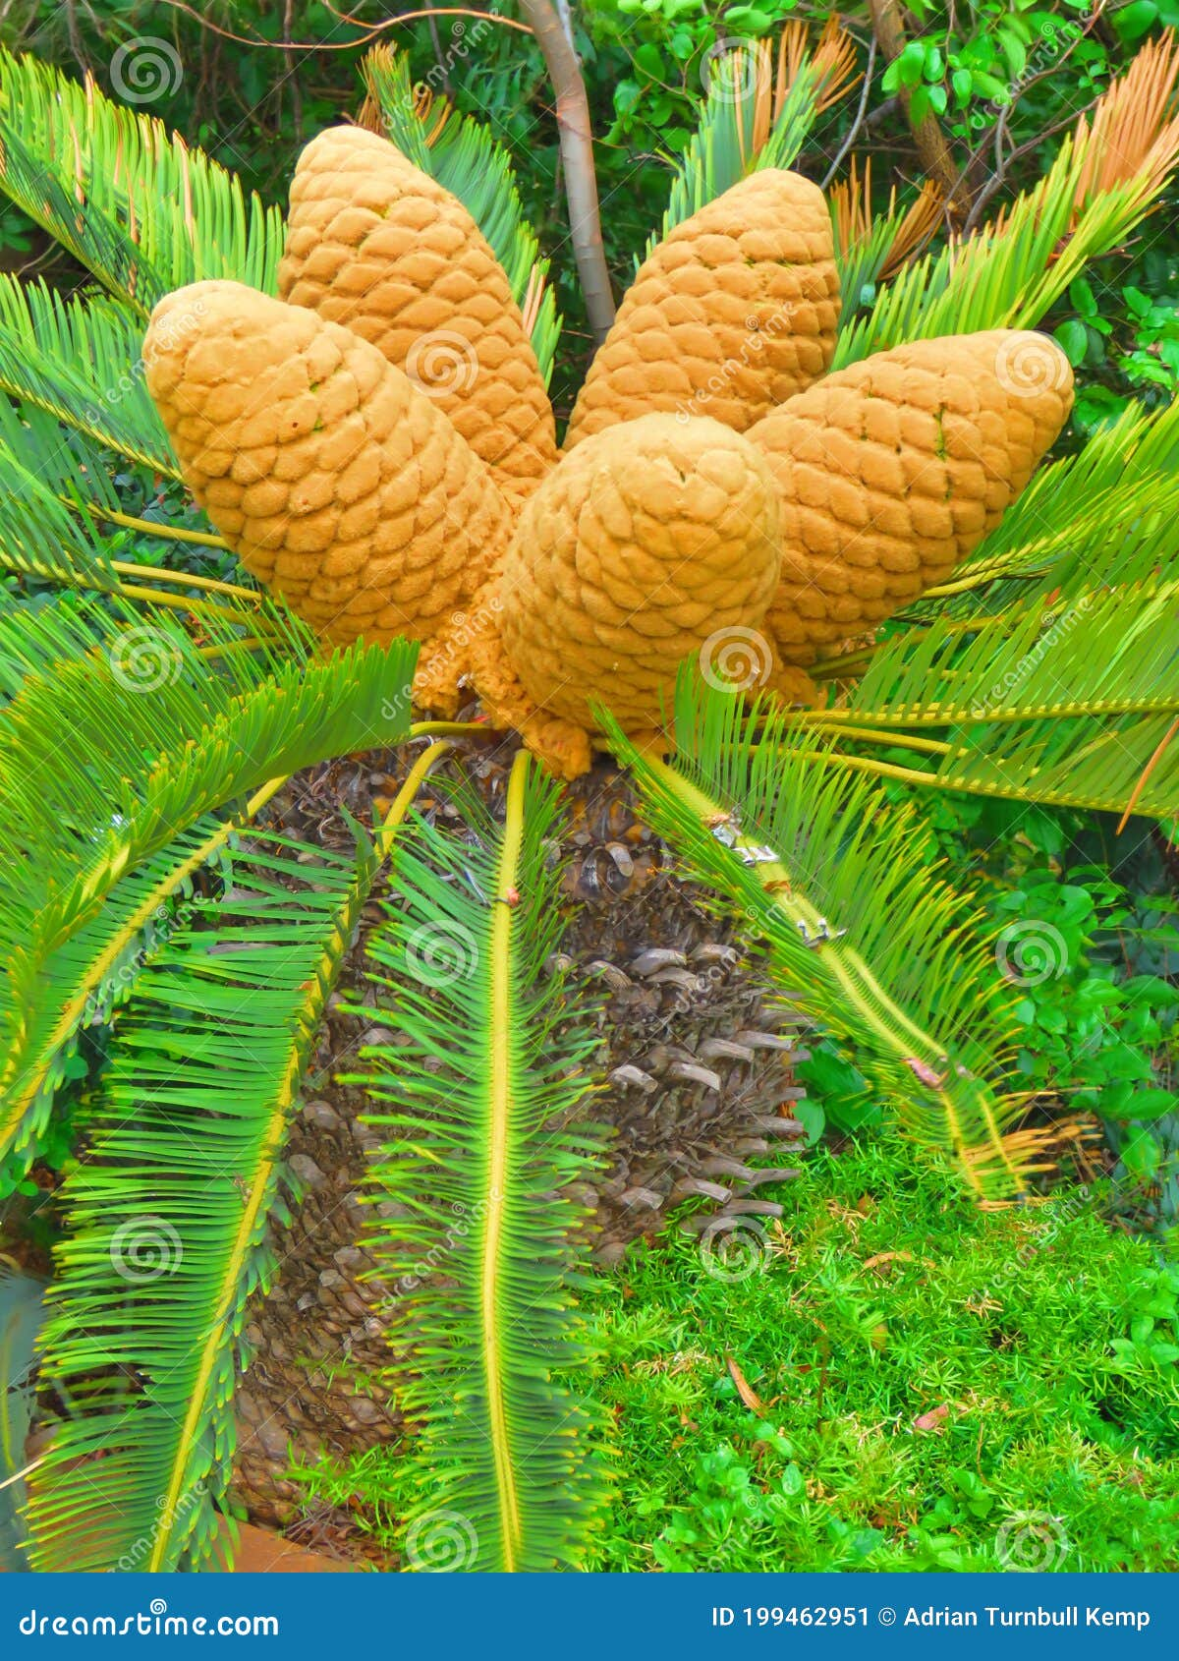
What is gymnosperms?
Gymnosperms comes from the word Gymnos which means NAKED and Sperma which means SEEDS.
This refers to one of the characteristics that after undergoing post-fertilization, they are not covered by seeds and are thus naked.
Cycus

Slide 4
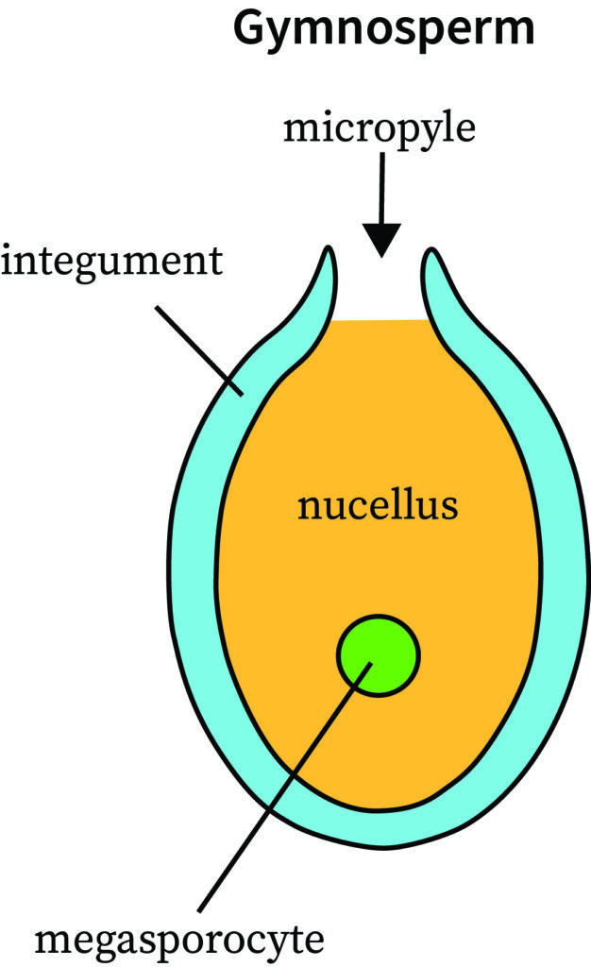
OVULE OF A GYMNOSPERM
Ovules of a Gymnosperm are not enclosed by ovary wall and always remain exposed even before and after fertlization
Opening if an ovule allowing pollen to reach the female gametophyte called endosperm
Protective layer of Gymnosperms
Single mother cell which undergoes meiosis(Reductional division) to produce Megaspores

Slide 5


Pal, I have a question:- Is Megasporocyte is haploid or diploid?
Hehe Mickey, Megasporocyte is DIPLOID.
Reason: It is a sporophytic cell formed through regular cell divison meiosis

Slide 6
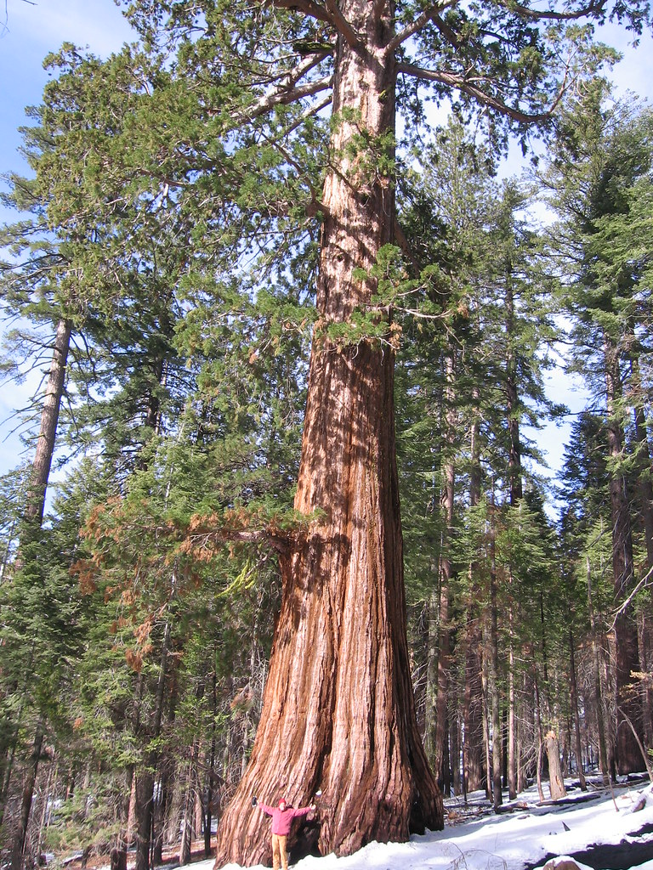
ABOUT GYMNOSPERMS WITH EXAMPLES
SEQUOIA
Includes medium sized tress or tall tress and shrubs
For example -> Sequoia

Slide 7
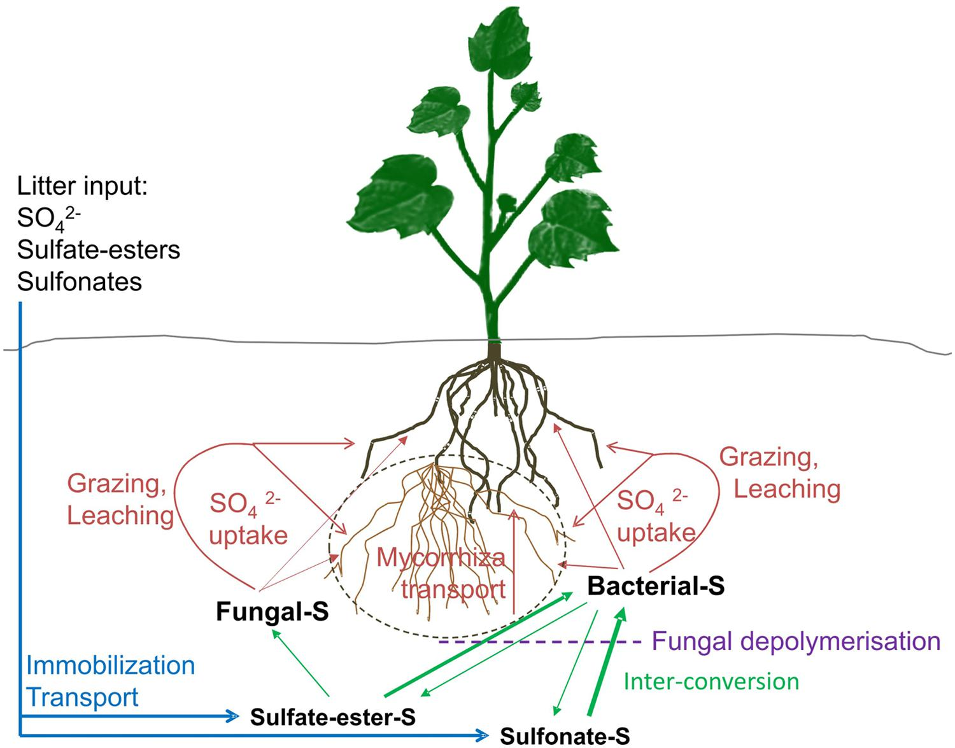
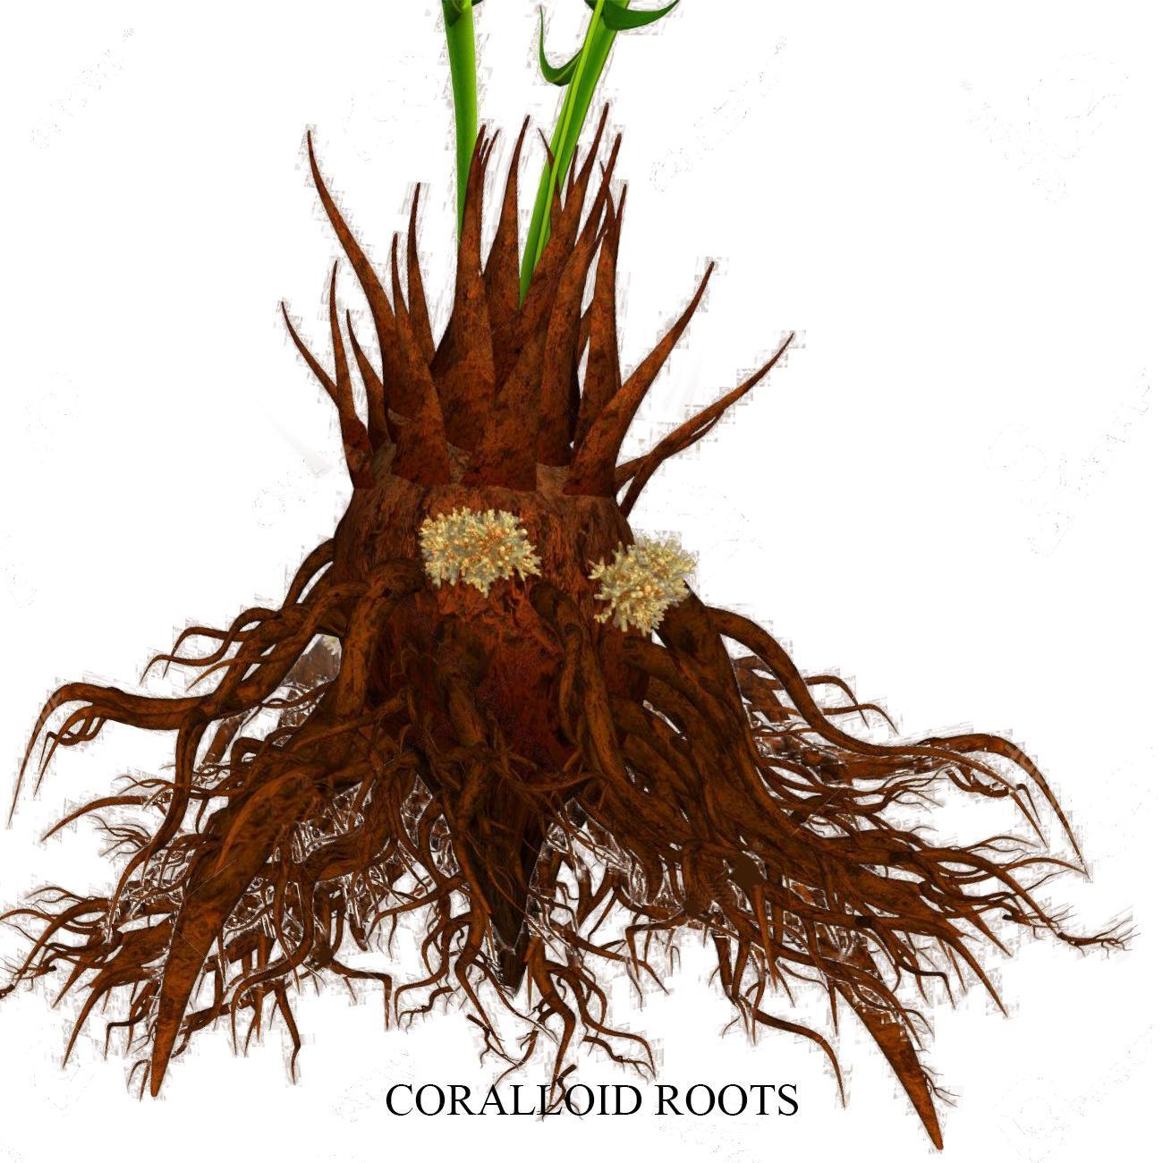
ROOTS ARE GENERALLY TAP ROOTS
Associated with N2 fixing cyanobacteria
Pinus Roots in association with Mycorrhiza

Slide 8
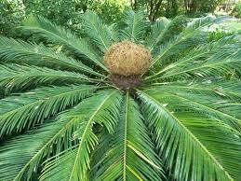
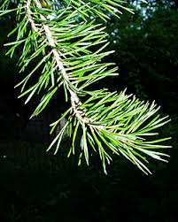
Overall characteristics
CUTICLE IS WAXY PROTECTIVE LAYER COVERING THE OUTER SURFACE OF LEAVES AND STEMS
Serves as barrier which prevents water loss and protect against pests and UV Radiation
Stems are unbranched like Cycas or branched like Pinus and Cedrus
Simple or compound leaves are adapted to survive extreme climatic conditions
Cycas pinnate leaves persist for a few years
Pinus needle leaves helps in surface area reduction and thick cuticle and sunken stomata also help in reducing water loss

Slide 9
ECONOMIC USES OF GYMNOSPERMS
Provides Timber
Paper Pulp
Resins
Edible Pine Nuts
Essential Oils for medicine and perfumes

Slide 10
REPRODUCTION POSSESS BY GYMNOSPERMS.
They are Heterosporous
Produces both microspores and megaspores.
Modification of leaves into sporophylls.
Compactly and spirally around an axis to form strobili or cones.
FEMALE STROBILI
MALE STROBILI

Slide 11
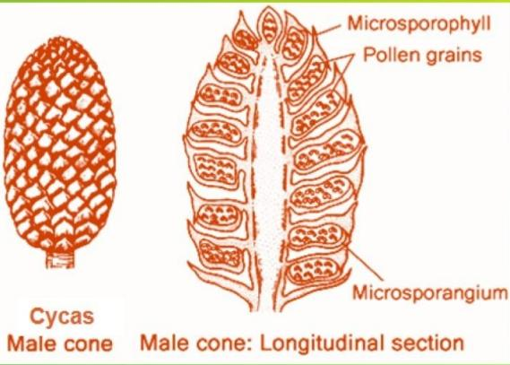
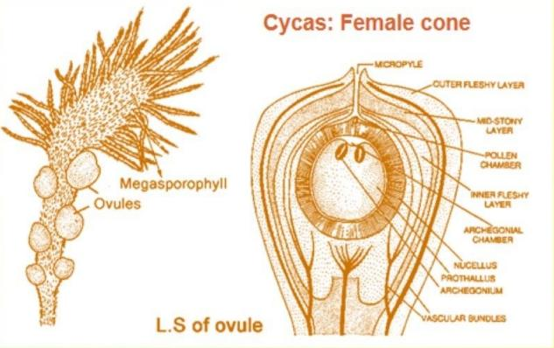
STROBILIS
MALE
FEMALE
MICROSPOROPHYLLS
MEGASPOROPHYLLS

Slide 12
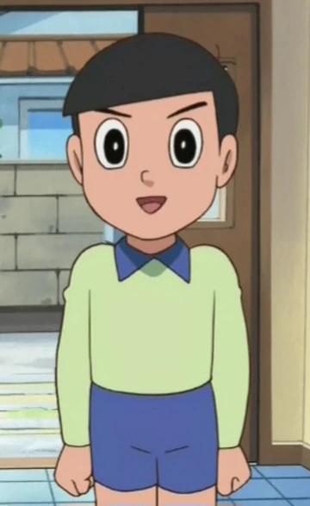
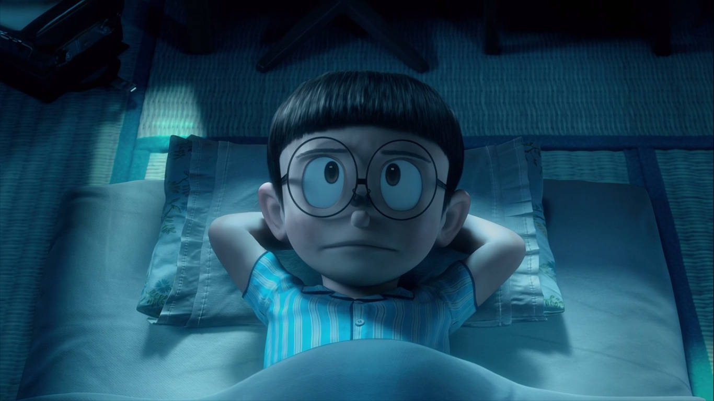
MICROSPOROPHYLL AND MEGASPOROPHYLL
WHICH ONE IS DIPLOID AND WHICH IS HAPLOID?
Nobita, both are diploid(2n) structures
REASON:
They are modified leaves of the sporophyte which is main plant body. While they may produce haploid(n) spores through meiosis, the “phyll” or leaf tissue itself remains part of the diploid generation.

Slide 13
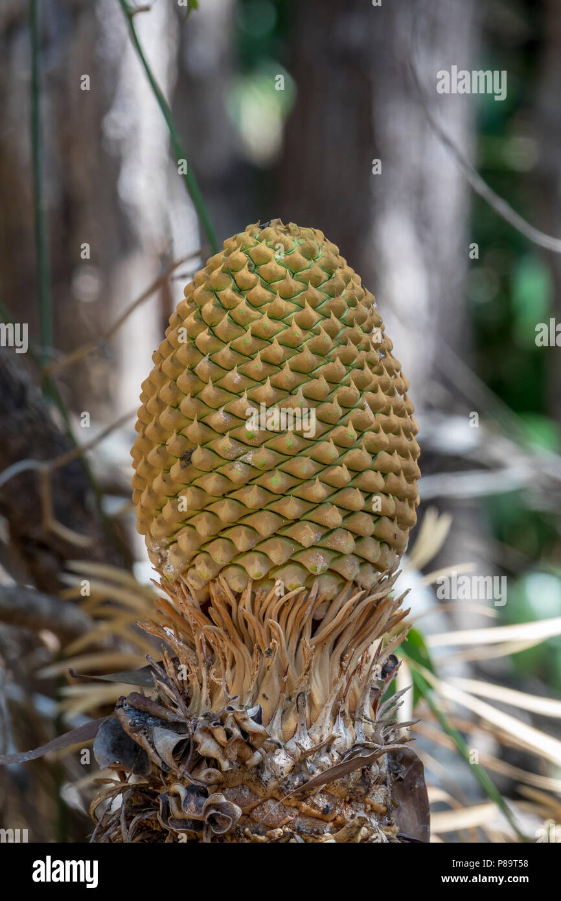
MICROSPOROPHYLLS
Arranged to male strobili which is microsporangiate.
Bears microsporangia.
Develops into male gametophytes and highly reduced and
Confined to only limited umber of cells. The gametophyte is
Pollen grain
Pollen grains are developed within the microsporangia.

Slide 14
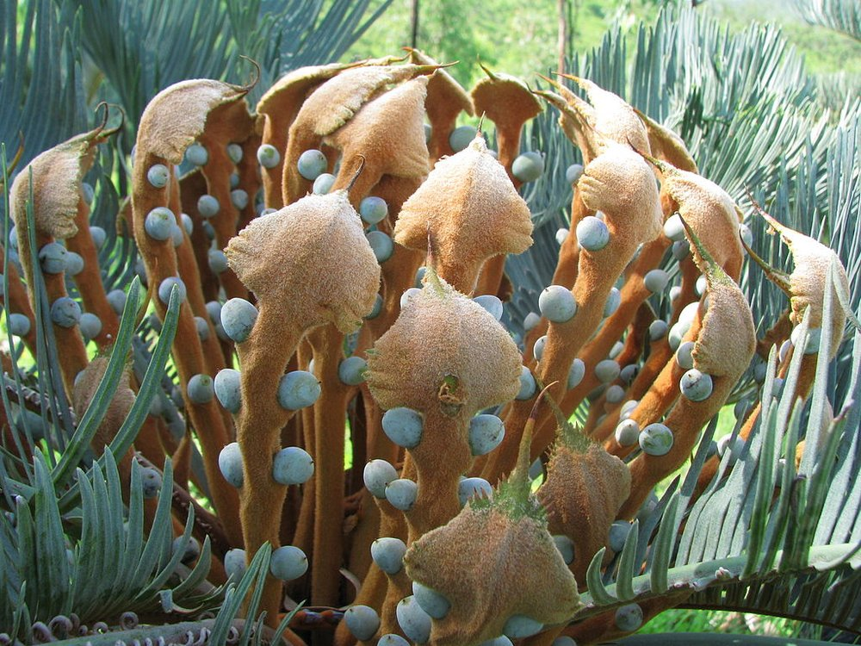
MEGASPOROPHYLLS
Arranged to female strobili called the macrosporangiate.
Bears megasporangia which are ovules.
Mainly consists of body called nucellus which is protected by envelops
Megaspore mother cell is differentiated from a cell of the nucellus.
The mother cell undergoes meiosis to form megaspores.
One of the ,megaspores enclosed within the Megasporangium(nucellus) develops into a multicellular female gametophyte bearing two or more archegonia.
Multicellular female gametophyte is also retained within megasporangium.

Slide 15
TRIVIA TIME
Do you know unlike Bryophytes and Pteridophytes, in gymnosperms the male and the female gametophytes don’t have independent free-living existence.
They remain within the sporangia which is retained on the sporophytes

Slide 16
LIFE CYCLE OF GYMNOSPERMS FLOW CHART
Pollen grain released from the microsporangium carried through air currents meets the ovule openings
After fertlization, zygote develops into an embryo and the ovules into the seeds
Pollen tubes carrying the male gametes tend to gametes grows towars archegonia in the ovules and discharges their contents near archegonia opening.

Slide 17
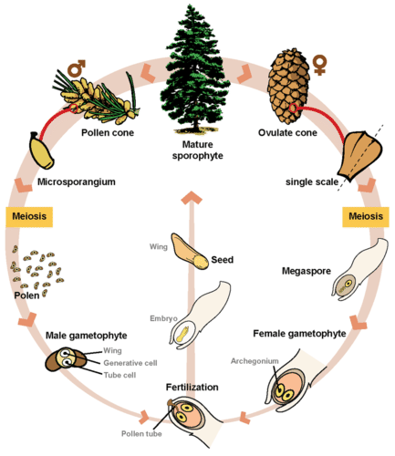
SCHEMATIC DIAGRAM OF THE GYMNOSPERMS

Slide 18
PRESENTATION BY:-
DEBRAJ SAHA
RAJ BARMAN
SOHAM NARAYAN CHOUDHURY
THANK YOU

