Slide 1
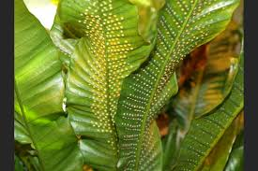

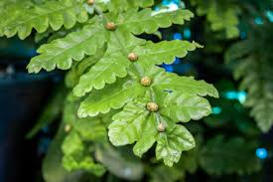
AN INTRODUCNTION TO SEEDLESS VASCULAR PLANTS
PTERIDOPHYTE

Slide 2
Basis of Classification
Habitat
Economic Importance
Vascular Tissue
Main Body
Life cycle of pteridophyte
Classification of pteridophyte

Slide 3
Habitat and Economic Significance
Introduction to Pteridophytes
“Found in cool ,damp and shady places; however some species are known to flourish well in sandy soil conditions”
“Medicinal-traditional remedies”
“Soil binder- erosion control “
“Ornamental -graden plantS”

Slide 4
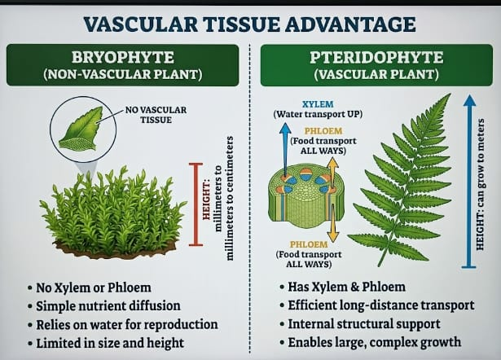
Vascular tissue
First terrestrial plant : The earliest plant to develop with xylem and phloem
Efficient transport: Transport water minerals and food
Structural support: Enable larger growth
Land dominance :Improved land colonization

Slide 5
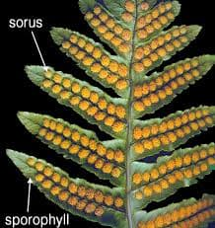
Main plant body : Sporophyte
The dominant phase is the sporophyte (2n)
Differentiated into true roots ,stem and leaves
Unlike bryophytes ,the sporophyte has independent growth
Leaves bearing sporangia are called sporophylls

Slide 6
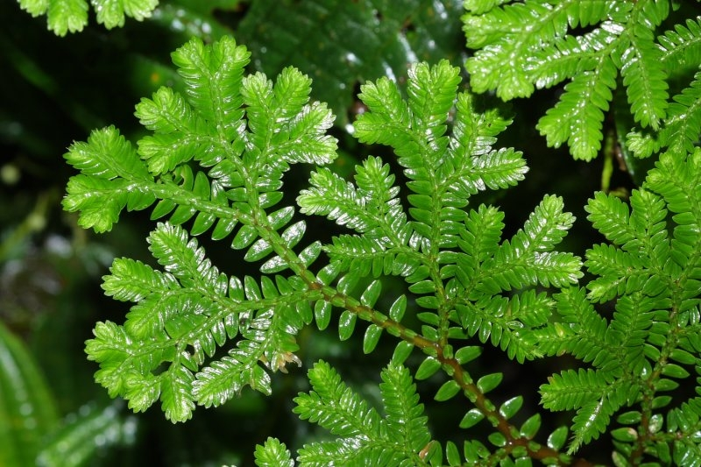
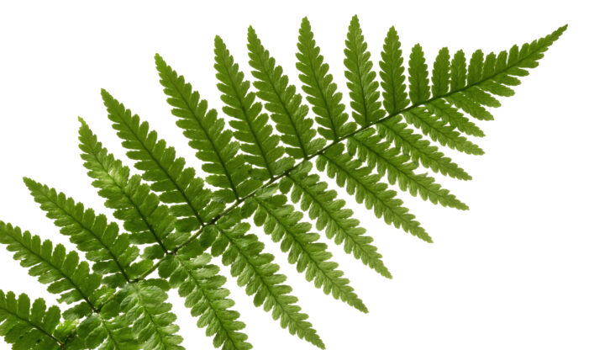
Diversity in Leaves
Small leaves found in plant
EX- selaginella
MICROPHYLL
MEGAPHYLL
Large , complex fronds with branching vein
EX-ferns

Slide 7
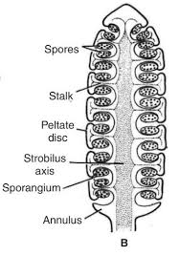
Structure: Equisetum
Sporangia and Sporophylls
Spore producing structure
Leaf like appendages
Process: Spores are produced in sporangia by meiosis within spore mother cell
Strobili and cones
In some genera like Equisetum sporophyll from compact structure
These compact cluster are known as strobili or cones

Slide 8
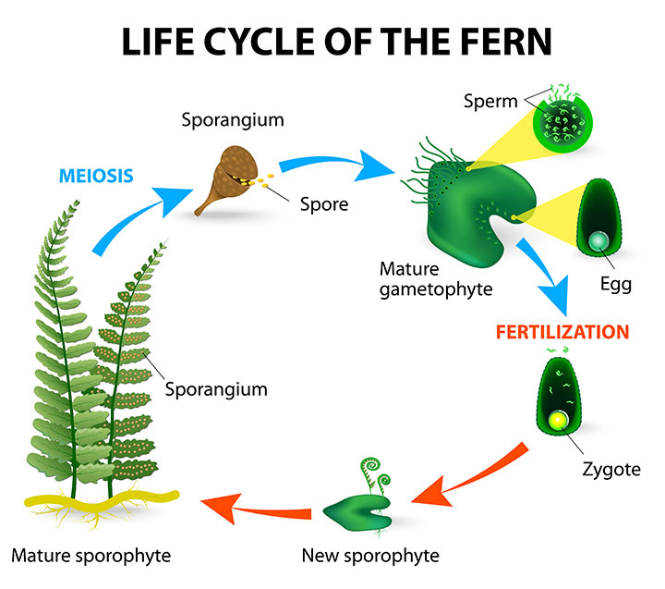

Slide 9
Alternation of generation in Pteridophyte
PROTHALLOID
Spores germinate to give rise to an inconspicuous small prothallus
It is multicellular, free -living, photosynthetic thalloid structure
Requires cool, damp, and shady places to grow
Because of this specific growing needs and the requirement of water for fertilization, their geographical spread is limited

Slide 10
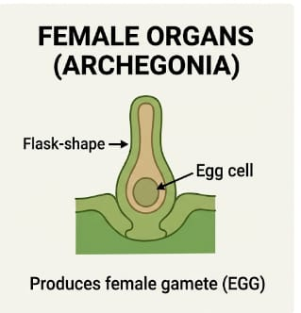
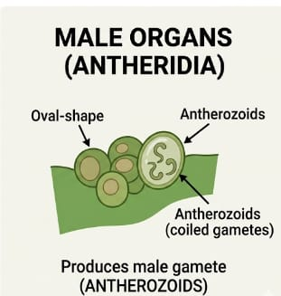
Sexual organs and Fertilization
The gametophytes bears sex organ:
Antheridia: produce male gametes (antherozoids)
Archegonia: produce the female gametes(egg)
The mechanism of fertilization
Water is essential for transfer of antherozoids to the mouth of archegonium. Fusion lead to zygote formation

Slide 11
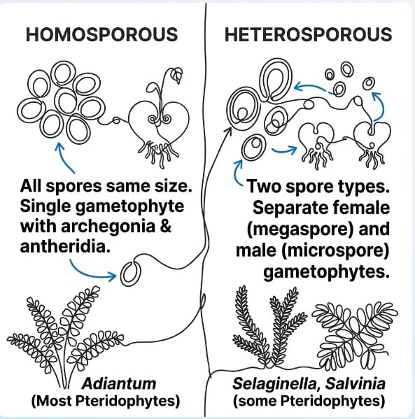
Spore production comparison
Heterosporous
Homosporous (most )

Slide 12
Evolution of seed habit
het
het
het
Heterospory
Production of large(mega) and small (micro) spore
Retention
female gametophyte is retained on parent sporophyte
Embryo zygote develops into embryo within the female gametophyte
Seed precursor
Crucial step in evolution classed seed habit
These adaptation collectively represent the transition from spore dispersal to seed production in plants

Slide 13
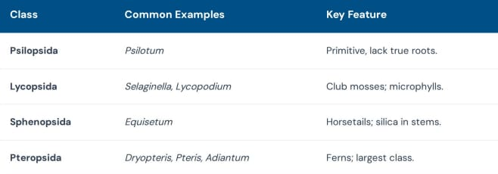
Pteridophyte classification

