Slide 1
CLASS TEST
MS EXCEL
FULL MARKS:15

Slide 2
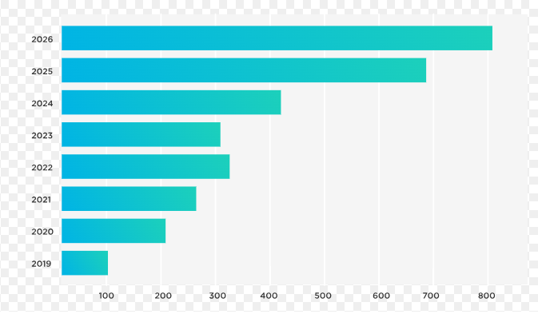
1. Identify the type of chart:-
Column chart c)Vertical chart
Bar chart d)Horizontal chart

Slide 3
2. The overall arrangement of elements in chart is called its …….
Layout
Style
Format
template

Slide 4
3.Which tab on the Ribbon do you use to insert a chart in Excel 2019?
a) Home
b) Page Layout
c) Data
d) Insert

Slide 5
4. Identify and create the following elements in the following chart: a. chart title b. gridline c.data label d. x-axis e. y-axis f. legend

Slide 6
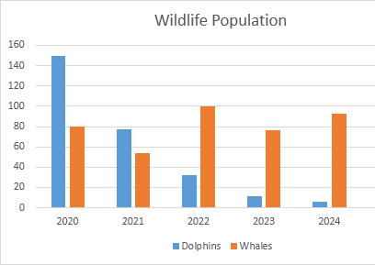

Slide 7
5. Create the table from the chart given in q.no 4

Slide 8
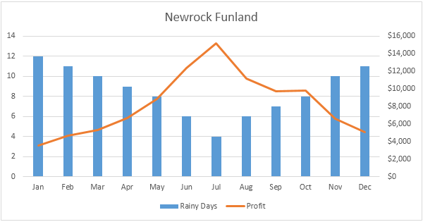
6. Combo chart uses two different types of chart. Identify the types of chart used in this image

Slide 9
7. Fill in the blanks:
The ……………….. Sparkline indicates whether a cell value is positive, negative or zero.
A ………………. Chart allows users to position data over a geographical area.
………………. Chart is used to show trends over a period of time.

