Slide 1
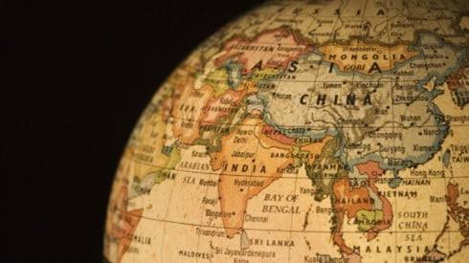
SHIFT OF ECONOMIC POWER FROM WEST TO EAST
From West to East: The New Axis
Members:
1.Niladri Sarkar
2.Shrijeet Saha
3.Sankalan Ghosh
4.Kalpak Acharjya
5.Sanmitra Das

Slide 2
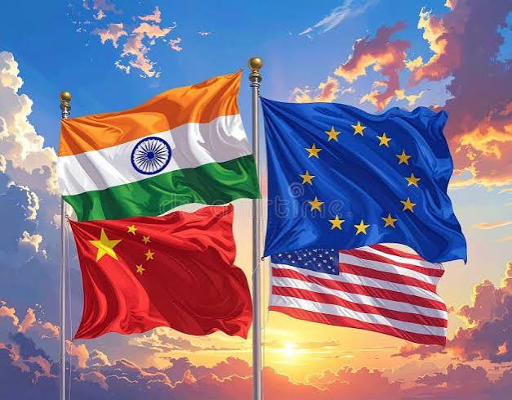
1. The Global Economic Paradigm Shift
The World is Tilting East
The Pivot: For 200 years, global wealth lived in the West. Today, it’s moving home.
The Speed: The world’s economic center of gravity is shifting eastward at an unprecedented 140 kilometers per year.
The Lineup:
  The West: The G7 nations (US, UK, Europe, Japan) and the EU.
  The East: Anchored by China and India, powered by the high-growth ASEAN economies

Slide 3
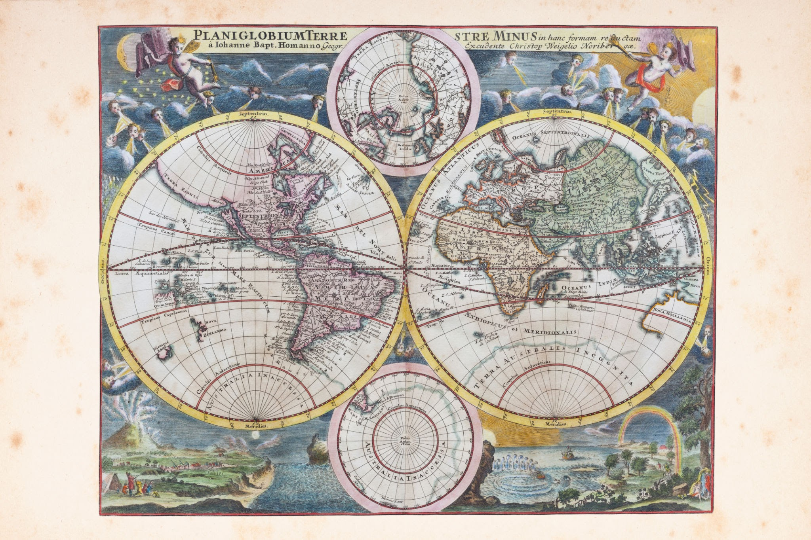
2.The Forgotten Glory of India and China
Reclaiming a historical baseline, not establishing a new phenomenon:
The Demographic Baseline: Prior to industrialization, economic output directly tracked population scale. Labor volume dictated wealth.
The Long-Term Equilibrium: For nearly two millennia, China and India combined generated 50% to 60% of global GDP.
The Geoeconomic Balance (Circa 1700):
Mughal India (approx.25% of Global Wealth): The world’s primary manufacturing hub, dominating international markets through high-value textiles, advanced shipbuilding, and spice networks.
Qing China (approx.30%+ of Global GDP): A highly centralized, bureaucratic trade machine holding an effective global monopoly on silk, porcelain, and tea.
The Structural Silver Drain: The West operated under a permanent trade deficit. Because Europe lacked manufactured goods of interest to Eastern markets, Western merchants were forced to liquidate precious metals to pay for luxury imports.

Slide 4
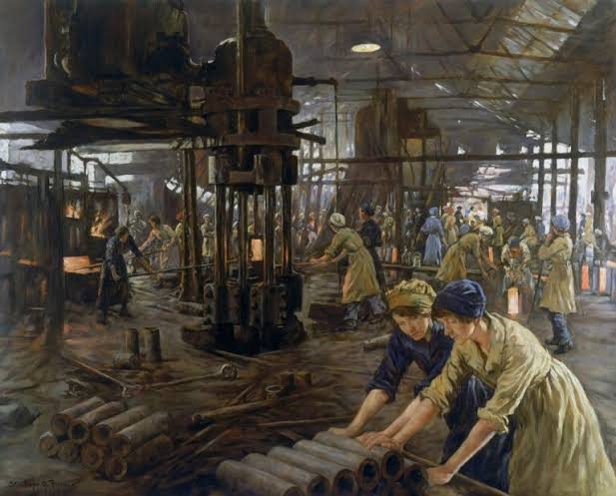

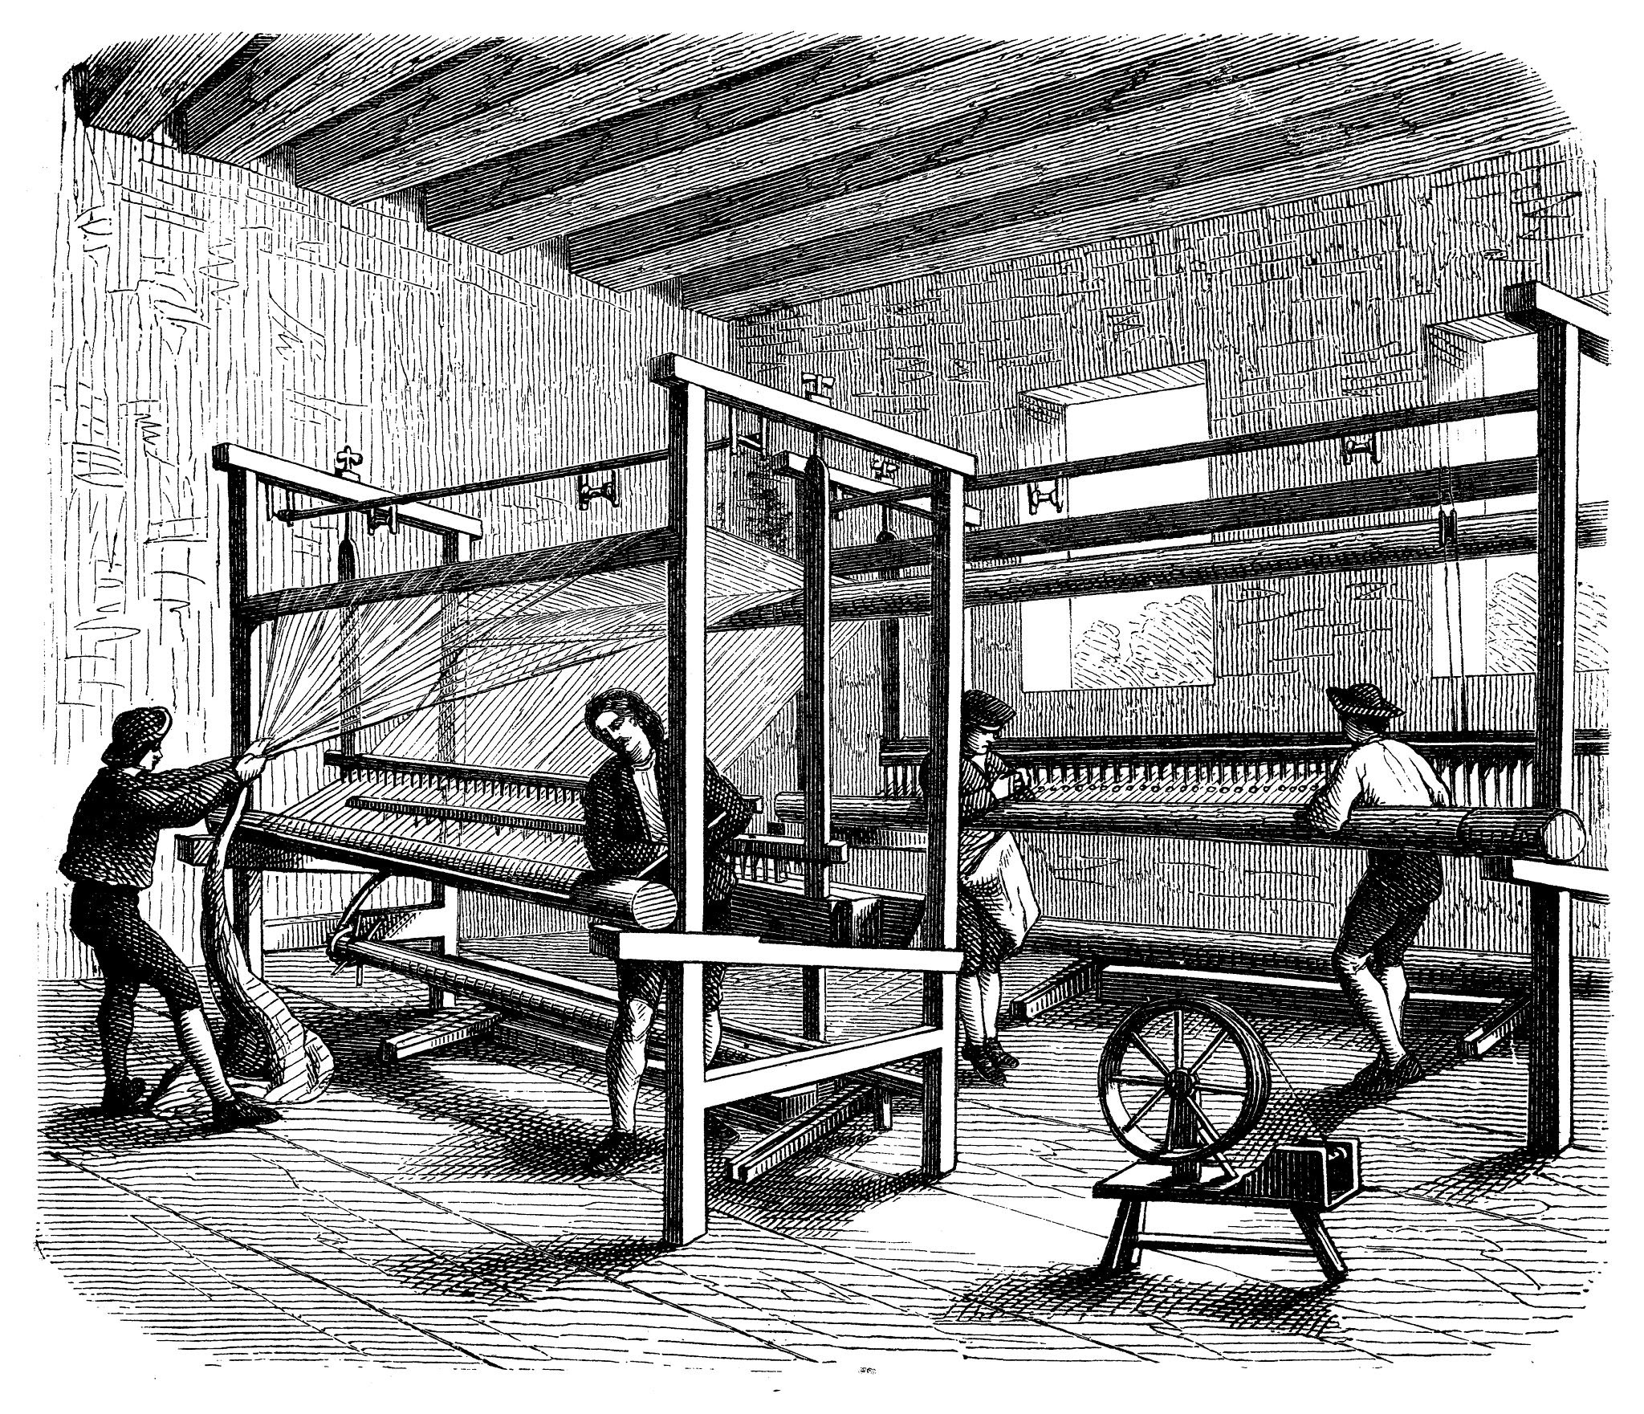
3. The Architecture of the Great Inversion (1800–1900)
Artisanal Diminishing Returns (The East)
Capital-Intensive Scaling (The West)
Labor-Absorbing Growth: Increased inputs yielded lower marginal returns per worker due to fixed land constraints.
• Structural Stagnation: Reliance on highly sophisticated, manual processes limited domestic output scaling.
Fig: An imagery
From China’s Qing
Dynasty
Increasing Returns to Scale: Capital investments in steam, automation, and infrastructure generated compounding output gains.
Asymmetric Terms of Trade: Colonial policies forced the East into raw material supply, keeping high-value margins in the West.
Fig:
Western Pre-Industrial
Capital
Centers

Slide 5
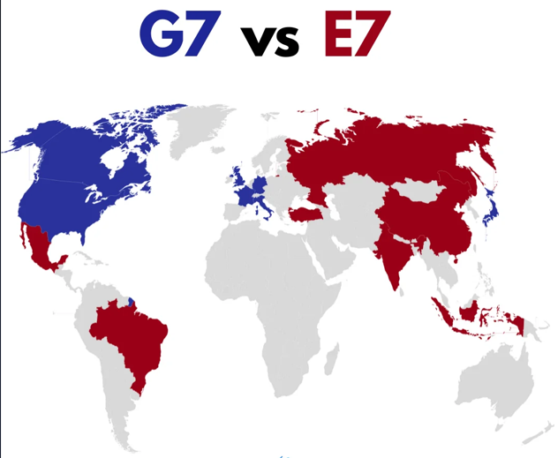
4.G7 vs. E7 Realignment
The G7 Bloc (Advanced / Financialized)
The E7 Bloc (Emerging / Productive)
The MER Valuation Mirage: Market Exchange Rates mask real output volumes; G7 accounts for under 30% of global GDP.
Tertiary Sector Bias: GDP is heavily financialized, anchored in consumption, services, debt expansion, and IP monopolies.
Low MPk maturity: Matured capital structures facing stagnant productivity and severe demographic contraction.
The PPP volume correction: Price-level adjustments reveal the E7 commands over 35% of global physical output.
Secondary Sector Engine: Growth is structurally tied to tangible industrial manufacturing, capital scaling, and resource processing.
Capital Efficiency Edge: Low input costs maximize the marginal productivity of capital (MPk) , shifting the global supply core.

Slide 6
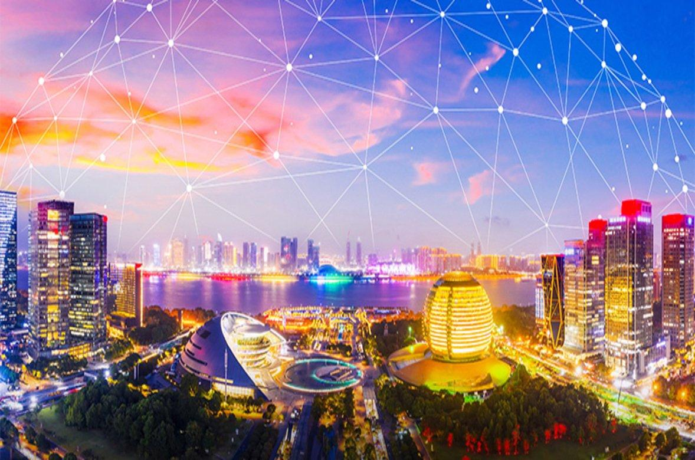
5.Key Drivers of Eastern Economic Growth
Demographic Advantage: A young and growing workforce, coupled with rapid urbanization and an expanding middle class, fuels productivity and domestic consumption.
Technological Leapfrogging: Many Asian economies bypassed legacy infrastructure, adopting 5G, digital banking, AI, and mobile payment ecosystems to accelerate growth.
Industrial Transformation: China has evolved into a global supplier of advanced machinery, industrial components, and clean-energy technologies, supporting manufacturing across Asia and beyond.
High Savings & Capital Formation: Strong household savings provide stable domestic capital for investments in infrastructure, innovation, and long-term economic development.
Regional Integration: Stronger trade partnerships, resilient supply chains, and regional agreements have enhanced economic cooperation and boosted exports.
Innovation & Manufacturing Leadership: Increasing investments in research, semiconductor production, renewable energy, and advanced manufacturing are strengthening the East's global competitiveness.

Slide 7
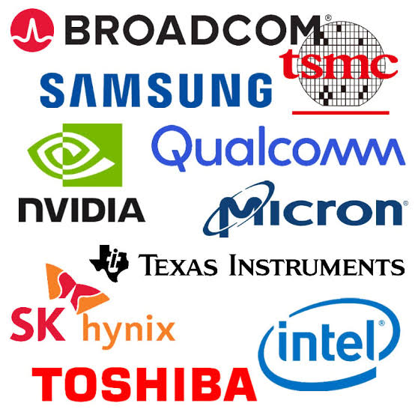
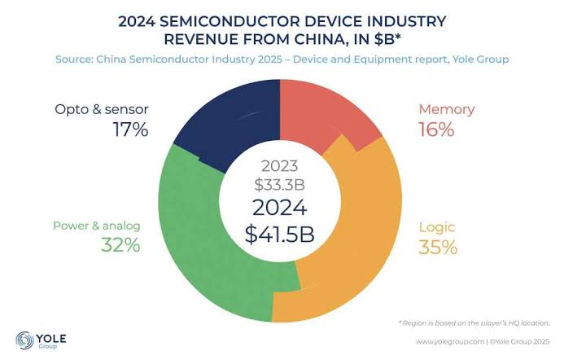
6.Major Economic Engines of the East
China: Industrial and technological superpower leading in EVs, batteries, drones, solar energy, and advanced manufacturing.
India: Digital and service engine driven by public digital infrastructure, consumer tech, service exports, and “Make in India” manufacturing.
Japan & South Korea: High-tech anchors specializing in semiconductors, displays, shipbuilding, robotics, precision machinery, and automotive engineering. For example: companies like Samsung , Sk Hynix etc
ASEAN Bloc: Alternative manufacturing hub benefiting from “China+1” strategies, with strengths in EV batteries and semiconductor packaging.

Slide 8
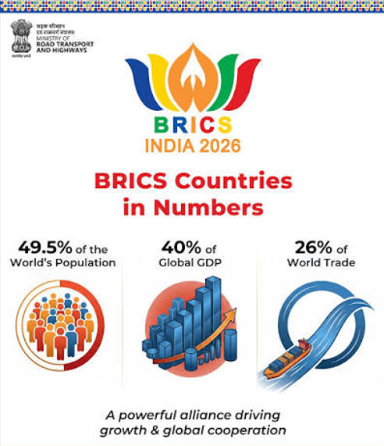
7. Influential Groups, Associations & Industrial Sectors
BRICS+: Expanding economic bloc promoting alternative financial systems and reducing reliance on Western institutions.
RCEP: The world's largest free trade agreement, strengthening trade and economic integration across Asia.
SCO: Enhances regional security, connectivity, and economic cooperation across Eurasia.
Semiconductors & Electronics: TSMC, Samsung, and SK Hynix lead global chip manufacturing and electronics.
Green Technology & EVs: BYD and CATL dominate electric vehicles and lithium-ion battery production.
Digital Infrastructure: Reliance Jio, Tencent, and Alibaba drive digital transformation, e-commerce, and fintech across Asia.

Slide 9
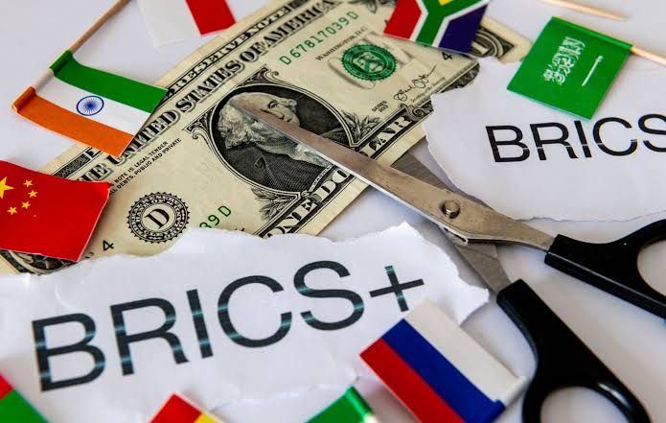
8.Growth Catalysts for Eastern Economies
De-Dollarization: Expand local currency trade and cross-border digital payment systems to reduce reliance on the US dollar.
Infrastructure Connectivity: Strengthen regional integration through projects like the BRI, INSTC, and cross-border energy and transport networks.
Innovation & R&D: Increase investment in AI, quantum computing, biotechnology, space technology, and other frontier industries.
Capital Market Reforms: Improve transparency, governance, and market depth to attract greater global investment.

Slide 10
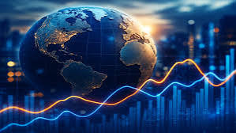
9. Future Outlook: The Next Phase of Global Economic Power
Innovation Will Define Leadership: Countries leading in AI, semiconductors, clean energy, biotechnology, and digital infrastructure will shape the global economy.
Regional Cooperation Will Deepen: Stronger trade agreements, infrastructure connectivity, and economic partnerships across Asia will accelerate sustainable growth.
Resilient Supply Chains: Businesses will increasingly diversify manufacturing and sourcing through strategies such as China+1 and friend-shoring to reduce geopolitical risks.
Emerging Markets Will Gain Influence: Rising consumer demand, expanding middle classes, and rapid urbanization in Asia will make emerging economies key drivers of global growth.
A More Connected Economic Ecosystem: The future will be characterized by greater digital integration, cross-border investment, and collaboration between Eastern and Western economies rather than complete economic separation.

Slide 11
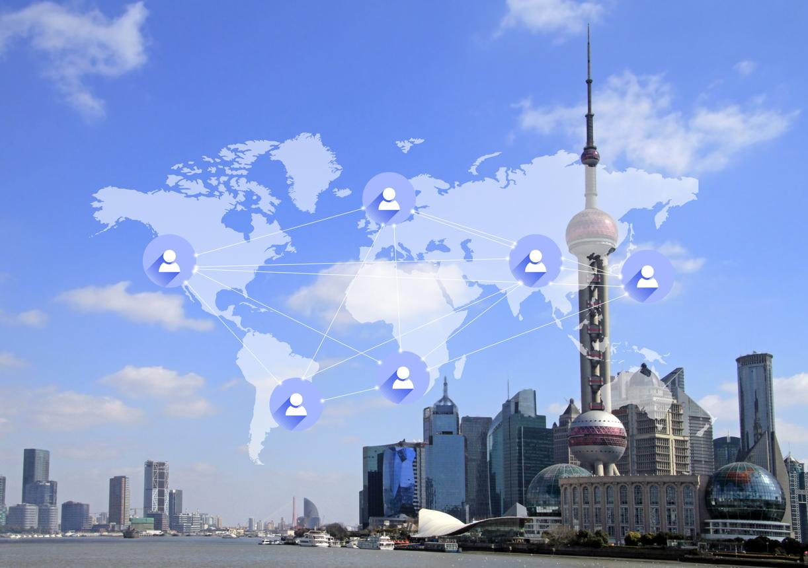
10. Conclusion: A New Chapter in the Global Economy
The global economy is entering an era of shared leadership, where no single region solely determines the direction of trade, technology, and innovation.
The rise of Eastern economies reflects long-term structural changes, driven by demographics, industrial transformation, digitalization, and strategic investment.
Success in the future will depend on adaptability, as governments and businesses respond to evolving supply chains, emerging technologies, and changing geopolitical dynamics.
Rather than replacing the West, the East is reshaping the global landscape, creating a more interconnected, competitive, and balanced world economy.
Closing Statement: The rise of the East is not the decline of the West—it is the emergence of a more interconnected and multipolar global economy, where collaboration and innovation will define the future.

Slide 12
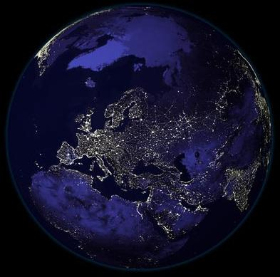
Thanks for watching
End

