Slide 1

$
A GLOBAL CURRENCY BRIEFING
Dedollarization
Is the world really moving away from the U.S. Dollar?
An evidence-based look at reserves, trade, gold & the multipolar money debate
JULY 2026

Slide 2

THE CONCEPT
What is Dedollarization?
The gradual, deliberate effort by governments, firms, and central banks to reduce reliance on the U.S. dollar for reserves, trade, and debt — in favor of gold, regional currencies, and local settlement systems.
01
02
03
Official Reserves
Trade Invoicing & Settlement
Sovereign Debt Markets
Central banks holding fewer dollar assets, more gold, euros and diversified currencies.
Bilateral deals priced and paid in local currencies — rupee, renminbi, ruble, dirham.
Governments issuing bonds in non-dollar currencies to cut sanctions and FX exposure.
DEDOLLARIZATION · 2026
02

Slide 3

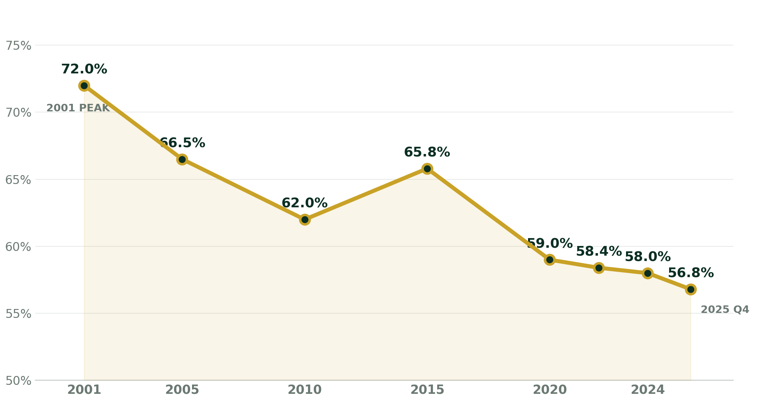
THE HEADLINE TREND
The Dollar's Slow Retreat
USD share of allocated global FX reserves, 2001–2025
72% → 57%
Fallen from its 2001
peak to a two-decade low
$13.0T
Total global FX reserves
held by 149 central banks
Yet the dollar still towers over every rival — the decline is real, but gradual.
DEDOLLARIZATION · 2026
Source: IMF COFER, Q4 2025
03

Slide 4
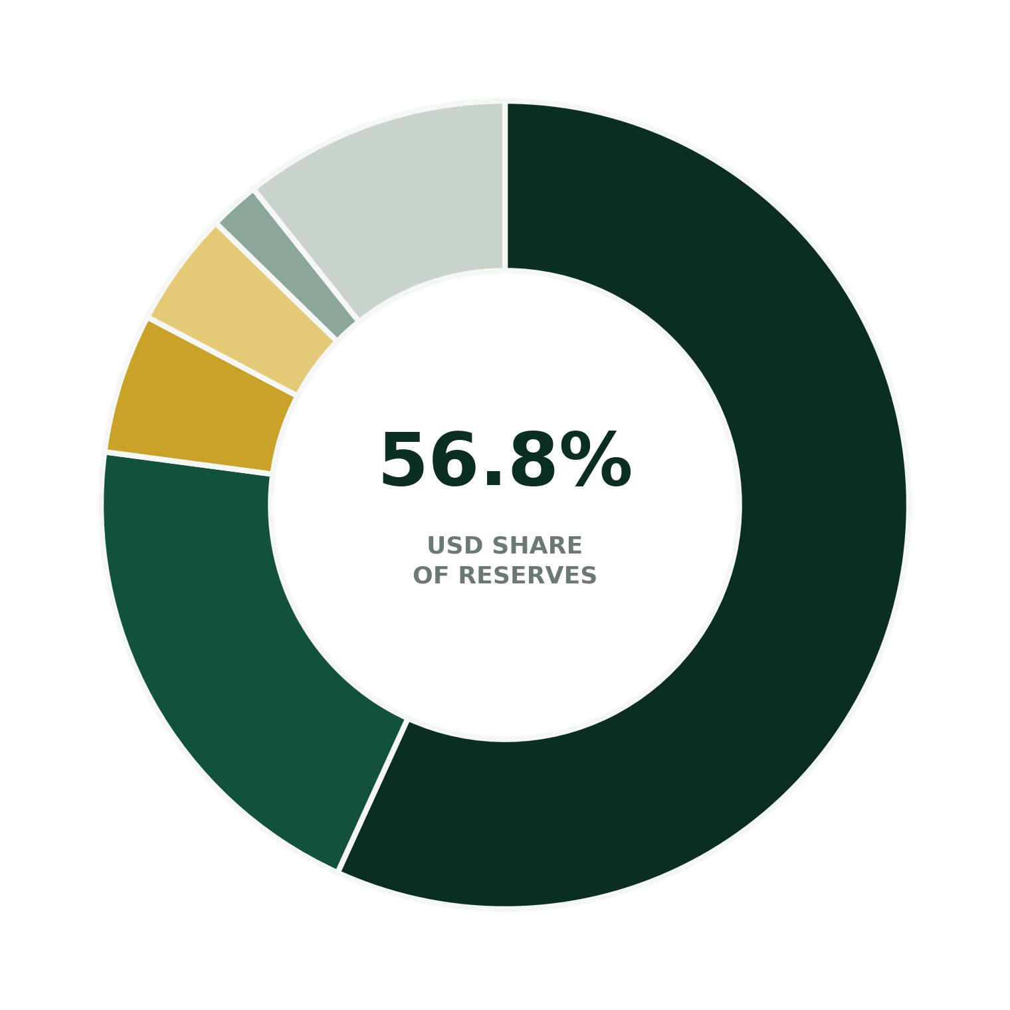
SNAPSHOT — Q4 2025
Who Holds What, Today
US Dollar
56.8%
Euro
20.3%
Japanese Yen
5.6%
British Pound
4.6%
Chinese Renminbi
2.0%
Other currencies
10.7%
The renminbi's reserve share (2.0%) remains tiny — dwarfed by its ambitions and its growing role in trade.
DEDOLLARIZATION · 2026
Source: IMF COFER, Q4 2025
04

Slide 5

SECTION 02
What's Driving
the Shift?
Four forces are reshaping how the world holds and moves money.
DEDOLLARIZATION · 2026
05

Slide 6
ROOT CAUSES
Four Forces Behind Dedollarization
01
Sanctions Shock
02
Gold Rush
Freezing ~$300B of Russia's reserves in 2022 showed every nation how dollar dependence can become a geopolitical weapon.
Central banks bought over 1,000 tonnes of gold annually (2022–24) — an insurance policy beyond Western jurisdiction.
03
BRICS Infrastructure
04
Policy Unpredictability
The BRICS Cross-Border Payments Initiative and China's CIPS network build settlement rails that bypass SWIFT.
Tariff swings and mixed signals on the dollar's value have pushed reserve managers toward diversification.
DEDOLLARIZATION · 2026
06

Slide 7
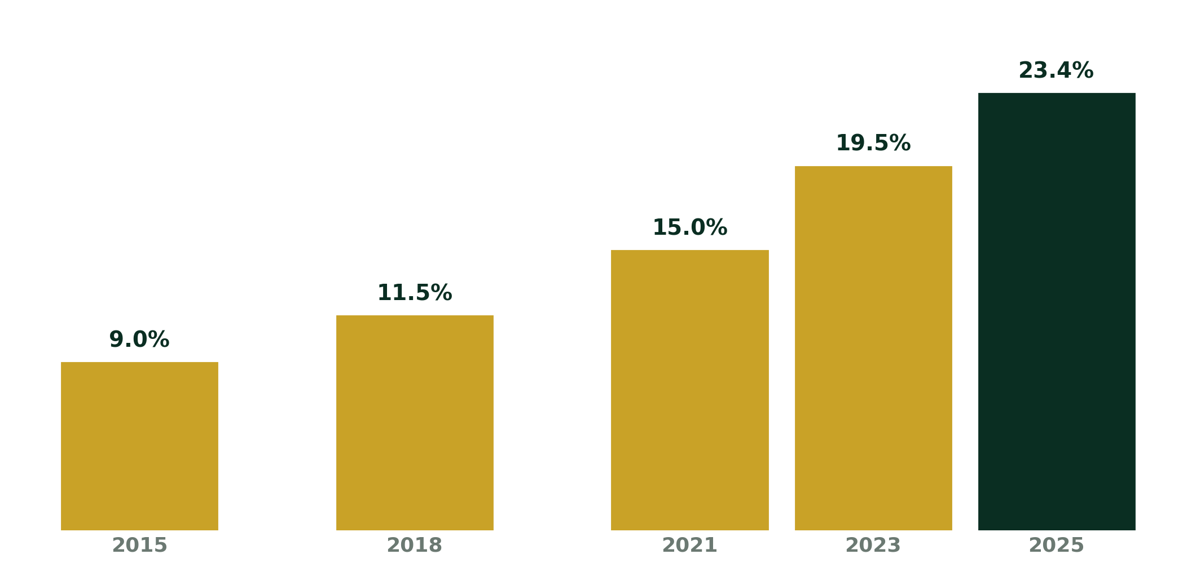
ASSET DIVERSIFICATION
Gold: The Quiet Rebellion
Gold's share of official global reserves, 2015–2025
1,000+ t/yr
Central bank gold purchases,
2022–2024 average
China, Russia, India, Turkïye
The leading buyers driving
the accumulation
Gold offers liquidity and sanctions-proof storage — but you can't pay for a tanker of oil with a gold bar.
DEDOLLARIZATION · 2026
Source: U.S. Federal Reserve, World Gold Council
07

Slide 8
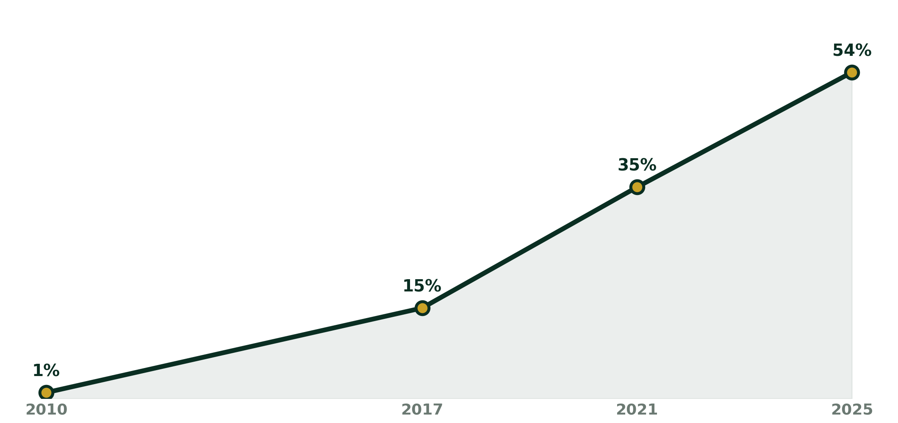
THE CHALLENGER
China's Push: Renminbi Rising
Share of China's cross-border transactions settled in RMB
30+
Central banks with
PBOC currency swap lines
54%
of China's cross-border
trade now settled in RMB
Yet capital controls and low convertibility keep the RMB's global reserve share at just 2%.
DEDOLLARIZATION · 2026
Source: PBOC, Atlantic Council Dollar Dominance Monitor
08

Slide 9
THE COUNTER-CASE
Yet the Dollar Still Reigns
The world isn't fleeing America — it's still buying it.
88%
$1.55T
$21T
40–50%
of global FX trading volume
still runs through the dollar
record foreign purchases of
U.S. financial assets in 2025
in U.S. equities now held
by foreign investors — an all-time high
of world trade invoicing has
stayed dollar-priced for 20 years
“
Dedollarization and investing in U.S. markets aren't contradictions — they're parallel rational strategies. Governments diversify reserves while still wanting ownership of the world's most profitable companies.
DEDOLLARIZATION · 2026
Source: U.S. Treasury Dept., BIS Triennial Survey, VT Markets
09

Slide 10
THE VERDICT
Diversification, Not Collapse
THREE TAKEAWAYS
DEDOLLARIZATION SEVERITY INDEX
1
The dollar's role is eroding at the margins — reserves, not trade or trading volume.
0 — NO CHANGE
2
No single rival is ready: the euro lacks unity, the renminbi lacks convertibility.
10 — FULL COLLAPSE
4 / 10
structural trend,
accelerating but not a crisis
3
Expect a slow drift toward a multipolar system — the dollar remains first among equals.
The dollar isn't being dethroned — it's being asked to share the room.
DEDOLLARIZATION · 2026
10

Slide 11

$
Thank You
Ainak Chowdhury
Priyanshu Bhattacharjee
Debarnab Das
Naireet Ghosh
Sauptik Guha
DEDOLLARIZATION · A GLOBAL CURRENCY BRIEFING

