Slide 1
TAPESTRY OF THE PAST · CHAPTER 6
The Age of
Reorganisation
c. 200 BCE – 300 CE | Kingdoms, Invasions and Cultural Confluence in the Subcontinent
CBSE Class 7 · Exploring Society: India and Beyond, Part 1

Slide 2
SETTING THE SCENE
The Big Questions
1
Why is the period after the Maurya empire called the ‘Age of Reorganisation’?
2
What values guided the emperors of that period?
3
How did foreign invaders assimilate into Indian society and enrich its culture?
“By continuous living tradition and a vital power of rejuvenescence, this land has readjusted itself through unnumbered transformations.” — Jagdish Chandra Bose (1917)
Chapter 6 · The Age of Reorganisation
2

Slide 3
HOW IT BEGAN
The Fall of the Maurya Empire
Little is known of Aśhoka’s successors — the dynasty weakened quickly.
c. 185 BCE: the last Maurya emperor was assassinated by his own commander-in-chief, Puṣhyamitra Śhunga.
This happened barely half a century after Aśhoka’s reign.
The empire broke into many smaller, competing kingdoms — many were former Mauryan tributary states.
The weakened northwest frontier opened the door to invasions from outside the subcontinent.
WHY ‘REORGANISATION’?
Existing regions were being reorganised into new, competing kingdoms. The political map of India — and people’s lives — changed dramatically.
~500 years
2nd century BCE to 3rd century CE — the span this chapter covers
Chapter 6 · The Age of Reorganisation
3

Slide 4
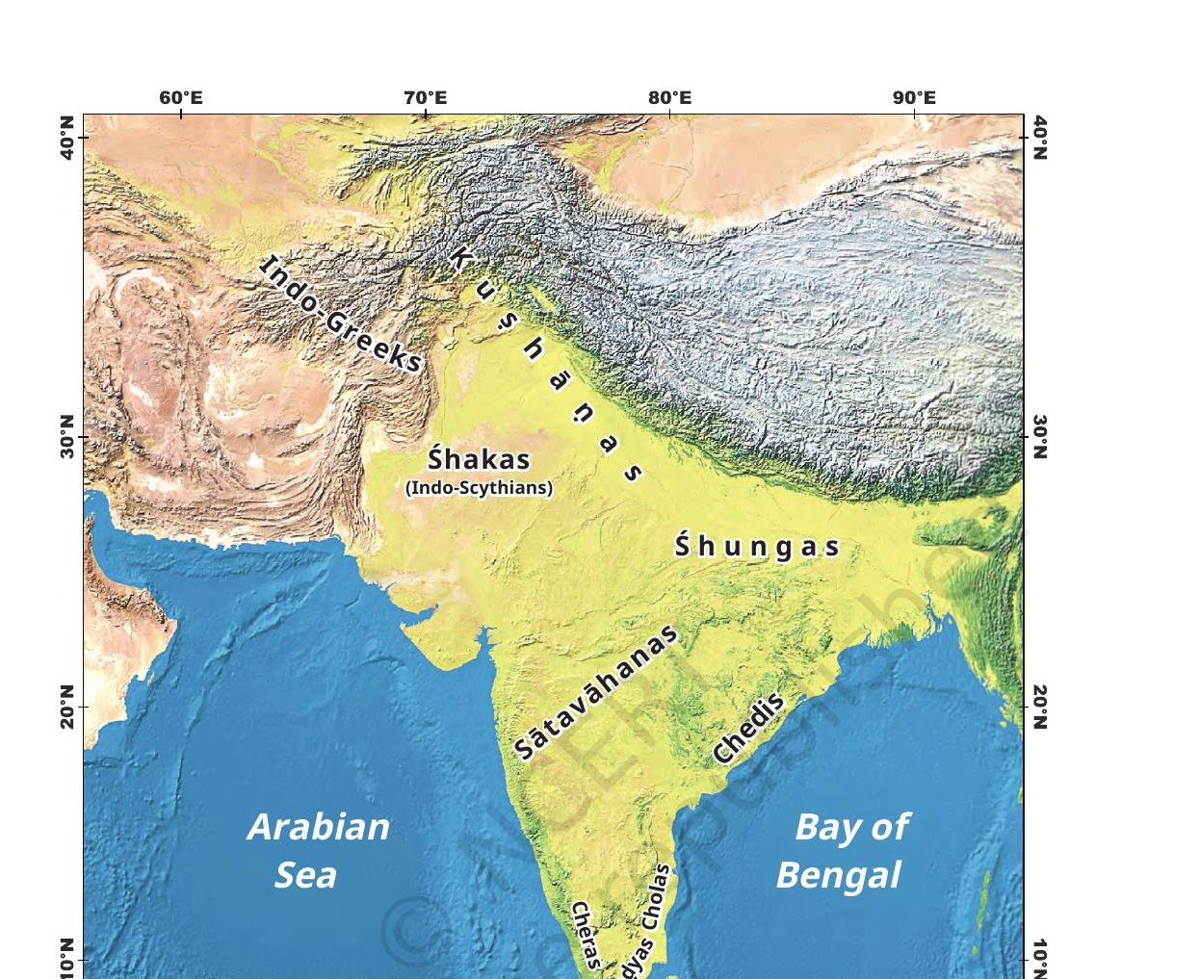
POLITICAL GEOGRAPHY
A Subcontinent of Many Kingdoms
TWO GROUPS OF DYNASTIES
From within the Subcontinent
Śhungas, Chedis, Sātavāhanas, Cholas, Cheras, Pānḍyas
From outside the Subcontinent
Indo-Greeks, Śhakas, Kuṣhāṇas
These kingdoms competed for territory through matrimonial alliances and warfare — while trade, art and literature flourished alongside the conflict.
Chapter 6 · The Age of Reorganisation
4
Fig. 6.2 — Prominent dynasties of the age of reorganisation

Slide 5
DYNASTY IN FOCUS
Surge of the Śhungas
Founded by Puṣhyamitra Śhunga; ruled parts of north and central India.
Performed the aśhvamedha yajña, a Vedic ritual, to declare supreme kingship.
Empire was smaller than the Mauryas’, but kept safe from invaders.
Maintained friendly relations with the Greeks after an initial campaign.
The dynasty lasted about a century after its founder.
The period saw a revival of Vedic rituals, while other schools of thought continued to flourish.
DON’T MISS OUT — Aśhvamedha Yajña
A horse, accompanied by soldiers, was left to wander freely. Any territory it crossed unchallenged became part of the king’s empire. If a ruler stopped the horse, a battle decided supremacy.
Compiled during this period: the Yoga Sūtras of Patañjali — and Sanskrit became a preferred language for philosophy and literature.
Chapter 6 · The Age of Reorganisation
5

Slide 6
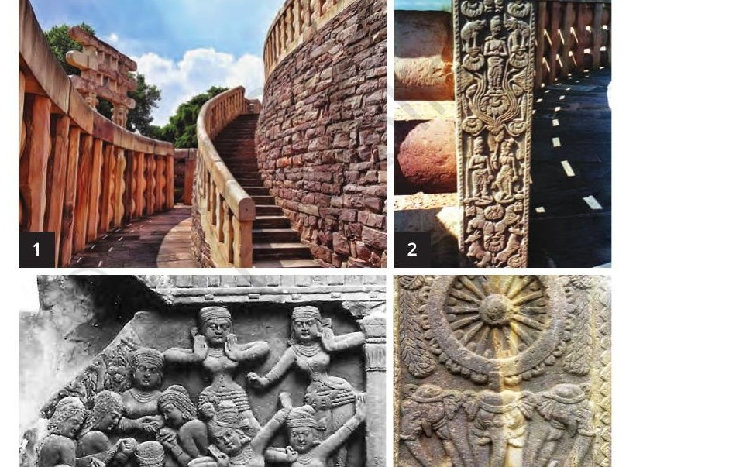
ART & ARCHITECTURE
The Bharhut Stūpa
Located in present-day Madhya Pradesh.
Probably built in Aśhoka’s time — the Śhungas added beautifully carved railings and reliefs.
Depicts stories from the Buddha’s life.
Considered among the earliest examples of Buddhist art.
THINK ABOUT IT
Look at the panel figures — what professions, attire, and daily-life details can you spot in Śhunga carvings?
Fig. 6.5 — Railings, carvings, singers & dancers, and elephants holding the wheel of dharma
Chapter 6 · The Age of Reorganisation
6

Slide 7
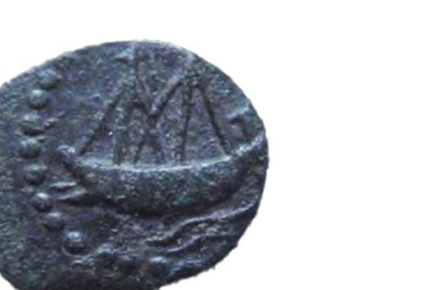
DYNASTY IN FOCUS
The Sātavāhanas of the Deccan
Ruled large parts of the Deccan from the 2nd century BCE — sometimes called ‘Andhras’.
Empire spanned present-day Andhra Pradesh, Telangana and Maharashtra.
Capitals included Amrāvatī and Pratiṣhṭhāna (Paithan).
Agriculture flourished in the Krishna–Godavari river system.
Active maritime trade reaching the Roman Empire: spices, textiles, sandalwood, gold-plated pearls and ivory exported; glass and perfumed ointments imported.
Tolls and taxes on trade added kingdom revenue.
Fig. 6.8 — Sātavāhana coin with a two-masted seafaring ship, showing advanced shipbuilding and navigation.
The Naneghat Caves near Pune sat on a major trade route — used for collecting tolls and taxes, and as resting places for traders.
Chapter 6 · The Age of Reorganisation
7

Slide 8
SOCIETY & CULTURE
Life Under the Sātavāhanas
Princes were often named after their mothers — e.g. Gautamīputra Sātakarṇi, son of Gautamī Balaśhrī, a powerful queen who donated land to Buddhist monks.
A Naneghat cave inscription describes a widow queen performing Vedic rituals, including the aśhvamedha yajña.
She donated land, cows, horses, elephants and silver coins to priests, scholars and monks.
Devout followers of Vāsudeva (Kṛiṣhṇa), yet they granted tax-free land to Vedic scholars, Jaina and Buddhist monks alike.
In the 3rd century CE, weak central control led the empire to fragment into smaller kingdoms.
BRAHMI NUMERALS
Naneghat inscriptions include numerals that, at times, resemble today’s shapes — early evidence that modern numerals ultimately originated in India.
THINK ABOUT IT
What could the tradition of using the mother’s name in a king’s title signify about the status of women?
Chapter 6 · The Age of Reorganisation
8

Slide 9
DYNASTY IN FOCUS
Coming of the Chedis
After the Maurya decline, Kalinga rose to prominence under the Chedi dynasty.
Khāravela, a main ruler, was a devoted follower of Jain teachings — sometimes called bhikṣhu-rāja, the ‘monk-king’ — yet he respected all schools of thought.
The Udayagiri–Khandagiri caves near Bhubaneswar were likely developed for Jain monks, with intricate panels and spacious rock-cut chambers.
The Hāthīgumphā inscription (Brahmi script) records his military victories and welfare works year by year.
He describes himself as ‘accomplished in extraordinary virtues, respector of every sect and repairer of every temple’ — part of the wider ‘Indian ethos’ of religious tolerance.
ROCK-CUT ARCHITECTURE
The Udayagiri caves showcase precise chambers carved directly into rock — a style we explore further in higher classes.
THINK ABOUT IT
How did artisans achieve such regularity with just a chisel and hammer, nearly two millennia ago?
Chapter 6 · The Age of Reorganisation
9

Slide 10
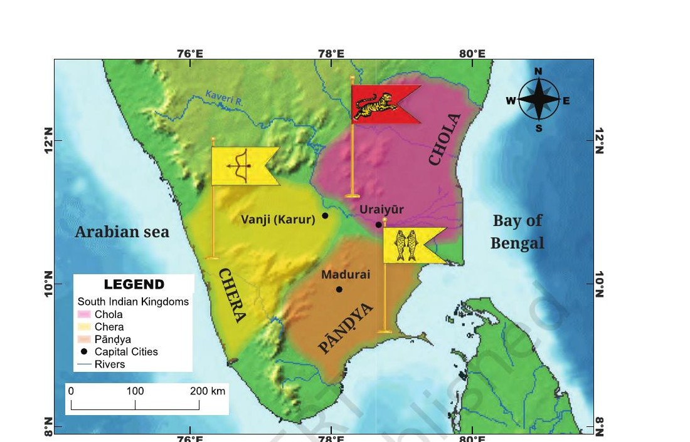
SOUTHERN INDIA
Kingdoms and Life in the South
Between the 2nd/3rd century BCE and the 3rd century CE, the Cheras, Cholas and Pānḍyas rose to power in the far south.
They competed with each other while also driving trade and cultural growth.
Aśhoka’s edicts mention these kingdoms as independent of Mauryan rule even at its height.
Khāravela claims a victory over a southern alliance, but he does not seem to have invaded the region himself.
Fig. 6.14 — The Chola, Chera and Pānḍya kingdoms (borders approximate)
Chapter 6 · The Age of Reorganisation
10

Slide 11
LITERATURE
The Sangam Age
sangam (Sanskrit sangha) = ‘association’ / ‘coming together’ — an assembly of poets
The three ‘crowned kings’ named in the Sangams were the Cholas, Cheras and Pānḍyas.
Sangam literature is the oldest literature of south India — several anthologies of poems.
It is widely consulted by historians studying the society and culture of the age.
Sangam poetry expresses personal emotions like love, and societal values like heroism and generosity, with great skill and delicacy.
Chapter 6 · The Age of Reorganisation
11

Slide 12
DYNASTY IN FOCUS
The Cholas
A powerful dynasty ruling parts of south India from the 3rd century BCE to the 13th century CE.
King Karikāla defeated a combined Chera–Pānḍya force and established supremacy.
Built the Kallaṇai (Grand Anicut) — a water diversion system on the Kāveri, just downstream of Srirangam island.
It brought more land under cultivation, earning the region the name ‘rice bowl of the South’.
Restored many times, the Anicut is still in use — supporting irrigation for millions in Tamil Nadu today.
KALLAṆAI — GRAND ANICUT
One of the oldest water-regulation structures in the world still functioning — an engineering legacy nearly 2,000 years old.
THINK ABOUT IT
Statues of Karikāla show him mounted on an elephant, richly attired. What does this posture and dress say about royal power and status?
Chapter 6 · The Age of Reorganisation
12

Slide 13
EPIC LITERATURE
Silappadikāram: The Tale of the Anklet
Composed soon after the Sangam collections; centres on Kaṇṇagi and her husband Kovalan.
Kovalan loses his wealth to a dancer, returns to Kaṇṇagi, and they travel to Madurai (Pānḍya capital) to rebuild their lives.
Kovalan is falsely accused of theft and executed; Kaṇṇagi proves his innocence with her second anklet.
Devastated, she curses Madurai, which is destroyed by fire — then is honoured as a goddess in the Chera kingdom.
The epic centres on justice and the ruler’s dharma to protect it, while showcasing trade-rich cities across three kingdoms.
Kaṇṇagi is still worshipped today in Tamil Nadu and Kerala — a striking example of literature shaping living tradition.
Fig. 6.15 — Statue of Kaṇṇagi, Chennai (referenced in the chapter)
Chapter 6 · The Age of Reorganisation
13

Slide 14
DYNASTIES IN FOCUS
The Cheras and the Pānḍyas
THE CHERAS
THE PĀNḌYAS
Also called Keralaputra (‘sons of Kerala’).
Ruled western Tamil Nadu and Kerala; capital at Vanji (present-day Karur).
Patronised Sangam poets and encouraged Tamil literature.
Extensive trade with the Roman Empire and West Asia — exported spices, timber, ivory and pearls.
Ruled Tamil Nadu’s far south from Madurai, dating back several centuries BCE.
Megasthenes’ Indika describes a prosperous kingdom with strong administration.
Traded actively with the Greeks and Romans, and internally — Khāravela mentions receiving Pānḍya pearls.
An important naval power; later Pānḍyas advanced art, architecture and prosperity.
Chapter 6 · The Age of Reorganisation
14

Slide 15
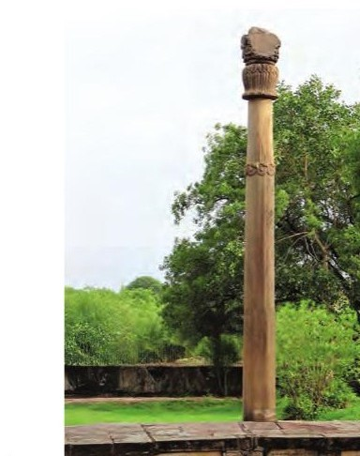
INVASIONS FROM THE NORTHWEST
Invasions of the Indo-Greeks
Legacy of Alexander’s brief Indus campaign: retreating, he left satraps who later became independent ‘Indo-Greek’ rulers.
After the Mauryas declined, the weakened northwest (present-day Pakistan and Afghanistan) became an easy target.
Though conquerors, the Indo-Greeks were deeply influenced by local culture — blending Greek and Indian elements in governance, art, language and daily life.
The Heliodorus pillar near Vidisha is named after an Indo-Greek ambassador who praised Vāsudeva as the ‘god of gods’ in his inscription.
Indo-Greek coins (gold, silver, copper, nickel) show a king on one side, and Greek or Indian deities — like Vāsudeva-Kṛiṣhṇa or Lakṣhmī — on the other.
Their rule ended with the invasion of the Śhakas (Indo-Scythians).
Fig. 6.19 — The Heliodorus pillar near Vidisha
Chapter 6 · The Age of Reorganisation
15

Slide 16
DON'T MISS OUT
The Śhakas and the Śhaka Samvat Calendar
The Śhakas (Indo-Scythians) invaded the northwest and ruled from the late 2nd century BCE to the 5th century CE.
Their power rose after the Indo-Greeks and lasted until the Kuṣhāṇas arrived.
During this period, the Śhaka Samvat calendar was developed.
It runs 78 years behind the Gregorian calendar (79 years behind for January–March).
Adopted as the Indian National Calendar in 1957 — still used alongside the Gregorian calendar in official publications today.
78
years behind the
Gregorian calendar
1957
adopted as India’s National Calendar
Chapter 6 · The Age of Reorganisation
16

Slide 17
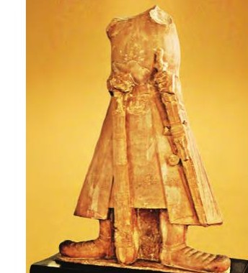
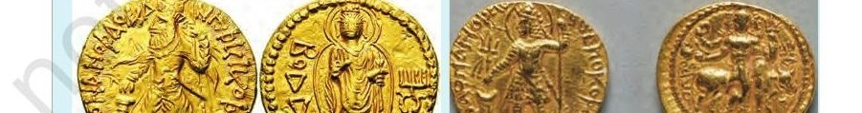
DYNASTY IN FOCUS
The Emergence of the Kuṣhāṇas
Originally from central Asia, the Kuṣhāṇas entered India probably in the 2nd century CE.
At its peak, the empire stretched from central Asia to large parts of northern India.
Kaṇiṣhka, their most powerful ruler, encouraged art and culture alongside his military campaigns.
His statue’s Brahmi inscription reads: ‘the great king, king of kings, son of God, Kaṇiṣhka’.
The Kuṣhāṇas controlled key sections of the Silk Route, boosting trade with Asia and the West.
Fig. 6.23 — Coins of Kaṇiṣhka: Buddha (Greek script BOΔΔO) on one; Śhiva with bull Nandi on the other.
Fig. 6.22 — Headless statue of King Kaṇiṣhka (1.85 m)
Why would a ruler feature both Buddha and Śhiva on his coins? What does that say about his values?
Chapter 6 · The Age of Reorganisation
17

Slide 18
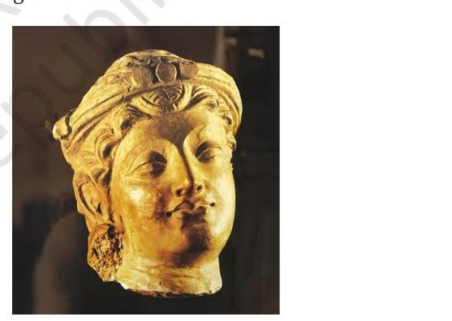
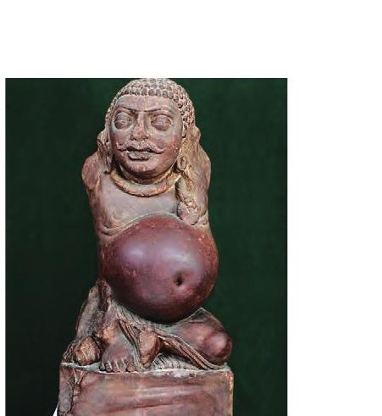
ART & SCULPTURE
Gāndhāra and Mathurā Schools of Art
GĀNDHĀRA STYLE
MATHURĀ STYLE
Emerged in the western Punjab region.
Blends Greco-Roman elements with Indian features.
Carved from grey-black schist stone.
Fine Buddha images, realistic anatomy, flowing robes.
Developed in the Mathura region, present-day Uttar Pradesh.
Distinctly Indian style, less Greco-Roman influence.
Primarily uses red sandstone.
Depicts Kubera, Lakṣhmī, Śhiva, Buddha, yakṣhas and yakṣhiṇīs with fuller, smoothly modelled figures.
Fig. 6.24 — Bodhisattva head
Fig. 6.26 — Kubera, god of wealth
Chapter 6 · The Age of Reorganisation
18

Slide 19
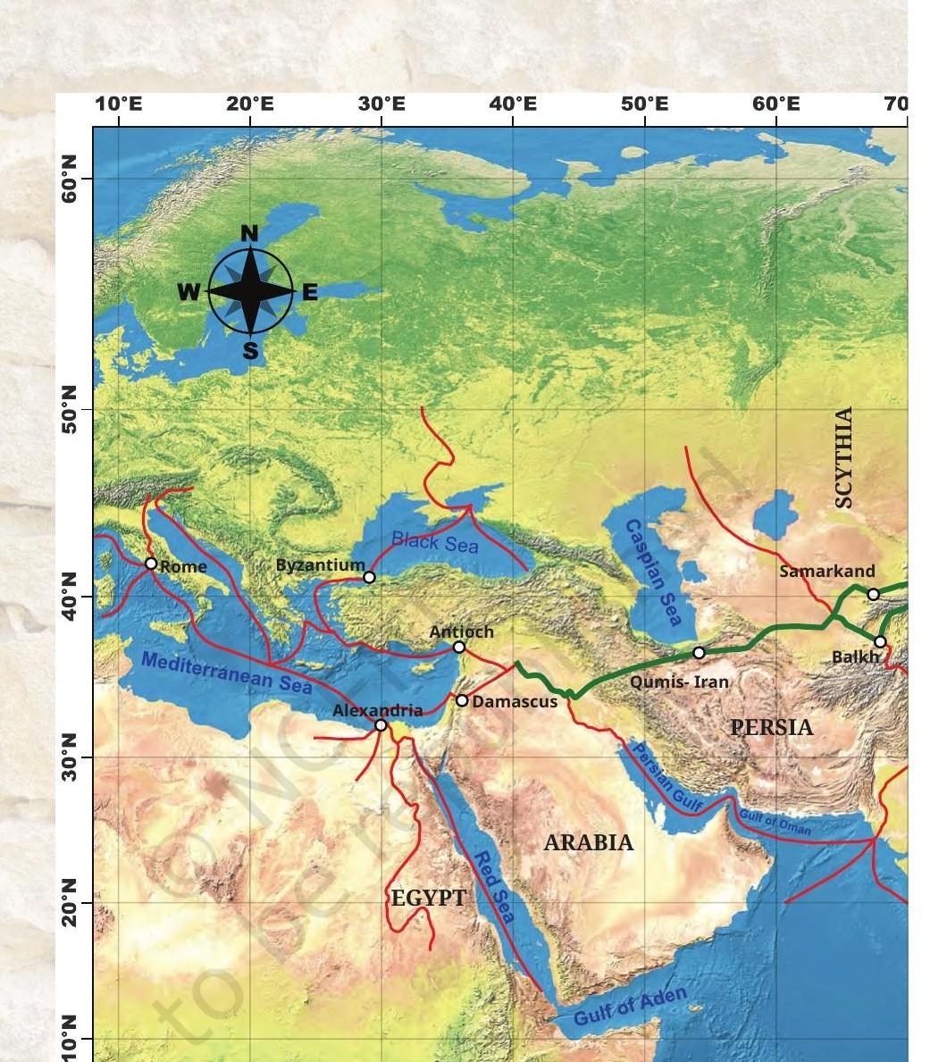
TRADE & CONNECTIVITY
The Silk Route and Cultural Confluence
Kuṣhāṇa control of the Silk Route connected India with central Asia, China and the West.
Despite political conflict, this era saw remarkable cultural exchange and assimilation.
Art and architecture absorbed multiple influences — yet Indian (Hindu and Buddhist) themes remained dominant.
Sanskrit literature flourished, including the composition of major texts like the Mahābhārata and Rāmāyaṇa.
Fig. 6.25 — Ancient trade routes; the Silk Route (green) linked China to the Mediterranean through central Asia and Persia
Chapter 6 · The Age of Reorganisation
19

Slide 20
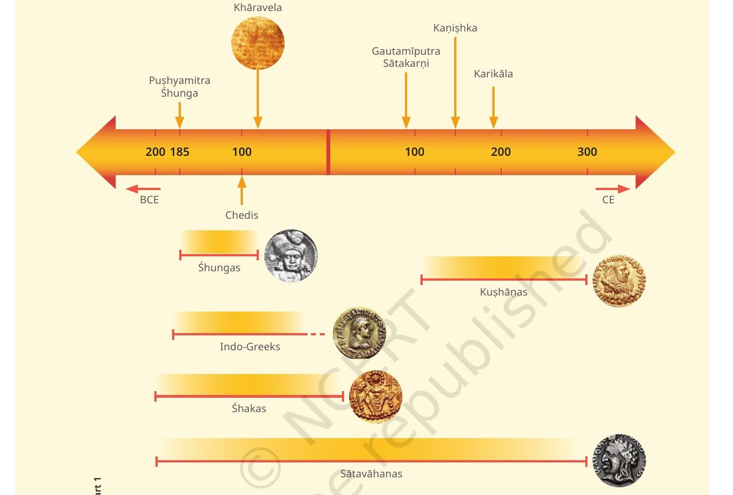
BEFORE WE MOVE ON
Timeline of the Age of Reorganisation
Many kingdoms rose from the Maurya breakup — internal conflict and foreign invasion together drove a dynamic reorganisation, and a rich confluence, of Indian political and cultural life.
Chapter 6 · The Age of Reorganisation
20

