Slide 1




More on PowerPoint
Class 5 Computer Science
DEBANJAN ACHARYYA
DEBANJAN ACHARYYA
This Photo by Unknown Author is licensed under CC BY-NC
This Photo by Unknown Author is licensed under CC BY-NC

Slide 2






Learning Objectives
Foundational Skills
Multimedia & Effects
PowerPoint Window & Ribbon
SmartArt, Shapes & WordArt
Applying Themes & Slide Layouts
Embedding Audio Clips & Videos
Formatting Text Boxes & Pictures
Applying Animations & Morph Transitions

Slide 3
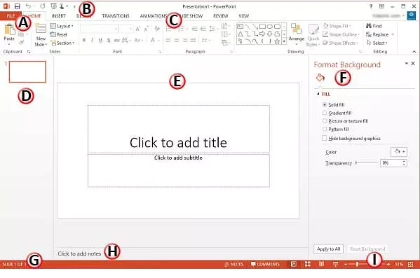


Slide 4






Warm-Up: Why PowerPoint?
Have you seen a slideshow before? Where do teachers, doctors, and scientists use them?
Why not plain paper? Presentations combine sound, pictures, and motion to make learning memorable!
What is a Slide? A slide is a single page of a presentation, like a page in a digital storybook.
Fun Fact: Over 30 million PowerPoint presentations are created worldwide every single day!

Slide 5








Parts of PowerPoint Window
The Ribbon
Slide Area & Pane
Notes & Status Bar
Located at the top, it contains tabs like Home, Insert, Design, and Animations packed with tools for every task.
The main center area shows your active slide. The left Slide Pane shows miniature thumbnail views of all slides.
Add speaker notes at the bottom. The status bar indicates the total slide count, view buttons, and zoom controls.

Slide 6





Themes & Slide Layouts
Document Themes
Slide Layouts
A Theme is a preset set of colors, fonts, and visual backgrounds that gives your entire presentation a professional, consistent look in 1-click!
A Layout arranges placeholders for titles, bullet points, charts, and images on a slide.
How to change: Go to Home Tab > Click Layout > Choose Title, Two Content, or Blank.
How to apply: Go to Design Tab > Select your favorite theme box.

Slide 7



Inserting Pictures & Shapes
Insert Pictures: Click Insert Tab > Pictures to add images from your computer or stock images online.
Drawing Shapes: Click Insert > Shapes to draw arrows, callout bubbles, banners, and stars.
Format Shape: Change Fill Color, Outline Thickness, and 3D Shadow Effects under Shape Format tab.
Remember: Hold the Shift Key while drawing a circle or square to keep it perfectly proportioned!

Slide 8







SmartArt, WordArt & Tables
SmartArt Diagrams
Stylized WordArt
Tables & Charts
Convert plain lists into colorful 3D flowcharts, process arrows, and hierarchy pyramids via Insert > SmartArt.
Add decorative titles with custom glows, reflections, and curved text paths using Insert > WordArt.
Organize numeric data cleanly into rows and columns or visual bar charts via Insert > Table / Chart.

Slide 9




Adding Audio & Video Media
Open Insert Tab: Navigate to the Media Group on the far right of the Ribbon.
Choose Media Type: Click Video or Audio (Select file from PC or Record Live Audio).
Set Playback Rules: Choose whether the video/audio starts Automatically or When Clicked during Slide Show!
Simple Steps to Add Media
This Photo by Unknown Author is licensed under CC BY-NC-ND
PW Tip: Trim video length directly inside PowerPoint using Video Format tools!

Slide 10


Animations & Slide Transitions
Entrance Animations (Green Icons): Controls how text or images fly onto the slide (e.g., Fade, Fly In, Zoom, Bounce).
Emphasis Animations (Yellow Icons): Draws attention to key words or diagrams while on screen (e.g., Spin, Pulse, Teeter).
Exit Animations (Red Icons): Controls how objects leave the screen before moving to the next topic.
Slide Transitions: Visual motion effects applied to the entire slide when moving from slide to slide (e.g., Morph, Push, Wipe).
Shortcut Alert: Press F5 anytime to start your live Slide Show from the beginning!

Slide 11






Project: My Favourite Animal
Choose Theme
Add Content
Animate
Present
Pick a clean, nature-inspired theme under Design Tab.
Insert 2 slides with Animal facts, photo, and a WordArt title.
Apply 'Fly In' animation to text & images step-by-step.
Press F5 and present your animal project to the class!

Slide 12


Interactive Class Quiz
# | Question / Scenario | Correct Tool / Key Answer
Q1 | Which tab do you use to insert pictures, shapes, and tables? | Insert Tab
Q2 | What shortcut key starts the Slide Show from Slide 1? | F5 Key
Q3 | True or False: Slide Transitions apply to individual images. | False (Transitions apply to entire slides!)
Q4 | Which animation color represents Entrance effects? | Green Icons

Slide 13


Great Job, Champs!
This Photo by Unknown Author is licensed under CC BY

