Slide 1
Control structure in python
FM: 15 marks

Slide 2
1. Which statement is used to terminate the loop?
if
continue
break
for

Slide 3
2. WHICH SERIES OF NUMBERS ARE GENERATED range(5) ?
1,2,3,4,5
0,1,2,3,4,5
0,1,2,3,4
1,2,3,4

Slide 4
3. WHICH SERIES OF NUMBERS ARE GENERATED range(5,0,-1) ?
5,4,3,2,1,0
5,4,3,2,1
0,1,2,3,4
5

Slide 5
4. Which of the following is used to repeat a block of code?
For
Range
Both (A) and (c)
If-else

Slide 6
5. Shewta was writing a program in which she wanted to execute a particular set of statements depending upon a test condition. Which type of statements she can use?
Decisional statement c) iterative statement
Sequential statement d) none of these

Slide 7
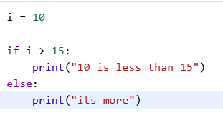
6. Write the output:

Slide 8
7. break, continue are also known as ……………..
Selection statements
Jump statements
Iterative statements
Sequential statement

Slide 9
8. Find the errors are rewrite the code
b=40
m=100
if m>b
print(“m is greater than b”)

Slide 10
9. Write a program that take input of age of a person and check if he/she is eligible to vote or not. (2)

Slide 11
10. Write a program to take input of age of a person and print the category given below: (4)
age | category
0-2 | Infant
3-12 | Child
13-19 | teen
20-59 | Working age
>60 | Old age

