Slide 1
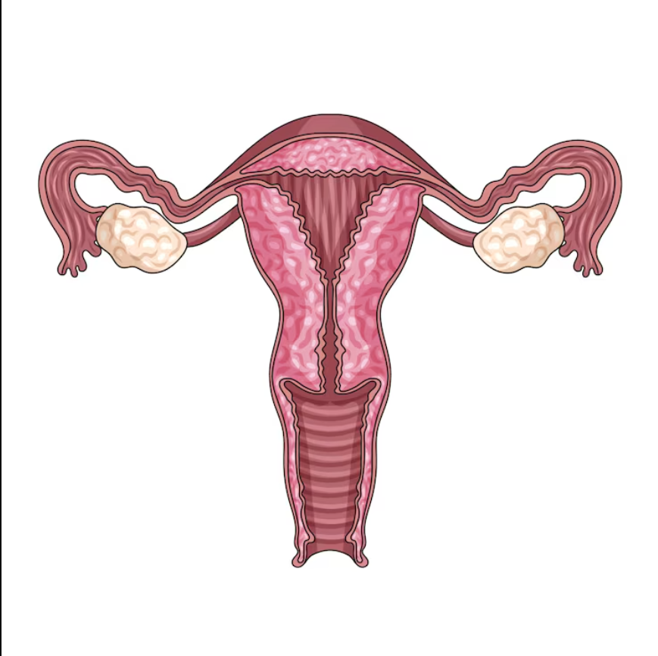
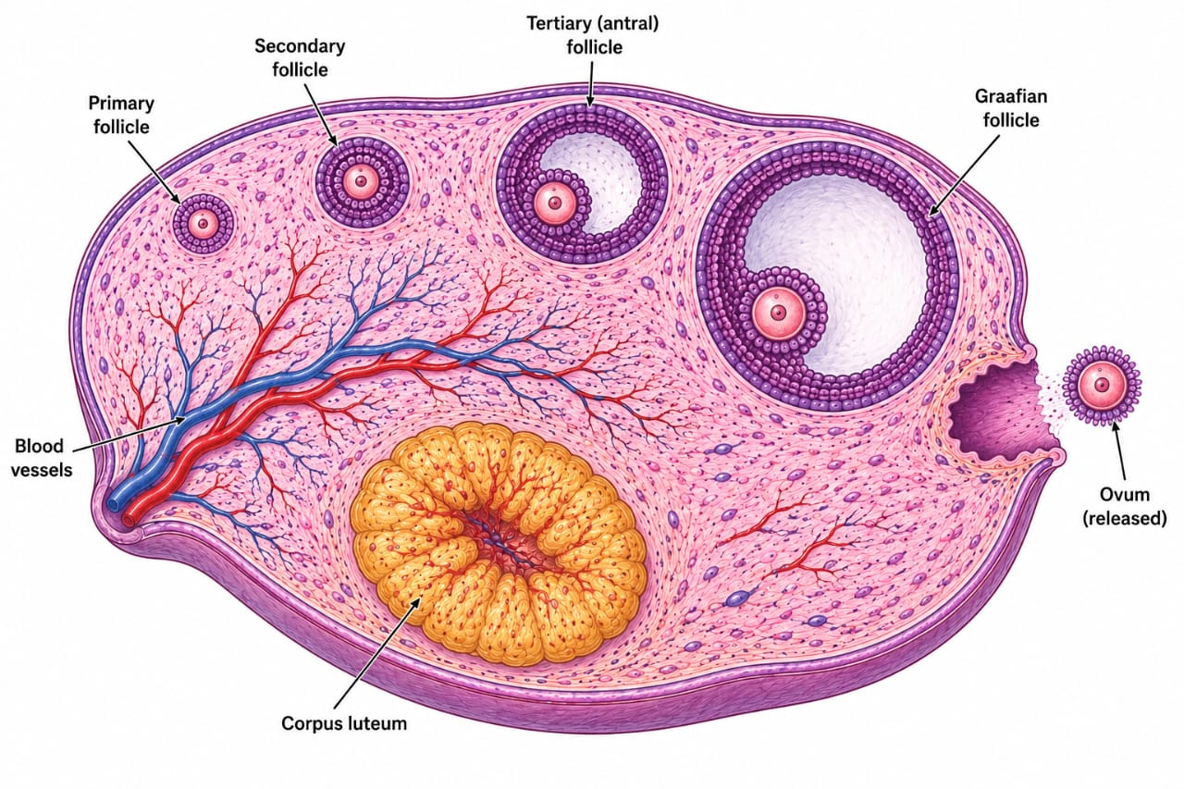
MENSTRUAL CYCLE & FERTILIZATION
1

Slide 2
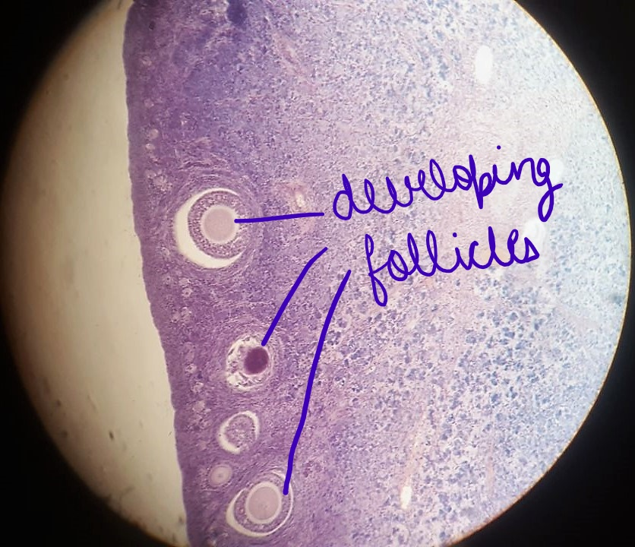

Slide 3
4. What happens inside the ovary?
One follicle usually becomes dominant and releases the secondary oocyte at ovulation.
Small follicle
Growing follicle
Mature follicle
OVULATION
Corpus luteum
• FSH encourages a group of follicles to grow.
• The dominant follicle makes more oestradiol.
• The LH surge triggers ovulation.
• After ovulation, the empty follicle becomes the corpus luteum and produces progesterone.
5

Slide 4
1. The menstrual cycle
MENSTRUAL
Days 1–5
FOLLICULAR
Days 1–13
OVULATION
~Day 14
LUTEAL
Days 15–28
What changes in the ovary?
Follicle grows → mature follicle → ovulation → corpus luteum forms.
What changes in the uterus?
Lining is shed → rebuilt → prepared for possible implantation.
2

Slide 5
2. The four phases — easy to remember
1. Menstrual
Endometrium lining sheds
Oestrogen and progesterone are low.
2. Follicular
FSH helps follicles grow: Primary follicle matures into graafian follicle.
Oestrogen rises.
3. Ovulation
Graafian follicle ruptures.
The oocyte is released.
High oestrogen leads to the LH surge.
4. Luteal
Corpus luteum makes progesterone; lining is maintained.
3

Slide 6
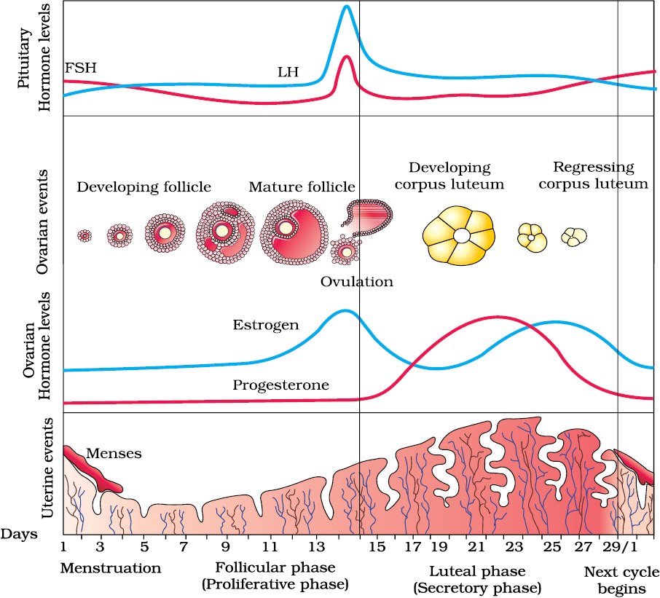

Slide 7
5. Meet the hormones
FSH
Helps ovarian follicles grow
LH
Triggers ovulation and supports the corpus luteum
Oestrogen
Helps rebuild/thicken the uterine lining
Progesterone
Helps maintain and prepare the uterine lining
6

Slide 8
6. Gamete formation (gametogenesis)
Gametes are haploid cells — they carry one set of chromosomes.
♀ Oogenesis — egg development
Occurs in the ovaries.
• Begins before birth
• Primary oocytes remain paused until puberty
• Usually one secondary oocyte is ovulated in a cycle
• Meiosis is completed only if fertilization occurs
Outcome: one large functional ovum plus small polar bodies.
♂ Spermatogenesis — sperm development
Occurs in seminiferous tubules of the testes.
• Begins at puberty
• Spermatogonia divide and enter meiosis
• One primary spermatocyte produces four spermatids
• Spermiogenesis changes spermatids into spermatozoa
Outcome: four haploid sperm cells.
7

Slide 9
7. Spermatogenesis — step by step
A simple pathway from germ cell to mature spermatozoon.
Spermatogonium
2n
Primary
spermatocyte 2n
Secondary
spermatocytes n
Spermatids
n
Spermatozoa
n
Mitosis
Maintains the germ-cell population and supplies cells for meiosis.
Meiosis
Reduces chromosome number from diploid (2n) to haploid (n).
Spermiogenesis
Reshapes spermatids into streamlined spermatozoa with a head, middle piece and tail.
8

Slide 10
8. Oogenesis + final recap
The two gamete-forming pathways use meiosis, but their timing and outcomes are different.
Primary oocyte
2n
Remember the story
FSH → follicle growth
Oestradiol ↑ → uterine lining grows
High oestradiol → LH surge
LH surge → ovulation
Corpus luteum → progesterone ↑
Progesterone + oestradiol fall → menstruation if pregnancy does not occur.
Quick check
Which hormone shows the dramatic mid-cycle surge?
Secondary oocyte
n
Quick check
What structure forms in the ovary after ovulation?
Ovum
n
Answer
LH surge; corpus luteum. 🎯
9

